Slide 1


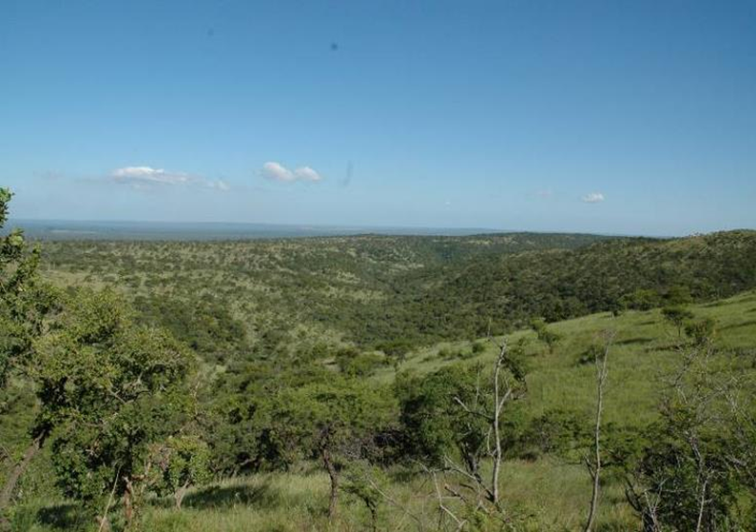

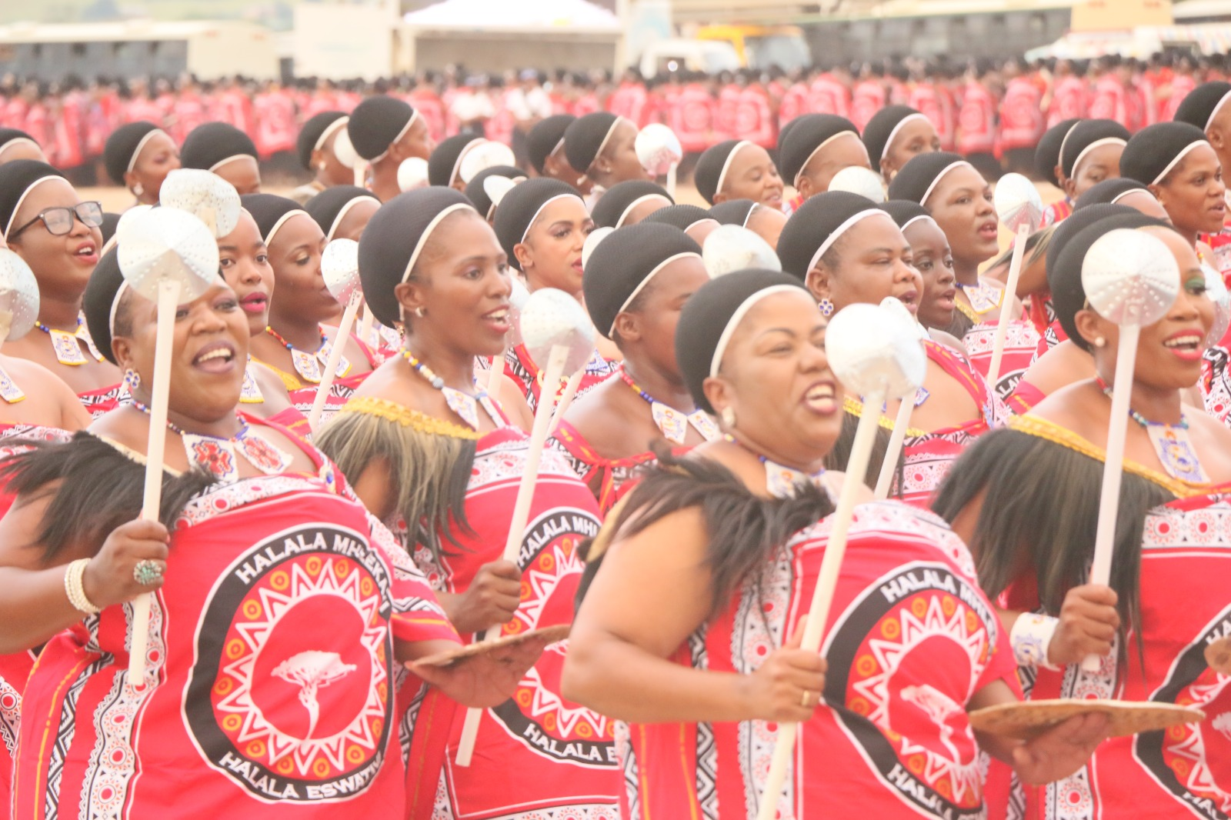
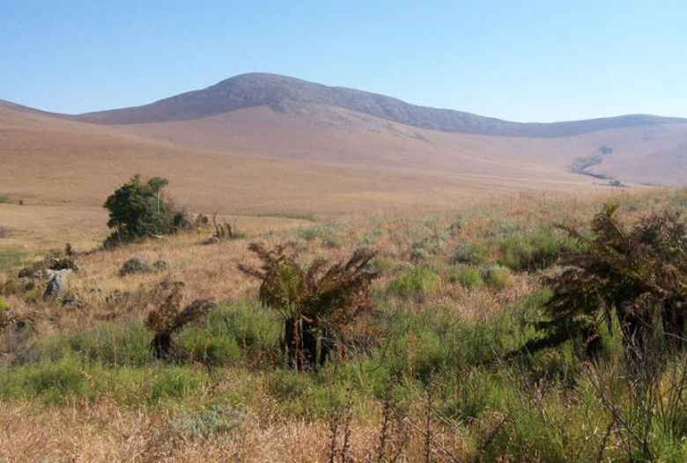
ACCELERATING SYSTEMATIC CHANGE FOR GENDER EQUALITY AND BIODIVERSITY CONSERVATION THROUGH NBSAPs
DEVELOPING GENDER AND BIODIVERSITY ACTION PLANS
2026-2030
Global Learning and Close-out Workshop
Bangkok, Thailand | 15th –19 June 2026

Slide 2
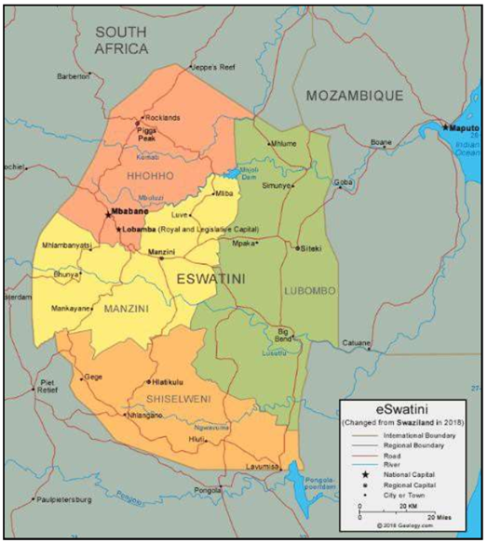

NATIONAL CONTEXT
Kingdom of Eswatini covers approximately 17, 364 km²
Population: ~1,269,859
Three types of land tenure:
  Swazi Nation Land (communal land),
  Title Deed and
  Crown Land
Approximately 68% of the population resides in rural Swazi Nation Land
333 Chiefdoms and 59 Tinkhundla
Notes:
With assistance from the NBSAP Accelerator Partnership, the project aims to support Eswatini as one of seven partner countries to apply a gender-transformative systems thinking approach to address biodiversity conservation and gender equality. This small project with a potentially big impact will also allow the country to respond to target 22 on inclusive participation and Target 23 on Gender Equality:

Slide 3

PROJECT IMPLEMENTATION APPROACH
MAY 2025 TO MAY 2026
Planning
Capacity Building
Situational Analysis
Establishing Stakeholder Engagement Plan
Mapped and Established key partnership
Workflow synchronization with NBSAP development
Conservation Stakeholders on Gender and Family Issues
Leadership and Women Economic Empowerment for 50 women from LCs
Informed by consultations, capacity assessment, capacity building efforts
Data Collection on Gender Representation in Traditional Governance structures
Consultations
Capacity Assessment
Action Plan
Toolkit for systematic inquiry
1 x Workshop for Gender specialists & women groups
3 x Local communities workshops -15 communities
1 x Women Parliamentary Caucus
Capacity Assessment for Readiness to Implement the Gender Plan of Action
Developed a gender-biodiversity action plan

Slide 4
Defining the consultation plan by asking the right questions
Who?
Used Initial Scoping exercise to map key actors. Targeted Local communities, Women Parliamentatry Caucus, biodiversity actors with limited gender training& NBSAP stakeholders
Why?
Leverage this Gender project to enhance NBSAP responsiveness to the CBD Gender Plan of Action
What?
Community level problems and solutions to natural resource management. Connect grassroots and decision makers. Buy-in from NBSAP stakeholders for implementation of action plan
How?
When?
Responsible?
Resources?
Engagements in local language (Siswati) and respect for communication protocol when engaging communities and parliamentaty caucus
Local communities-> before November 2025. Women Parliamentary Caucus->Before close of Cabinet.NBSAP stakeholders-> before NBSAP validation
PMU, NBSAP-Gender Consultant and Core Country Team
Set target on numbers. Set budget for consultations and identified co-financiers and technical partners

Slide 5
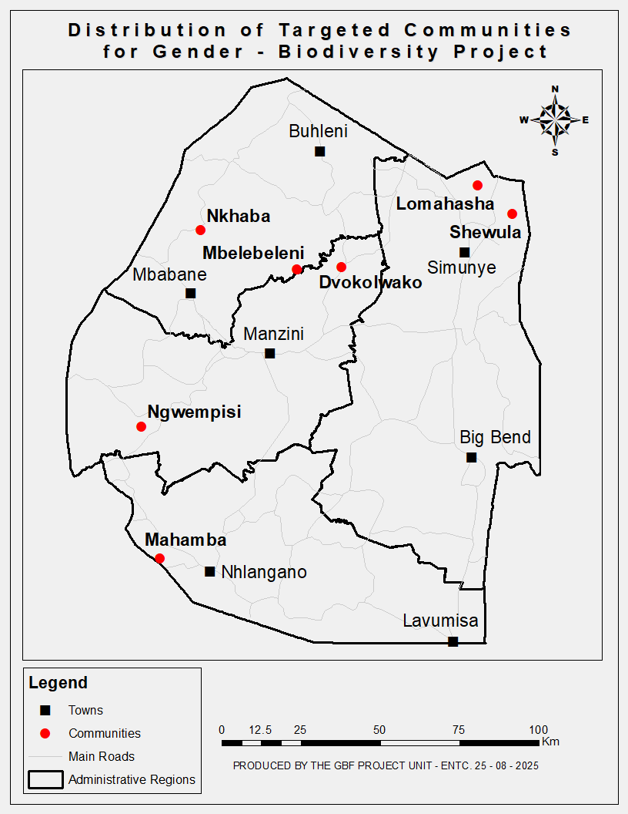
KEY FINDINGS FROM CONSULTATIONS
Women are key natural resource managers, but have limited access to land, resources, and decision-making opportunities.
Social and cultural norms continue to restrict women's leadership and participation in environmental governance.
Socio-economic inequalities and data gaps persist, particularly regarding land ownership, resource access, and participation in environmental management.
Institutional capacity gaps exist in gender-responsive budgeting, gender-disaggregated data systems and coordination between gender and environmental sectors.
Inclusive governance structures have demonstrated potential to improve women's influence and participation.
  Additional question asked: besides focus group discussions, where do we get the database tracking women’s influence and participation?
Notes:
Sharing Findings from consultations as we explored the gender-biodiversity nexus…

Slide 6
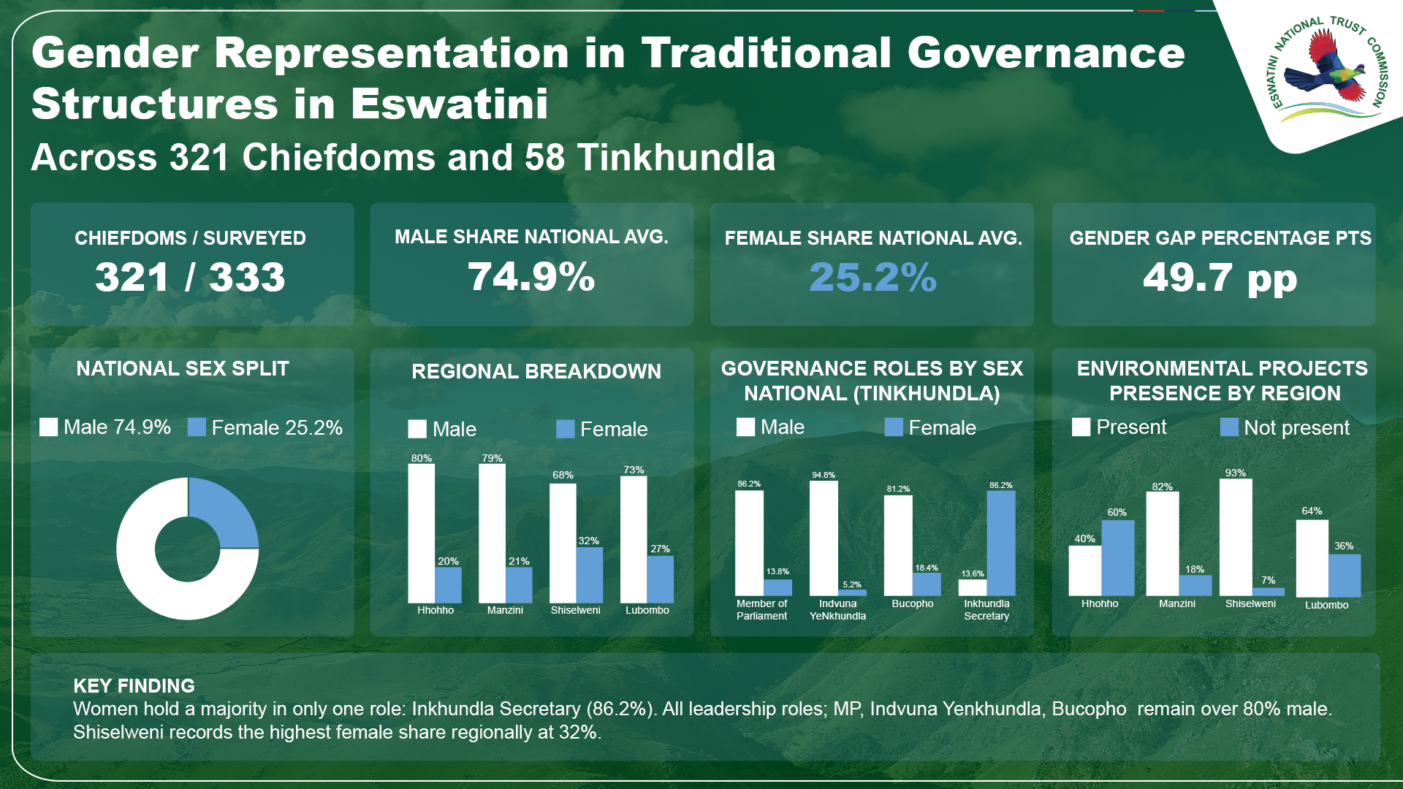

ESWATINI GENDER – BIODIVERSITY:PRIORITIES
SEPT 2025
NOV 2025
JAN 2026
MAR 2026
OCT 2025
DEC 2025
FEB 2026
CAPACITY ASSESSMENT FOR GPA IMPLEMENTATION
CONSULTATION WITH GENDER- BIODIVERSITY STAKEHOLDERS
WOMEN PARLIMENTARY CAUCUS MEETING
CONSULTATION WITH GENDER SPECIALISTS, CSO, WOMEN GROUPS & LOCAL COMMUNITIES
VALIDATE SITUATIONAL ANALYSIS AND GENDER PLAN OF ACTION
DEVELOPMENT OF KNOWLEDGE PRODUCTS
SUBMIT PROPOSAL TO NBSAP AP/GCF/GEF
IDENTIFY GENDER TRANSFORMATIVE ACTIONS FOR NBSAP
FINALIZE STRATEGIC ACTIONS FOR THE GBF TARGETS
CAPACITY BUILDING FOR SELECTED COMMUNITIES AND ACTORS TO STRENGTHEN INSTITUTIONAL CAPACITY
COMMUNITY CONSULTATIONS FOR GENDER-NBSAP

Slide 7
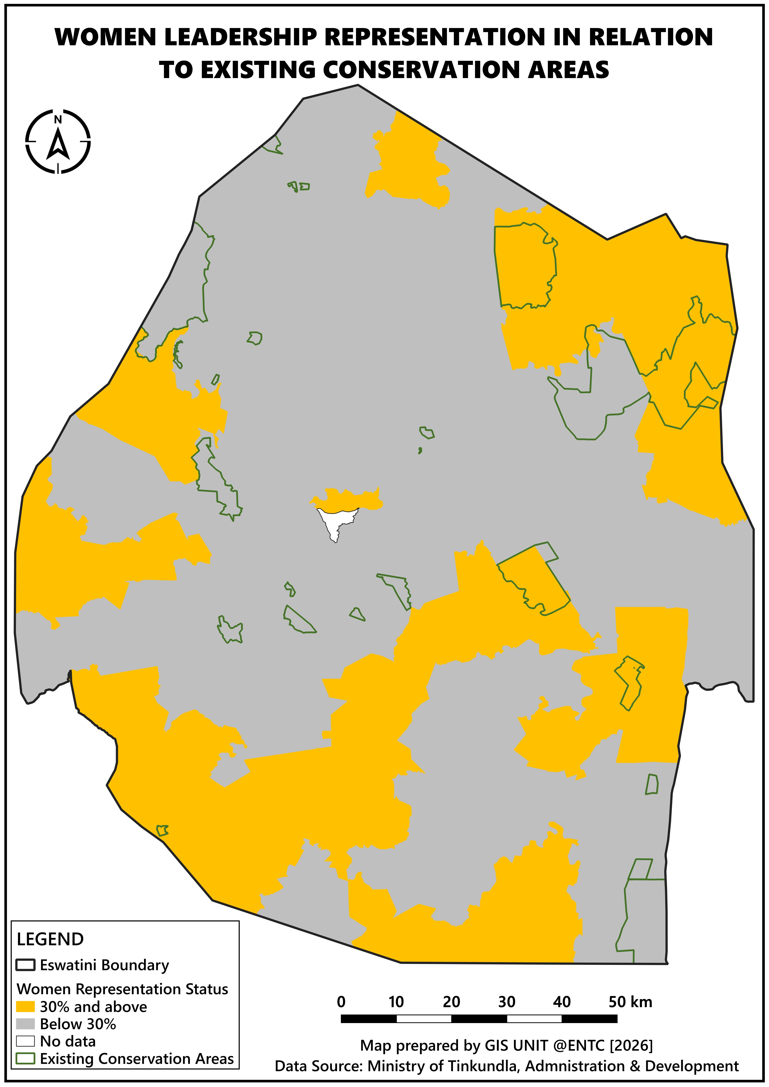
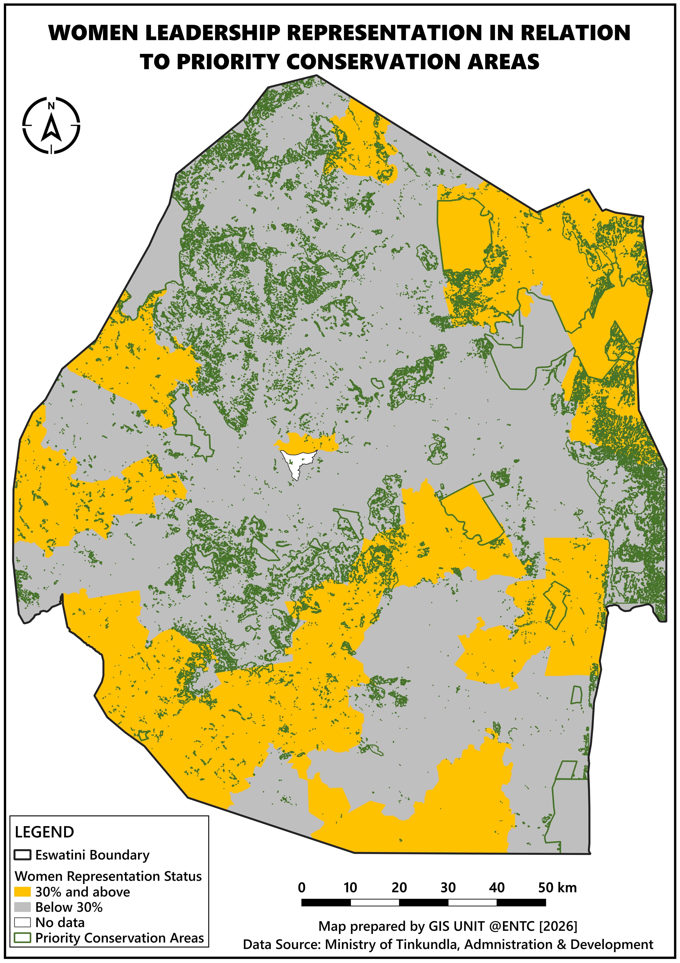

Slide 8
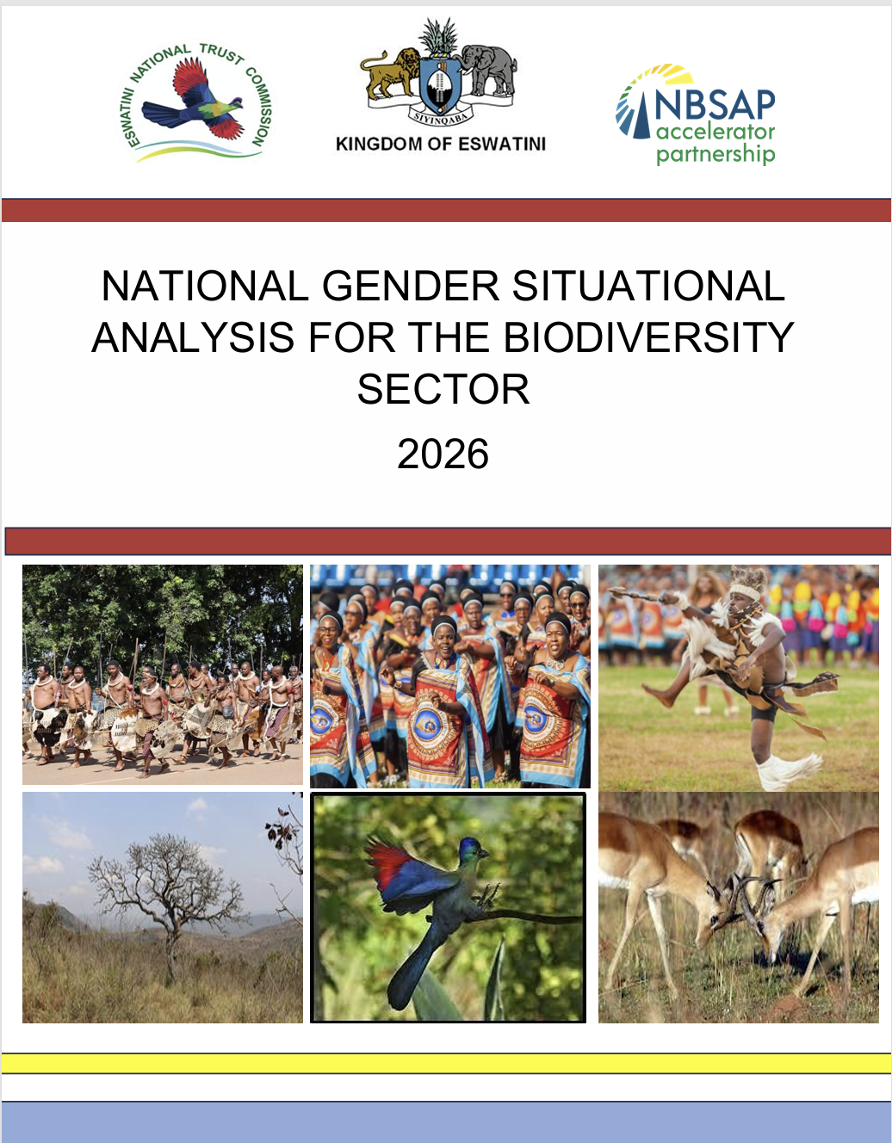
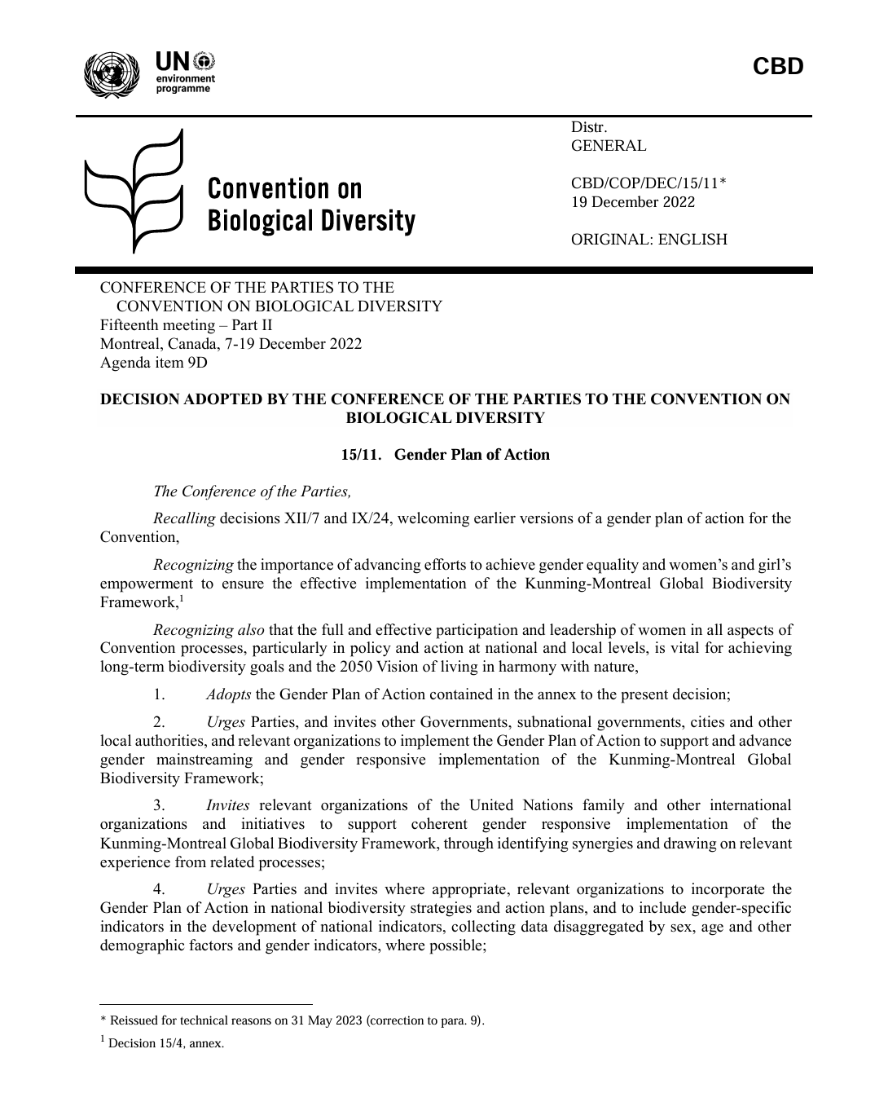
TRANSLATING INSIGHTS TO ACTIONS
3. Selected Solutions identified by stakeholders that are feasible (2030 timeframe and culturally acceptable)
1. Listed material issues from Gender Situational Analysis
2. Examined the CBD GPA- Expected Outcomes, Objectives and Possible Indicative Actions
4.Structured the Eswatini’s action plan using the CBD GPA template
5. Verified that each material issue is addressed with an action. (Where hard intervention not possible- chose advocacy and awareness)
6. Consultative Workshop with NBSAP Stakeholders on the situational analysis & proposed action plan

Slide 9
EXAMPLE: MATERIAL ISSUE TO PRIORITY
EXPECTED OUTCOME 1: ALL PEOPLE (LNOB)-PARTICULARLY ALL WOMEN AND GIRLS, PEOPLE WITH DISABILITIES, YOUTH, WIDOWS -HAVE EQUAL OPPORTUNITY AND CAPACITY TO CONTRIBUTE TO THE THREE OBJECTIVES OF THE CBD
Objective | Action ID | Priority Actions | Performance Indicators | Key Deliverables | Timeline | Target group | Lead Institution | Key Partners
1.4 Address GBV prevention & response | 1.4.1 | Train and adopt survivor referral pathways for reporting in PA & OECMs and community-based biodiversity projects | # of PA & OECM staff trained | Reported GBV cases | 2027-2030 | PA & OECM staff; NRMCs & CDCs | DPMO (DGFI), MTEA, Big Game Parks | CSOs; Rangers’ association
 | 1.4.2 | Conduct GBV and Violence Against Children training on case identification, the Sexual Offences & Domestic Violence (SODV) Act, 2018 Act & the Children's Protection and Welfare Act | # of community members trained; % of youth trained | Pre-and post-training assessments | 2027-2030 | Local Communities | DPMO (DGFI), MTEA | CSOs

Slide 10
EXAMPLE: MATERIAL ISSUE TO PRIORITY
EXPECTED OUTCOME 2: BIODIVERSITY POLICY, PLANNING AND PROGRAMMING ADDRESS EQUALLY THE PERSPECTIVES, NEEDS AND HUMAN RIGHTS OF ALL PEOPLE ESPECIALLY WOMEN AND GIRLS
Objective | Action ID | Priority Actions | Performance Indicators | Key Deliverables | Timeline | Target group | Lead Institution | Key Partners
2.1 Increase opportunities and strengthen the meaningful and effective participation of women in leadership at all levels in line with the three objectives of the CBD | 2.1.1 | Establish baseline assessing women representation in biodiversity-related institutions, decision-making structures, COP delegations, local governance structure | Baseline conducted (Y/N) | Baseline report | 2027 | Biodiversity- related institution; local communities | MTEA | DPMO, MTAD, EEA, ENTC

Slide 11
REFLECTION ON THE PROCESS
CHALLENGES
Success
Buy-in from the Biodiversity Sector/NBSAP stakeholders for the situational analysis and action plan
Generation of gender disaggregated data in traditional structures
Umbrella Programme for NBSAP & Gender-NBSAP Workflow Integration- consultant delivery
Convening targeted stakeholders (57% women- 413 stakeholders) and meeting desired target.

Slide 12
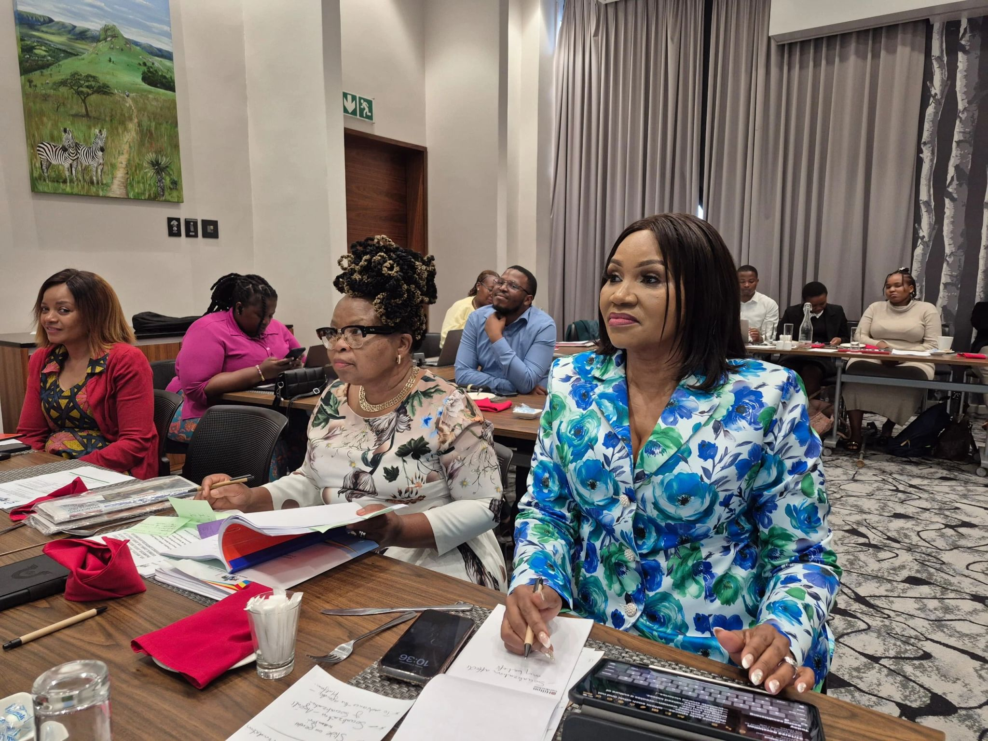
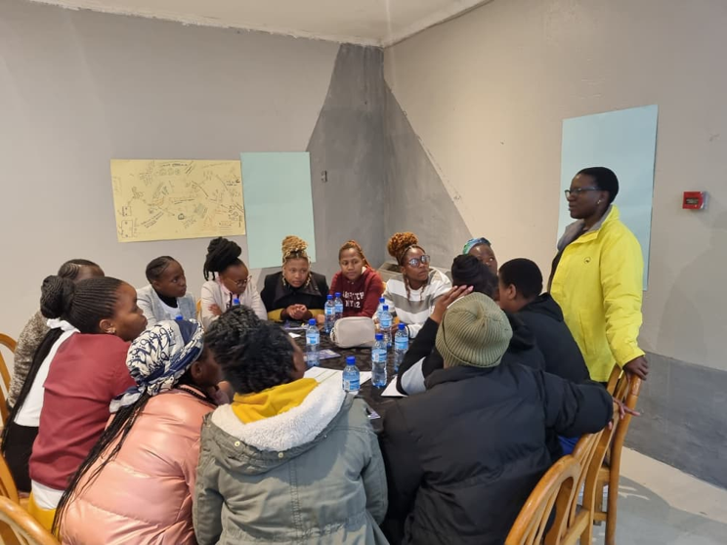
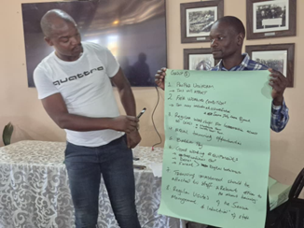
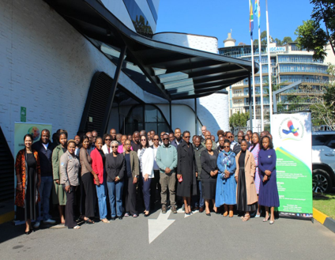
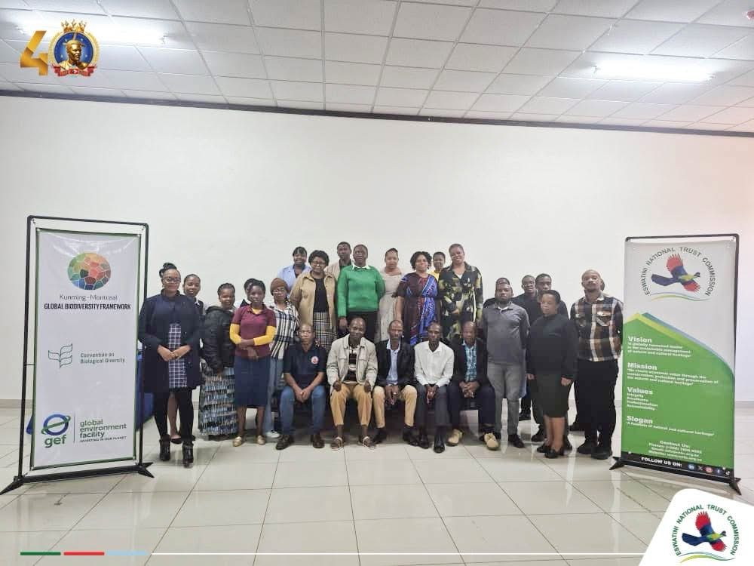
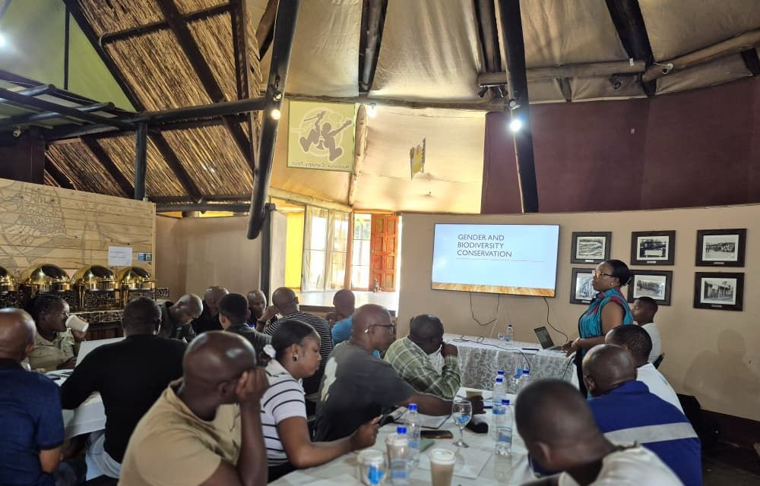
Notes:
Sharing Findings from consultations as we explored the gender-biodiversity nexus…

Slide 13
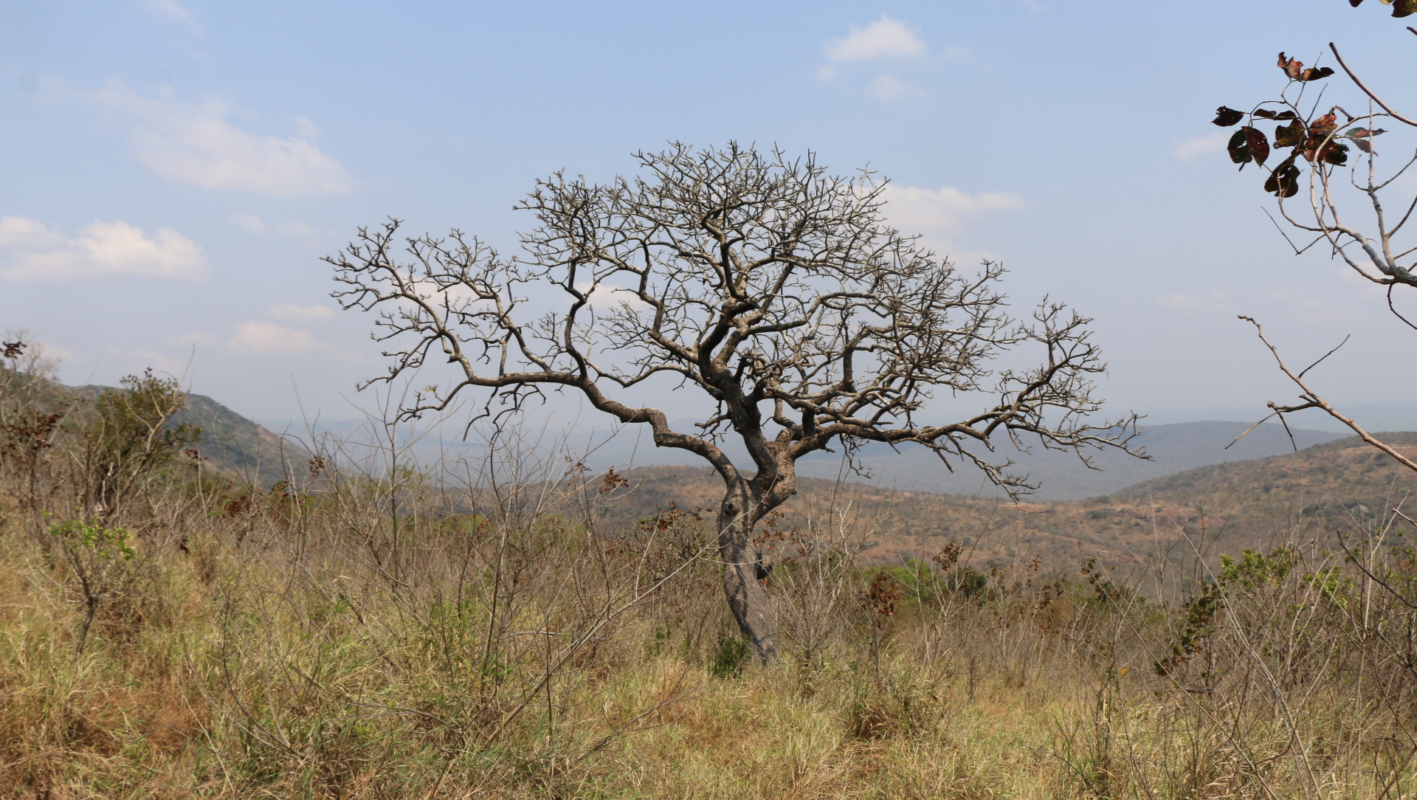
        THANK YOU
Mbali Mabuza
Project Manager
ESWATINI NATIONAL TRUST COMMISSION
mbali.mabuza@entc.org.sz

