Slide 1

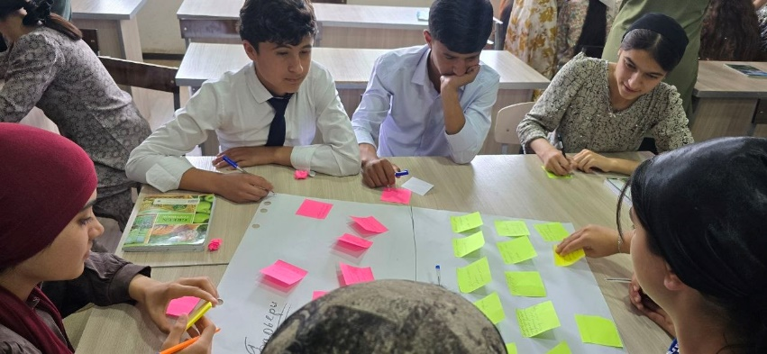
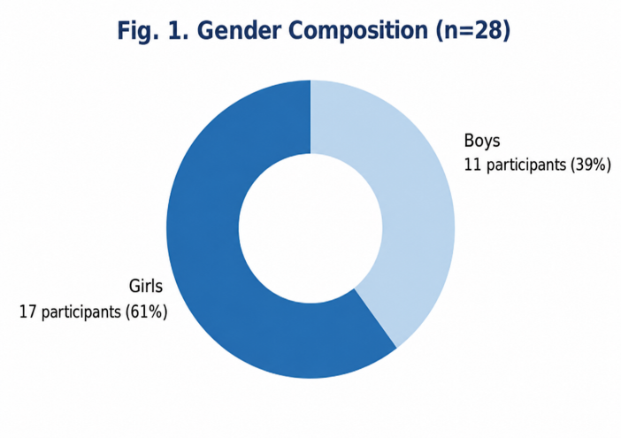
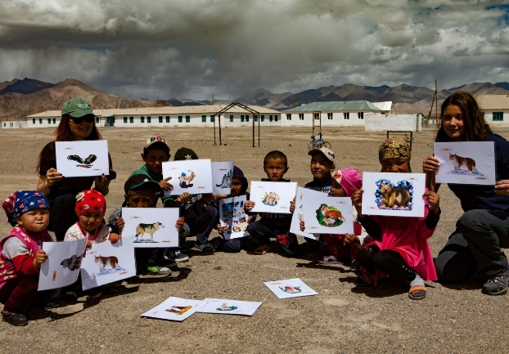
Accelerating systemic change for gender equality and biodiversity conservation through NBSAPs
Youth Voices for Nature: Building an Inclusive Future
Global Learning and Close-out Workshop
Bangkok, Thailand | 15th –19th June 2026
Notes:
Good morning, everyone.
Today, I would like to share the results of our awareness-raising event that took place in Nurek. The main goal was to understand how young people, especially girls, see their role in biodiversity conservation.
We had 28 participants, and 61% of them were girls, which was really encouraging. Also, 89% were between 15 and 18 years old, so we were working with a very young audience.
Another important point is that 100% of participants completed the surveys before and after the event, which helped us better understand their knowledge and opinions.

Slide 2
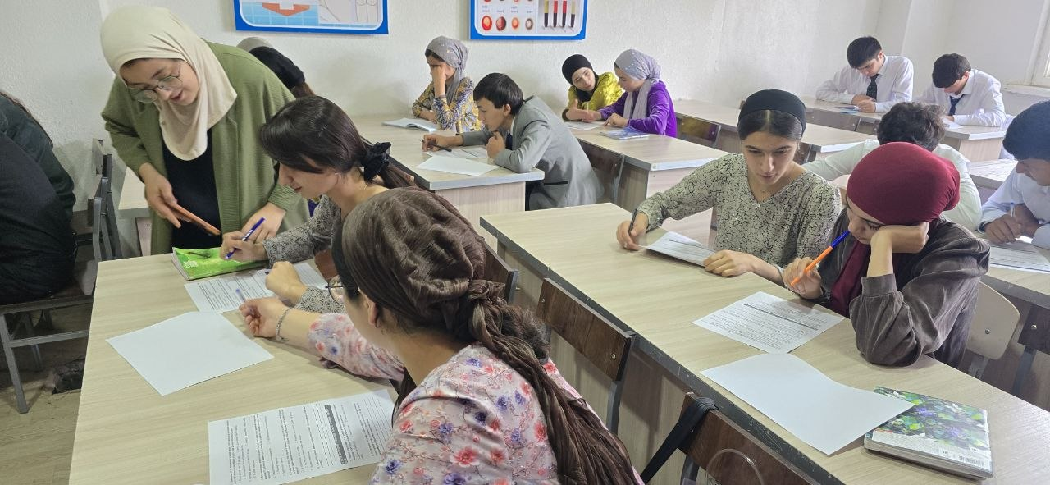
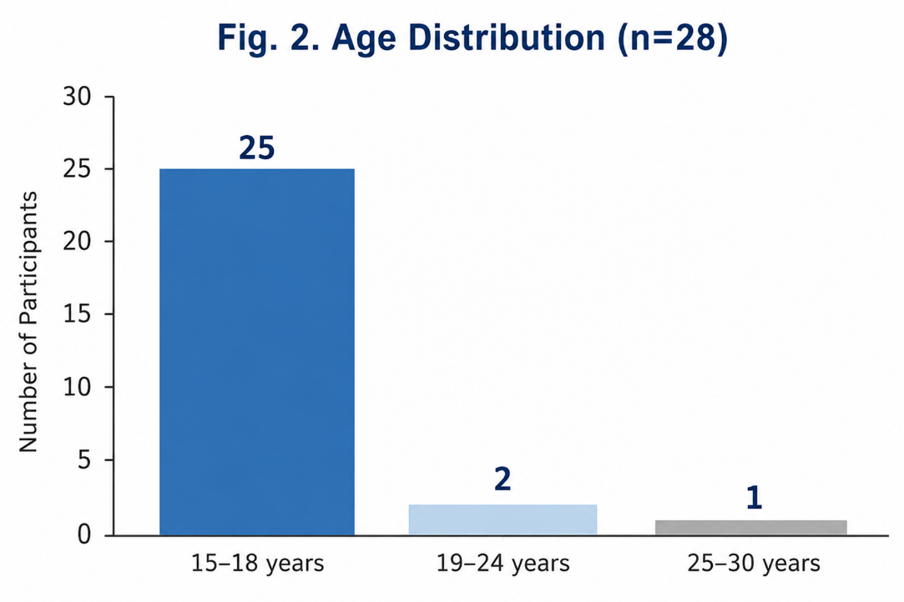
Youth and Girls — Ready to Take Action
28 participants
61% were girls (17 participants)
89% of participants were aged 15–18
100% completed both pre- and post-event questionnaires
Notes:
Good morning, everyone.
Today, I would like to share the results of our awareness-raising event that took place in Nurek. The main goal was to understand how young people, especially girls, see their role in biodiversity conservation.
We had 28 participants, and 61% of them were girls, which was really encouraging. Also, 89% were between 15 and 18 years old, so we were working with a very young audience.
Another important point is that 100% of participants completed the surveys before and after the event, which helped us better understand their knowledge and opinions.

Slide 3
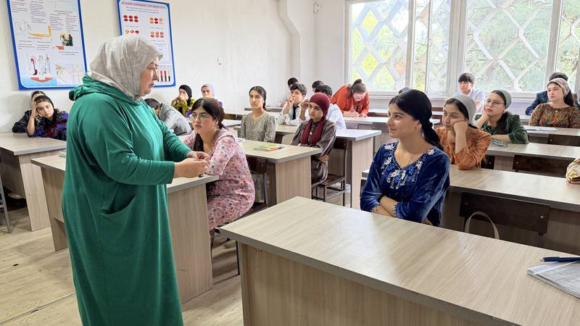
What We Talked About
Main Training Topics:
Biodiversity of Tajikistan
Protected Areas (PAs)
National Biodiversity Strategy and Action Plan (NBSAP)
The International 30×30 Target
Gender Equality in Nature Conservation
The Role of Youth in Biodiversity Conservation
Special Focus:
Why are women, as holders of traditional knowledge about nature, rarely involved in decision-making?
The International 30×30 Target as an opportunity to increase the participation of women and young people.
Notes:
During the training, we talked about biodiversity in Tajikistan, protected areas, our National Biodiversity Strategy and Action Plan, and the international 30×30 target.
But one topic created a particularly interesting discussion.
We asked a simple question:
If women often keep traditional knowledge about nature, why are they still not fully involved in making decisions?
Many participants had never thought about this before, and it helped them see that biodiversity conservation and gender equality are closely connected.

Slide 4
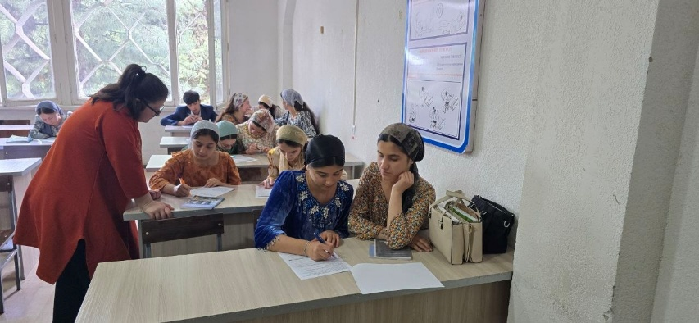
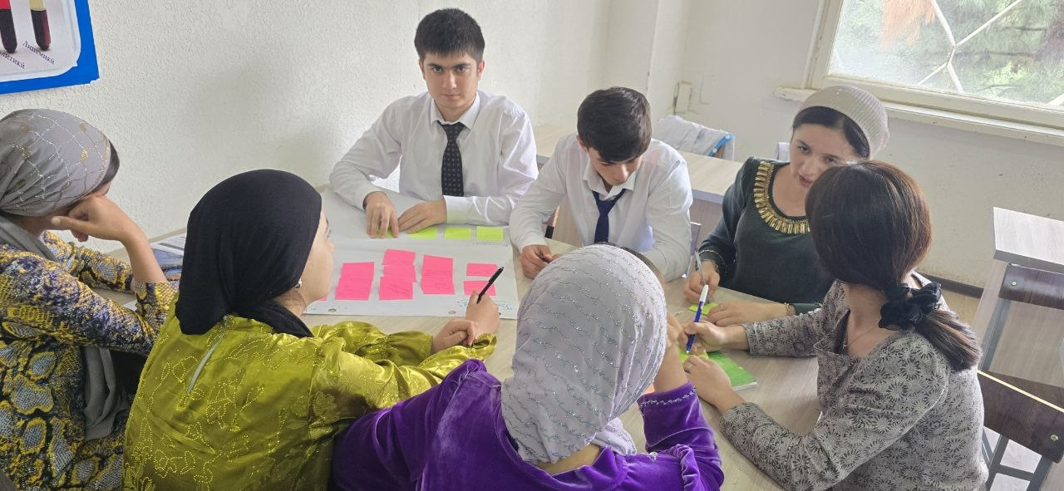
How We Worked with Young People
Results:
18 barriers identified;
22 solutions proposed;
40 practical ideas developed.
Rich Pictures
Participants worked in teams to identify:
key challenges;
possible solutions.
Particularly Important:
One of the groups independently identified the limited participation of girls as an environmental issue.
All 40 practical ideas were generated by the participants themselves.
Notes:
Instead of giving a traditional lecture, we used an interactive method called Rich Pictures.
The participants worked in groups and discussed problems and possible solutions.
In total, they identified 18 barriers, suggested 22 solutions, and came up with 40 practical ideas.
What surprised us the most was that one group independently identified the limited participation of girls as an environmental challenge. This showed that young people already understand that protecting nature also means making sure everyone has a voice.

Slide 5
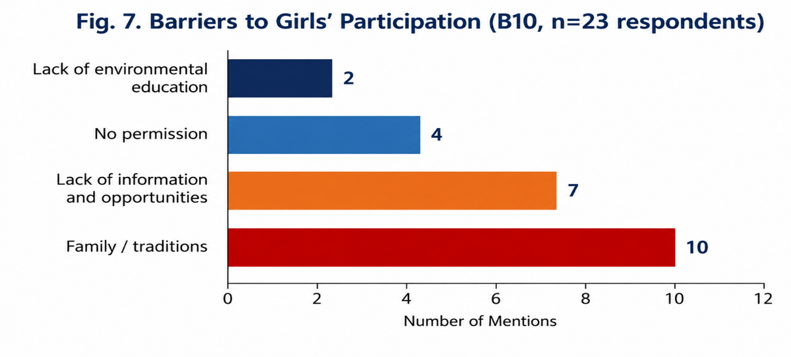
How Young People See Women's Participation
Survey Results:
57% believe that women are the main holders of knowledge about nature;
68% believe that girls should be involved in environmental decision-making;
No participant described nature conservation as exclusively "men's work.
Main Barriers:
Family and traditions;
Lack of information and opportunities;
Lack of support;
Insufficient environmental education.
Notes:
The survey results showed strong support for women's participation.
57% of participants believe that women are the main holders of knowledge about nature, and 68% think that girls should be involved in environmental decision-making.
One of the most positive findings was that not a single participant said that protecting nature is only a man's responsibility.
At the same time, when we asked about barriers, the most common answer was family and traditions, followed by lack of information, support, and environmental education.

Slide 6


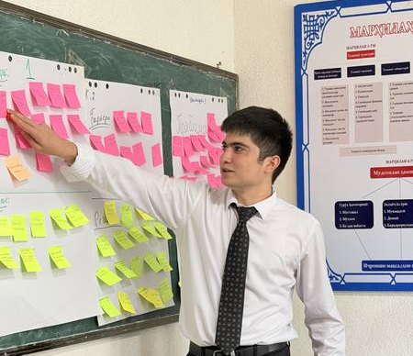
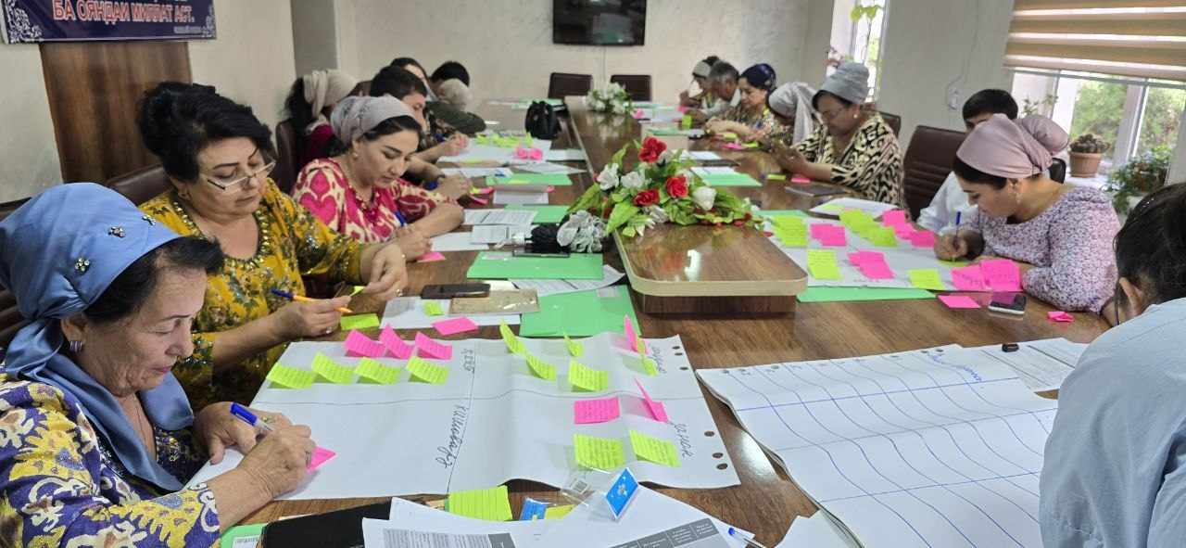
Young People Offer Solutions
Key Message:
Young people not only recognize problems but also propose practical mechanisms for participation.
Participants' Ideas:
Establish a women's environmental club;
Include ecology and protected areas in educational programmes;
Organize student environmental patrol groups;
Use social media for environmental awareness;
Involve older women as holders of traditional knowledge;
Engage young people in discussions on protected area management.
Notes:
Another interesting result was that participants did not only talk about problems—they also suggested real solutions.
For example, they proposed involving older women as holders of traditional knowledge, so that local experience and practices can be passed on to younger generations.
They also suggested including young people in discussions about the management of protected areas, because they want to be part of real decision-making processes.
I think these ideas show that young people want to contribute and take responsibility, not just listen.

Slide 7

Voices of the Participants
Most Memorable Quotes:
"Girls care about nature more than boys — they plant flowers and trees and take care of them."
"The lack of environmental education in schools and colleges is what prevents girls from participating."
"Young people should protect the nature of their homeland, Tajikistan."
Notes:
Finally, I would like to share a few comments from the participants themselves.
These quotes show that young people understand the important role that girls and women play in protecting nature.
They also believe that better environmental education can create more opportunities for girls to get involved.
For me, the maнin message is simple:
Young people are not only able to identify problems—they are also ready to become part of the solution. Final Remarks
Before I finish, I would like to highlight what I believe is the most important outcome of this work.
The main achievement was not only that we organized consultations, but that we created a truly inclusive platform for dialogue.
We managed to bring together a wide range of stakeholders, including government representatives, decision-makers at both national and local levels, local authorities, women, young people, and rural communities.
More importantly, we did not just ask for their opinions. We gave them the opportunity to discuss challenges together, exchange ideas, and develop practical solutions.
We made a special effort to ensure that the voices of women, youth, and local communities were heard, because they have valuable knowledge and experience that are essential for biodiversity conservation.
And the most important result is that all of these recommendations and ideas were collected and became part of the Roadmap.
So, the Roadmap is not based only on expert opinions. It reflects the needs, experiences, and ideas of the people who will actually help implement it.
Thank you very much. "I hope you could follow everything. I had to speak a bit quickly because we only had 10 minutes."
Thank you for your attention.

