Slide 1






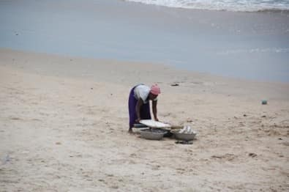
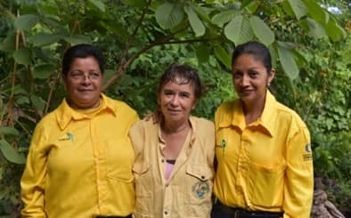


Thematic Clinic 7:
National Knowledge Products
Developing Knowledge Products to support gender-responsive implementation of KM-GBF
Image here
Gender and NBSAP Capacity Building & Exchange Process
7TH APRIL 2026

Slide 2


Objectives
  Clarify what we mean by knowledge products in this project
  Understand different types of knowledge and whose knowledge is visible
  Run through a practical step-by-step process for deciding on strategic knowledge products
  Share tips on strategic communication and knowledge mobilization that can be adapted to different country contexts
  Peer exchange between countries on type of knowledge products to support national goals
  Explore some ideas for intended global products that will showcase country experiences and insights to share regionally and globally
  Discuss support, timelines, and next steps

Slide 3
10:00– 10:05
Welcome
Welcome and objectives
Brief description of the Work Clinic
10:05– 10:50
Key steps in strategizing knowledge products
Interactive presentation to introduce key knowledge types and terms and suggested steps to produce knowledge products
10:50 -11:00
Q&A
Participants will have the opportunity to ask questions on the key steps
Agenda
11:00 -11:20
Interactive discussion & peer to peer exchange
Interactive discussion with the NBSAP partnership and peer to peer exchange on ideas for national knowledge products
11:20 -11:30
Support and Next Steps
Planning for support to develop knowledge products and agreed timelines

Slide 4




How do we leverage the knowledge we have generated?

Slide 5


Key terms
Knowledge management is about how the project organises what it has learned:
  data
  analyses
  findings
  case examples
  methods
  tools
Knowledge mobilisation is about what happens next:
  how that knowledge is translated and communicated
  how it is shared with people who can use it
  and how it supports uptake, learning, and decision-making
A knowledge product is one form that knowledge takes when it is prepared for use by a specific audience.
It is not just a document. It is a purposeful output

Slide 6
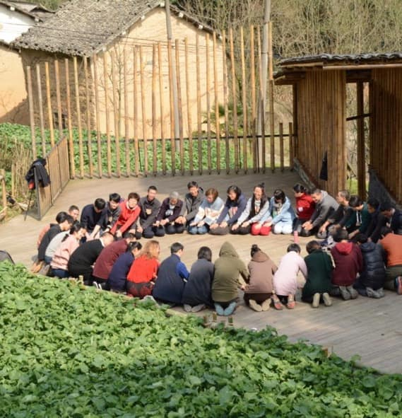
From a communication output to decision influence
Knowledge products are not just “communications outputs”
They are part of how the project contributes to:
  policy influence
  implementation support
  peer learning
  reporting
  global visibility for gender-responsive biodiversity action
This Photo by Unknown Author is licensed under CC BY-SA-NC

Slide 7

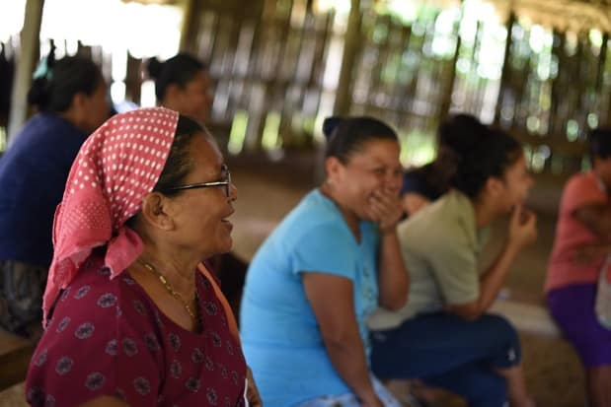
A lot of evidence, knowledge and insights generated!
You have already generated a lot of knowledge and evidence:
  national situational analyses
  consultations with women and women’s groups
  co-identified solutions
  reflections on barriers, priorities, and implementation needs
  examples of change at local, institutional, and policy levels
This knowledge now needs to be synthesised, shaped for an audience and packaged
This session will support with some key steps and suggested approaches to developing and finalising national knowledge products

Slide 8
What kinds of knowledge are we working with?
Technical / scientific knowledge
gender analysis, biodiversity data, indicators
Policy knowledge
NBSAP processes, policy entry points, reporting obligations
Indigenous and local knowledge and experiences
place-based knowledge, traditional practices, stewardship on how women and communities interact with biodiversity in practice
Practice-based knowledge
what worked, what did not, lessons from implementation and consultations
REFLECT
Whose voices are visible?
Who is treated like an expert?

Slide 9
TIP
National knowledge products need to be co-authored – how can you leverage different voices to co-develop key messages
Possible co-authors or collaborators:
  government partners
  women’s organisations
  civil society partners
  local leaders or community actors
  technical partners
  other government sectors

Slide 10
Opportunities for different products
What can a knowledge product make visible?
Showcase a grassroots women’s organisation
Show how women’s groups influenced priorities
Document best practice and how local consultations improved NBSAP relevance
Create momentum for future inclusion of certain organisations or sectors
TIP
Turning findings into a format that is documented, shareable and actionable

Slide 11
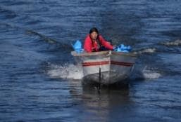



Suggested steps to develop knowledge products

Slide 12





Key steps in development of knowledge products
1
Define the purpose
2
Understand the target audience and opportunities to influence them
3
Articulate the key message and insights from a specific perspective
4
Choosing the right product
5
Packaging and strategic timing and outlets for dissemination

Slide 13


1
Define the purpose
National knowledge products are intended to support awareness raising, and wider uptake of lessons beyond the project countries
Possible purpose:
influencing NBSAP revision or implementation
supporting a national dialogue or validation process
feeding into reporting on the CBD Gender Plan of Action
documenting a country process for peer learning
raising visibility for a country experience
contributing to broader dialogue ahead of COP or other biodiversity events
strengthening future proposals or matchmaking requests

Slide 14

1
TIP
Help brainstorm the purpose with clear questions
Do?
What does your core country team want these knowledge products to do?
Influence?
What decision, conversation, or process should it influence?
What for?
Is it for policy, implementation, reporting, learning, visibility, or advocacy?

Slide 15
2
Understand the target audience and opportunities to influence them
Who is the target audience?
Environment ministries
NBSAP focal points and technical teams
Ministries responsible for gender, planning, or related sectors
Women’s organisations and civil society
Local communities
Donors and technical partners
Global audiences, including biodiversity and gender networks
TIP
A product can have more than one audience, but it should have a primary one

Slide 16
Example of audience deep dive: Government and ministries
  Policy alignment
  Implementation feasibility
  Reporting and accountability
  Politically viable recommendations
Constraints
Key formats
  Very limited time
  Formal review processes
  Competing priorities
  Need for concise evidence
  Clear recommendations
  Alignment with NBSAP language and policy priorities
  Practical, usable messages
  Packaged in short policy notes, insights, or policy briefs
Care about

Slide 17
Example of audience deep dive:
Women’s organisations, advocacy groups & communities
Care about and strengths
Being heard and meaningfully included
Constraints
Key formats
Limited access to policy spaces
Clear, accessible language
Influence on decisions that affect them
Practical outcomes (not just consultation)
Deep local and lived knowledge
Strong connection to biodiversity and ecosystems
Experience in community-based solutions
Trusted voices in local contexts
Limited time and resources
Technical language may be a barrier
Risk of being consulted but not influencing
Representation of their voices (quotes, stories)
Recognition and visibility
Practical and relevant outputs – toolkits, posters

Slide 18
2
Understand the target audience and opportunities to influence them
Important to understand the opportunities for influence from the outset
Policy and decision windows are moments when
decisions are being made
priorities are being shaped
there is openness to new ideas or evidence
ASK
Is there a meeting, process, or event coming up where your knowledge product could be used?
Example – are you targeting national policymakers because they are revising their NBSAP, so it needs to be ready before the revision process ends?

Slide 19
Examples of windows
National level
NBSAP revision and finalisation
Development of implementation plans
National consultations and validation processes
Gender policy processes (e.g. gender strategies, cross-ministerial coordination)
Development of national biodiversity programmes
Budget planning cycles
Donor-funded project design (e.g. GEF, bilateral programmes)
Global level
CBD processes (e.g. Gender Plan of Action follow-up)
COP17 and related dialogues
Project level
Final workshop and dissemination phase
BRIDGE exchanges and peer learning
NBSAP Accelerator Partnership visibility opportunities

Slide 20
3
Articulate the key message and insights from a specific perspective
Countries may have a lot of material
A product is NOT the full analysis. It is a sharpened message based on that analysis.
For example:
  Insight: women’s knowledge is essential but under-recognised in biodiversity management
  Why it matters: this weakens both inclusion and effectiveness
  Call to action: create stronger pathways for women’s engagement in NBSAP implementation – then add details

Slide 21
How do we move from a long situational analysis to a small number of usable insights, messages, and product angles?
Patterns
What themes appear again and again?
Tensions / gaps
Where is there a disconnect between policy and practice?
What matters most
Which issues are most important for NBSAP action?
What is usable
What can be turned into recommendations, stories, or examples?

Slide 22
A situational analysis may say:
  women are underrepresented in decision-making
  women have unequal access to land or finance
  local women have strong biodiversity knowledge but little visibility in formal policy spaces
Those are findings.
The insight may be:
  “gender inequality is not peripheral to biodiversity action — it is shaping who participates, whose knowledge is used, and which solutions are possible”
REFLECT
A finding is often descriptive
An insight goes one step further — it helps explain significance and direction

Slide 23
Layer approach to unpack a situational analysis
Layer 1: What is the problem?
What inequalities, barriers, or gaps are most visible?
Layer 2: What is the opportunity?
What strengths, contributions, practices, or entry points are visible?
Layer 3: What action follows?
What should change in policy, implementation, engagement, or support?
TIP
A long analysis may contain 20 or 30 interesting points
A product usually needs only 3 to 5 headline insights

Slide 24
4
Choosing the right product
One analysis can generate different products
Policy brief
“Top priorities for gender-responsive NBSAP implementation”
Story of change
“How consultations made women’s knowledge visible”
Case study
“What we learned from a multi-actor consultation process”
Strategy
“Priority actions and enabling conditions”

Slide 25
Knowledge product ideas – key findings
Insight-focused products
Insight brief
Policy insights note
Research summary
Policy & decision-support products
Policy brief
Implementation brief
Priority actions note
Narrative & visibility products
Story from the field
Impact story
Practice & learning products
Case study
Learning note
TIP
You already have the knowledge; these products are just
different ways of shaping it depending on what you want to achieve

Slide 26
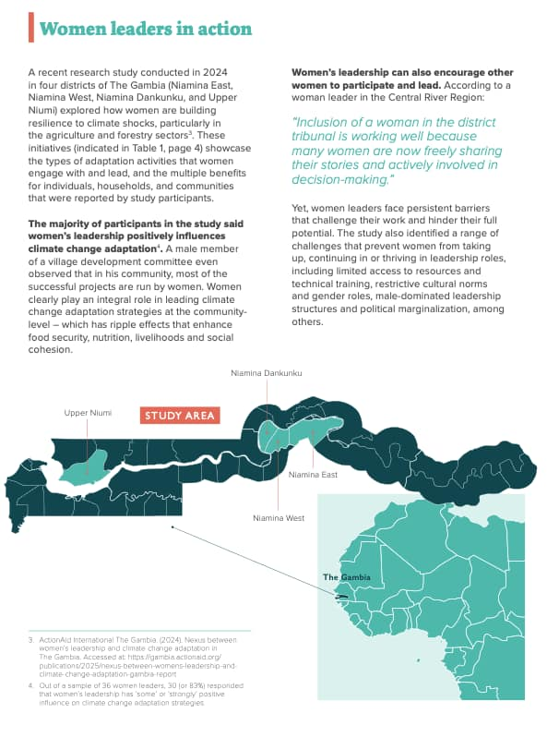
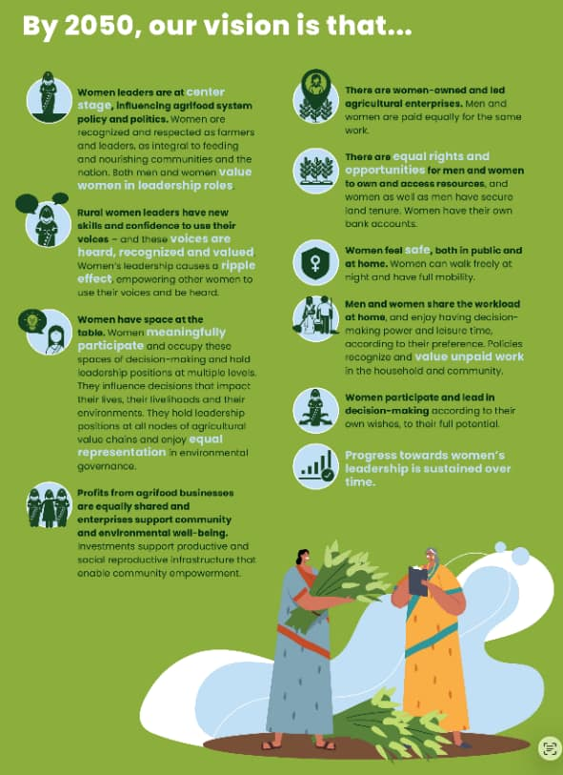
Clear visions and time-bound recommendations
Insights from location specific findings

Slide 27

Madagascar: Example of a
10-year action plan on land rights

Slide 28

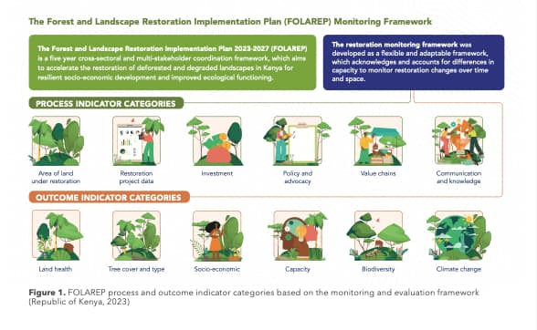
Policy briefs and clear summary of indicators

Slide 29
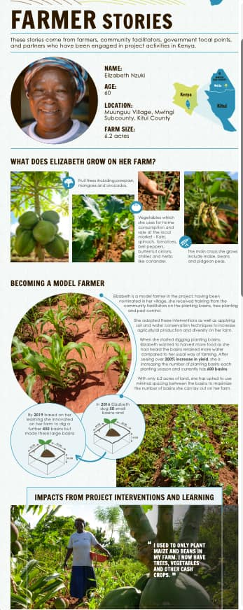
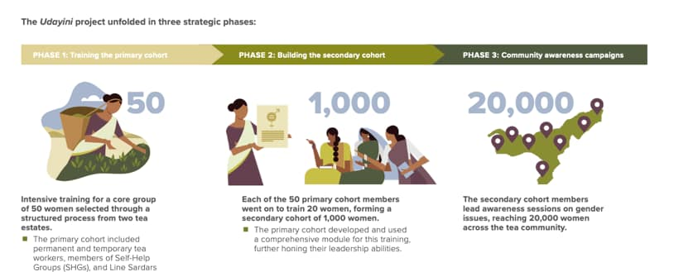
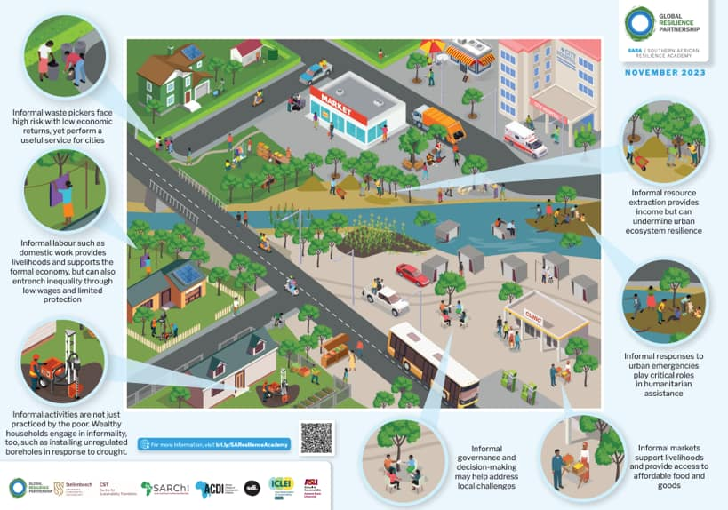

Slide 30
Knowledge product ideas – the process
Advocacy & influence
Advocacy brief
Engagement framework
Methods & tools
Method note
Toolkit
Guidance note
Process reflections
Consultation process reflection
Institutional or coordination reflection
TIP
Documenting your process (including what worked and didn’t work) is very valuable for peer learning, national-level sharing and best practice

Slide 31
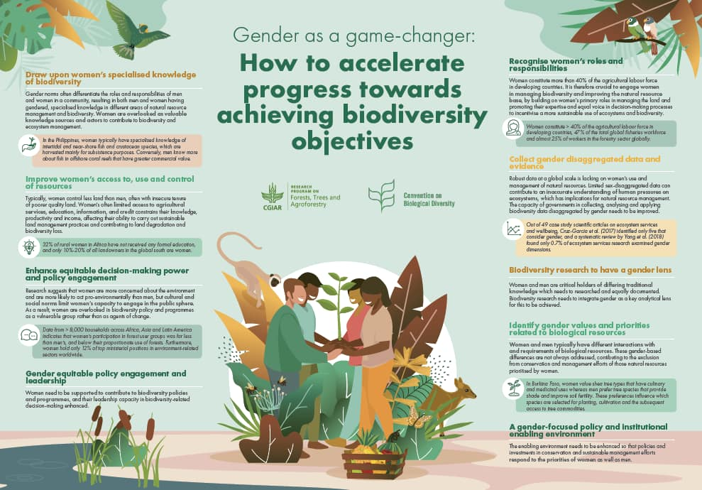
Synthesis infographic or poster on findings

Slide 32

Toolkits –
to share innovations in your analysis or engagement activities and consultations

Slide 33
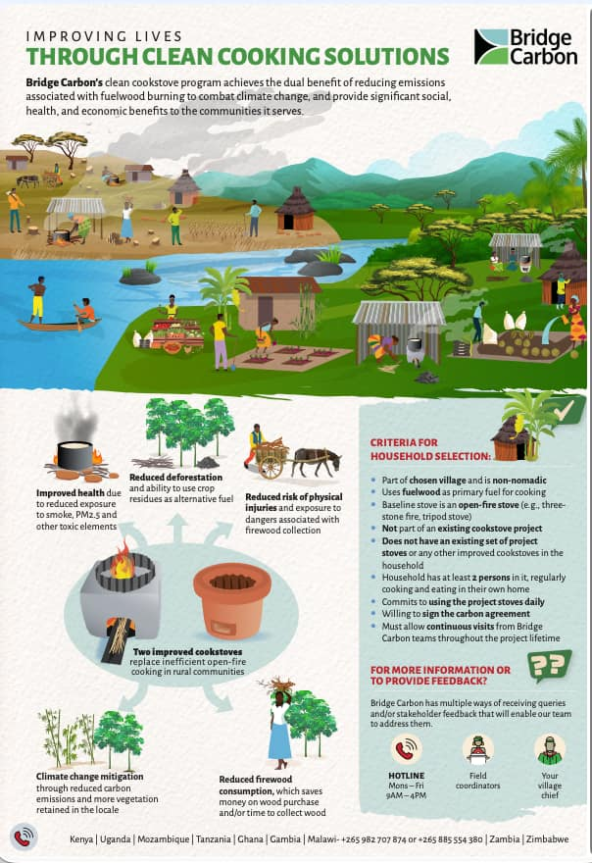
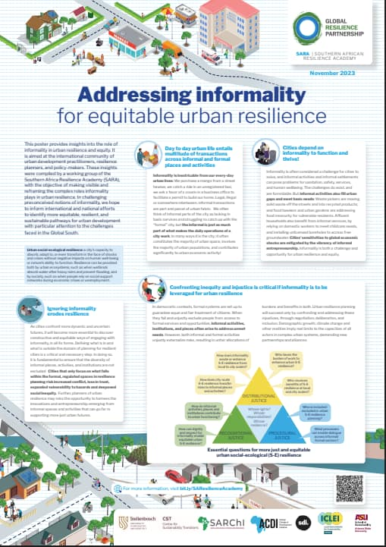
Posters

Slide 34
TIP
Reflect!!
This is where teams often jump too early.
They start with “let’s make a video” or “let’s do a report.”
But the sequence matters:
    First, define purpose,
    then audience,
    then message,
    then product.
What format will best help this audience understand and use this message?

Slide 35
5
Packaging and strategic timing and outlets for dissemination
Good packaging means
    clear message
    simple structure
    concise content
    easy to read
    visually accessible

Slide 36
General guidance
A clear opening
What is this about?
Why does it matter?
Key insights or messages
3–5 main points
What is most important
Explanation or examples
Evidence from your analysis
Examples or quotes
What this looks like in practice
Why it matters
Why this is important now
Link to NBSAPs, policy, or implementation
Next steps or implications
What should happen next
Recommendations, actions, or reflections
TIP
If someone reads only the first page, they should still understand the key message

Slide 37
Plan for dissemination
Who needs to receive this?
Where will it be shared?
Who will share it?
How many times will it be used?
Possible opportunities include:
  Ministry meetings
  NBSAP discussions
  Validation workshops
  Inter-ministerial platforms
  Gender coordination forums
  Programme design meetings
  Budget / funding discussions
TIP
Dissemination is a process — not a single event

Slide 38
Re-purposing your knowledge product
Your product can become:
  slides
  talking points
  social media content
  inputs to reports
  proposal content
  workshop materials
TIP
The goal is not to produce a document;
it is to get your message into the spaces where decisions are made

Slide 39




Q & A

Slide 40




NBSAP Accelerator Communication Insights

Slide 41
Peer to Peer Learning
Idea sharing:
Who are you trying to influence?
With what message?
How (what type of product)?
Who are you working with?
Will you need to procure a consultant?

Slide 42
Project knowledge requirements and technical support

Slide 43
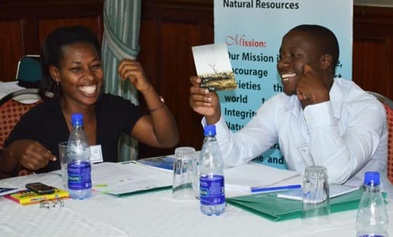
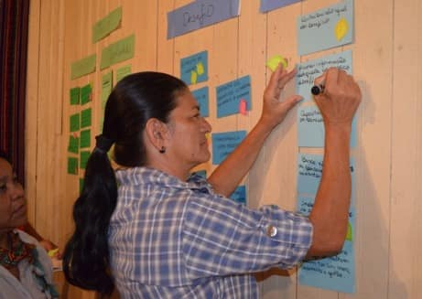
Project requirement:
2 national co-authored knowledge products
Primary focus: what is most useful for your country process
Secondary focus: what will be useful for others in peer and global learning to other Parties and actors

Slide 44
Technical support offered to country teams on knowledge products
Strategic positioning
  Helping think about where products fit in the wider project and dissemination landscape
  Helping identify what matters most based on your audience needs
Product structuring
  Helping shape the outline for a situational analysis summary, policy brief, case study, story, or roadmap
Technical synthesis ideas
  Supporting messaging to turn long analyses or consultation findings into clear messages
Branding and formatting
  Supporting consistency with project or partner expectations
  Can provide a boilerplate/project logos, if desired by countries
Design and layout
  Ensuring products are more visual and usable

Slide 45
Proposed plan of support and timelines
Identify product ideas: based on learning from the session, countries to reflect on what is most strategic, practical and useful for them as knowledge outputs from the project
Early April
Bilateral consultations: Individual country meetings to run through the key steps, concretely identify knowledge products that ensure your key message and audience are targeted and agree on a process and timelines
Mid April – Mid May
Co-development: Based on agreed format, content finalization and design and layout
End May – Mid June
Finalizing: Review, refine and finalize knowledge products and getting them into dissemination format for online access, printing and presenting and final workshop
June
Prepare for dissemination and strategic use: Support on leveraging your knowledge product sharing (including on NBSAP partnership website), presenting key insights and using it within country processes
End June

Slide 46
Global project team are responsible for developing global knowledge products to share learning
Global knowledge products will aim to:
  draw out common themes across the 7 countries
  create stronger visibility at global level
  support COP-related or broader advocacy moments
  help position the project as a meaningful contribution to global understanding of gender-responsive biodiversity planning
Possible collective outputs:
  Synthesis of common lessons
  Shared messages on gender-responsive NBSAPs
  A joint call to action
  Country examples with a common framing
Notes:
.

Slide 47
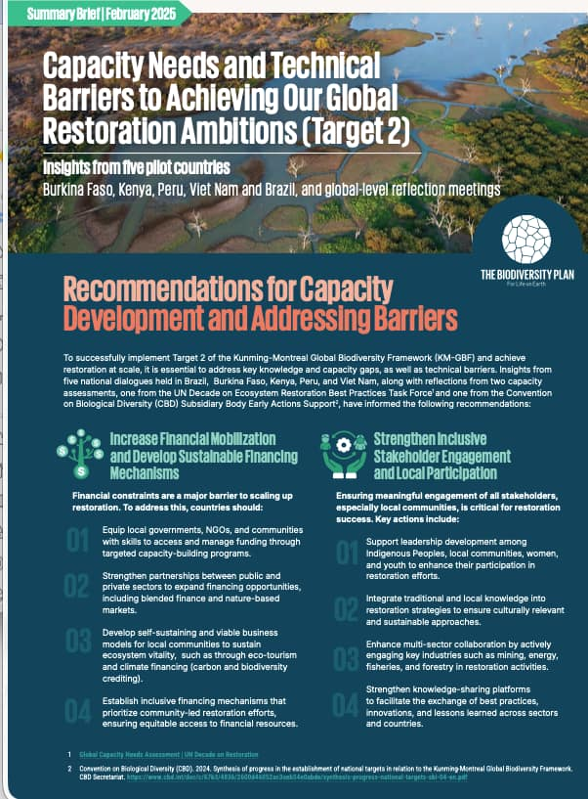
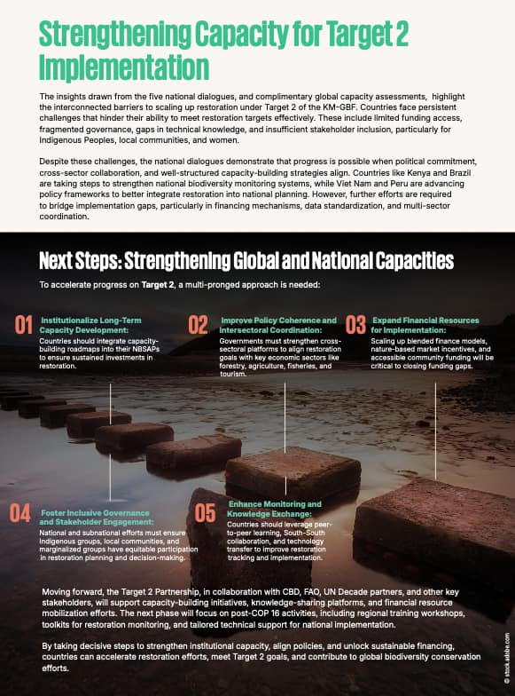
Using national findings on Target 2 of the Global Biodiversity Framework into a joint summary brief

Slide 48

Final workshop is a great opportunity for
Visibility
Peer learning
Showcasing your country work
Launching your knowledge products and getting any final feedback

Slide 49







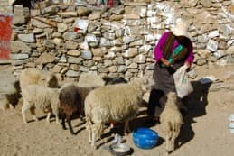
Thank you!
Merci!
Gracias!
Спасибо!
ขอบคุณ!

