Slide 1










Thematic Clinic 6
Mobilizing Support:
Tips to develop resource mobilization proposals and Match Making Mechanism Gender Proposal and development of a Gender Biodiversity Project
Image here
Gender and NBSAP Capacity Building & Exchange Process
24th March 2026

Slide 2
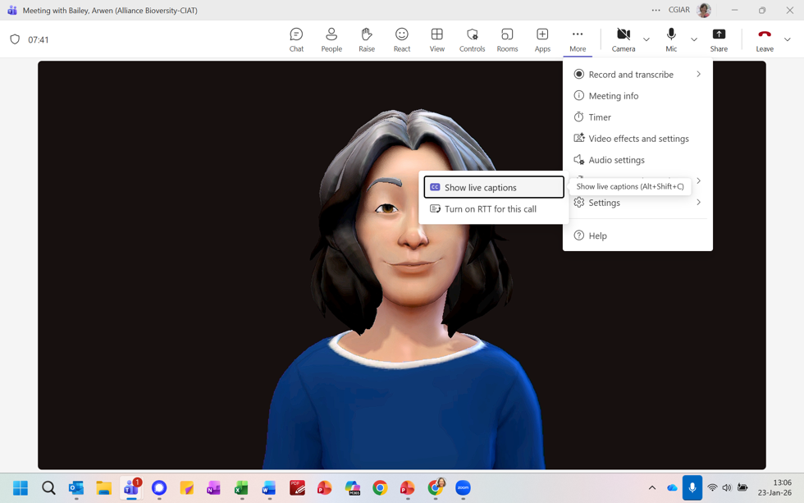
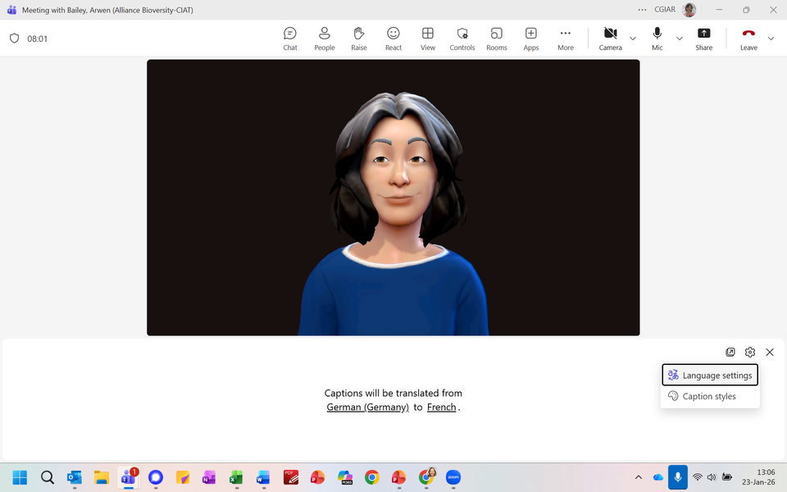


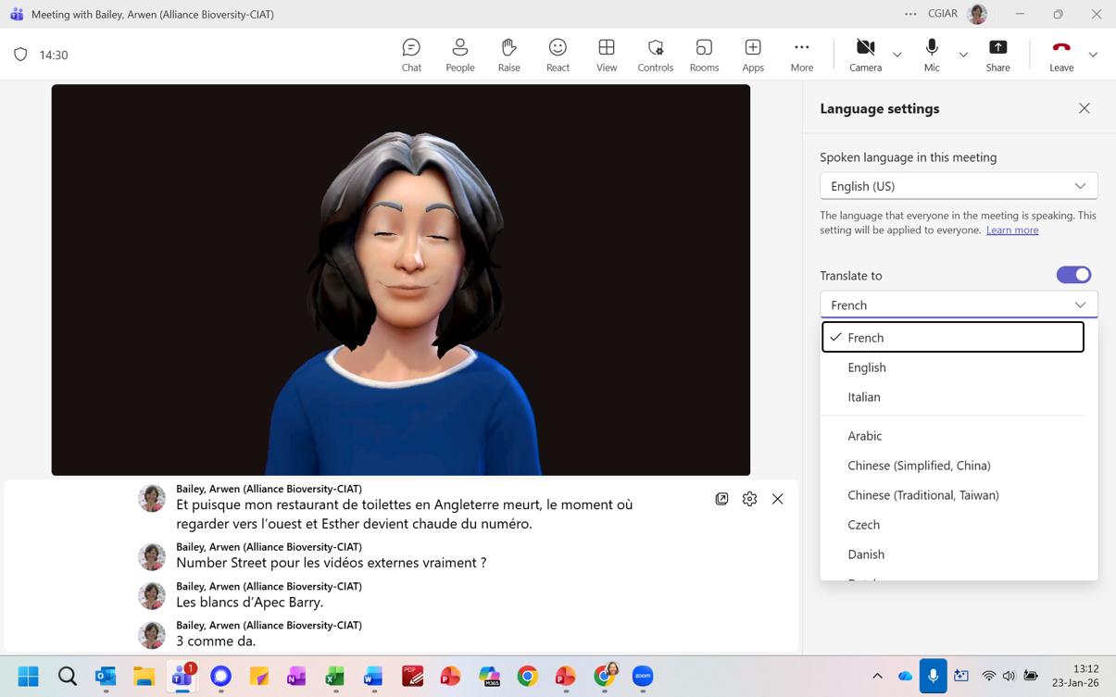
1
2
3

Slide 3
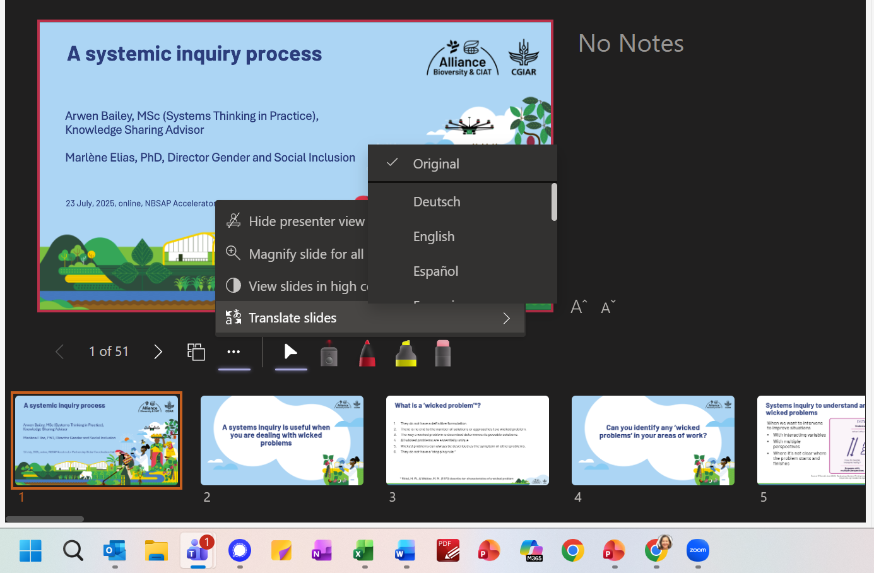

Slide 4

10:00– 10:05
Welcome
Welcome and objectives
Brief description of the Work Clinic
Agenda
10:05– 10:50
Sharing our knowledge: Thematic Work Clinic
Interactive presentation to share tips and practical advice to develop a, inclusive multi actor consultation
10:50 -11:00
Q&A
Participants will have the opportunity to ask questions on the recommendations presented
11:00 -11:25
Together is better: Peer exchange and troubleshooting
Countries will share their experiences and challenges in developing a gender analysis to obtain recommendations from participants
11:25 -11:30
Wrap up
Planning for the next capacity building session

Slide 5
Objectives
Mobilizing support for gender-biodiversity projects
Provide an overview on mobilizing support for gender-biodiversity projects
NBSAP Accelerator Partnership MatchMaking Mechanism (MMM)
Provide an overview on the MMM
Share practical tips on developing request for the NBSAP AP MatchMaking Mechanism
Introduce the support we can provide for surfacing ideas and submitting a request to the MMM
Promote peer-to-peer exchange on good practices and lessons learned
Expected outcome of this session:
Country partners understand better how to fulfill the output “ 1 request package developed and submitted to NBSAP AP MMM“ and are well aware of the individual support that will be provided by the team

Slide 6
Building on our previous clinics and components of the gender-biodiversity project
Previous clinics and your in-country work under the gender-biodiversity project builds the foundation for developing gender-biodiversity projects:
Situational analysis
(Clinic 1)
National workshops
Gender and biodiversity
roadmap
(Clinic 4)
National gender and biodiversity goals and expected outcomes
National and local data and information on gender and biodiversity
Stakeholder consultations
(Clinic 2)
Validated roadmaps
Focus of today‘s clinic event
Part I:
Overview on mobilization support for gender-biodiversity projects
Landscape of financing opportunities
Part II:
Develop gender-biodiversity requests for the
NBSAP Accelerator Partnership MatchMaking Mechanism
(1 request package developed and submitted to NBSAP AP MMM)

Slide 7



Part I:
Mobilizing support for gender-biodiversity projects

Slide 8

Mobilizing support means
Securing political and community backing
Building partnership across sectors
Raising awareness and demonstrating value
And of course securing technical and financial resources
Image Source: Unsplash/Neil Thomas Link

Slide 9
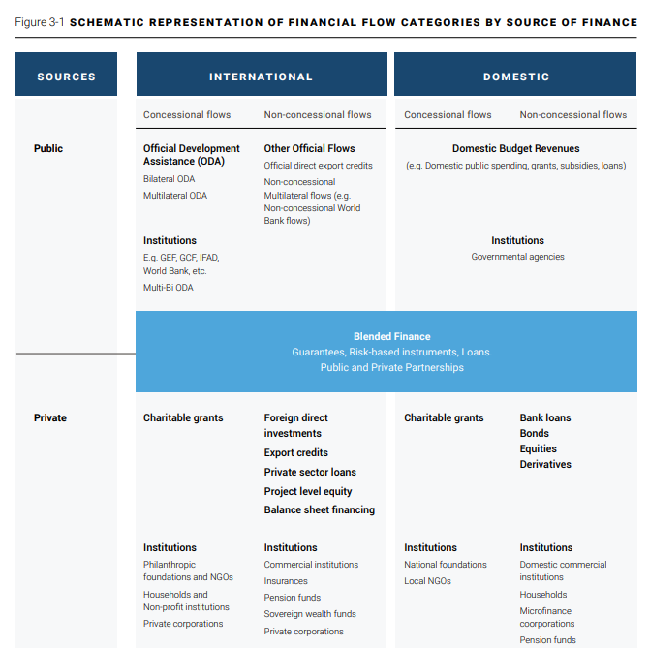
An Evolving Landscape
International climate and biodiversity funds
National budgets and development programmes
(biodiversity finance plans)
Blended finance and private sector investment
Image source: UNCCD_Financial needs assesments-WEB2.pdf, p 34

Slide 10
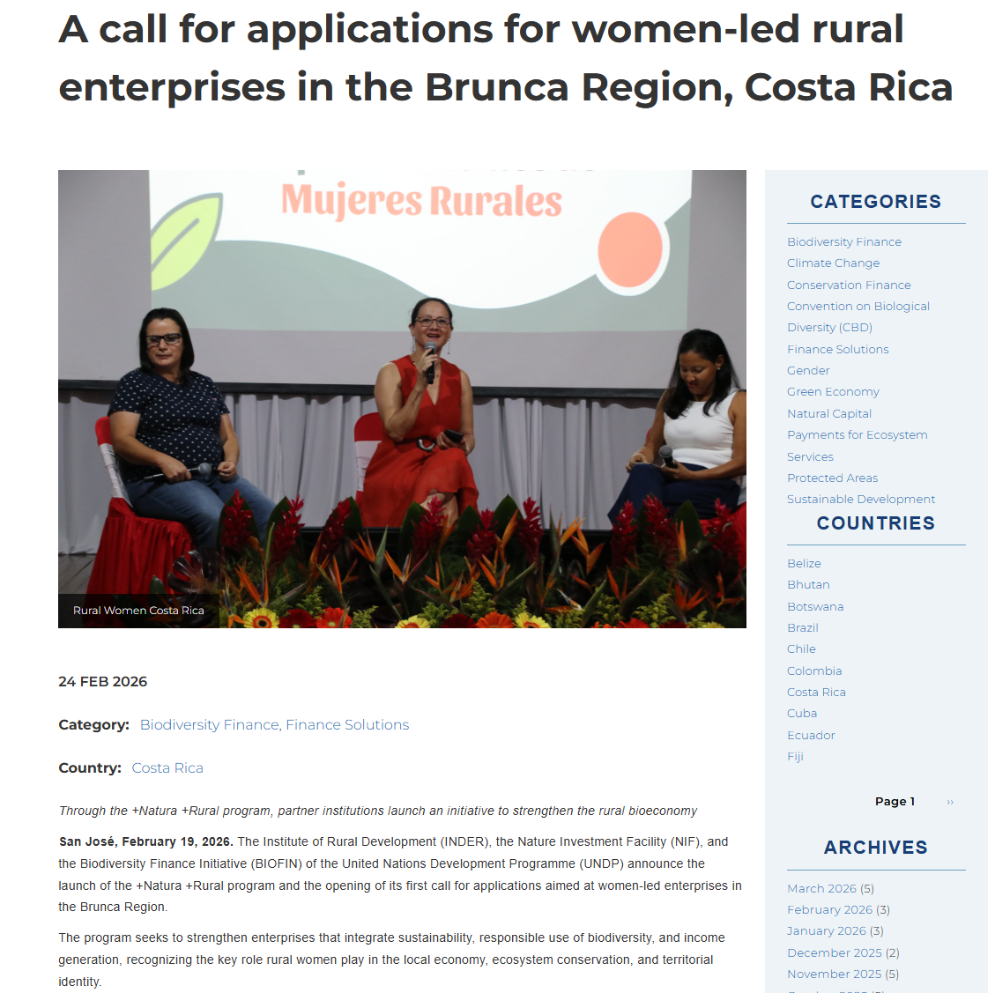
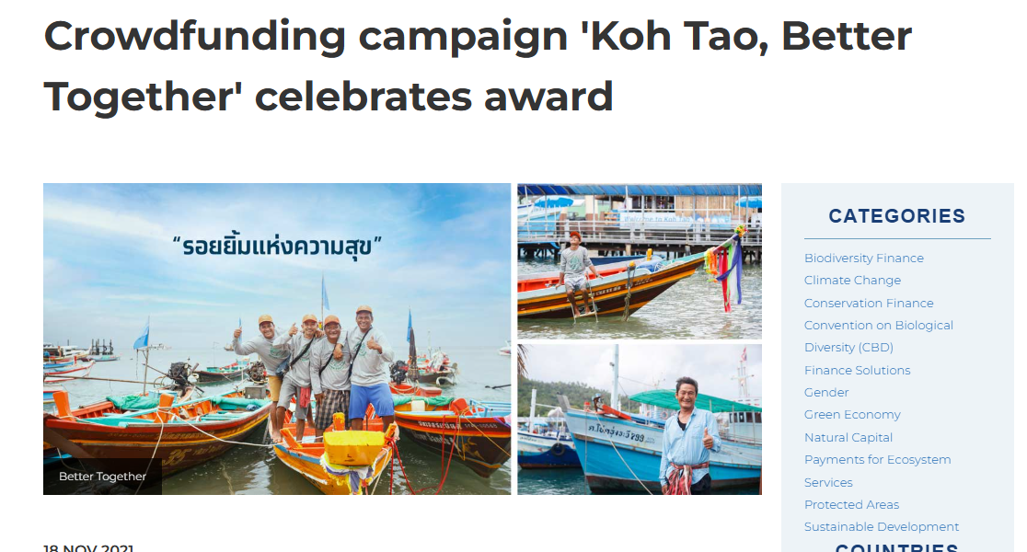

No ‘One Size Fits All‘ Solutions
Payments for Ecosystem Services
Biodiversity Credits
Carbon Markets
Biodiversity Enterprise Funds
Budget Tagging
Nature- and people-positive
business incubators

Slide 11
Part II:
How to develop a request for the NBSAP AP MatchMaking Mechanism (MMM)?
What is the NBSAP AP MatchMaking Mechansim?
Tips and success factors for strong MMM requests
What is needed from country partners & support we can provide for surfacing ideas and submitting a request to the MMM

Slide 12
Part II:
How to develop a request for the NBSAP AP MatchMaking Mechanism (MMM)?
What is the NBSAP AP MatchMaking Mechansim?
Tips and success factors for strong MMM requests
What is needed from country partners & support we can provide for surfacing ideas and submitting a request to the MMM

Slide 13

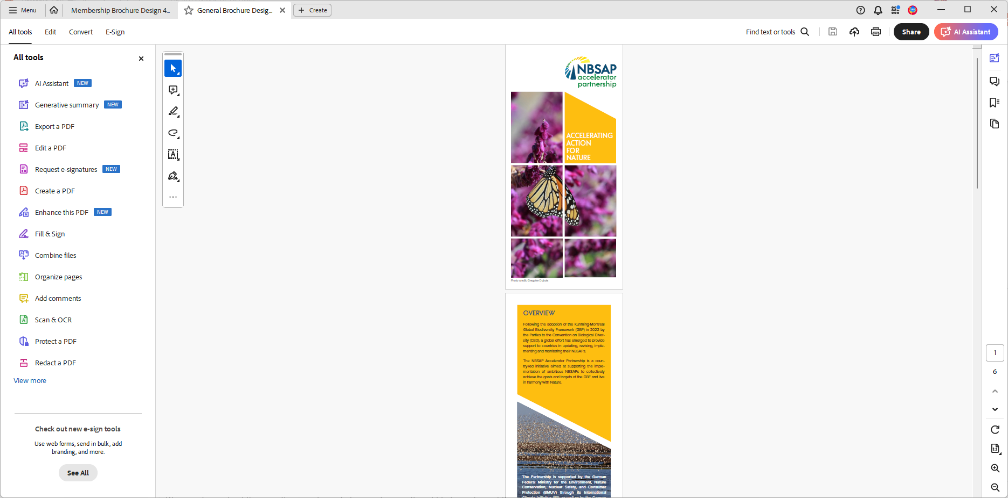










NBSAP Accelerator Partnership
Announced at COP 15, a country-led partnership to accelerate implementation of National Biodiversity Strategies and Action Plans aligned with the Global Biodiversity Framework
Support NBSAP implementation
Strengthen technical and institutional capacity
Facilitate access to biodiversity finance
Align financial flows for biodiversity mainstreaming
Foster peer to peer learning and collaboration
Elevate NBSAPS in national development planning

Slide 14

MatchMaking Mechanism
Demand led hybrid platform to accelerate country access to technical assistance, financial resources and knowledge services across 23 GBF targets.
Central mechanism of the NBSAP AP
Theory of change:
  If national needs are articulated, centralised, and connected to the right partners through a transparent and coordinated process, then engagement becomes more efficient, less fragmented, and more likely to result in technical and financial support.
Objectives
  Fast-track connections
  Centralize country requests
  Enhancing synergies
  Maximizing impact
  Providing tailored support
Notes:
The NBSAP Accelerator Partnership's MatchMaking Mechanism is designed to quickly connect country members with the technical and financial support needed to accelerate NBSAP implementation. It does so by connecting country-identified requests for technical and financial support with institutional, non-state actor, and country member services, efficiently matching needs with solutions. The MatchMaking Mechanism is an exclusive service to NBSAP Accelerator Partnership members.

Slide 15


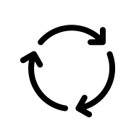
MatchMaking Mechanism
Mission
Match
Connect country biodiversity needs with relevant technical and financial partners.
A match is a confirmed connection between a country and one or more partners— not a funding decision.
MatchMaking Mechanism
  Neutral broker
  Partnership platform
  Structured coordination process
  Supported by digital infrastructure
Mechanism
Countries submit requests; the MMM centralizes and shares them with the membership; interested partners signal intent; countries decide whether to engage
Notes:
The process is demand-driven and country-led.
The country submits a request for support by email.
We receive the request, centralize it within our system, and share it with the membership of the NBSAP Accelerator Partnership.
Interested partners express their intent to engage.
The country decides whether to move forward with the engagement.
In summary, the MatchMaking Mechanism:
Acts as a neutral broker
Serves as a partnership platform
Provides a structured coordination process
Is supported by digital infrastructure

Slide 16
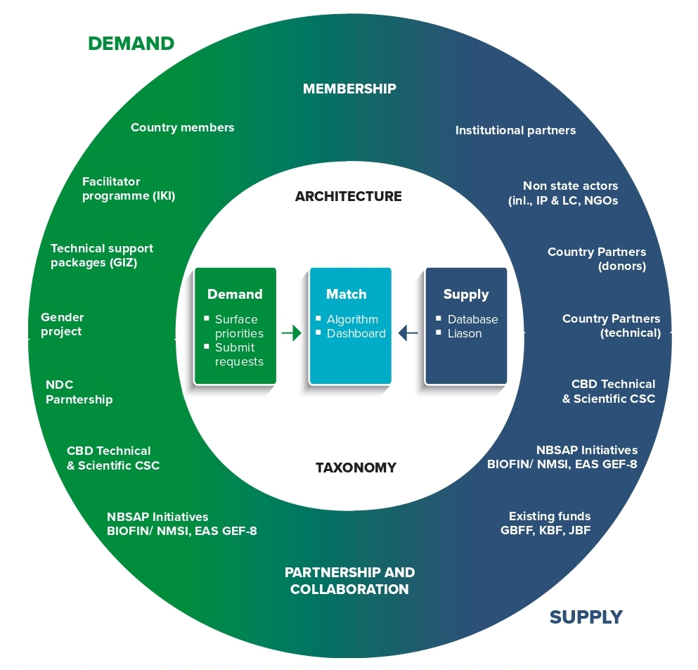
Connect countries with technical and financial support across 23 GBF targets:
Surface and capture requests
Distribute to supplier network
Coordinate match

Slide 17
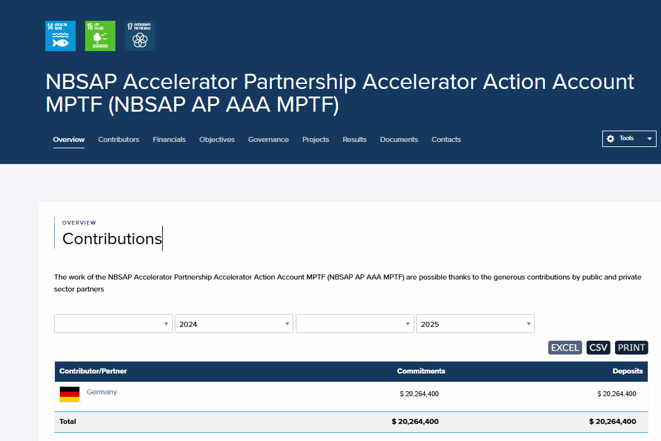
Accelerator Action Account
Dedicated Multi-Partner Trust Fund (MPTF) designed to support promising requests submitted through the MatchMaking Mechanism that cannot be met elsewhere.
Launched at COP16 in Cali, the AAA helps bridge funding gaps and enables delivery of technical support when no immediate partner match is available.
It currently holds about $20 million, available through 2030.

Slide 18
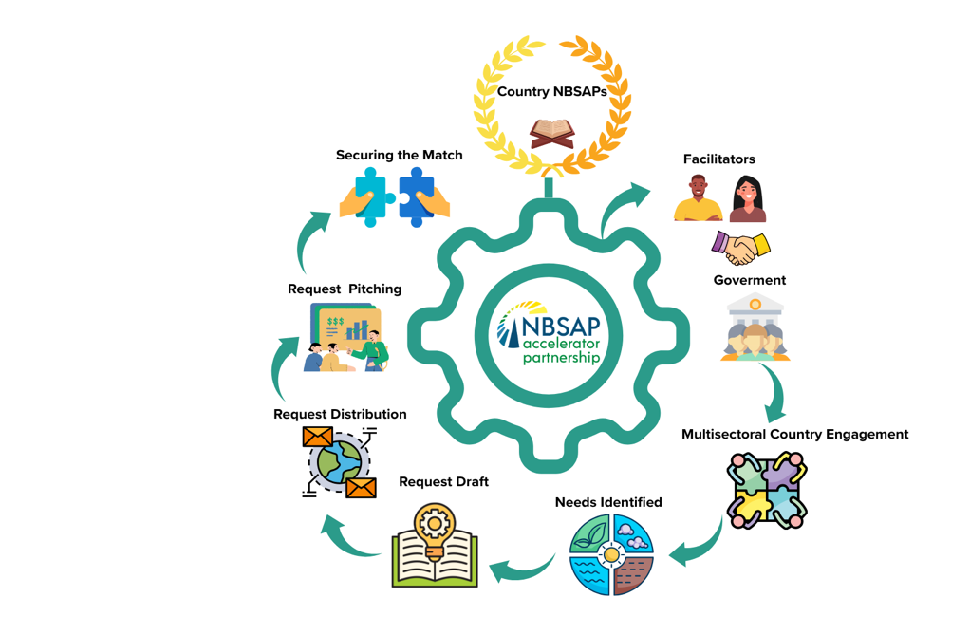
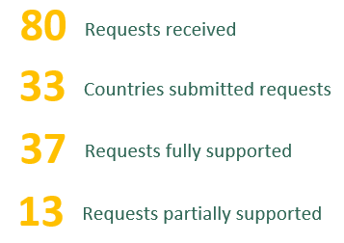
NBSAP AP Government Focal Points
(+ 24 with facilitator support)

Slide 19
How it works: From need to match
Country approval
Indication of Interest
Define & Submit
Share
Match
Finalize
  Surface needs
  Research
  Feedback and review
  Refine and articulate request
  Suppliers express interest.
  Countries review expression of interest and determine whether to proceed.
  Suppliers and countries engage directly to define next steps
  Requests are centralised and distributed to a global network of technical, financial and implementation partners.
Notes:
What is the platform vs mechanism vs total countries

Slide 20

      Questions

Slide 21
Part II:
How to develop a request for the NBSAP AP MatchMaking Mechanism (MMM)?
What is the NBSAP AP MatchMaking Mechansim?
Tips and success factors for strong MMM requests
What is needed from country partners & support we can provide for surfacing ideas and submitting a request to the MMM
Notes:
Welcome 5 min
Meeting objectives and structure
Introduction of Participants ( warm up question: why are you excited to be here?)

Slide 22
Key considerations for strong request
Strategic Alignment:
Is this request clearly linked to a priority action or target in the NBSAP?
Does it have relevance to NBSAP priorities?
Catalytic Support:
Will this intervention unlock, accelerate, or remove a bottleneck to broader NBSAP implementation?
Readiness:
Is the country institutionally ready to implement within 12–24 months?
Scope & Proportionality
Is there a clear scope of support that is needed?
Is the request appropriately scoped for catalytic acceleration (e.g, not a full GEF-style programme)?
Budget Realism:
Is the proposed budget proportionate to outputs and feasible within acceleration parameters?

Slide 23
Success factors for strong requests
Participatory process to identify a topic that is timely & relevant
    A participatory process ensures ownership, an inclusive process (full and effective participation of rightsholders and stakeholders), highest priority for your local context, securing political and community backing, enables building partnership across sectors, etc.
Develop a strong theory of change
Tell a compelling story
Clearly demonstrating the value of the request is key to raising awareness and generating interest among potential suppliers.

Slide 24

Participatory process to identify a topic that is timely & relevant
Build on your situation analysis and roadmap that you co-developed in the consultations processes in order to
    identify the problem you want to address
    OR
    develop the solutions further that were brought forward and discussed to elevate women’s voices, accelerate gender-responsive NBSAP implementation?
    Cleary show the relevance of the request for priority action and targets in the NBSAPs
Clearly show how the request will unlock or accelerate NBSAPs implementation

Slide 25
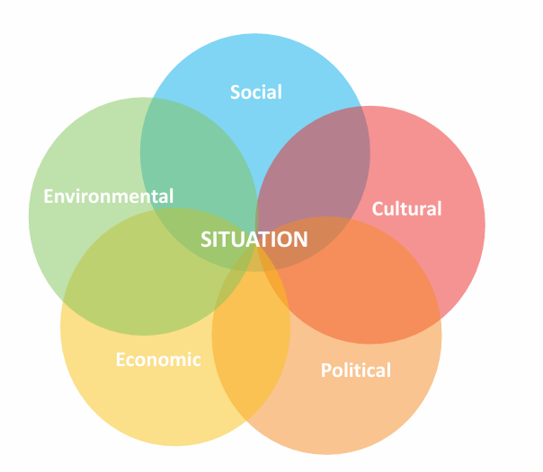
TIP
Build on your situational analysis and consultation processes
„If you incorrectly understand the situation and misdiagnose the problem, everything that follows is likely to be wrong.“
(Wisconsins Logic Model Tutorial)
    Thoroughly screen the entire process conducted so far in order to
    1. identify the problem you want to address
    OR
    2. develop the solutions further that were brought forward and discussed to elevate woman’s voices, accelerate gender-responsive NBSAP implementation?
Further reading and sources: Theory of Change Guide No. 1 - The Situation

Slide 26
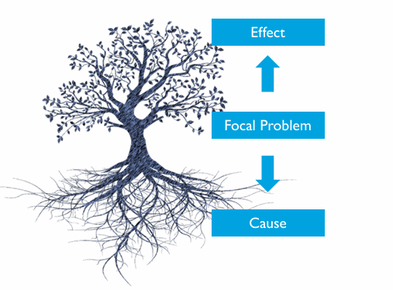
TIP
Invest in understanding cause and effect of the problem/solution identified
    When you have identified the problem you want to address or solutions you want to further develop, think about the causes and effects of this identified problem/solution. This will help you to prioritize action
Further reading and sources: Theory of Change Guide No. 1 - The Situation

Slide 27
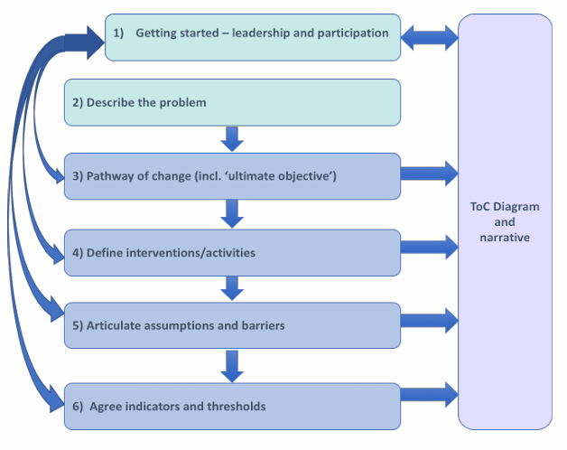
Theory of Change – selected definition
“The theory of change approach is a process of project planning and evaluation which maps the relationship between a long-term goal of a project and the intermediate and early changes that are required to bring it about. It encourages a project team or group of stakeholders to explain how the project is understood to reach its goals, and the process through which changes will occur. The approach emphasizes the theory and assumptions underlying the pathway of change from the implementation of selected interventions and activities to intended outcomes.” (Conservation International, 2013)
Further reading and sources: Microsoft Word - Theory of Change Briefing note v8_MH edit_IMPACT format_PP_RA.docx

Slide 28
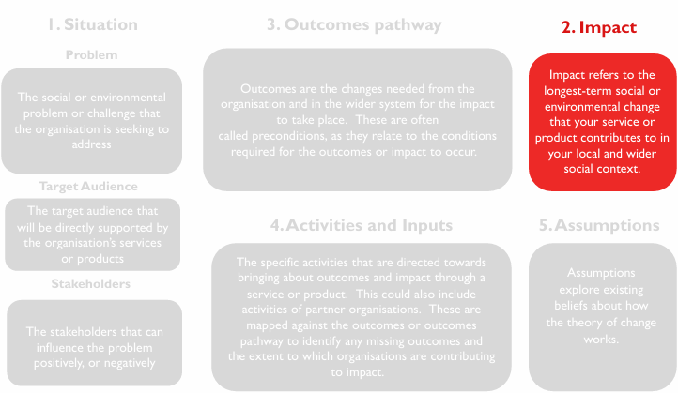
TIP
Use backward mapping
    Test your outcome pathway by working backwards from the ultimate outcome/the change you wish to see: place the phrase “In order for this to happen…” between each precondition/outcome.
    This will lead to a strong “if [outcome] then [impact] ” logic
Further reading and sources:
Microsoft Word - Theory of Change Briefing note v8_MH edit_IMPACT format_PP_RA.docx / Theory of Change Guide No. 2 - Impact

Slide 29
Part II:
How to develop a request for the NBSAP AP MatchMaking Mechanism (MMM)?
What is the NBSAP AP MatchMaking Mechansim?
Tips and success factors for strong MMM requests
What is needed from country partners & support we can provide for surfacing ideas and submitting a request to the MMM

Slide 30
Building on our previous clinics and components of the gender-biodiversity project
Previous clinics and your in-country work under the gender-biodiversity project builds the foundation for developing gender-biodiversity projects:
Situational analysis
(Clinic 1)
National workshops
Gender and biodiversity
roadmap
(Clinic 4)
National gender and biodiversity goals and expected outcomes
National and local data and information on gender and biodiversity
Stakeholder consultations
(Clinic 2)
Validated roadmaps
Focus of today‘s clinic event
Part I:
Overview on mobilization support for gender-biodiversity projects
Landscape of financing opportunities
Part II:
Develop gender-biodiversity requests for the
NBSAP Accelerator Partnership MatchMaking Mechanism
(1 request package developed and submitted to NBSAP AP MMM)

Slide 31
Developing and validating MMM requests
What is needed?
How can we support?
Thematic Work Clinic 24th March 2026
“Mobilizing Support: : Tips and tools to develop resource mobilization proposals for gender-biodiversity projects”
Guidance brief for developing and validating a NBSAP AP MatchMaking Mechanism request incl. background information on gaps and success factors
Bilateral exchange and support
Priority topics identified by countries to develop proposals
Countries develop and validate MMM requests

Slide 32




Q & A
Notes:
Welcome 5 min
Meeting objectives and structure
Introduction of Participants ( warm up question: why are you excited to be here?)

Slide 33
Experience sharing
Notes:
Welcome 5 min
Meeting objectives and structure
Introduction of Participants ( warm up question: why are you excited to be here?)

Slide 34
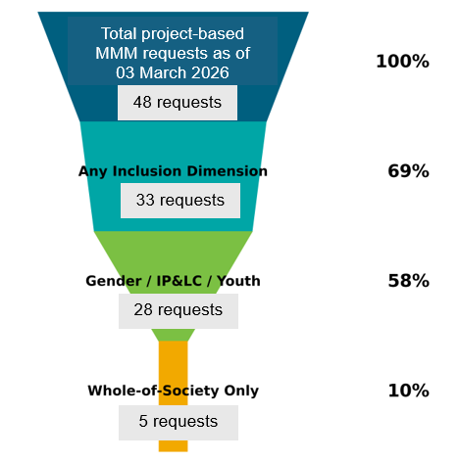
Whole-of-society approach in MMM requests
→ Reference to mainstreaming whole-of-society approach, but few requests include gender-responsive or gender-transformative activities
28 of the 48 project-based MMM requests mention at least one of the three inclusion dimensions in their Proposed Activities section
Gender is mainly listed together with Youth and IP & LC rights, there are only 6 requests that only mention gender.
AI-supported analysis of project-based MMM requests as of 3 March 2026

Slide 35
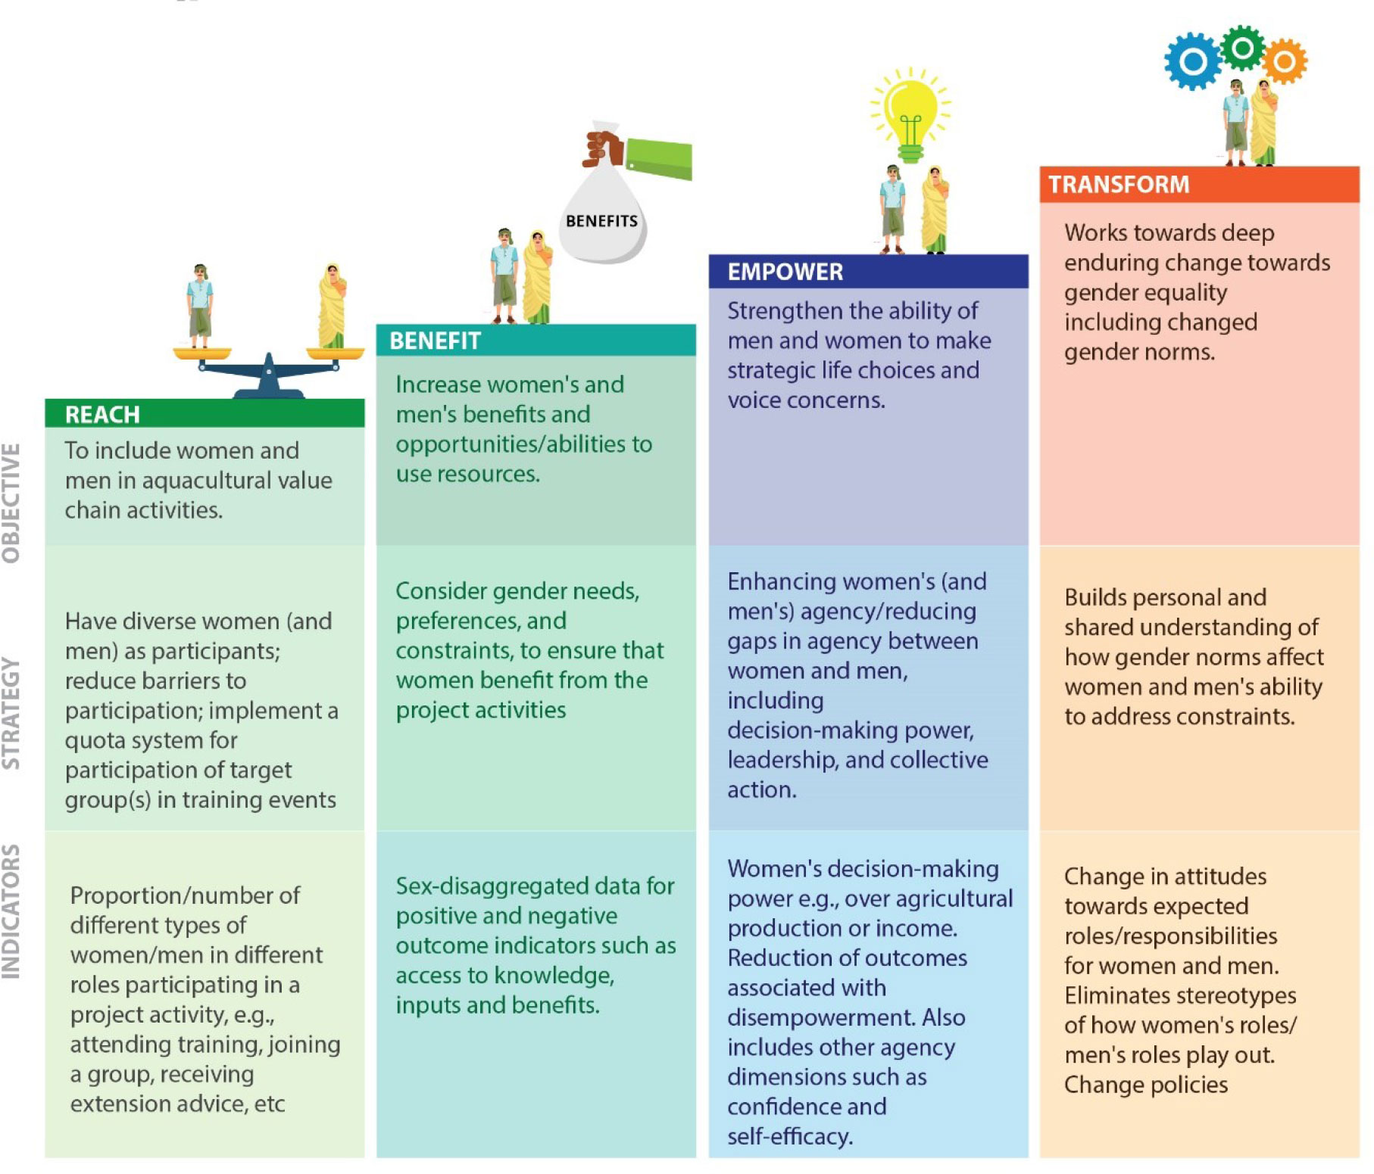
Social inclusion in MMM requests
A qualitative view
Works towards deep enduring change including changed gender norms and policies.
Strengthen the ability of women to make strategic life choices and put those choices into action
Consider gender needs, preferences and constraints, to ensure that women benefit from project activities
(e.g. increasing food security, income, health)
Include women in project activities.
Moving from gender-sensitive to gender-responsive and gender-transformative
Image sources: Reach-benefit-empower-transform (R-B-E-T) framework: Adam R and Njogu L (2023) adapted from (Johnson et al., 2017) and (Mcdougall et al., 2021b).
Indicators
Gender-sensitive
Gender-responsive
Gender-transformative

Slide 36
Example: Implementing the Women’s Route of Colombia’s Biodiversity Action Plan to 2030
Suppliers | UN Women Colombia and financed by the AAA
Topic | Institutionalizing involvement of women’s groups in NBSAP implementation
Aim | By empowering women through education, networks, and direct support for biodiversity initiatives, → collective action, strengthening governance, communications, and local implementation so Colombia’s BAP 2030 goals are advanced with measurable community impact and enhanced international commitments
Selected activities | Pedagogical strategy for the dissemination of the Gender and Biodiversity Action Plan (GBAP) of the NBSAP. Desing and establish a Women Multipliers School Consolidate a National Network of Women Biodiversity Caregivers: formalizes dialogue, advocacy agendas, and alliances that feed planning instruments and improve coherence Strengthen biodiversity conservation community processes led by women through funding, technical support, training, experience sharing

Slide 37




Next Thematic
Work Clinic
Notes:
Welcome 5 min
Meeting objectives and structure
Introduction of Participants ( warm up question: why are you excited to be here?)

Slide 38
Capacity Building Plan: Thematic Work Clinic
March 31th
Highlighting the added value of gender: Tips to systematize case studies and documenting gender impacts of nature-based solutions

Slide 39

Thank you!
Merci!
Gracias!
Спасибо!
ขอบคุณ!

