Slide 1










Thematic Clinic 5
Enabling Conditions to ensure the gender responsive implementation of the NBSAPs
Image here
Gender and NBSAP Capacity Building & Exchange Process
17th March 2026

Slide 2

Objectives
Discuss the main steps to strengthen enabling conditions to ensure the gender responsive implementation of the NBSAPs
Share tips that can be adapted to different country contexts
Promote a peer-to-peer exchange on good practices to strengthen enabling conditions
Obtain recommendations to identify gaps and propose concrete actions to strengthen enabling conditions

Slide 3
10:00– 10:05
Welcome
Welcome and objectives
Brief description of the Work Clinic
Agenda
10:05– 10:50
Sharing our knowledge: Thematic Work Clinic
Interactive presentation to share tips and practical advice to develop a, inclusive multi actor consultation
10:50 -11:00
Q&A
Participants will have the opportunity to ask questions on the recommendations presented
11:00 -11:25
Together is better: Peer exchange and troubleshooting
Dominican Republic will share their experiences and challenges in developing a national gender working group
11:25 -11:30
Wrap up
Planning for the next capacity building session

Slide 4




Why are enabling conditions key to ensure the gender responsive implementation of the NBSAPs?
Notes:
Welcome 5 min
Meeting objectives and structure
Introduction of Participants ( warm up question: why are you excited to be here?)

Slide 5


Enabling conditions are needed to implement gender-responsive NBSAPs
Once the NBSAP is present, countries should:
Conduct a strengths and gaps analysis of national governance, policies, programs and monitoring structures to determine if the country has the enabling conditions to implement the NBSAP in a gender responsive manner.
Gender and biodiversity working groups
Capacity building processes
Gender and biodiversity analysis
Gender and Biodiversity Action Plans
Gender responsive information systems
Commitment
Ambition
Innovation

Slide 6
Create an ecosystem conducive to implement a gender-responsive biodiversity agenda
Develop gender-responsive policies
Collect gender data or information
Strengthen biodiversity governance
Conduct gender-responsive consultations
Creating the right ecosystem
of enabling conditions
Strengthen capacities
Gender-sensitive or responsive climate programs or projects
Promote gender-responsive biodiversity finance
Promote gender-responsive biodiversity monitoring & reporting

Slide 7




How to strengthen enabling conditions needed to ensure the gender responsive implementation
of the NBSAPs?
Notes:
Welcome 5 min
Meeting objectives and structure
Introduction of Participants ( warm up question: why are you excited to be here?)

Slide 8






Recommendations to strengthen enabling conditions
1
Establish a formal governance structure to oversee work on gender and biodiversity
2
Conduct tailored capacity building sessions for different sectors
Include comprehensive and ambitious gender commitments in NBSAP implementation plan and sectoral strategies
3
Allocate specific biodiversity finance to implement gender commitments included in NBSAPs , national gender action plans, or biodiversity agenda
4
Establish a national gender and biodiversity programme and design gender specific biodiversity projects
5
Ensure the national biodiversity information system includes gender data and indicators
6
Notes:
Review of main gender and biodiversity laws and national documents.
Review of biodiversity and gender literature relevant to the country context.
Map gender experts, organizations and representatives of women’s machinery, associations and women stakeholders (rural and indigenous women).
Gender analysis of relevant national and local data.
Meetings with actors from various sectors (government, civil society, etc.) to identify lessons learned or extra data that have not been previously identified.
Field visits to rural and indigenous communities.

Slide 9


Key actions to strengthen enabling conditions
1
Establish a formal governance structure to oversee work on gender and biodiversity
Established multisectoral national gender and biodiversity group that can define and monitor national gender and biodiversity priorities and support the gender responsive implementation of the NBSAPs
Include Women's Mechanism in official biodiversity governance

Slide 10
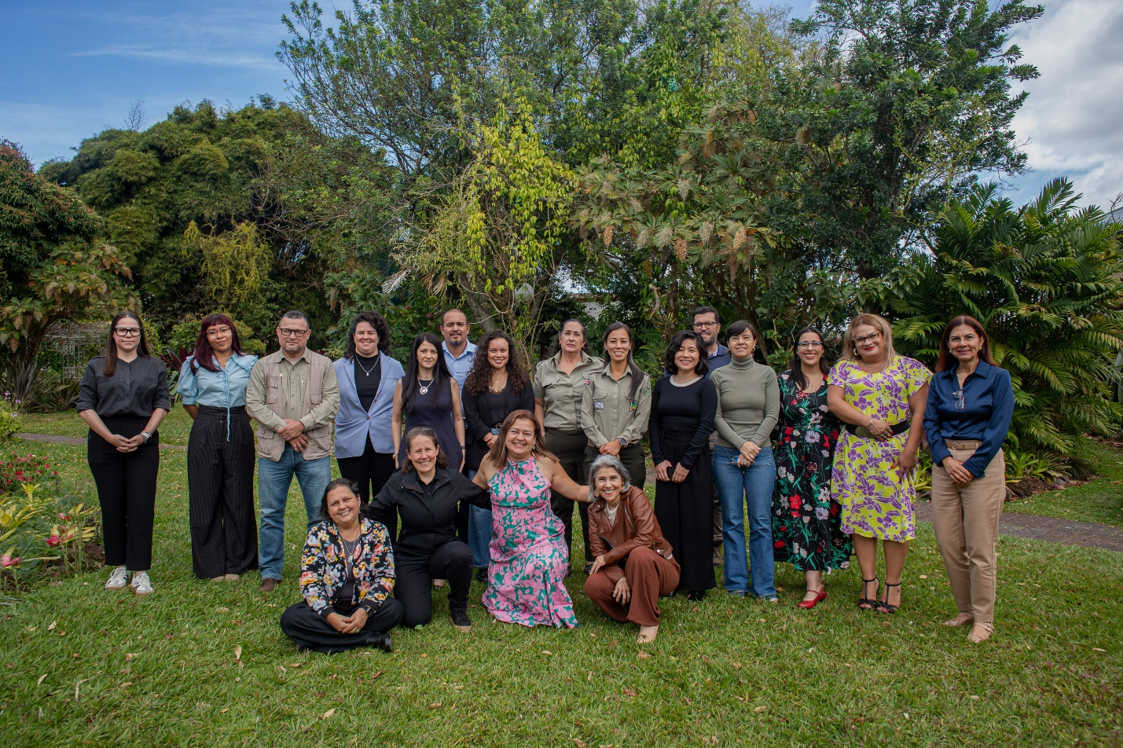
TIP
CCTs can be expanded and formalized into national gender and biodiversity working group
1
Identify gender focal points from the government institutions involved in the implementation of the NBSAP
Involve Women’s Mechanism
Invite national gender and biodiversity experts
Involve women representatives

Slide 11
Key actions to strengthen enabling conditions
2
Conduct tailored capacity building sessions for different sectors
Design a comprehensive and diverse capacity building process that includes workshops, awareness-raising processes and national forums
Develop gender and biodiversity guidelines for different sectors
Develop formal or long-term training with academia, CSOs and women’s groups

Slide 12
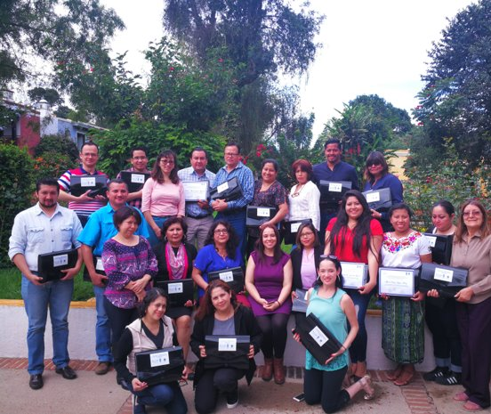
TIP
Establish an alliance with a national academic institution and develop a technical diploma on gender and biodiversity
2
A Diploma on Gender and Biodiversity
A series of workshops that addressed issues of gender and biodiversity
Workshops on Women's Livelihoods and NbS

Slide 13
Key actions to strengthen enabling conditions
3
Include comprehensive and ambitious gender commitments in NBSAP implementation plan and sectoral strategies
Align national gender commitments with gender mandates included KM GBF and the CBD’s GPA
Incorporate gender considerations into the biodiversity policy framework that is developed to implement the NBSAP
Incorporate environmental issues in the gender equality policy framework
Develop gender and biodiversity action plans or roadmaps

Slide 14
TIP
Ensure sectoral policies and strategies include key gender equality and women's empowerment elements
3
NBSAP Principles and Vision
Governance and Inclusion for NBSAP update and Implementation
Capacity Building for NBSAP Implementation
Data and situation analysis included in NBSAP
NBSAP areas or sectors of intervention
NBSAP Targets and Indicators by Sector
Finance to implement gender commitments

Slide 15
Key actions to strengthen enabling conditions
4
Allocate specific biodiversity finance to implement gender commitments included in NBSAPs , national gender action plans, or biodiversity agenda
Include gender considerations in biodiversity finance strategies
Conduct gender analysis of financing structures
Identify gender classifiers in relation to biodiversity finance (gender budget tagging)
Design and implement gender responsive green finance mechanisms

Slide 16
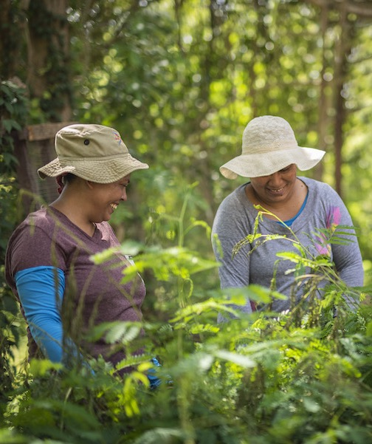
TIP
Ensure national biodiversity incentive mechanisms are gender responsive
4
Develop and include gender-sensitive indicators, such as the number of indigenous women and men actively involved in the formulation of the financial plan and the number of women benefiting from employment opportunities due to increased investments in ecotourism;
Ensure women's participation in all BIOFIN consultations and bodies, and teams: Steering Committee, conference panels, etc.;
Create an enabling environment for women's participation in all BIOFIN activities, including by rapidly identifying solutions to sensitively address social and cultural factors that may impede their fruitful participation;
Be aware of and adopt gender-sensitive language in all documents, including BIOFIN reports, job descriptions, etc.;
Engage gender experts for professional advice on the above;
Foster partnerships with specialized organizations that promote gender considerations, such as government gender focal points, UN Women, and national women's alliances and organizations.

Slide 17
Key actions to strengthen enabling conditions
5
Establish a national gender and biodiversity programme and design gender specific biodiversity projects
Develop a series of detailed investigations to understand the gender dimension in different sectors
Develop gender specific interventions in different biodiversity sectors
Co design projects with women’s organisations, IP&LCs, cooperatives, ensuring leadership roles throughout planning, governance, implementation and monitoring.

Slide 18

TIP
Establish a national program on gender and biodiversity in the Ministry of Environment
5
A multidimensional and multisectoral economic recovery response that promotes women's access to financial instruments.
Natura Women's Credit: This private capital instrument provides loans from USD $800 to USD $16,000, with an interest rate between 8% and 15% per year and a term of up to 5 years. Between 2020 and 2021, 22 loans totaling USD $105,000 were granted to rural women.
FONAFIFO by Your Side / Rural Women's Credit: A publicly funded forestry loan with an annual interest rate of 4% to 7%, secured by mortgage, fiduciary, and organizational guarantees, and with a term of up to 10 years. A total of 25 loans totaling nearly USD $200,000 were granted to rural women in 2021.
FONAFIFO Women's PSA: Applications submitted by women landowners receive additional points within the program's scoring system.

Slide 19
Key actions to strengthen enabling conditions
6
Ensure national biodiversity information system includes gender data and indicators
Establish a national data Registry on Gender and Biodiversity
Design a gender-responsive national biodiversity information system
Develop specific gender indicators for the biodiversity measurement, reporting and verification (MRV) system
Design guidance documents for conducting gender responsive monitoring

Slide 20
TIP
Establish a national repository of gender and biodiversity data
6
First phase: identify and define gender dimensions of biodiversity agenda
Second phase: mapping of national data sources and review of secondary data sources (surveys, manuals, reports).
Management of respective permits for the verification and use of various sources
Third phase: definition of nominally and operationally indicators.
Fourth phase: construction of indicators and elaboration of statistical report in Excel.
Fifth phase: correction and implementation of each of the indicated indicators

Slide 21




Q & A
Notes:
Welcome 5 min
Meeting objectives and structure
Introduction of Participants ( warm up question: why are you excited to be here?)

Slide 22



Together is better:
Peer Exchange and
Troubleshoot
Notes:
Welcome 5 min
Meeting objectives and structure
Introduction of Participants ( warm up question: why are you excited to be here?)

Slide 23
Next Thematic
Work Clinics
Notes:
Welcome 5 min
Meeting objectives and structure
Introduction of Participants ( warm up question: why are you excited to be here?)

Slide 24
Capacity Building Plan: Thematic Work Clinics
March 24th
Mobilizing Support: Tips to develop resource mobilization proposals and Match Making Mechanism Gender Proposal and development of a Gender Biodiversity Project
March 31th
Highlighting the added value of gender: Tips to systematize case studies and documenting gender impacts of nature-based solutions

Slide 25

Thank you!
Merci!
Gracias!
Спасибо!
ขอบคุณ!

