Slide 1










Thematic Clinic 4
Gender and Biodiversity National Roadmaps
Image here
Gender and NBSAP Capacity Building & Exchange Process
3rd March 2026

Slide 2

Objectives
Discuss the main steps to develop gender and biodiversity roadmap
Share tips that can be adapted to different country contexts
Promote a peer-to-peer exchange on good practices to develop gender and biodiversity roadmaps
Obtain methodological recommendations for improving processes to develop a national gender and biodiversity roadmap

Slide 3
10:00– 10:05
Welcome
Welcome and objectives
Brief description of the Work Clinic
Agenda
10:05– 10:50
Sharing our knowledge: Thematic Work Clinic
Interactive presentation to share tips and practical advice to develop a, inclusive multi actor consultation
10:50 -11:00
Q&A
Participants will have the opportunity to ask questions on the recommendations presented
11:00 -11:25
Together is better: Peer exchange and troubleshooting
Costa Rica will present their experience (10 min) Countries will share their experiences and challenges in developing a consultations to obtain recommendations from participants
11:25 -11:30
Wrap up
Planning for the next capacity building session

Slide 4


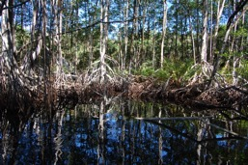

Why develop a national
gender and biodiversity
roadmap?

Slide 5

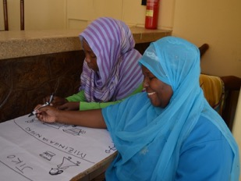
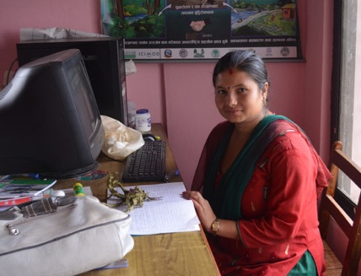
Developing a national long-term strategy is essential to ensure the
gender responsive implementation of the NBSAP
Developing a national gender and biodiversity roadmap can allow countries to:
Translate global commitments (CDB GPA and COP decisions) into concrete national actions
Identify national gender and biodiversity priorities aligned with the KM GBF, national biodiversity goals and NBSAP
Define concrete expected results and activities based on the country context, and national capacities
Propose concrete actions to address gender differentiated needs and priorities in different biodiversity sectors
Adopt a long-term commitment and monitor the implementation of the gender commitments included in the NBSAP

Slide 6
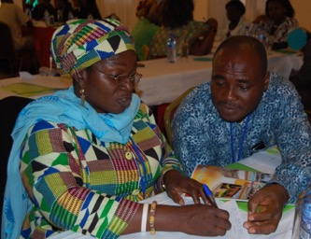
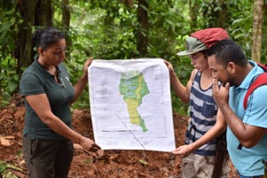
What are the key elements of an ambitious roadmap?
Targets with diverse impacts (impacts on inequalities, gender relations, empowerment opportunities for women)
Specific activities based on the national context and the local context where the project will be implemented
Process, results and impacts indicators
A baseline to be able to measure progress in quantitative and qualitative terms for each expected result
Means of verification aligned with the NBSAP's monitoring and evaluation proposal and national information systems
Budget required to implement the activities
An analysis of social and environmental risks associated with the proposed activities

Slide 7

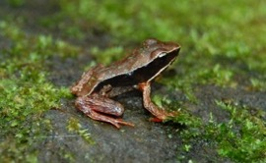


How to develop a
gender and biodiversity roadmap ?

Slide 8
Recommended Steps
Starting out
Evaluate existing policies, strategies, plans, programmes and projects to identify how they addressed gender considerations
Design
Conduct the consultations
Conduct a multi-sectoral and multi-stakeholder validation session of the planning instrument
Develop a methodology that allows obtaining data or information that reflects the gender diversity of the country
Conduct a multisectoral gender analysis that identifies gender roles, prevalent inequalities in access to and control of resources, power relations
Identify relevant gender considerations related to the NBSAP
Conduct an analysis of gaps and strengths of institutional capacities on gender and biodiversity
Articulate the proposed actions with national climate change planning instruments and the international gender mandates of the CBD, CEDAW, among others
Establish specific spaces for women in their diversity and young people to share their ideas, perceptions and priorities
Define strategic objectives and a structure that considers expected results, concrete actions, indicators and responsible partners
Promote ownership of the instrument at various political levels
Define a roadmap for the implementation of the planning instrument (including gender budgeting)
Define the institution responsible for carrying out participatory and inclusive monitoring, evaluation, reporting, and dissemination processes

Slide 9





Methodology to develop a gender roadmap
1
Compile national and local data and information on gender and biodiversity
2
Define national gender and biodiversity goals and expected results
3
Define activities, indicators and baselines based on the national context
4
Review roadmap with CDB focal points to ensure it aligns with the NBSAP
5
Validate roadmap with different actors

Slide 10
Key actions to develop a gender and biodiversity roadmap
1
Compile national and local data and information on gender and biodiversity
Gender-differentiated use of biological resources and dependance on ecosystem services
Differentiated roles, knowledge, needs and contributions of women and men in relation to the conservation and sustainable use of biodiversity.
Main gender inequalities prevalent in the environmental sectors relevant to the NBSAP.
Main cultural, institutional, and social barriers that prevent stakeholders, particularly women, from participating fully and effectively in all phases of the NBSAP implementation.
Gender differential impacts of environmental degradation, pollution, loss of biodiversity or climate change.
Strategic environmental and sustainable development interests or priorities of women and men.
Differentiated environmental stewardship and agency of men and women.
Gender differentiated risks, costs, impacts and opportunities associated with the NBSAP implementation.
Census of women's needs and preferences in terms of their participation and the sharing of benefits, costs and responsibilities.

Slide 11
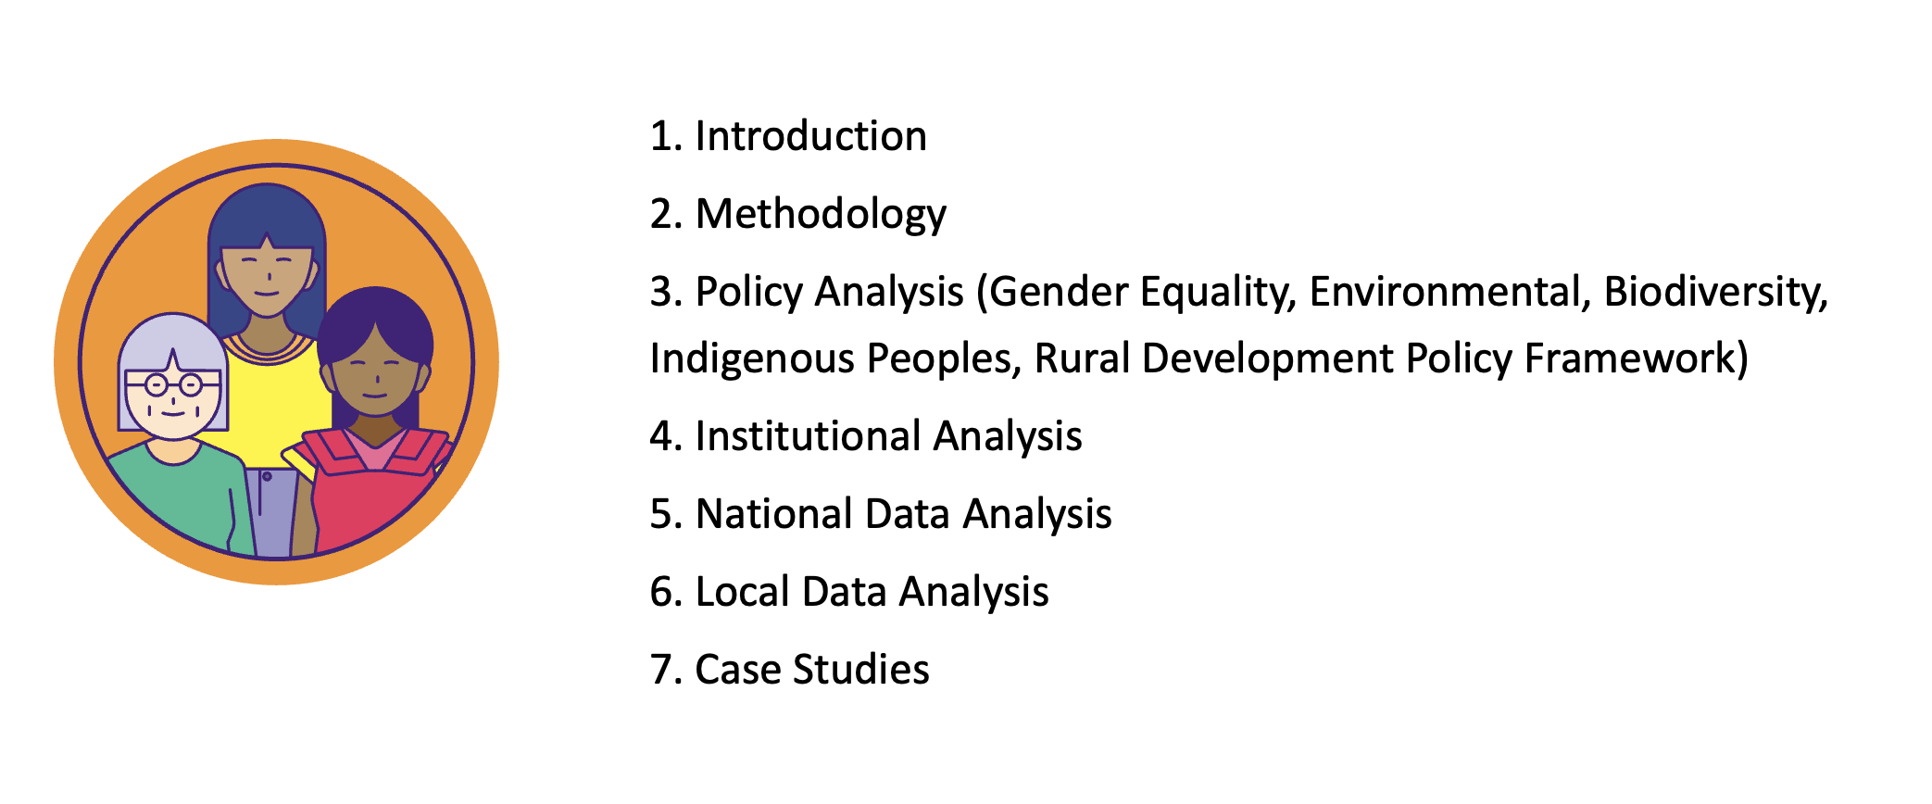
TIP
Have a good gender and biodiversity analysis
1

Slide 12
Key actions to develop a gender and biodiversity roadmap
2
Define national gender and biodiversity goals and expected results
Ensure that the roadmap is based on a theory of change that addresses the main inequalities or priorities identified in the gender analysis and consultations.
Propose expected outcomes that are creative and promote transformative results related to gender equality and women’s empowerment.
Harmonize priorities included in the roadmap with the NBSAP’s goals and measures.

Slide 13
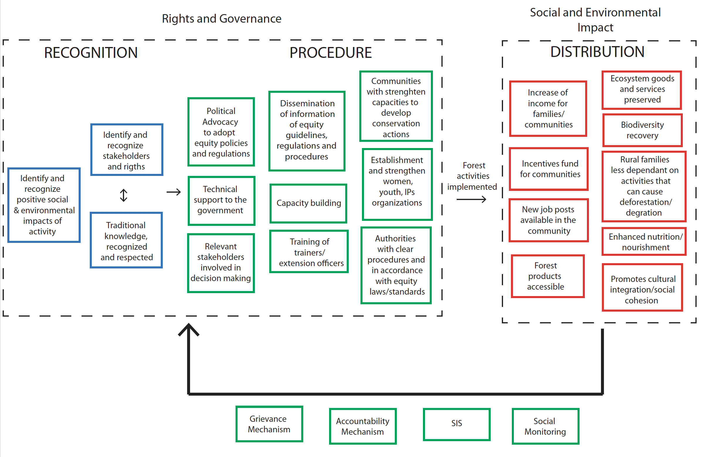
TIP
Define a comprehensive and long-term theory of change
2

Slide 14
TIP
Propose priorities or expected results that go beyond guaranteeing
the participation or inclusion of women
2
Contributions to biodiversity objectives
Sustainable and Inclusive Green Jobs
Promote Innovation
Reduce Inequalities
Improve livelihoods and resilience
Sustainable and Inclusive Enterprises
Women’s Empowerment
Efficient and effective NBS

Slide 15
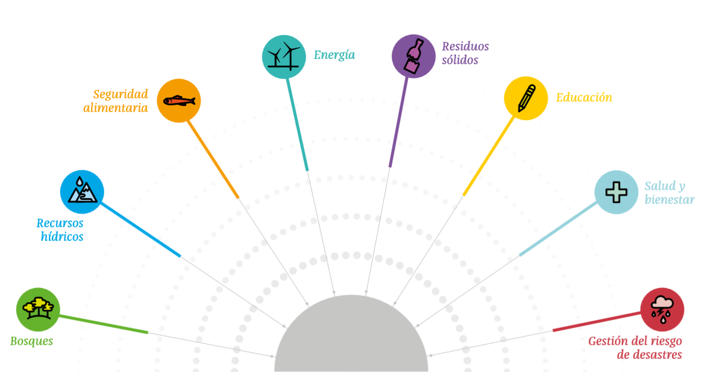
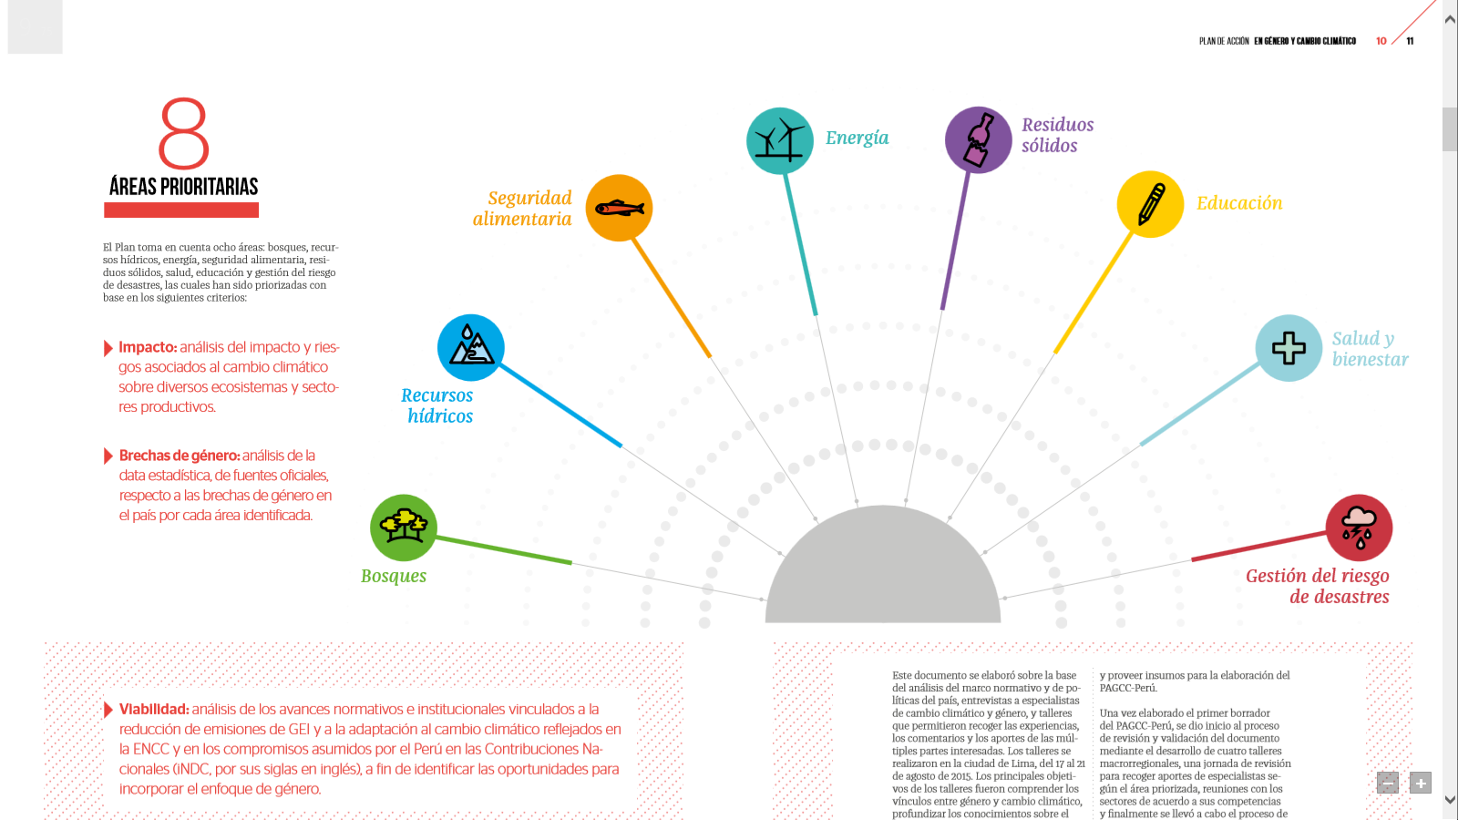
TIP
Including too many expected results is not recommended
2
Energy
Waste
Management
Food
Security
Education
PRIORITY AREAS
Health
Wellbeing
Water
Management
Forests
Disaster Risk Reduction

Slide 16
Key actions to develop a gender and biodiversity roadmap
3
Define activities, indicators and baselines based on the national context
Include activities that address prevailing inequalities and generate opportunities for women's empowerment (including financing opportunities or the development of alternative livelihoods).
Include indicators that allow measuring how addressing inequalities or promoting women’s empowerment and stewardship contributes to the national biodiversity goals.

Slide 17
TIP
Propose detailed activities that can be implemented gradually
3
Goal | EXPECTED RESULTS | ACTIONS
By 2030, the number of hectares of sustainable agricultural production managed by men and women will increase | Increase in the number of sustainable agriculture solutions led by women. Empowered women that implement activities that contribute to sustainable agriculture | Update the mapping of farms and integral productive units where there is a greater number of women producers. Define the methodology for collecting data on the roles of women and men in productive and conservation activities. Prepare database of farms and integral productive units where there is a greater number of women producers. Promote farms and integral productive units led by women. Establish pilot projects for gender-responsive farms and integral productive units that recognize and value gender-differentiated contributions and provide differentiated technical assistance for women. Increase the coverage of farms and integral productive units led by women through the expansion, improvement and simplification of financial-environmental instruments

Slide 18
TIP
Do not be afraid of considering results and impact indicators
3
TARGET 10: Improve biodiversity in agriculture
Goal | Process Indicators | Result Indicators | Environmental Impact Indicators
By 2030, the number of hectares of sustainable agricultural production managed by men and women will increase | Number of studies or tools developed to determine the differentiated conditions and needs of women and men who are producers Number of capacity-building actions on sustainable agricultural practices that address the differentiated needs of women and men Number of women and men with capacities to implement sustainable practices Number of agricultural credits or incentives with criteria that take into account the differentiated conditions and needs of women and men. | Percentage of producers adopting sustainable practices (e.g., reduction of pesticide consumption, integrated pest management) Type of sustainable practices adopted (e.g. reduction of pesticide consumption, integrated pest management) (disaggregated by sex and by type of production) Number of hectares and the percentage that is harvested sustainably (disaggregated by sex and by type of production) | Increase in species in sustainable agricultural production plots (disaggregated by sex and by type of production) Reducing emissions per hectare by adopting sustainable practices (disaggregated by sex and by type of production)

Slide 19
Key actions to develop gender and biodiversity roadmaps
4
Review roadmap with CDB focal points to ensure it aligns with the NBSAP
Goals, priorities, actions and indicators that recognize and measure the differentiated vulnerability of men and women to biodiversity loss
Goals, priorities, actions and indicators that recognize and measure the differentiated contributions of men and women to biodiversity actions and nature-based solutions
Goals, priorities, actions and indicators that recognize and measure the differentiated contributions of men and women to biodiversity conservation and sustainable use
Goals and Indicators recognize and measure how biodiversity solutions or goals contribute to reducing gender inequalities or increasing women's empowerment

Slide 20
TIP
Ensure a diversity of goals, priorities, actions and indicators
4
NATIONAL CONTEXT
Nature Positive Action, Action for Nature
or Nature-based Solution
Recognizes Stewardship
Addresses Inequalities
Generates Opportunities

Slide 21
Key actions to develop gender and biodiversity roadmaps
5
Validate roadmap with different actors
Identify and invite some of the actors, women leaders or groups that participate in national and local consultations to participate in the validations
Validate the expected results and activities with women's groups to determine if their priorities were well captured
Build trust, accountability, and willingness of women and women’s groups to engage in future implementation

Slide 22



What could be the structure of a
gender and biodiversity roadmap?
Notes:
Welcome 5 min
Meeting objectives and structure
Introduction of Participants ( warm up question: why are you excited to be here?)

Slide 23
Prevalent gender inequalities in environmental sectors
Conservation and protection of protected areas
EXPECTED RESULTS | ACTIONS | Indicators | Baseline | Goal | Means of Verification | $ | Risks
Women participate fully and effectively in the conservation and use of biodiversity and natural resources in the buffer zones of protected areas and biological corridors. | 1. Obtain data from participatory biological monitoring groups, local biological corridor councils, brigades and other committees and organized groups related to the protection and conservation of biodiversity and natural resources) to determine the participation of women, their proportion and their contributions. 2. Organize discussion sessions on the importance of the gender issue in committees and in internal and external bodies, in order to identify actions to promote gender equality and the participation of women. 3. Conduct induction and capacity-building processes for internal and external bodies in a gender-responsive manner, to increase the accreditation of women. 4. Guideline for protected area officials to conduct asynchronous gender training modules. 3. Design an awareness strategy on positive masculinities and good relationships between men and women 5. Link the gender commission with the Interinstitutional Network of Men for Gender Equality 6. Develop a gender equality policy for the national protected areas institution | Gender Commission in the institution in charge of protected areas Gender Policy | The institution does not have a policy or a committee | The institution has a gender policy and committee | Commission Operating Guidelines Policy | $100,000 | Socio-environmental NA Implementation Resistance from officials to forming the commission There is no political will to develop and institutionalize gender policy Change of government

Slide 24
Prevalent gender inequalities in environmental sectors
Fire Prevention
EXPECTED RESULTS | ACTIONS | Indicators | Baseline | Goal | Means of Verification | $ | Risks
Fire control and prevention program incorporates gender-responsive actions. The program for prevention, protection and control, as well as comprehensive fire management, has human, logistical and financial resources to improve its response capacity with gender-responsive actions. | 1. Document the experiences and lessons learned of forest firefighters and their contributions to fire prevention, control and management. 2. Systematize the experiences and lessons learned when establishing mixed fire control brigades. 3. Implement a training process to conduct training on gender, harassment and IP asynchronously and online. 4. Implement gender-responsive training processes for target populations identified in the training plan for forest firefighters. 5. Design and implement a gender-responsive communication and outreach strategy that highlights women's contributions and does not reinforce negative gender stereotypes. 6. Incorporate gender considerations into the regulations for volunteer forest brigades and into the guidelines for the development of fire management plans for protected areas. | Gender-responsive regulations for volunteer forest brigades. Number of people trained Lessons learned report Level of satisfaction of men and women in the workshops Gender-responsive communication strategies and materials | There are no regulations. There is no publication No training has been provided | Publication of lessons learned Communication strategy and materials 80% of trained officials increase their gender skills Adjusted regulations | Publication Communication strategy and materials Participation lists | $250,000 | Socio-environmental Female forest firefighters are marginalized when guidelines are changed and actions are implemented to promote gender equality. Implementation Resistance from officials to participate in training and integrate gender guidelines and mandates Program staff are overworked and their responses are slow. Change of government Turnover

Slide 25
Prevalent gender inequalities in environmental sectors
Restoration
EXPECTED RESULTS | ACTIONS | Indicators | Baseline | Goal | Means of Verification | $ | Risks
Women participate fully and effectively in the restoration of forest landscapes and ecosystems | 1. To recognize and document the contribution and knowledge of women in relation to restoration 2. Identify forest products that can generate economic alternatives for women and maintain the forest for the future. 3. Identify women leaders who are interested in carrying out restoration activities. 4. Promote a network of women who restore and protect forest ecosystems where they can share experiences, carry out field practices and apply knowledge. 5. Promote the implementation of green infrastructure initiatives, regenerative agroforestry, watershed restoration, domestic agroforestry systems, home gardens and other agroforestry systems led by women that involve the family and the community. 6. Facilitate credit to establish individual and communal nurseries that reproduce native timber species and ornamental plants, which can supplement restoration efforts. | Number of restoration initiatives led by women and generating economic alternatives | # Number of women's restoration initiatives that were documented | Network of women restoring forests Five women's groups receive loans to carry out restoration activities | Systematization document Women's Network Loans granted to women | $500,000 | Socio-environmental Increased burdens and responsibilities for women Increase in the economic resources that women must generate to participate in restoration activities Negative repercussions in the home as women's responsibilities increase Women who do not own land lose investment by losing the right to use the land Implementation Women cannot participate in restoration initiatives due to lack of interest/resources/time

Slide 26
Prevalent gender inequalities in environmental sectors
Finance Incentives
EXPECTED RESULTS | ACTIONS | Indicators | Baseline | Goal | Means of Verification | $ | Risks
Simplified financing modality that facilitates the entry of women who are carrying out forest conservation and management activities. | 1. Identify the profile of women who own and do not own the forest. 2. Systematize the sex-differentiated characteristics of farms and productive spaces that are not farms and that do not meet the criteria of current financing mechanisms, in order to create robust databases and build baselines. 3. Develop a tool to identify the types of requirements and expectations of women owners and non-owners who do not receive financing. 4. Identify the service offerings in financial mechanisms to compile information and disseminate it to women. 5. Implement a gender-responsive training and technical assistance system for managing forms and requirements. 8. Design an induction and support process so that women can access financing. | Increase in the number of women producers benefiting from environmental financing mechanisms | Number of women currently involved in PSA and CREF | 50 women producers benefited from environmental financing mechanisms | Applications from women Women's contracts signed | $3,000,000 | Socio-environmental Women who receive the incentives do not have control over the use of the resources Implementation There is no political or institutional support to implement CREF-women and PSA-gender responsive modalities. Women lack the information or resources to access credit and incentives The process for accessing credit is complex, and women cannot easily participate.

Slide 27
Prevalent gender inequalities in environmental sectors
Indigenous Women
EXPECTED RESULTS | ACTIONS | Indicators | Baseline | Goal | Means of Verification | $ | Risks
Resource guardian program involves both men and women and recognizes and strengthens their capabilities equally. | 1. Identify indigenous women who wish to participate in the resource guard programs. 2. Promote a dialogue with a cultural focus that highlights the participation and monitoring from the perspective of indigenous women as guardians and protectors of the forest. 3. Promote the integration of a comprehensive vision that fosters teamwork and collective action in the resource guard program. 4. To train and provide materials equally to indigenous men and women of various ages, so that they can monitor protected areas, forests, rivers and mountains. 5. Design a training process for new generations of resource wardens where the contributions of both women and men are recognized and valued. | Increase in the number of women, young indigenous people and older adults trained as resource guards . | Obtain information from INDER on the number of male and female resource guards | 20 women and young people join as resource guards | Participant list List of recognized resources | $250,000 | Socio-environmental They generate conflicts in the territories by focusing on women Women who do not participate in the ADI are excluded To create conflict between the ADI and women's groups Implementation The ADIs are not willing to carry out activities Women do not want to participate as guardians of resources/interest/resources/time There is no political will on the part of the institutions to carry out the activities

Slide 28
Prevalent gender inequalities in environmental sectors
Waste Management
EXPECTED RESULTS | ACTIONS | Indicators | Baseline | Goal | Means of Verification | $ | Risks
Promote access equitable for women and men to jobs green related to waste management | 1. Identification and creation of financial mechanisms to provide equipment and infrastructure to domestic recycling centers and alternative projects led by associations of recyclers and MSMEs 2. Organize technical workshops to provide training to women and men in alternative trades that revolve around the management of post-consumer inorganic materials (plastics, metals, etc.). 3. Organize workshops to train women and men in repairing items to extend their useful life and thus reduce consumption and waste generation 4. Organize technical education projects aimed at women to teach them how to build community infrastructure from waste materials Promote organic waste recovery projects in soup kitchens and educational centers 5. Strengthen initiatives being carried out in shelters and daycare centers to guarantee the comprehensive development of the sons and daughters of recycling families. | Number of non-traditional businesses created by women Feasibility study of alternative sources of income Number of financial institutions and preferential products aimed at the sector, broken down those aimed at women and men | # non-traditional businesses led by women % of funding for women in the recycling sector | 20 non-traditional companies led by women | Report of loans granted | $250,000 | Socio-environmental Increased burdens and responsibilities for women Increase in the economic resources that women must generate to participate in training processes Negative repercussions at home from having to travel to the workshops Implementation Women cannot start businesses due to lack of resources /time

Slide 29



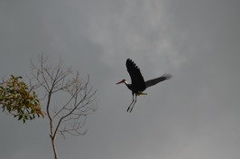
Q & A
Notes:
Welcome 5 min
Meeting objectives and structure
Introduction of Participants ( warm up question: why are you excited to be here?)

Slide 30
Together is better:
Peer Exchange and
Troubleshoot
Notes:
Welcome 5 min
Meeting objectives and structure
Introduction of Participants ( warm up question: why are you excited to be here?)

Slide 31
Next Thematic
Work Clinics
Notes:
Welcome 5 min
Meeting objectives and structure
Introduction of Participants ( warm up question: why are you excited to be here?)

Slide 32
Capacity Building Plan: Thematic Work Clinics
March 17th
A Strong National Foundation: Tips to establish a national gender and biodiversity programme and strengthening institutional capacities
March 24th
Mobilizing Support: Tips to develop resource mobilization proposals and Match Making Mechanism Gender Proposal and development of a Gender Biodiversity Project
March 31th
Gender Highlighting the added value of gender: Tips to systematize case studies and documenting gender impacts of nature-based solutions

Slide 33

Thank you!
Merci!
Gracias!
Спасибо!
ขอบคุณ!

