Slide 1










Thematic Clinic 2
Multi Actor
Consultations
Image here
Gender and NBSAP Capacity Building & Exchange Process
6th February 2026

Slide 2

Objectives
Discuss the main steps to develop gender responsive and inclusive consultations to identify gender responsive nature-based solutions that contribute to KM-GBF targets
Share tips or participatory methodologies that can be adapted to different country contexts
Promote a peer-to-peer exchange on good practices to develop gender responsive and inclusive consultations
Obtain methodological recommendations for improving processes to develop gender responsive and inclusive consultations associated with the NBSAP AP Gender Project

Slide 3
10:00– 10:05
Welcome
Welcome and objectives
Brief description of the Work Clinic
Agenda
10:05– 10:50
Sharing our knowledge: Thematic Work Clinic
Interactive presentation to share tips and practical advice to develop a, inclusive multi actor consultation
10:50 -11:00
Q&A
Participants will have the opportunity to ask questions on the recommendations presented
11:00 -11:25
Together is better: Peer exchange and troubleshooting
Eswatini will present their experience (10 min) Countries will share their experiences and challenges in developing a consultations to obtain recommendations from participants
11:25 -11:30
Wrap up
Planning for the next capacity building session

Slide 4


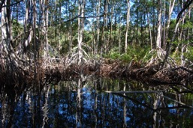

Why conduct gender
responsive and inclusive consultations?

Slide 5


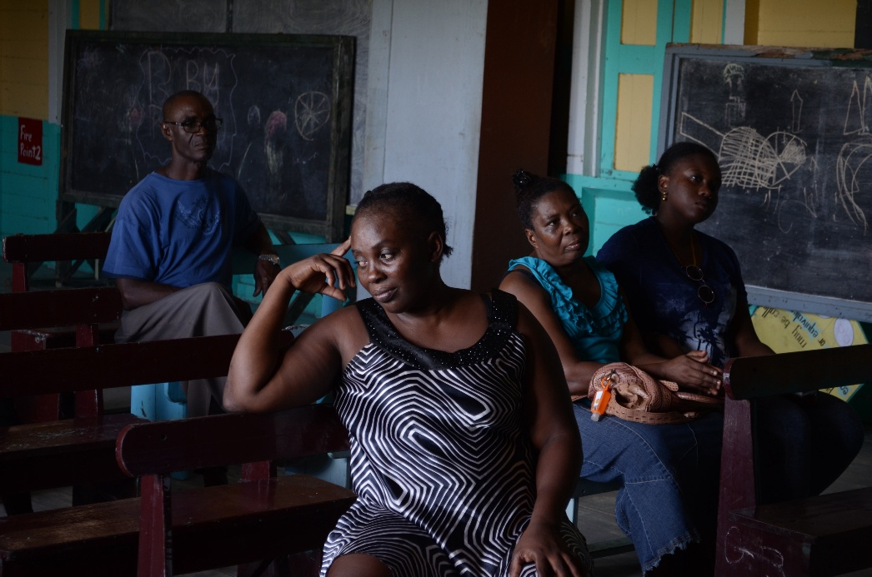
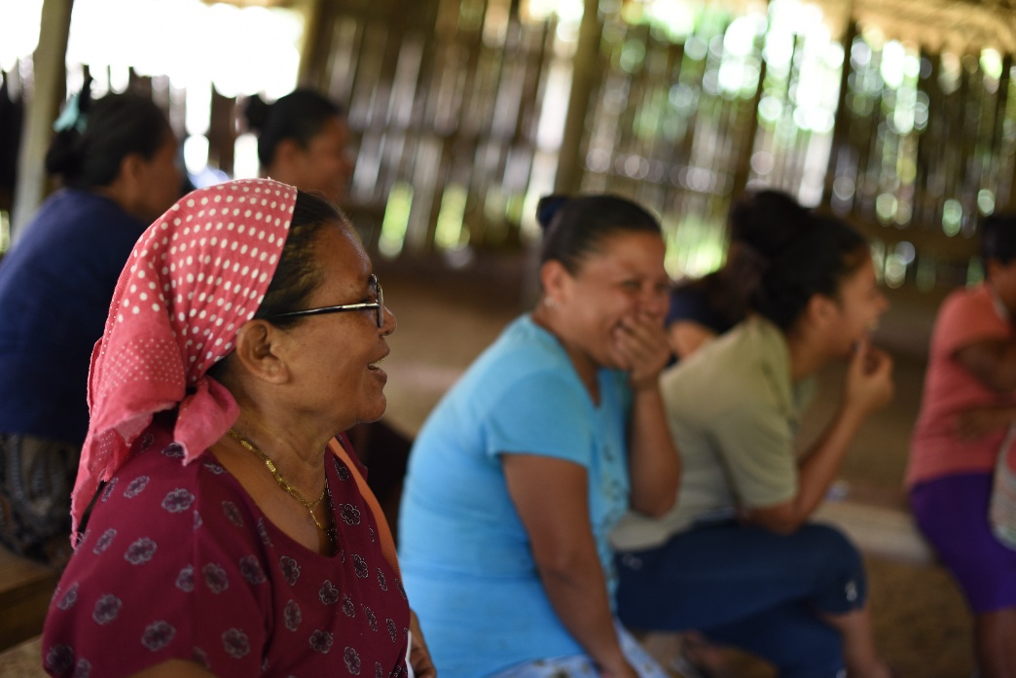
Collecting and analyzing data on the experiences of grassroots women and men is essential for designing a gender-responsive or transformative NBSAP
Multi actor consultations are a key element of the Whole of Society approach that is part of the GBF. These consultations allow countries to:
Empower local actors, particularly women and marginalized groups.
Identify gender differentiated priorities through the actors themselves.
Learn and incorporate gender differentiated knowledge in biodiversity solutions and actions.
Analyze the local context - including potential opportunities and challenges to implement gender responsive nature-based solutions
Improves effectiveness and sustainability of biodiversity actions by reflecting gender differentiated access, roles, and inequalities
Complement national data on gender and biodiversity

Slide 6
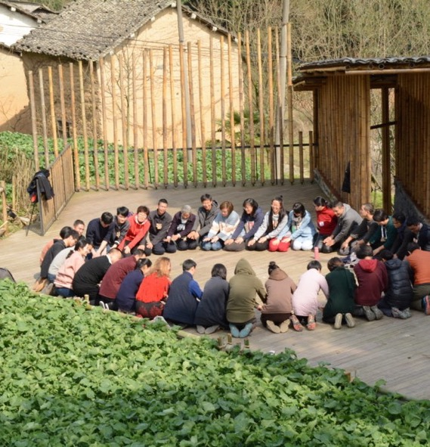
What are the key elements of a meaningful consultation?
Free from manipulation, interference, coercion, and intimidation
Inclusive, intersectional and gender responsive
Culturally appropriate
Accessible information - prior and timely disclosure of information
Identifies potential risks, trade‑offs, and unequal impacts before decisions are made to prevent harm and reduce inequality
Strengthens legitimacy and ownership of both women and men
This Photo by Unknown Author is licensed under CC BY-SA-NC

Slide 7




How to conduct a gender responsive and inclusive consultation?

Slide 8
Recommended Steps
Starting out
Conduct mapping of groups/collectives who have stakes in the issues relevant to the NBSAP (including women's groups)
Design
Conduct the consultations
Identify potential conflicts, e.g., between the implementation of rights and the interests of various groups
Identify consultation processes carried out in the country and identify good practices
Conduct an analysis of the capabilities of the various relevant actors and design opportunities to equate knowledge
Identify key allies who can contribute to implementing inclusive and participatory consultation processes
Promote consultations based on an intersectional approach and that includes representatives from different social groups that reflect the diversity of the country
Ensure equitable and fair access and conditions for both men and women to participate effectively in the consultation process
Facilitating the process should ensure that diverse viewpoints are captured and that different groups can influence decisions, particularly the most vulnerable.
Implement safe and democratic consultation processes to ensure that women's perspectives and voices are valued equally with men's. The process must be adapted from traditional structures.
Incorporate a structure that allows women or vulnerable groups to request independent help or advice.
Develop a consultation process that uses different face-to-face methodologies (focus groups, interviews, and workshops)
Consider virtual consultation processes in the case of some groups that cannot participate in face-to-face processes
Identify specific actions to address the barriers that prevent women or other vulnerable groups from participating fully and effectively. For example, providing childcare or eldercare during consultations.
Take into account mobility, workload, schedules, and cultural restrictions when defining consultation time, places methods.

Slide 9



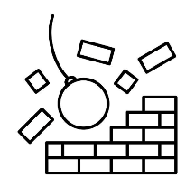

Methodology to develop a multi actor consultation
1
Define the purpose, objectives and how the process will influence NBSAPs
2
Map the relevant actors and ensure diversity
3
Design inclusive and participatory methodology
4
Remove participation barriers and create a safe and enabling space
5
Share outcomes with participants and explain how their inputs will influence the NBSAP

Slide 10


Key actions to develop a gender responsive consultations
1
Define the purpose, objectives and how the process will influence NBSAPs
Identify gender responsive and inclusive consultation processes carried out in the country and identify good practices that could be incorporated in the new consultation process
Clearly define why the consultation is being held, how it will inform the NBSAP, and how women’s inputs will be integrated.
Be transparent from the outset to avoid extractive engagement.

Slide 11
TIP
Define the consultation plan by asking the right questions
1
Who?
Which communities should be engaged, based on the stakeholder analysis? Why are these communities participating?
Why?
What are your interests and goals?
What?
What gender and biodiversity data are you interested in obtaining?
How?
When?
Responsible?
Resources?
Communication methods, are the special measure necessary to allow the participation of certain women?
What is the Schedule for programming participation activities and timeline?
What role will stakeholder representatives play? Are additional facilitators or participation experts required? Is additional support needed?
What will the consultation plan cost? Where will the resources come from?
Which processes and timelines of the local communities need to be respected?

Slide 12

TIP
Consultations: Ask the right questions and look for answers through different methodologies (focus groups, interviews, workshops)
1
Gender-differentiated roles, practices, knowledge, and values
Gender Inequalities and Gaps in Relation to Access and
Decision-Making Power over Resources
Differentiated Contributions to the Management, Sustainable Use,
and Protection of Resources or Ecosystems
Differentiated Participation and Impacts
of Environmental Projects/Activities

Slide 13
Key actions to develop a gender responsive consultations
2
Map the relevant actors and ensure diversity
Identify different groups of women to engage (e.g. age, ethnicity, livelihood, disability, Indigenous status, location)
Analyze the influence, interests, roles, and potential contributions of different women or women’s groups
Conduct mapping of the women’s groups or communities that are working on initiatives relevant to the NBSAP
Work with trusted local organizations or leaders to reach women who are often excluded.

Slide 14
TIP
Mapping Actors: Group women by different categories
2
Women directly affected by NBSAP (positively, negatively): Beneficiaries, women negatively/positively impacted; Indigenous peoples women (specific treatment), local leaders, elders, religious leaders, youth
Groups of women directly responsible for decision-making: Local authorities, women’s network, women involved in local governments, women led business, etc
Groups of women that may have an interest in or influence the NBSAP: Civil society groups, business associations, trade unions, credit groups, farmers' associations, cooperatives; the private sector; academic/technical professional associations, etc.

Slide 15
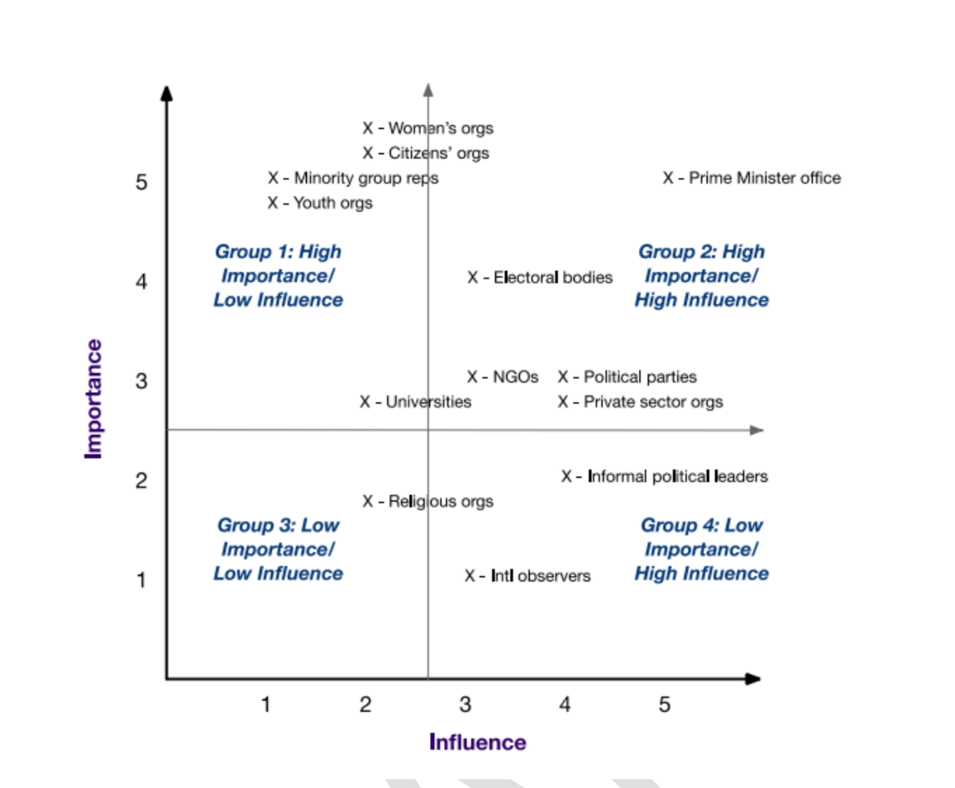
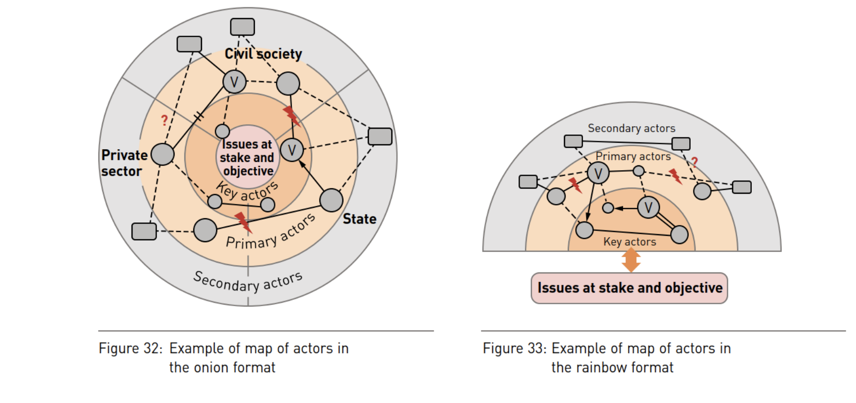
TIP
Adapt Tool 3: Actor Analysis to your national context!
2

Slide 16
Key actions to develop gender responsive consultations
3
Design inclusive and participatory methodology
Develop a consultation process that uses different face-to-face methodologies (focus groups, interviews, and workshops)
Identify and use dynamics that value lived experience and local knowledge.
Select tools, methods and dynamics that help foster critical dialogue, create bonds, and strengthen cohesion within a community, promoting the collective construction of solutions

Slide 17
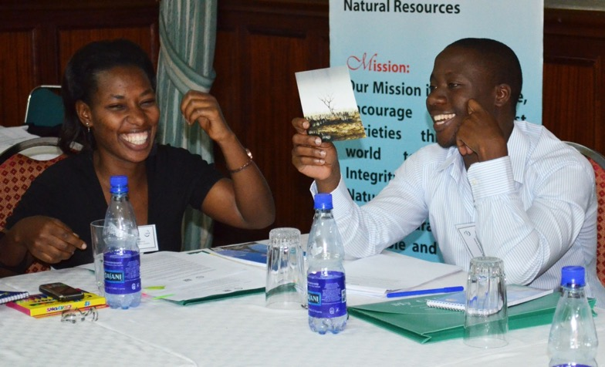
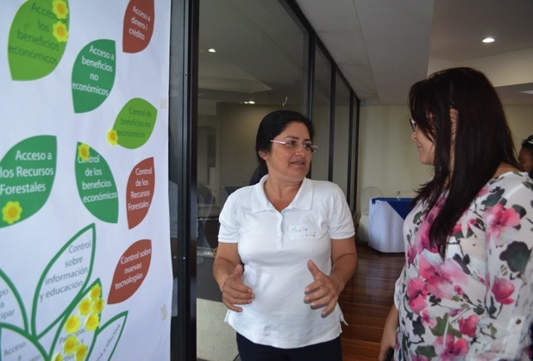
TIP
Go beyond formal presentations: use storytelling, mapping, ranking exercises, or visual tools
3

Slide 18
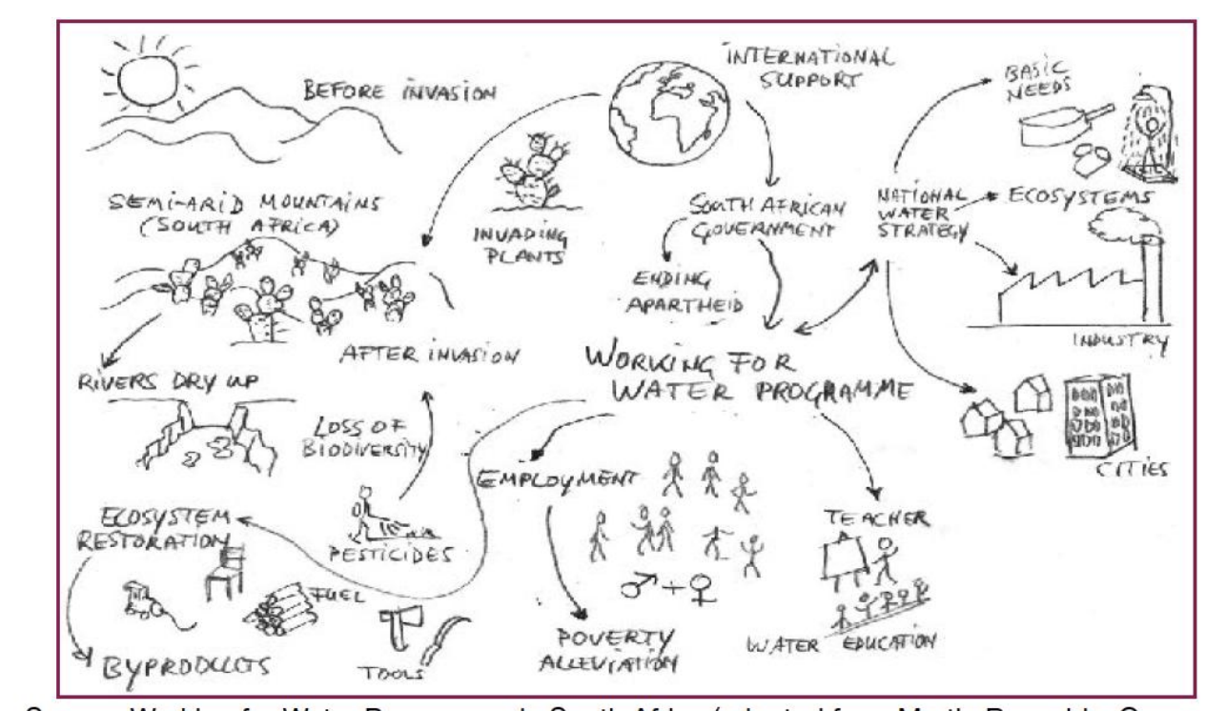
TIP
Adapt Tool 2: Rich Picture to your national context!
3

Slide 19
Key actions to develop gender responsive consultations
4
Remove participation barriers and create a safe and enabling space
Design the consultation around women’s realities by asking local leaders or experts that have worked previously with the same communities.
Consider timing, location, language, childcare, transport, safety, and compensation for time.
Use facilitation methods that encourage open participation, such as women‑only sessions, small groups, or trusted facilitators.
Establish ground rules to ensure respect, confidentiality, and non‑retaliation.

Slide 20
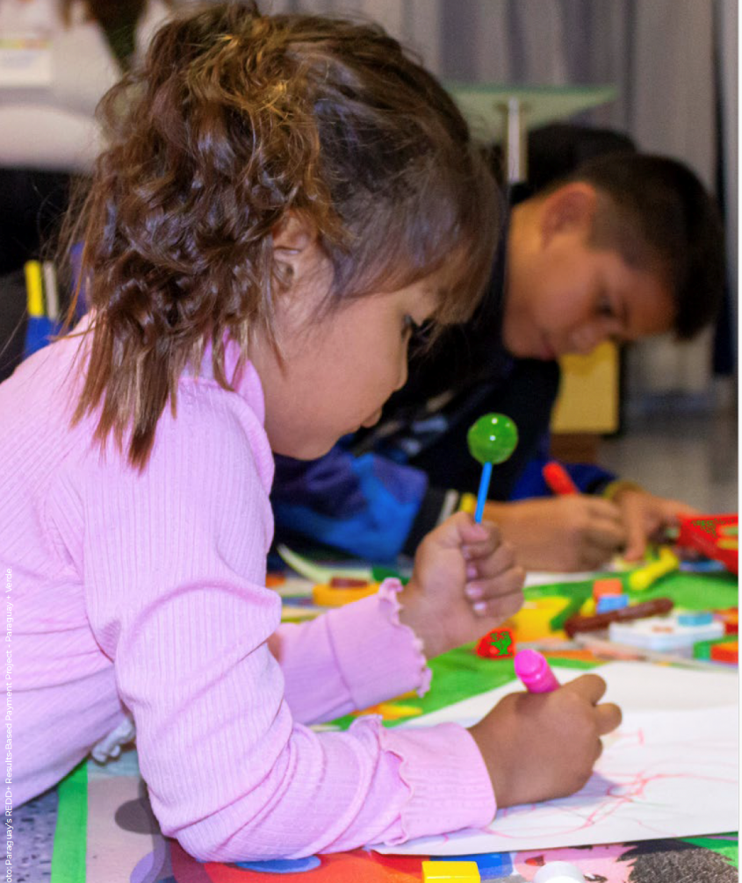
TIP
Ensure that consultations offer childcare services or provide additional resources to cover childcare
4
Provide a safe, designated childcare space at or near the consultation venue, staffed by trained caregivers.
Include childcare as a standard line item in consultation budgets (e.g. caregiver fees, materials, snacks, insurance). Treat it as an essential participation cost, not an optional add‑on.
Partner with nearby local schools can provide access to educational resources and facilities during consultations
Where on‑site childcare is not feasible, offer financial support so participants can arrange care themselves. This may include reimbursements or small stipends tied to participation.

Slide 21
Key actions to develop a gender responsive consultations
5
Share outcomes with participants and explain how their inputs will influence the NBSAP
Build trust, accountability, and willingness of women and women’s groups to engage in future processes
Share details of the project and explain how the results will be used to inform the NBSAP update and implementation
Identify and invite some of the women leaders or groups that participate in local consultations to participate in the national workshops or consultations to share their perspectives and ideas

Slide 22
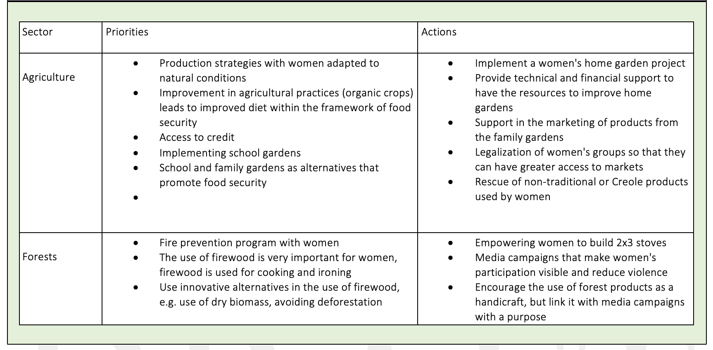
TIP
Show the participants how you will summarize the data
5

Slide 23



What could be the agenda of a local consultation?
Notes:
Welcome 5 min
Meeting objectives and structure
Introduction of Participants ( warm up question: why are you excited to be here?)

Slide 24

Prevalent gender inequalities in environmental sectors
What could be the agenda of a local consultation with women?
Welcome
Session 1. Gender and Biodiversity Nexus
Session 2. Gender differentiated contributions to conservation and nature-based solutions
Session 3. Prevailing gender inequalities in biodiversity sectors and how to overcome them
Session 4. Gender differentiated local biodiversity conservation and sustainable use priorities
Session 5. Gender-responsive nature-based solutions

Slide 25
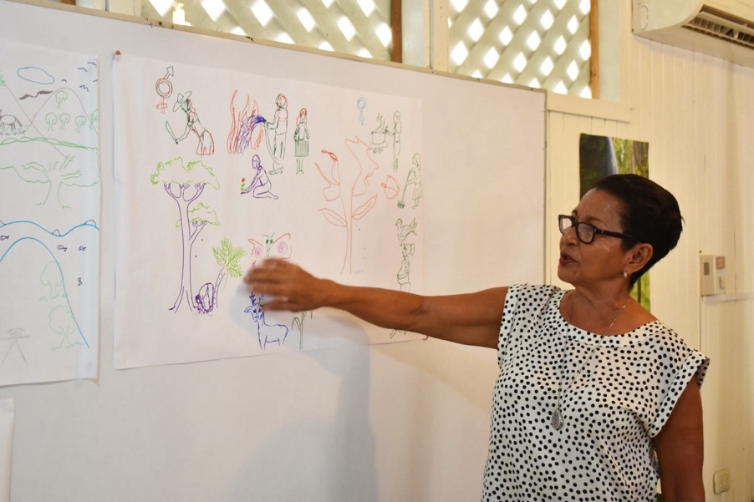
Session 1. Talking Maps: Gender and Biodiversity Nexus
Ask the women to draw or explain their relationship with natural resources
You can ask them to draw or talk about their community and indicate the activities that men and women perform.

Slide 26
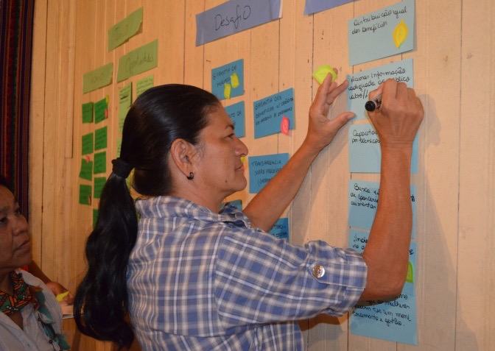
Biodiversity BINGO: Gender differentiated contributions to conservation and nature-based solutions
Ask the participants to share what are the main conservation activities or nature-based solutions that are implemented in the community/region
Participants will be asked to place different color stickers in the activities that are done by women and those done by men

Slide 27
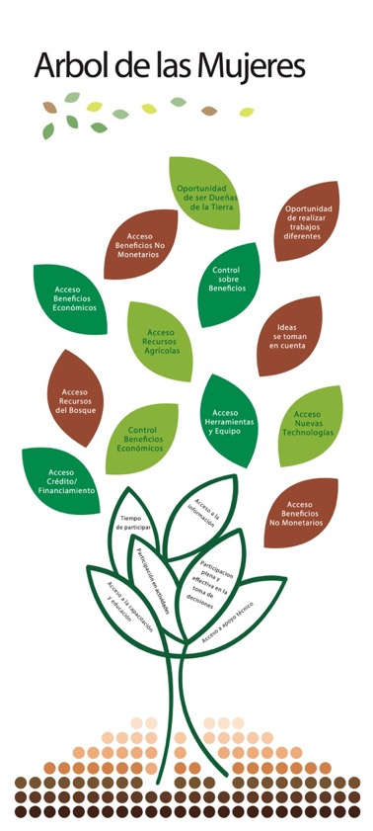
Session 3. Tree of women and men: prevailing gender inequalities in biodiversity sectors
Ask women to identify the main inequalities that limit their access to and decision making power over natural resources and their livelihoods

Slide 28
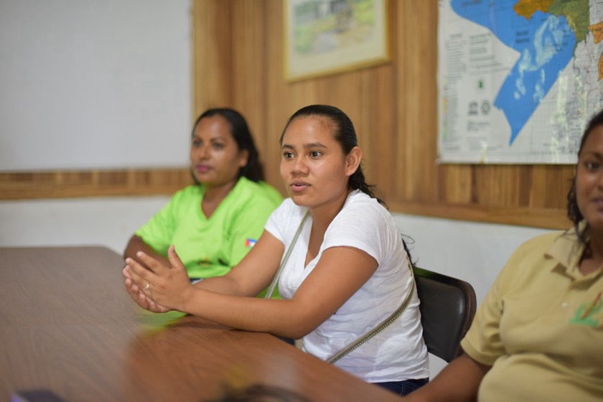
Session 4. I have a dream of a better future: gender differentiated local biodiversity conservation and sustainable use priorities
The facilitator will give examples of biodiversity conservation or sustainable use activities that are priorities for the country that they see in their dream and ask participants to also dream
Participants to open their eyes and write what activities they saw in their own dreams

Slide 29
Session 5. Planting the right seeds: gender-responsive nature-based solutions
Ask the women to identify nature based solutions they would like to "plant" in their communities. Then, give them a blue piece of paper and a yellow piece of paper. On the blue paper, they will be asked to write the "drops of water" required for the seeds to grow, and on the yellow paper, to write "the things that would dry out the seeds."

Slide 30




Q & A
Notes:
Welcome 5 min
Meeting objectives and structure
Introduction of Participants ( warm up question: why are you excited to be here?)

Slide 31
Together is better:
Peer Exchange and
Troubleshoot
Notes:
Welcome 5 min
Meeting objectives and structure
Introduction of Participants ( warm up question: why are you excited to be here?)

Slide 32
Next Thematic
Work Clinics
Notes:
Welcome 5 min
Meeting objectives and structure
Introduction of Participants ( warm up question: why are you excited to be here?)

Slide 33
Capacity Building Plan: Thematic Work Clinics
February 17th
Gender Transformative Actions for Nature: Tips to identify innovative nature-based solution and a new generation of gender and biodiversity indicators that can be included in the NBSAP
March 3rd
The Long-Term Road: Tips to develop a National Roadmap that would lead to the implementation of gender responsive nature-based solutions and how to include it on National Policies
March 10th
A Strong National Foundation: Tips to establish a national gender and biodiversity programme and strengthening institutional capacities
March 24th
Mobilizing Support: Tips to develop resource mobilization proposals and Match Making Mechanism Gender Proposal and development of a Gender Biodiversity Project
March 31th
Gender Highlighting the added value of gender: Tips to systematize case studies and documenting gender impacts of nature-based solutions

Slide 34

Thank you!
Merci!
Gracias!
Спасибо!
ขอบคุณ!

