Slide 1










Thematic Clinic 1
Gender and Biodiversity
Analysis
Image here
Gender and NBSAP Capacity Building & Exchange Process
30th September 2025

Slide 2

Objectives
Discuss the main steps to develop a comprehensive gender and
biodiversity analysis
Share tips to develop gender analysis that includes evidence to
support gender responsive NBS and innovative data analysis
Promote a peer-to-peer exchange on good practices to develop gender
and biodiversity analysis
Obtain specific recommendations for improving national processes to develop a situational analysis

Slide 3
10:00– 10:05
Welcome
Welcome and objectives
Brief description of the Work Clinic
Agenda
10:05– 10:50
Sharing our knowledge: Thematic Work Clinic
Interactive presentation to share tips and practical advice to develop a comprehensive gender analysis
10:50 -11:00
Q&A
Participants will have the opportunity to ask questions on the recommendations presented
11:00 -11:25
Together is better: Peer exchange and troubleshooting
Countries will share their experiences and challenges in developing a gender analysis to obtain recommendations from participants
11:25 -11:30
Wrap up
Planning for the next capacity building session

Slide 4


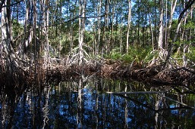

Why conduct a gender and
biodiversity analysis?
Notes:
Welcome 5 min
Meeting objectives and structure
Introduction of Participants ( warm up question: why are you excited to be here?)

Slide 5


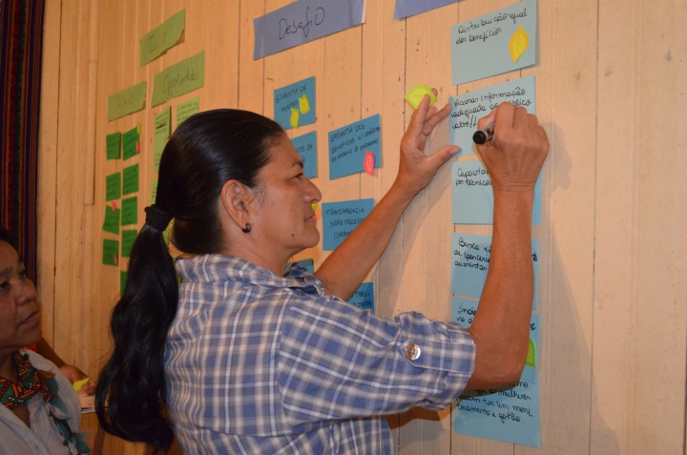
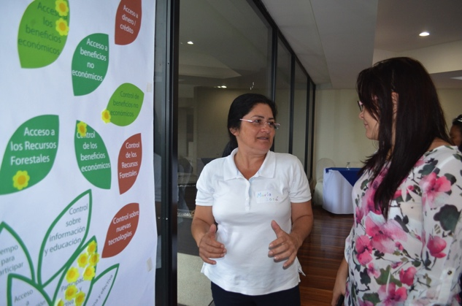
A gender analysis is the first step in designing a gender-responsive or
transformative policy or strategy
It allows countries to:
Recognize both women and men as environmental stewards and key agents of change needed to achieve biodiversity goals
Ensure that the voices, ideas, concerns and experiences of women and men are considered as integral aspects of design, implementation, monitoring and evaluation of the policy or strategy
Assess the differentiated impacts on women and men of any action or intervention associated with the policy or strategy
Ensure that gender inequalities are not perpetuated or increased during the implementation of the policy or strategy
Ensure that the benefits, responsibilities and costs associated with the policy or strategy are shared equitably between men and women.

Slide 6
Each environmental sector has a different social landscape
Forests
Cities
Needs
Priorities
Contributions
AFOLU
Inequalities
Discrimination
Rights
AFOLU
Roles
Coasts
Roles
Ideas, Experience
Knowledge
Access and control of resources
Species
Waste
Based on CBD.2020. Addressing Gender Issues and Actions in Biodiversity Objectives

Slide 7
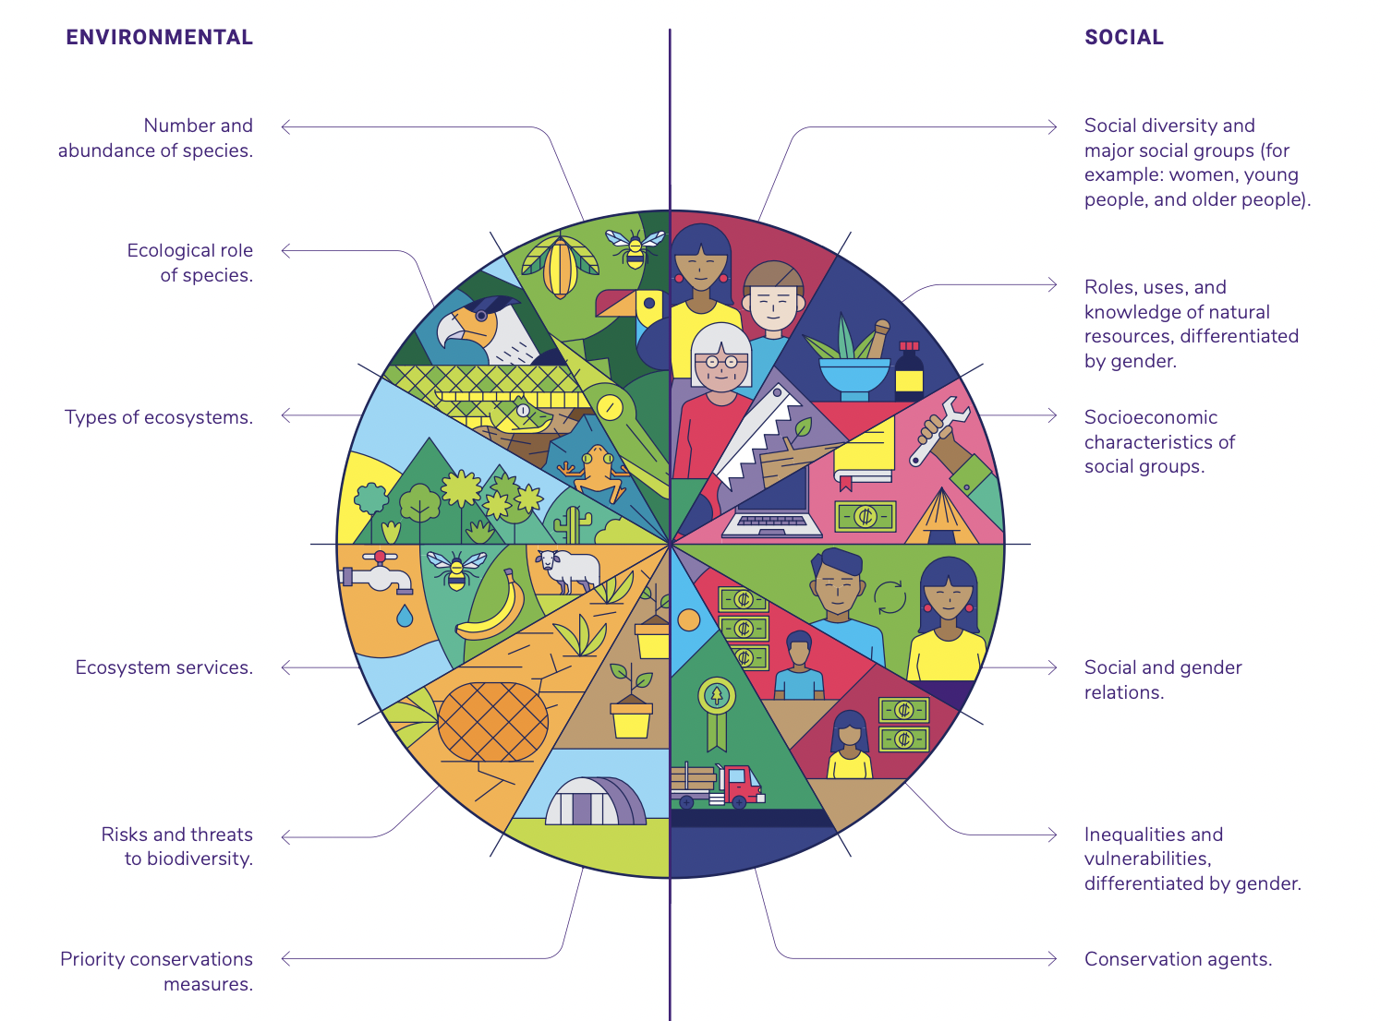
Prevalent gender inequalities in environmental sectors
Do not be afraid of understanding the social landscape…. it’s like collecting data for environmental sectors

Slide 8

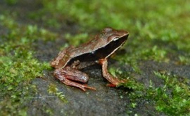


How to develop a comprehensive and
innovative gender and biodiversity analysis?
Notes:
Welcome 5 min
Meeting objectives and structure
Introduction of Participants ( warm up question: why are you excited to be here?)

Slide 9
Recommended Steps
Starting out
Identify previous gender analyses and relevant literature
Design
Do a preliminary gap and strengths analysis of available information and case studies
Conduct the analysis
Analyze the gender and biodiversity policy frameworks to identify policy synergies
Identify experts with relevant experience on gender and environment
Establish MOUs between relevant ministries and institutes to access data
Identify data specialists
Map out women’s groups, organisations, academics and other institutions who work on the topic
Consider different methodologies and approaches to generate data
Define a template to systematize case studies
Organize meetings with different sectors to conduct interviews, workshops, etc
Agree on an approach to data collection that reflects diversity
Analyze the institutional capacities in gender and biodiversity
Collect and analyze local and national data on the gender and biodiversity nexus
Systematize case studies of gender-responsive initiatives
Ensure data reflects the reality of men and women in all their diversity.
Include extra data collection. Consider field visits to rural and indigenous communities.
Analyze the contributions of women-led biodiversity actions
Organize meetings to validate findings and identify gaps
Notes:
Short/ simplified version

Slide 10






Methodology to develop a gender analysis
1
Review gender and biodiversity laws & national documents
2
Review biodiversity and gender literature
3
Map gender experts, women organizations and stakeholders
4
Analyze global and national gender and biodiversity data
5
Meet with actors (various sectors) to identify lessons learned/extra data
6
Conduct consultations with rural and indigenous communities
Notes:
Review of main gender and biodiversity laws and national documents.
Review of biodiversity and gender literature relevant to the country context.
Map gender experts, organizations and representatives of women’s machinery, associations and women stakeholders (rural and indigenous women).
Gender analysis of relevant national and local data.
Meetings with actors from various sectors (government, civil society, etc.) to identify lessons learned or extra data that have not been previously identified.
Field visits to rural and indigenous communities.

Slide 11


Key actions to develop a gender analysis
1
Review gender and biodiversity laws & national documents
Conduct an analysis of the gender policy framework to identify key environmental mandates
Conduct an analysis of the biodiversity policy framework to identify key gender mandates and policy synergies
Conduct an analysis of institutional capacities in gender and biodiversity

Slide 12
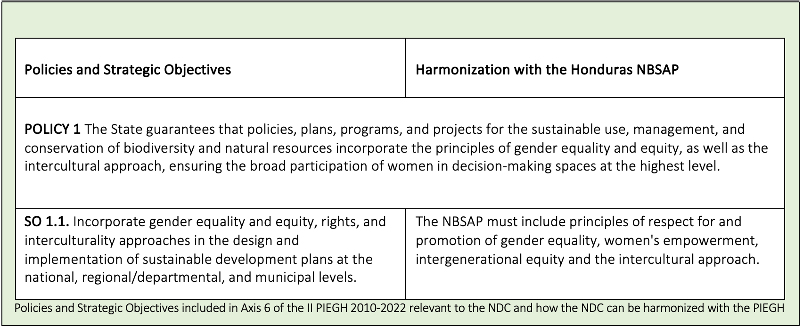
TIP
Policy Analysis: Translate gender policy commitments into
actions that can be included in the NBSAP
1

Slide 13
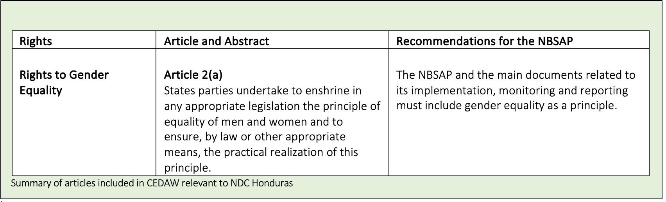
TIP
Policy Analysis: Relate global gender commitments to the NBSAP
1

Slide 14
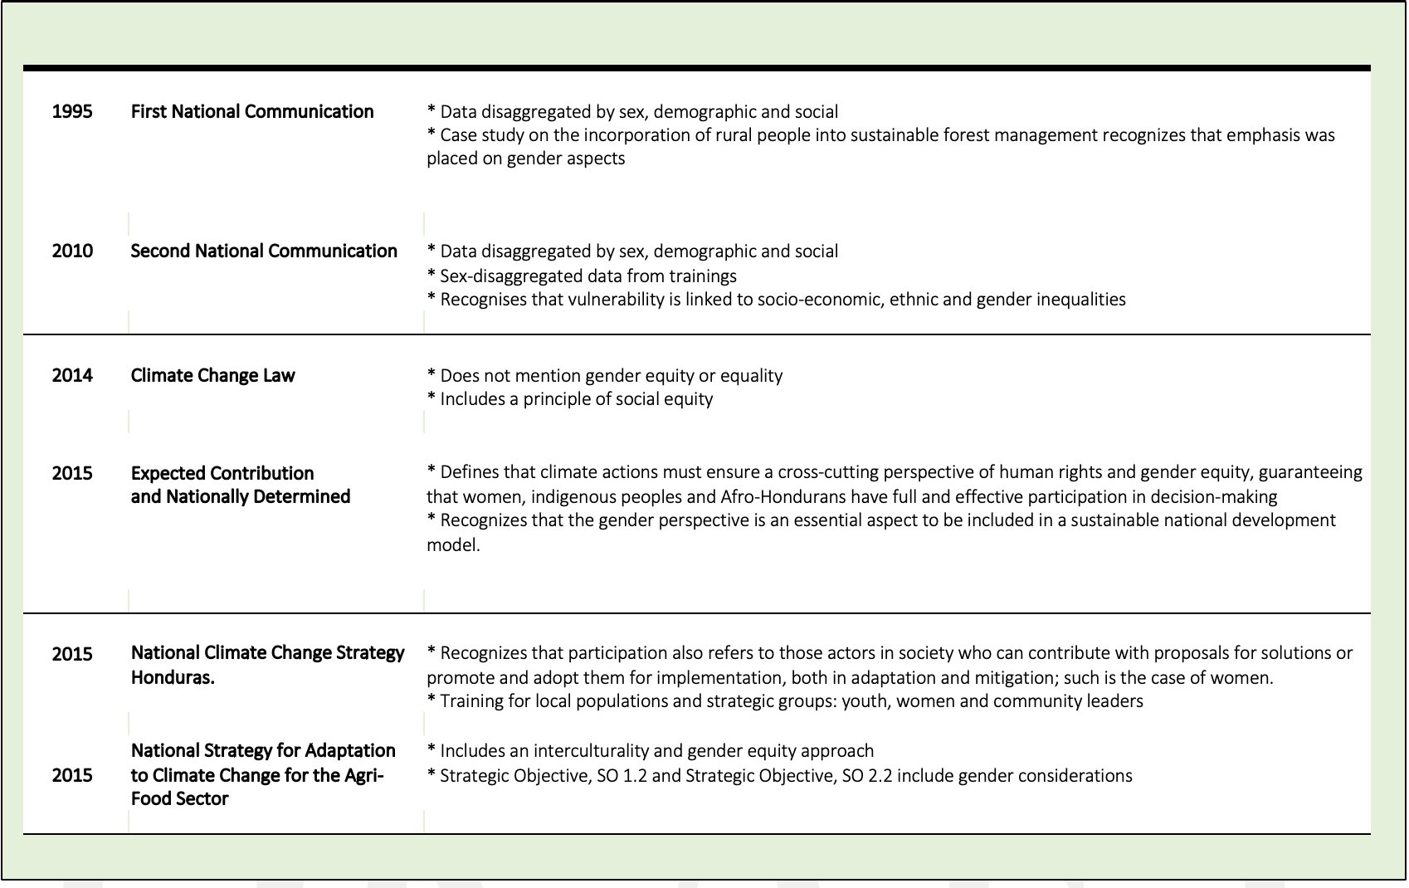
TIP
Policy Analysis: Develop a timeline of national policies to determine how the inclusion of gender commitments has evolved
1

Slide 15
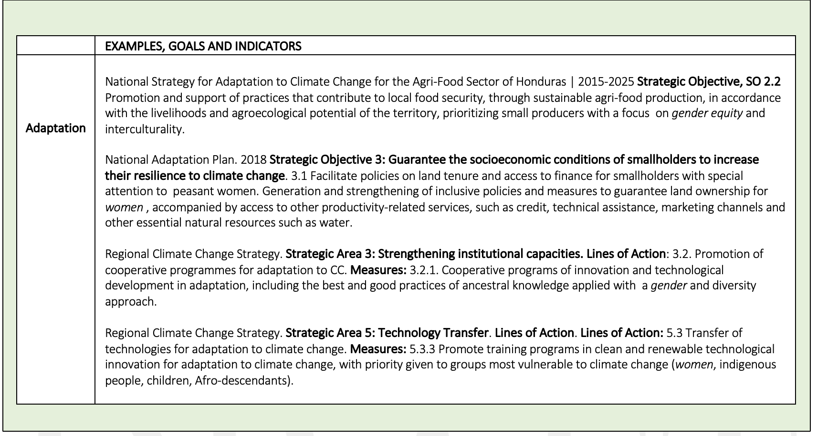
TIP
Policy Analysis: Identify gender goals and actions
included in sectoral policies
1

Slide 16
TIP
Institutional Analysis: Carry out a rapid diagnosis of the gender capacities of the institutions relevant to the NBSAP
1
Ministry of Natural Resources and Environment
Gender Policy: ✔ The country has the Gender Equity and Environment Strategy, the Action Plan for Gender Inclusion of the Ministry of Natural Resources and Environment and the Guide for the Incorporation of the Gender Perspective in the Development of Environmental Projects.
Gender and Environment Experts: ✔✖ The Secretariat has a gender focal point; however, its time has to be divided into several responsibilities.
Gender-Sensitive Staff: ✔ The staff is gender-sensitive and the secretary has a gender unit.
Capacity Building on Gender and the Environment: ✔✖ Staff have received several trainings from INAM.
Gender-Sensitive or Gender-Responsive Projects: ✔ The School for Equality and Empowerment of Rural Women has been implemented.

Slide 17
Key actions to develop a gender analysis
2
Review biodiversity and gender literature
Identify previously developed gender analyses in relation to biodiversity
Search for global publications that might have case studies from the country
Place a call for gender and biodiversity publications and invite government institutions and CSOs

Slide 18
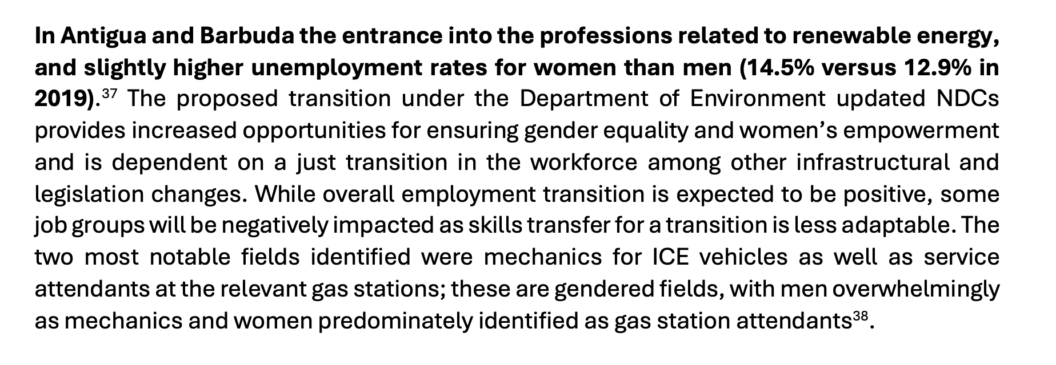
TIP
Literature review: Identify data included in the gender analysis
of the projects supported by vertical funds (GEF, GCF, GBFF)
2

Slide 19
TIP
Literature review: Review previous Strategies and National Reports
related to MEAs to identify gender data
2
Comoros First NBSAP Strategie Nationale Et Plan D’action pour la Conservation de La Diversite Biologique. 2003
Seagrass beds. Uses and development. Seagrass beds play an important role in stabilizing coastal dynamics by consolidating sediments and providing a barrier against marine erosion and storms. They are also of considerable interest given the diversity of species they support and as feeding grounds for dugongs and sea turtles. They are also used as fishing grounds by women and other fishermen and as recreational sites for snorkelers.

Slide 20
Key actions to develop a gender analysis
3
Map gender experts, women organizations and stakeholders
Identify gender experts who have experience conducting gender analysis for various environmental sectors
Carry out mapping of women's groups/collectives and civil organizations, academia, other institutions and international cooperation that work on gender and the environment
Identify gender experts or gender units in institutions involved in the NBSAP

Slide 21
TIP
Map Stakeholders: Review previous Strategies and National Reports
to identify the women’s group and gender experts consulted
3
Estrategia Nacional de Biodiversidad Costa Rica 2016-2025. 2016
List of the organizations that participated in the process of building the ENB2 from the indigenous peoples. 3. Communal Association of Indigenous Women of Talamanca "ACOMUITA 26. Association of Men and Women of Quitirrisí 28. Women's Association "Mano de Tigre" 29. Palenque Margarita Women's Association 30. Mano de Tigre Women's Association 31. Palenque Margarita Women's Association

Slide 22
Key actions to develop a gender analysis
4
Analyze global and national gender and biodiversity data
Establish MOUs between the ministries involved, gender machinery, and statistical institutes to have access to national databases, national censuses or household surveys
Identify data specialists to correlate gender data with biodiversity data and generate innovative analysis and indicators
Conduct a preliminary gap and strengths analysis in relation to disaggregated information and case studies
Conduct an analysis of national data on prevailing gender inequalities relevant to the biodiversity sectors

Slide 23
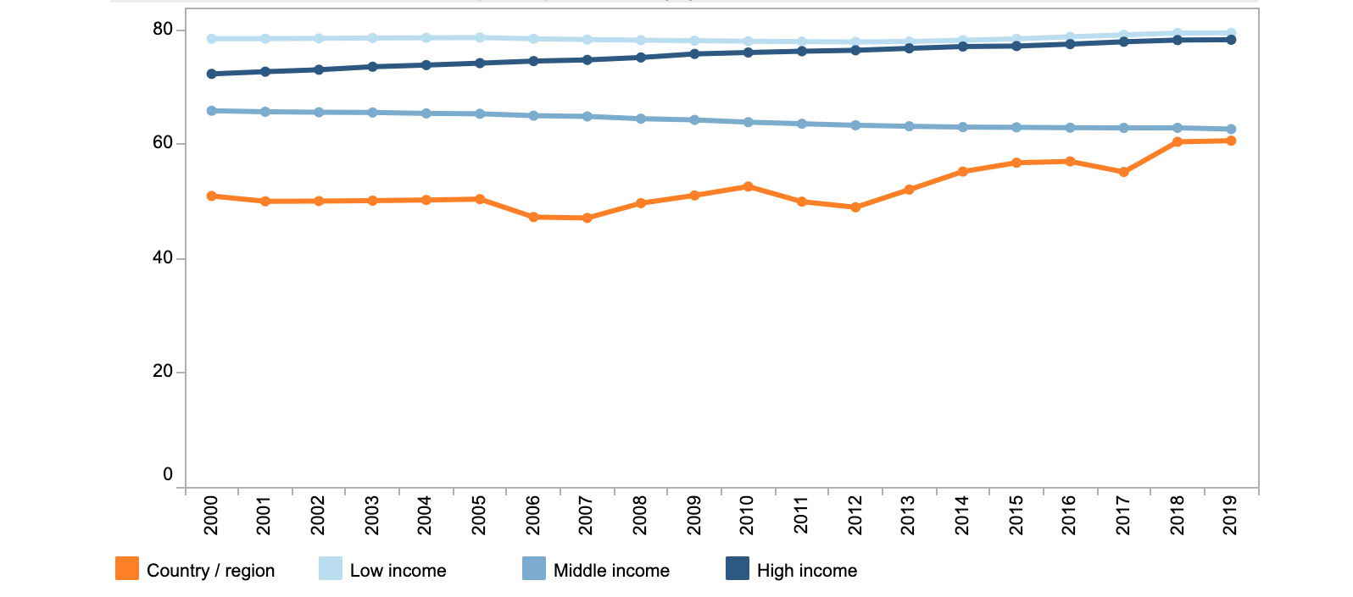
TIP
Data Analysis: Identify data in national and international sources
4
Type of household and percentages of male and female heads
Source: EPHPM 2019
Tipo de hogar | Jefatura masculina | Jefatura femenina | Total
Unipersonal | 5,7 | 10,0 | 7,2
Pareja sin hijos | 9,6 | 1,3 | 6,8
Monoparental masculino | 2,9 | 0,0 | 1,9
Monoparental femenino | 0,0 | 32,6 | 11,1
Biparental | 55,1 | 7,3 | 38,9
Compuesto (a) | 21,1 | 40,3 | 27,6
Extendido (b) | 5,5 | 8,5 | 6,5
Source: World Bank. Gender Data Portal

Slide 24
TIP
Data Analysis: Connect existing gender and biodiversity data to understand potential gender differentiated contributions to nature-based solutions
4
Initiatives with the highest environmental performance are also those which often fully integrate a gender perspective and actively promote the participation of women and encourage their leadership.
These initiatives demonstrate the value and multiplier effect that women’s contributions can have, particularly in reducing deforestation and forest degradation, wherein it not only has a great impact on conservation, but also in improving women’s own well-being and that of their communities.
Forest conservation and restoration
Women have different responsibilities concerning the management of forest resources
Slide obtained from GGCA Establishing links between gender and climate change

Slide 25
TIP
Data Analysis: Connect existing gender and biodiversity data to understand potential gender differentiated impacts of biodiversity loss
4
Coral bleaching and loss of marine ecosystems due to heat stress
The tourism industry is an important sector for women-they represent 60% of its workforce.
Reduction or extinction of marine species used by women for self-consumption or productive activities.
Rising ocean temperatures
More than 40.000 species are threatened with extinction
Rural women in developing countries collect forest products and use them as fuel, food, medicine or animal feed. The reduction or disappearance of these products would have negative impacts on the quality of their life and their families.
Loss of species
Slide obtained from GGCA Establishing links between gender and climate change

Slide 26
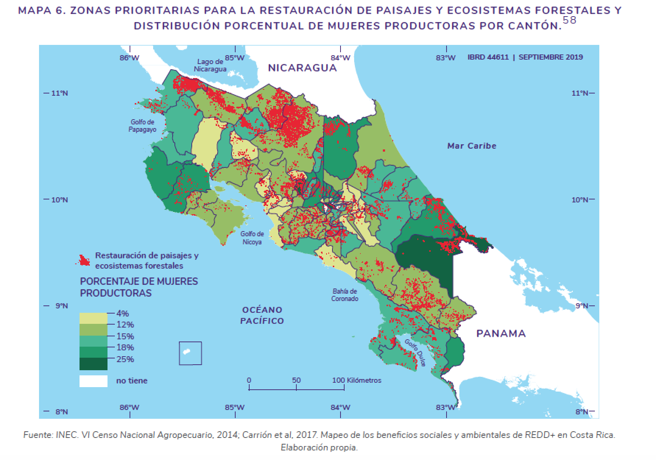
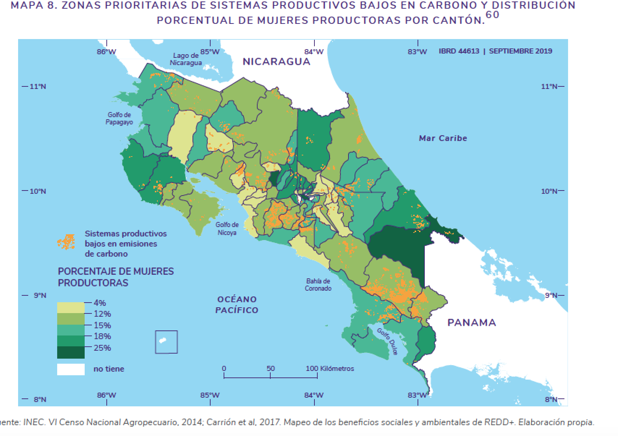
TIP
Data Analysis: Combine gender and biodiversity national data
in an innovative and creative manner
4

Slide 27
Key actions to develop a gender analysis
5
Meet with actors (various sectors) to identify lessons learned/extra data
Define a template for the systematization case studies
Organize meetings with different sectors to conduct interviews, participatory workshops, and collect data
Conduct an analysis the contributions of women-led biodiversity actions to achieve the national biodiversity goals
Systematize case studies of gender-responsive initiatives

Slide 28
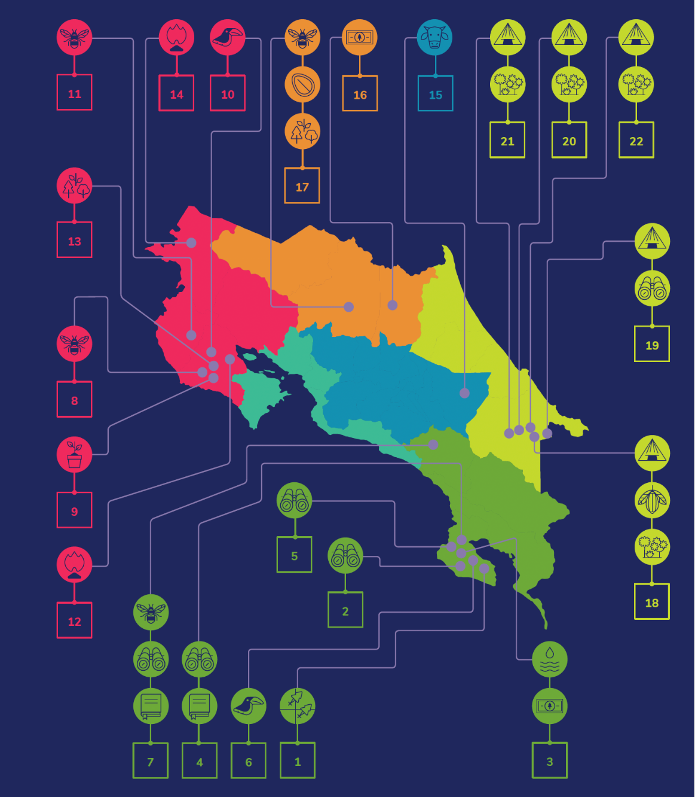
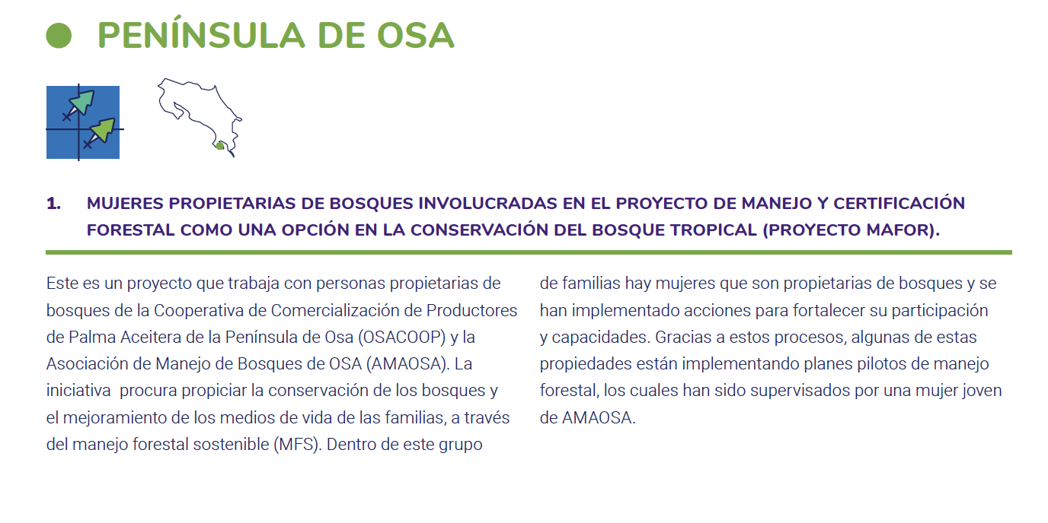
TIP
Case studies: Systematize and map gender responsive biodiversity initiatives
5

Slide 29
Key actions to develop a gender analysis
6
Conduct consultations with rural and indigenous communities
Consider different methodologies for obtaining data at different levels (literature review, interviews, focus groups, online consultations, workshops)
Develop a methodology to obtain data that reflects the country's gender diversity
Propose an experimental design for innovative data analysis
Conduct an analysis of local data that reflects the reality of women in all their diversity, as well as their needs, preferences and priorities in the various sectors

Slide 30
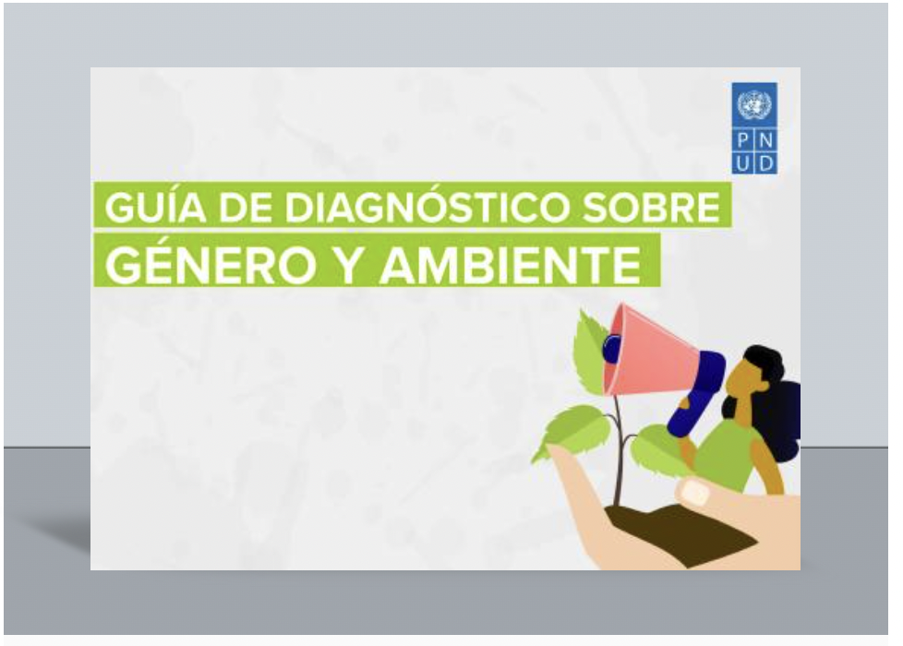
TIP
Consultations: Ask the right questions and look for answers through different methodologies (focus groups, interviews, workshops)
6
Gender-differentiated roles, practices, knowledge, and values
Gender Inequalities and Gaps in Relation to Access and
Decision-Making Power over Resources
Differentiated Contributions to the Management, Sustainable Use,
and Protection of Resources or Ecosystems
Differentiated Participation and Impacts
of Environmental Projects/Activities

Slide 31
Gender-differentiated roles, practices, knowledge, and values
What activities do women and men carry out in relation to the ecosystem/natural resources?
What knowledge do women and men have?
Where do women and men conduct activities related to the ecosystem/natural resource?
What is the monetary value of ecosystems/natural resources for women and men?
What is the non-monetary value (cultural, spiritual, etc.) of ecosystems/natural resources for women and men?
What types of resources do women and men obtain?

Slide 32
Gender Inequalities and Gaps in Relation to Access and
Decision-Making Power over Resources
Who has access to ecosystems/natural resources?
Who has access to information about ecosystems/natural resources?
Who has access to capacity-building processes
/extension services?
Who has control over ecosystems/natural resources?
Who has access to and control over tools and equipment/technologies?
Who has access to and control over the benefits?
Who owns the land?
Who makes the decisions?

Slide 33
Differentiated Contributions to the Management, Sustainable Use, and Protection of Resources or Ecosystems
Differentiated Participation and Impacts of Environmental Projects/Activities
Does project/activity planning take into account the specific barriers and needs of men and women?
What are the differentiated views on conservation/exploitation of these resources?
How do men and women contribute differently to the management, sustainable use, and protection of resources or ecosystems?
Who participates in the projects/activities?
What are the impacts of the project/activities on men and women?

Slide 34
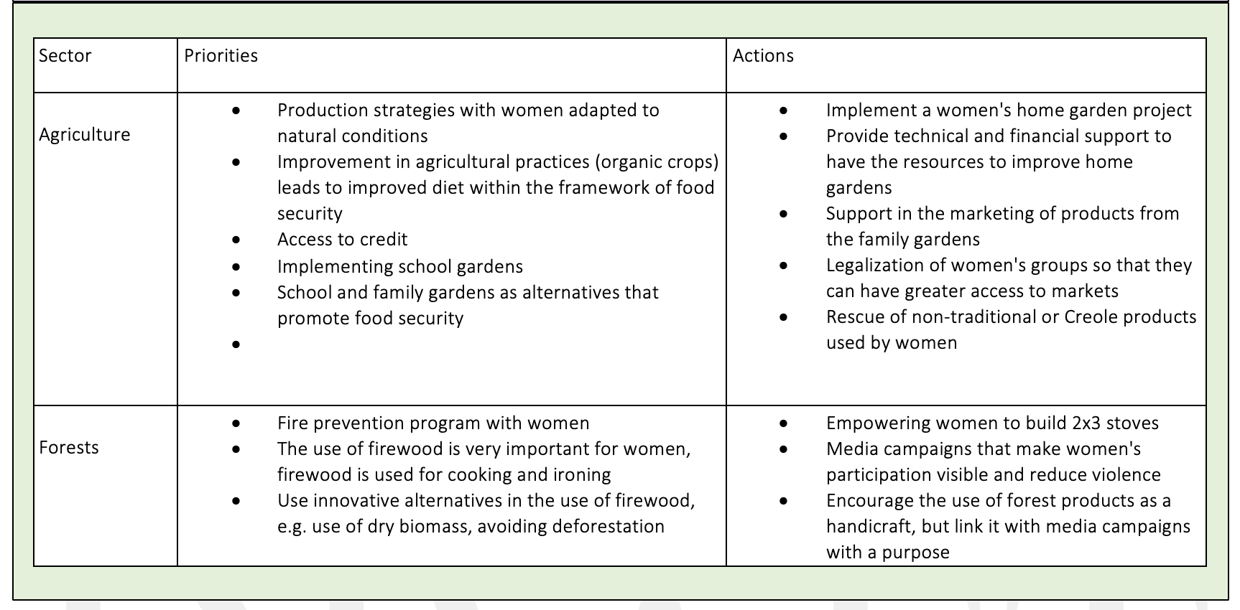
TIP
Consultations: Conduct focus groups or local consultations
to obtain recent qualitative data specific to the topic
6

Slide 35



What could be the content of a
gender analysis?
Notes:
Welcome 5 min
Meeting objectives and structure
Introduction of Participants ( warm up question: why are you excited to be here?)

Slide 36

Prevalent gender inequalities in environmental sectors
What could be the Index of a Gender Analysis
1. Introduction
2. Methodology
3. Policy Analysis (Gender Equality, Environmental, Biodiversity, Indigenous Peoples, Rural Development Policy Framework)
4. Institutional Analysis
5. National Data Analysis
6. Local Data Analysis
7. Case Studies

Slide 37
Prevalent gender inequalities in environmental sectors
Key Data that could be included in a Gender Analysis
Gender-differentiated impacts of environmental degradation, pollution, loss of biodiversity or climate change.
Gender-differentiated use of biological resources and ecosystem services on which communities depend and the benefits derived from these resources and services
Differentiated roles, knowledge, needs and contributions of women and men in relation to the conservation and sustainable use of biodiversity:
    Differentiated environmental stewardship and agency of men and women.
    Strategic environmental and sustainable development interests of women and men.
    Women's needs and preferences in terms of their participation and the sharing of benefits, costs and responsibilities.
Gender considerations relevant to the NBSAP:
    Main gender inequalities prevalent in the biodiversity sectors relevant to the NBSAP.
    Main cultural, institutional, and social barriers that prevent stakeholders, particularly women, from
    participating fully and effectively in all phases of the update and implementation of the NBSAP.
    Gender-differentiated risks, costs, impacts and opportunities associated with the NBSAP.
    Baseline of sex-disaggregated information relevant to the NBSAP.

Slide 38



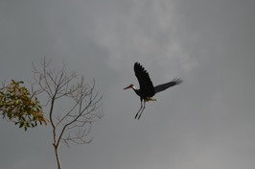
Q & A
Notes:
Welcome 5 min
Meeting objectives and structure
Introduction of Participants ( warm up question: why are you excited to be here?)

Slide 39
Together is better:
Peer Exchange and
Troubleshoot
Notes:
Welcome 5 min
Meeting objectives and structure
Introduction of Participants ( warm up question: why are you excited to be here?)

Slide 40
Next Thematic
Work Clinics
Notes:
Welcome 5 min
Meeting objectives and structure
Introduction of Participants ( warm up question: why are you excited to be here?)

Slide 41
Capacity Building Plan: Thematic Work Clinics
September 30th
1. Gender and Biodiversity Analysis: Tips to develop gender analysis that includes evidence to support gender responsive NBS and innovative data analysis
October 21tst
2. Gender Transformative Actions for Nature: Tips to identify innovative nature-based solution and a new generation of gender and biodiversity indicators that can be included in the NBSAP
October 28th
3. Getting the right stakeholders in the table: Tips to develop a mapping multiple actors and consultations to identify gender responsive nature-based solutions that contribute to M-K targets
November 11th
4. The Long-Term Road: Tips to develop a National Roadmap that would lead to the implementation of gender responsive nature-based solutions and how to include it on National Policies

Slide 42

Thank you!
Merci!
Gracias!
Спасибо!
ขอบคุณ!

