Slide 1
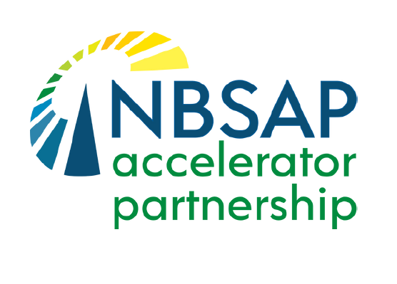

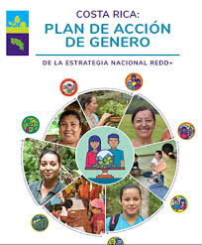
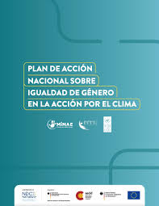



Costa Rica's experience:
Public policies that accelerate the link between gender equality and nature-based solutions
“Accelerating systemic change for gender equality and biodiversity conservation through NBSAPs” – Costa Rica

Slide 2



Background:
Little by little, Costa Rica has gone from mentioning gender equality as a principle to prioritizing the identification of relevant gender inequalities and proposing concrete measures to address them .
Executive Directive No. 005-2019 of the Ministry of Environment and Energy (MINAE) that marks the starting point to reduce gender gaps in the biodiversity sector —water, protected areas and forests— and ensure gender equality and the contribution of women in said sector.

Slide 3
Gender Action Plan of the National REDD+ Strategy:
a) Promote and implement low-emission and gender-responsive production systems, implement the gender perspective in strengthening the ASP and in the institutional management of SINAC,
b) Strengthen fire protection, prevention and management programs to make them gender-responsive,
c) Promote positive financial mechanisms for the conservation and sustainable management of forests, which benefit women and men equally,
d) Promote the restoration of forest landscapes and ecosystems in a gender-responsive manner,
e) Promote the participation of indigenous women in the 5 special topics established in a participatory manner by the Indigenous Peoples and,
f) Create the enabling conditions to integrate a gender perspective into environmental and climate change initiatives. It is worth mentioning that the Action Plan for Gender Equality in the SINAC Forest Fire Brigades was developed within this framework.

Slide 4
National Action Plan for Gender Equality and Climate Action:
To articulate the multisectoral response and reduce the differentiated impacts of the climate crisis on women in 06 strategic sectors through gender-sensitive and transformative actions in employability and strengthening of economic autonomy, capacity building and innovation, risk management, incorporation of the intersectional gender perspective in climate action and production of disaggregated information.
Sectors: agriculture, forestry, mobility and transport, tourism, infrastructure and energy.

Slide 5
National Relevance:
Pioneering and innovative proposals that demonstrate the country's commitments to the Gender Equality Action Plans of the Environmental Conventions.
These are roadmaps that, while incomplete, coordinate national efforts to accelerate gender equality in different sectors.
They start from diagnoses of gender gaps to understand the realities that women experience and to better guide decision-making.
They promote the design of nature-based solutions and boost women's economic autonomy: a winning bet for women, nature and the climate.

Slide 6
Institutional Relevance:
Budget allocated for the implementation of actions
Year | INDER | FONAFIFO | REDD+ Secretariat | CNE
2024 | $24,289,878.99 |  | $25,261.72
2025 | $39,066,066.12 | $3,444,852.26 |  | $12,742.98
Total | $63,355,945.11 | $3,444,852.26 | $25,261.72 | $12,742.98
Total budget invested over two years: $66,838,802.07

Slide 7
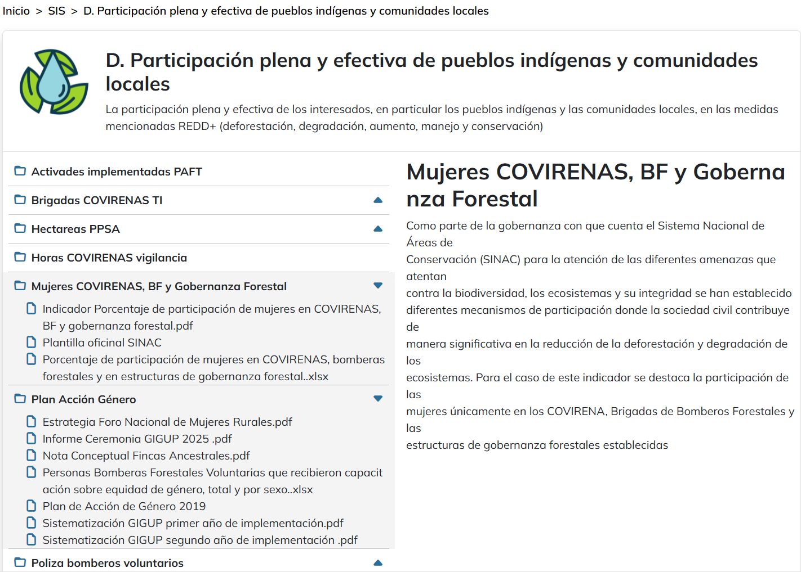
Institutional Relevance:
Report on the progress of communications to the UNFCCC in compliance with the Cancun Safeguards for the REDD+ Project.
Website: SINIA

Slide 8
Costa Rica's experience:
Public policies that accelerate the link between gender equality and nature-based solutions
“Accelerating systemic change for gender equality and biodiversity conservation through NBSAPs” – Costa Rica

