Slide 1

Women for Nature: Tajikistan in Practice
Gender NFP: Bonu Sharifzoda

Slide 2

Gender Gaps in the Implementation of NBSAPs and the Goals of the GBF
Key barriers limiting women’s participation in biodiversity conservation:
Limited access to green jobs and decision-making processes
Insufficient access to finance and technologies
Undervaluation of women’s traditional ecological knowledge
Limited access to climate-resilient agricultural practices
Social barriers in rural areas

Slide 3

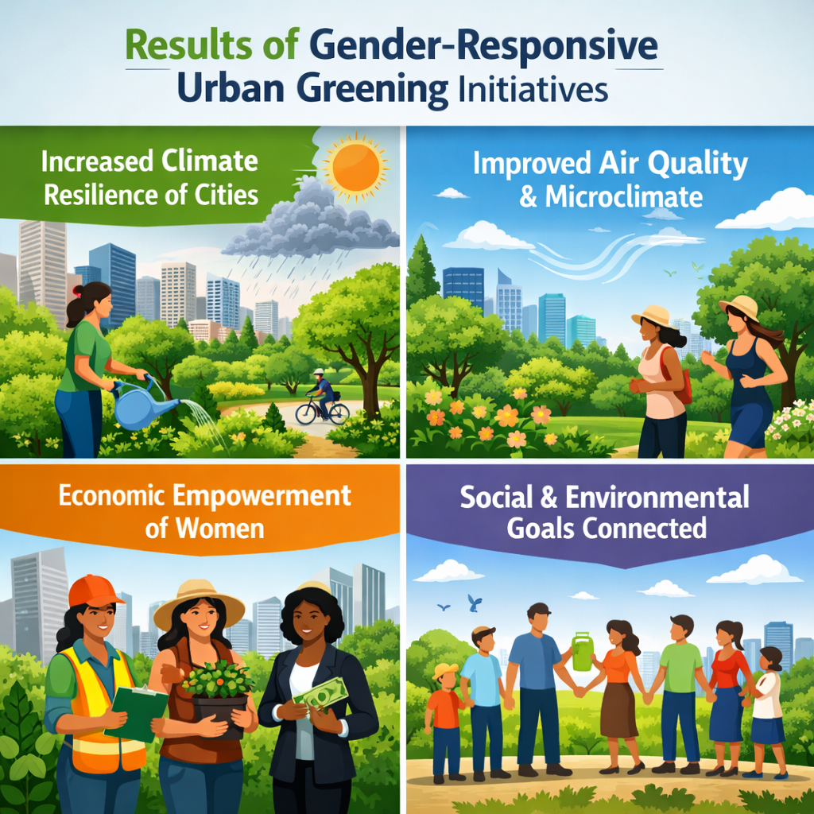
Urban Greening as a Gender-Responsive NBSAP Approach
Within the updated NBSAP priorities on expanding urban green areas:
Municipalities establish women-led working groups on urban greening
Tree planting reduces the risks of landslides, dust storms, and urban heat
Women gain stable, paid employment
Awareness is raised about the role of ecosystems in urban resilience
Proposed Gender-Responsive Indicators:
% of women employed in green municipal programs
Women’s participation in environmental decision-making bodies
Area of green spaces restored with women-led initiatives

Slide 4

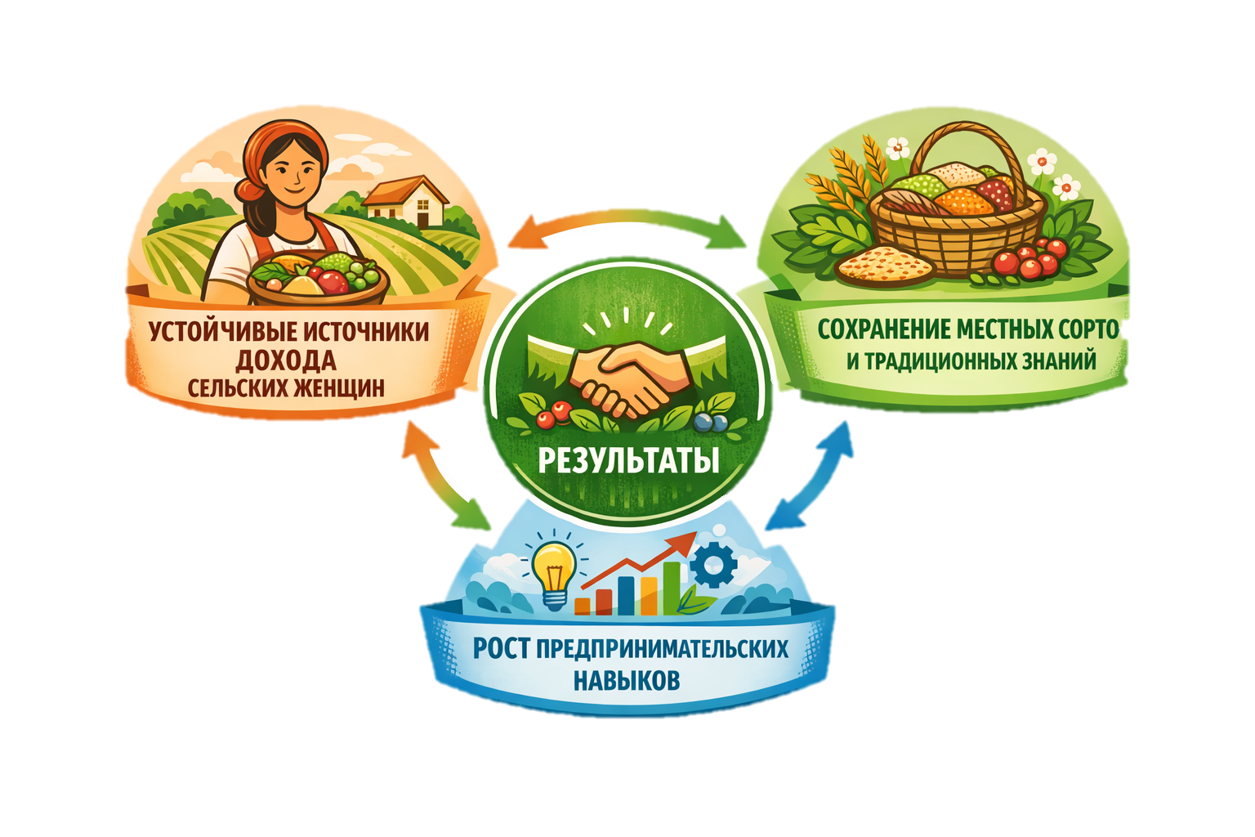
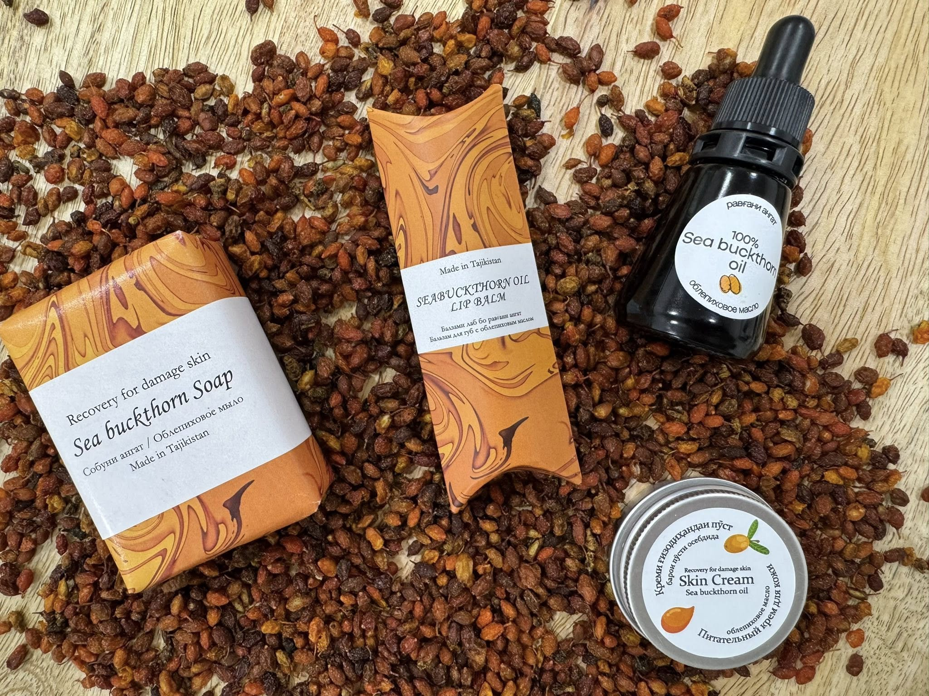

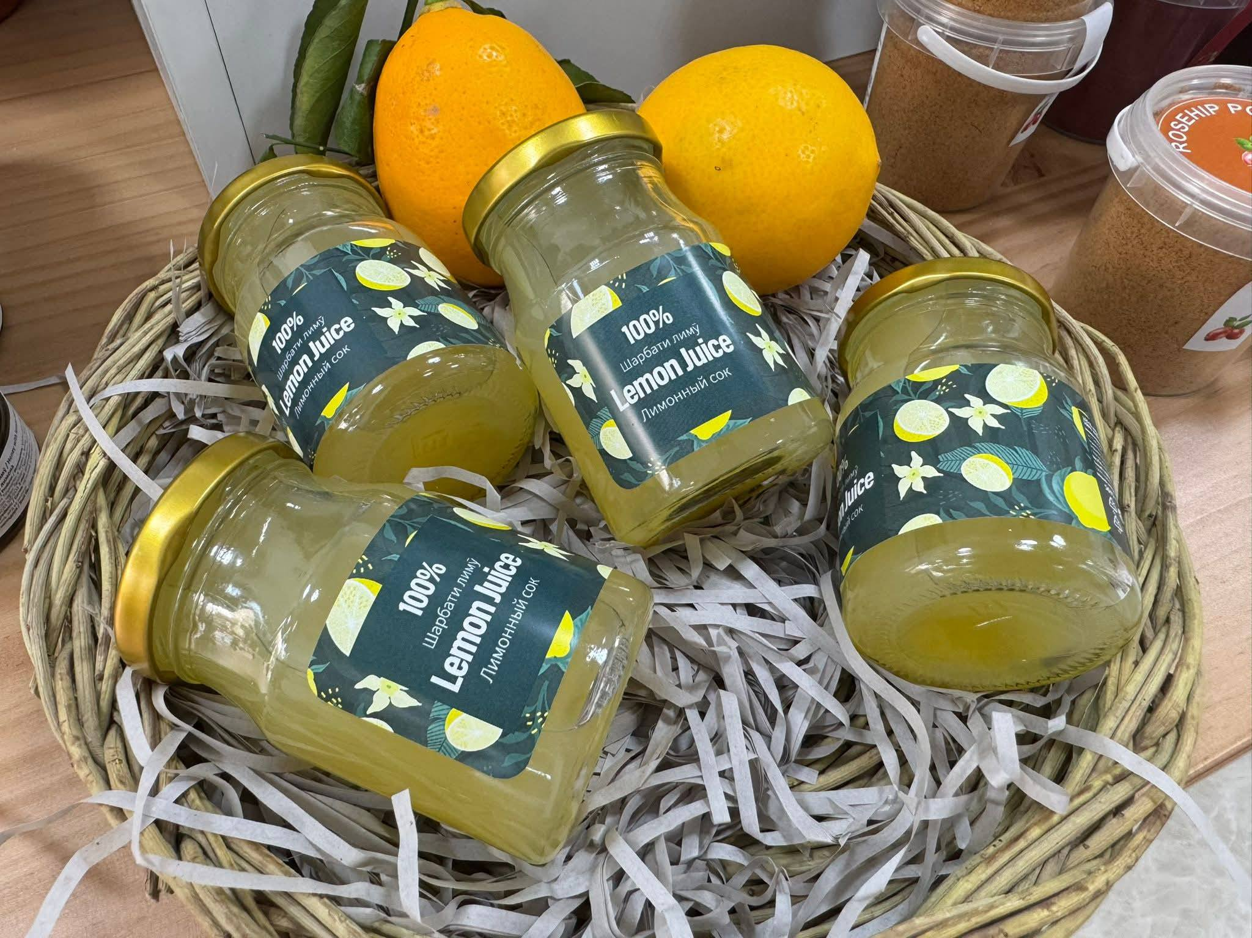
Women's cooperatives and agrobiodiversity
The One Village One Product Initiative: • developing women's cooperatives based on agrobiodiversity • sustainable use of local varieties and natural resources • promoting a green and circular economy
Transformative Element:
Biodiversity as a source of income
Women as economic actors in conservation
Indicators
Number of local varieties preserved
Income from biodiversity-based products
% of women-led sustainable rural enterprises
Связь с GBF: Target 10, Target 22

Slide 5
Integration of Biodiversity into Women’s Business Grants
Presidential Grants for Rural Women:
Environmental criteria are integrated into the project selection process
Priority is given to sustainable business initiatives
Mainstreaming biodiversity into economic development programs
Linkages with the GBF: Target 14, Target 22
Linkages with the NBSAP: Integration of biodiversity into development processes
Mainstreaming Mechanism:
Biodiversity integrated into public financing systems

Slide 6

Women as Custodians of Genetic Resources
Development of Local Genetic Banks:
A significant share is managed by women
Conservation of local varieties and crop wild relatives
Support for traditional knowledge
Resilience Dimension:
Climate adaptation
Food security
Intergenerational knowledge transfer
2 indicators:
Number of community genetic banks with women leadership
Number of traditional varieties preserved
Notes:
.

Slide 7

Women and Sustainable Ecotourism
Training Women Guides in Mountain Areas:
Capacity-building in ecotourism
Promotion of the sustainable use of ecosystems
Engagement of local communities
Nature-Based Economic Incentive Model
Number of certified women eco-guides
Biodiversity – based tourism income
50% of revenue reinvested in conservation

Slide 8

Key Conclusions for the NBSAP
Key Lessons Learned:
Women are central actors in Nature-based Solutions (NbS)
Traditional knowledge strengthens resilience
Economic empowerment improves conservation outcomes
Gender integration accelerates the achievement of the GBF

Slide 9


