Slide 1


Chief Digital Office (CDO) Unpacked
AI Trust and Safety Re-Imagination Programme
Global Call for Presentations
Notes:
Few T&S advisors/ big tech/ small tech companies. Stanford HAI+ BKC? TSPA. More than AI Hub. Speak to UNDP AI promise. Industry development. Broader than private sector.

Slide 2
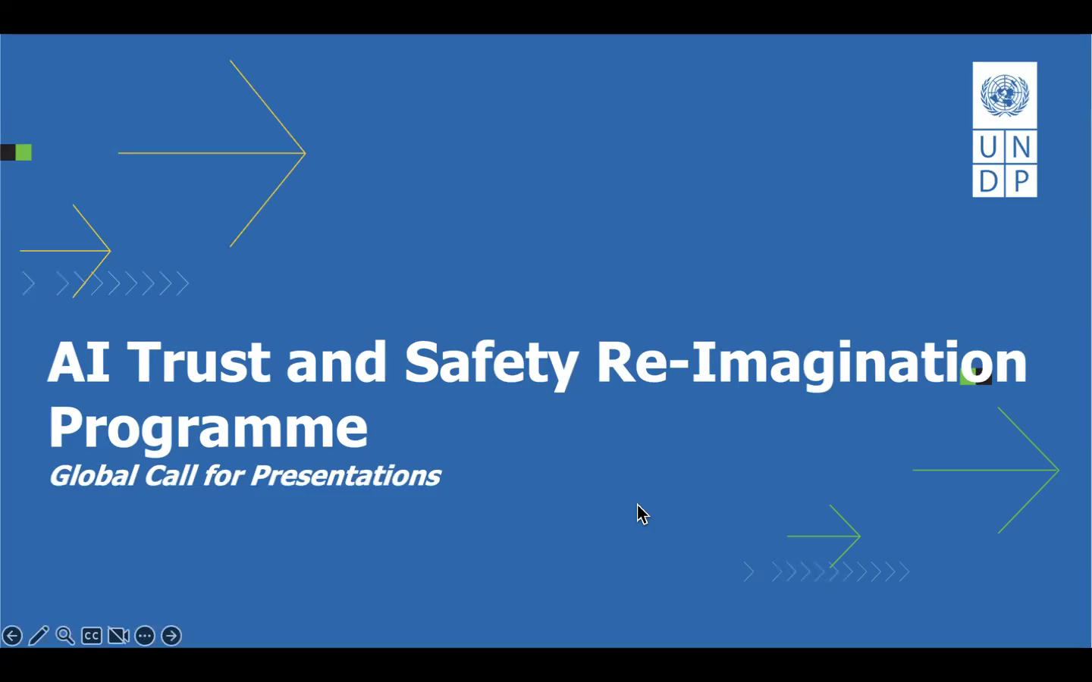
🎥 Recording of info session Mar 18, 2025

Slide 3
What is Trust & Safety?
PRIVATE SECTOR GOVERNANCE OF DIGITAL RISKS AND HARMS
ESCALATIONS
ENFORCEMENT
COMPLIANCE
the reporting mechanisms and subsequent review of content that end users and/or media or partners report to the company.
Commonly includes content moderation blocking, profile authenticity, spam, and other methods of proactive detection and enforcement against bad actors or prevention of bad activity
Legal compliance
Policy and regulatory compliance
Private partnership compliance with rules and agreements (including APIs)
USER SAFETY
BUSINESS AND BRAND INTEGRITY
PLATFORM INTEGRITY
policies and actions to help proactively ensure user safety
Business requirements for monetization and commercial use.
Business requirements for monetization and commercial use.

Slide 4
Trust and Safety (T&S) refers to:
Practical methods of managing emerging AI & digital escalations
Tactical approaches to identifying, defining and mitigating risks
How policies and laws are interpreted into product designs, business operations, escalations processes, and corporate communications to achieve their intended purposes

Slide 5
Trust and Safety is a key foundational component
to strengthen the AI Development Ecosystem
and attracting investment

Slide 6
The Next Great Trust and Safety Innovations of the Future
Will Come from the Global Majority

Slide 7
Local regional start-ups, business leaders, developers, and
researchers are in the best position to inform the needs for
AI Trust and Safety for their communities

Slide 8
LOCAL ENABLEMENT
POLICY EVIDENCE & ALIGNMENT
Equitable, Inclusive, Safe and Trustworthy Development and Deployment of AI and Digital Technologies Globally.
Make AI Trust and Safety resources accessible at the local level to support the safe and equitable development, deployment and use of AI. Spotlight local experts who understand local challenges and priorities.
Identify opportunities for policy alignment and data collection that reduces friction and impairment to the success and viability of safe AI
CO-DESIGNED SOLUTIONS
ADAPTIVE TO POPULATION NEEDS
UNDP Trust & Safety Programme Goals
Strengthen and expand upon private and public partnerships to ensure alignment on policy and proper interventions
Ensure that solutions are not uniform and are culturally sensitive as well as address the needs of the most vulnerable populations

Slide 9
AI TRUST AND SAFETY RE-IMAGINED
TODAY’S REALITY
A SAFE AND INCLUSIVE DIGITAL FUTURE
MANAGED BY PRIVATE COMPANIES
SHARED RESPONSIBILITY
Governance led and executed by private tech companies with liability placed on companies reactively
Collaborative and co-designed governance practices in private and public sector partnership that distributes responsibility and diffuses liability
CENTRALIZED & UNIVERSAL
LOCALLY EMPOWERED, SOVERIEGN AND RELEVANT
Globally scaled, universally applied policies risk replicating hierarchical and colonial governance models that threaten principles of sovereignty
Scaled localized solutions, sensitive to the public interests as determined by cultural contexts
REACTIVE, CRISIS FOCUSED
PROACTIVE, ANTICIPATORY AND ADAPTIVE
Focused on managing escalations based on user reports. Priorities are ranked by severity of harm, imminent risk and market priorities
Mitigate systemic risks in proactive ways that are adaptive to emerging risks and harms

Slide 10
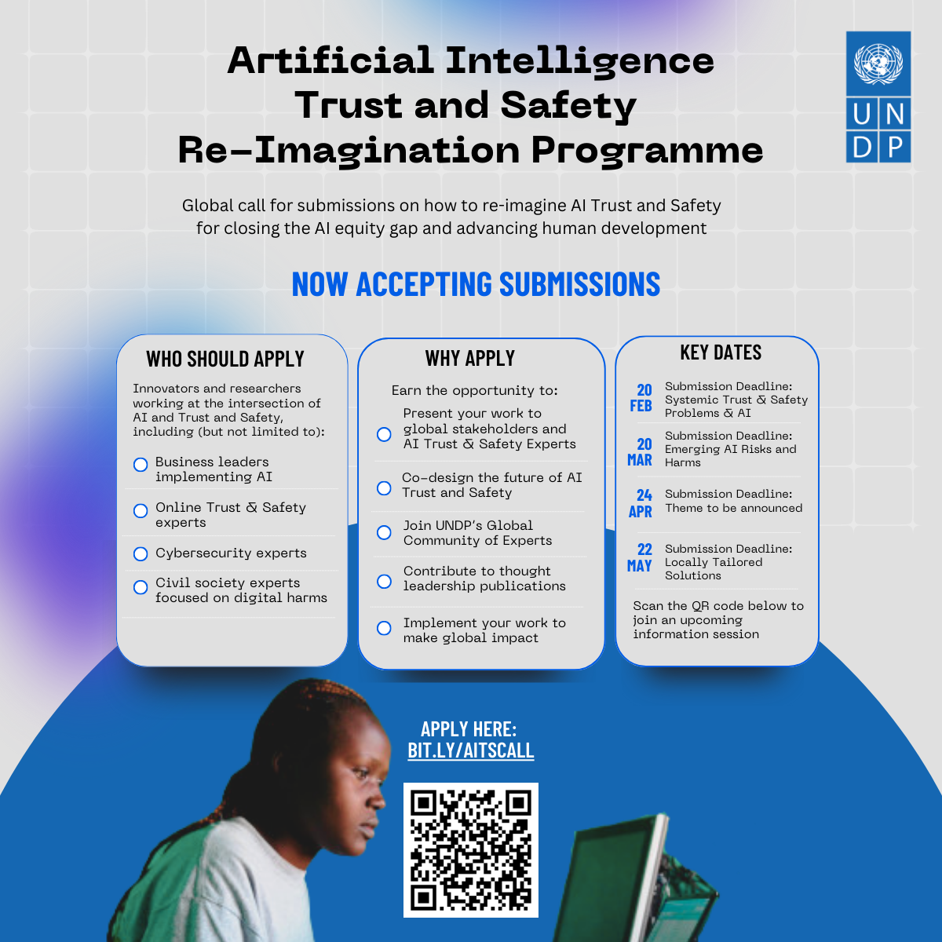
Goals:
The primary ambition is to spotlight local experts, surface regional risk and harm priorities, and foster informed, actionable solutions for AI trust and safety.
Discussions may include AI readiness in hardware and software, cybersecurity crimes and fraud, mis-info, deep-fakes, low resourced languages, impact on AI T&S equity, among others.
Selection Process:
“Rolling Admissions”, topics determined by
Regional priorities and data surfaced by submissions (see key dates and high level topics)
Info sessions for applicants is every first Thursday of the month at 8am ET and 8:30pm ET.
If you/ your offices want to partner/ get involved in hosting or facilitating an online convening for AI Trust & Safety please contact: Jennifer.louie@undp.org

Slide 11
APPLY EARLY
THINK PARTNERSHIPS
We want collaborative presentations that creatively share skills to make bigger impact
You will have more chances to pitch your ideas and present to global leaders and receive mentorship and coaching from leaders
BE SPECIFIC AND LOCALLY RELEVANT
AUDIENCE MATTERS
ADVICE
We don’t expect a one size fits all approach will work for everyone. We encourage nuance and specificity that is culturally aware and locally focused
Translate your work for a general audience and not only experts.
The goal is to uplevel the knowledge base and help people understand the impact and why this is a priority

