Slide 1
Gender Equality Seal Public Institutions
Induction Webinar Series 2024
Session 1: Basics of the Seal

Slide 2

Welcome and introduction
If you have not already done so, please write in the chat:
Your name
Function
Country you represent
The first thing that made you smile today

Slide 3
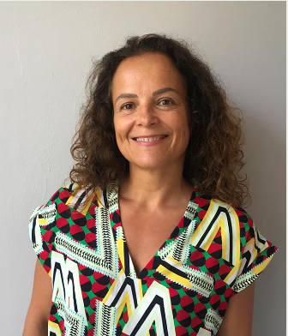
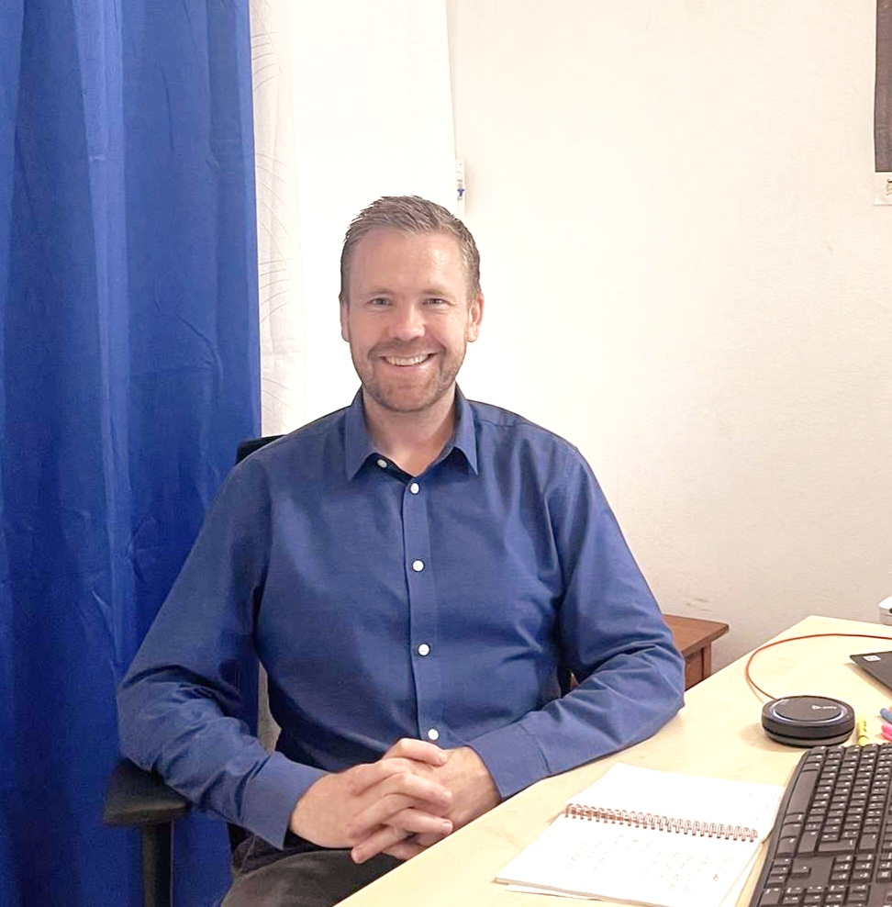
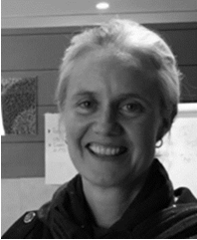
Meet your facilitators
Ana Landa Ugarte
Global Manager
ana.landa@undp.org
David Davidsson
Fiscal institutions Specialist
david.davidsson@undp.org
Joanna Hill
Gender Specialist
joanna.hill@undp.org
Notes:
We say overview because this training is not a deep-dive into the Seal benchmarks per se.

Slide 4

Objectives
Provide knowledge and awareness of the Seal process to country office teams, regional experts, consultants and partner institutions that are implementing the Seal or thinking about doing so.
Specific objectives for participants:
Understand the logic, reasoning and the Theory of Change of the Seal.
Clarify roles and responsibilities of involved actors.
Understand the process and steps of Seal implementation.
Overview of different dimensions, standards and benchmarks.
Notes:
We say overview because this training is not a deep-dive into the Seal benchmarks per se.

Slide 5
Target audience & participants
UNDP CO, regional and global experts (gender, governance, tax, finance, …)
Consultants and advisors supporting Seal implementation in public institutions
Members of the Gender Equality Committees of public institutions that are implementing the Seal
Other if considered

Slide 6
Logistics
4 webinars, 1.5 hours each
Timing:
            Tuesdays 7th and 14th May
            Thursday 9th and 16th
            7- 8.30 AM EDT
Bonus Q&A session in early June subject to demand
Microsoft Teams – same link every time!
PPTs and recordings will be shared
Notes:
There is also time for Q&A at the end of each session.

Slide 7
Agenda (indicative!)
7 May, 7:00 – 8:30 (EDT)
Gender Equality Seal – Part 1 Basics of the Seal What and why Theory of Change, Dimensions and standards Process, steps and roles Branding Branding
9 May, 7:00 – 8:30 (EDT)
Gender Equality Seal – Part 2 Step 1: Engage Letter of commitment Forming and training the Gender Equality Committee Communicating the institutional commitment Seal work plan
14 May, 7:00 – 8:30 (EDT)
Gender Equality Seal – Part 3 Step 2: Setting the baseline Seal toolbox Self-assessment methodology Dimensions and benchmarks Dimension 1: Planning and management Dimension 2: Architecture and capacities
16 May, 7:00 – 8:30 (EDT)
Gender Equality Seal – Part 4 Step 2: Setting the baseline (cont.) Dimensions and benchmarks Dimension 3: Enabling work environment Dimension 4: Partnerships and accountability Dimension 5: Results and impacts Step 3: Learn and improve Step 4: External assessment Online platform

Slide 8
Motivation and vision
What is the Seal?
Why implement the Seal?
Theory of Change, dimensions and standards
Process, steps and roles
Branding guidelines
Session 1:
7 May 2024
Basics of the Seal
Notes:
Consider today a warm-up! Some of you are already familiar with some elements of today’s presentation.

Slide 9
Motivation and vision

Slide 10
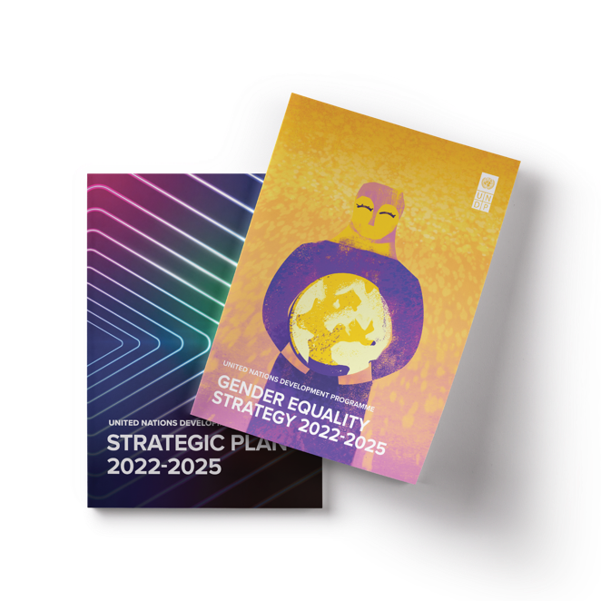


Our vision
500 INSTITUTIONS
Acquire the Gender Equality Seal
100 BILLION USD
Aligned and leveraged for gender equality

Slide 11

What is the Gender Equality Seal for Public Institutions?
Our vision
Strong, integrated public policies and services that ACCELERATE GENDER EQUALITY
through PUBLIC ADMINISTRATION REFORM
that focuses on the PEOPLE and INSTITUTIONS that drive it.
Notes:
It’s about achieving meaningful and positive change.

Slide 12

Our vision
The Challenge
The Opportunity
Democracy is at stake: people are losing trust in their institutions.
Increasing equality is key for rebuilding trust in public institutions.
Strategies for gender equality tend to be fragmented and not comprehensive.
Public Institutions need comprehensive approaches to achieve Agenda 2030 commitments.
Addressing gender stereotypes could trigger 12 Trillion $ in global economy.
Gender stereotypes remain widespread.

Slide 13

Gender equality at the center of public administration reforms
  Reforming public administration systems and regulations
  Improving leadership and personnel management practices
  + Breaking silos
  + Strengthening gender equality ministries
  + Building civil society trust
  GENDER EQUALITY RESULTS
Notes:
Public administration reform is about Increasing the capacity of the government's internal machinery of organizations and personnel through reforms of government structures and systems for designing and implementing policies; and improving leadership and personnel management practices that influence the ability, motivation, and accountability of public sector workers. This is what the Seal intends to facilitate, public administration reforms towards advancing gender equality in public policies and services.

Slide 14
The UNDP advantage
  Strengthening public governance is at UNDP’s CORE
  The Seal: a globally VALIDATED methodology
  Extensive pool of GENDER EXPERTS in house: 49 experts & 5 global teams
Global network for peer-to-peer learning and MENTORING
DATOS D
  Strong GENDER EXPERTISE IN ‘HARD’ AREAS: tax and fiscal policies, transport, climate, energy...
CONVENING capacity: governments, civil society, academy, private sector
DATOS E

Slide 15
What is the Gender Equality Seal for Public Institutions?

Slide 16




What is the Gender Equality Seal for Public Institutions?
What is the Seal?
A comprehensive and articulated set of QUALITY STANDARDS on gender equality to achieve institutional transformations in management practices.
A comprehensive public administration initiative that supports public institutions towards meeting gender equality targets.
A tailored ROADMAP with steps to improve the way they plan, implement, monitor and evaluate public policies and services.
A package of context specific SERVICES AND TOOLS through which UNDP provides sustained support.
A GLOBAL CERTIFICATION and recognition granted by UNDP to public institutions that achieve gender equality global standards.
Notes:
It’s about achieving meaningful and positive change.

Slide 17




What is the Gender Equality Seal for Public Institutions?
What is the Seal?
The Seal drives institutional transformation
A process requiring consistent and evidence-based improvement.
Independent external assessment managed at the global level with strong quality assurance.
Recertification required after 3 years.
Not a box-ticking exercise
Not gender washing
Not all institutions make it
Notes:
It’s about achieving meaningful and positive change.

Slide 18



GES: “The Gender Equality Seal will continue to be the UNDP global initiative for operationalizing this strategy”
Private Sector
UNDP COs
Public Institutions
2018
2012
2009
Driving gender equality accross who WE ARE, WHAT WE DO and WHO WE WORK with
Notes:
A special track for Tax Administrations and Ministries of Finance launched in 2023.
UNDP Gender Equality Strategy 2022-2025.
The Seal for Public Institutions builds on UNDP’s experience with other Seal formats.

Slide 19
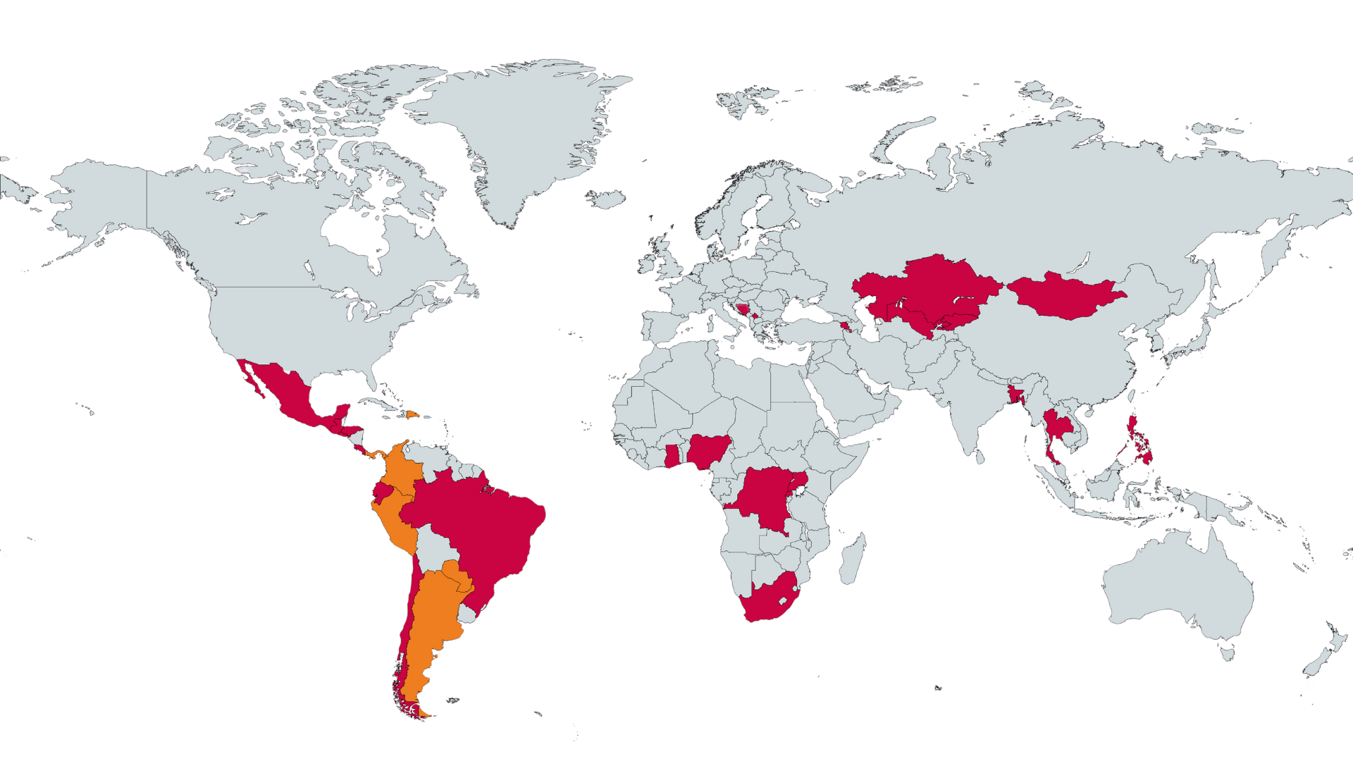

Status 2024
30
COUNTRIES
91
INSTITUTIONS
6
GOLD
7
SILVER
7
BRONZE
3
Institutions awarded
NOT AWARDED
In progress
Notes:
Upwards of 300.000 public officers reached/touched

Slide 20
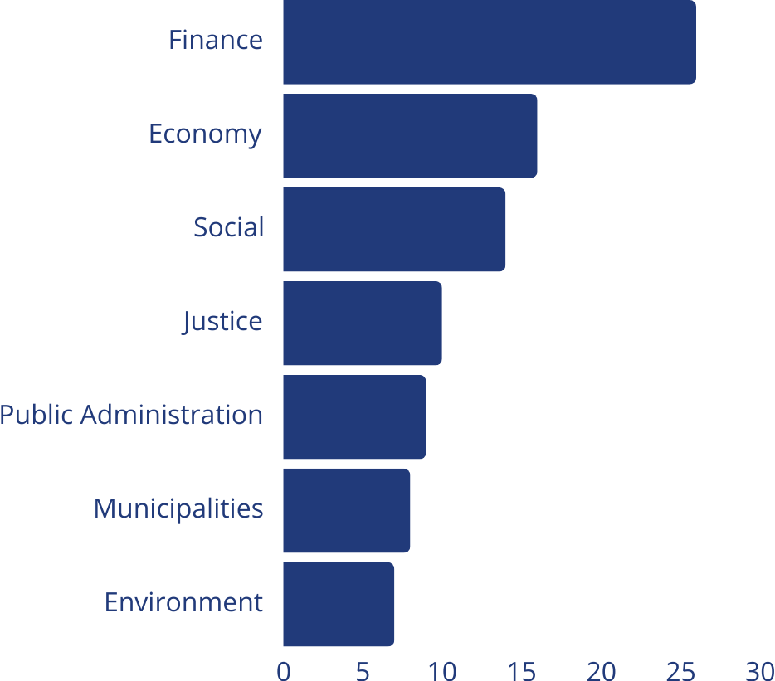
Public institutions by sector
26
16
14
The Seal is cross-cutting, bolstered by UNDP’s cross-sectoral expertise
10
9
8
7

Slide 21
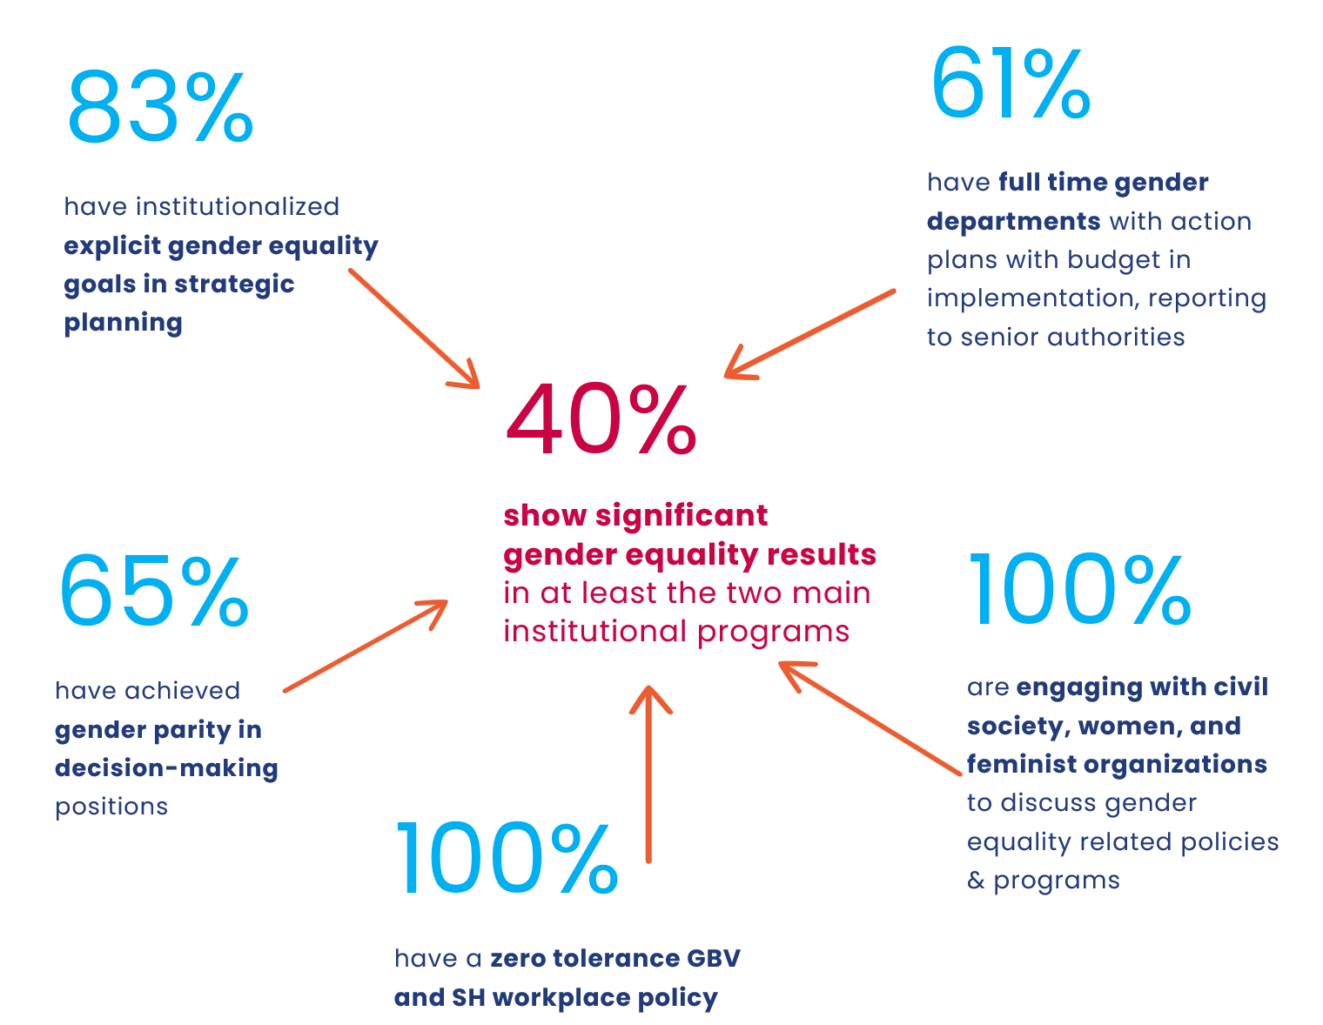
Results by number

Slide 22
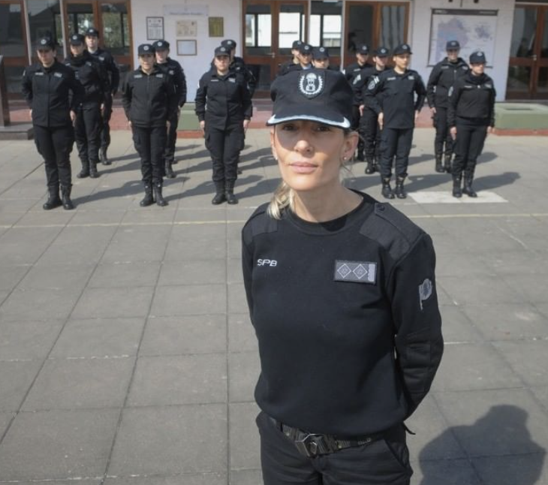

Justice and Human Rights Ministry
Buenos Aires Province, Argentina
Reduced recidivism by 20 per cent among men prosecuted for gender-based violence (2020 to 2023). 70%+ increase in the participation of women deprived of liberty in university studies 2020-2023. Reversed the masculinized trend of the penitentiary career: First-ever woman director of the school.
Notes:
Ministry of Justice and Human Rights, Buenos Aires Province (MJDH), Argentina. The Ministry achieved the reduction of 20% in the recidivism of men prosecuted for gender violence because of the masculinities programs for male aggressors accompanied by the Patronato de Liberados Bonaerense (exclude perpetrators of femicides or men convicted of attempted femicide). The application of the measure of house arrest for mothers with children under 5 years of age increased to 50%, and the participation of women deprived of liberty in university studies increased by 70% in the last 4 years. Importantly, it has managed to reverse the masculinizing trend in the penitentiary career, with the modification of the Prison Service admission regulations to eradicate indirect gender biases; gender parity achieved in graduates from the Cadet School of the Prison Service, increasing from 30% to 70% (2019-2023) women applications to the penitentiary service, and the first ever woman promoted as director of the school. The Ministry and the National University of La Plata launched the bachelor’s degree in Prison Management, whose curriculum includes “Gender and Diversity Perspective” as part of the curricula.

Slide 23


Ministry of Transport
Colombia
Increased women’s access to employment in 4G infrastructure projects. National Strategy for the Prevention, Attention and Social Punishment of Violence against Women in Transportation
Notes:
Ministry of Transport, Colombia. One of the Seal pioneer institutions, the Ministry of Transport Increased access women’s employment in 4G infrastructure projects and integration of the prevention of gender-based violence and street harassment in strategic and mass public transportation systems, by means of a national Strategy for the Prevention, Attention and Social Punishment of Violence against Women in Transportation and a Protocol for Addressing Violence against Women, Children and Adolescents in Transportation.

Slide 24
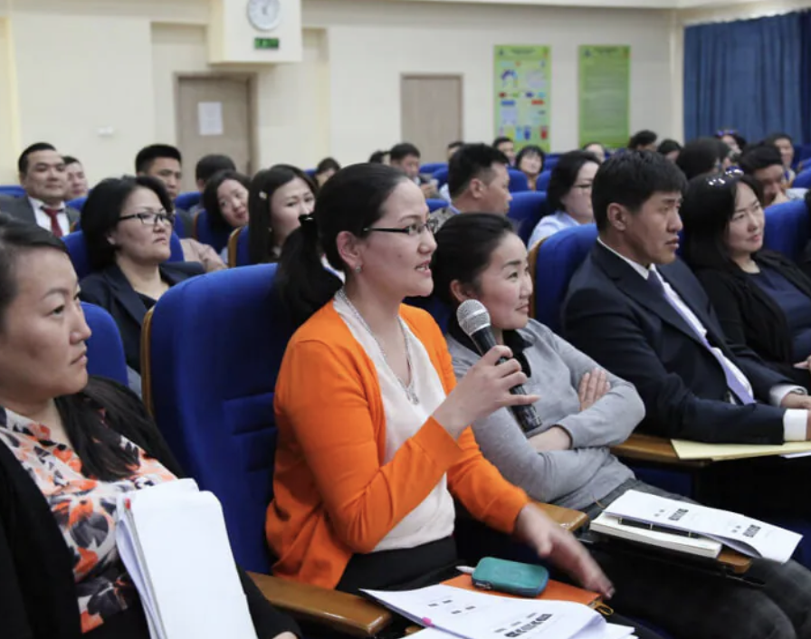
SEAL …. IN THE MAKING
General Tax Authority
Mongolia
Dedicated taxpayer education programs for women taxpayers and entrepreneurs. Tax services gender checklist institutionalized and staff in the regions trained to implement it. Engagement with women’s CSOs to better understand and address gender issues in tax compliance. + Ministry of Finance diagnosing indirect gender biases in personal income tax policies.
The Seal is clear, rational, and aligned with our national policies and regulations.
Ch. Chimidsure, Acting Head of Mongolian General Tax Authority

Slide 25
Why implement the Gender Equality Seal?

Slide 26
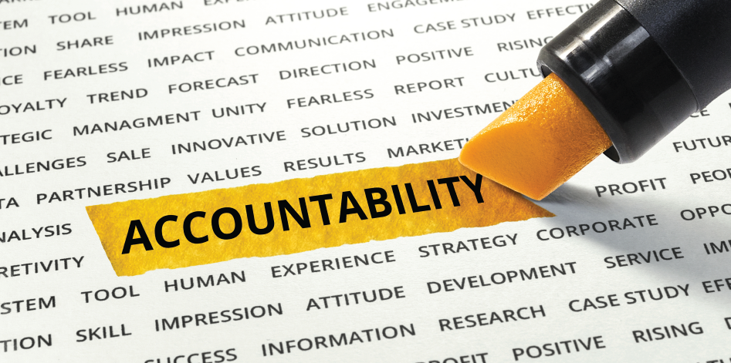
Why should public institutions implement the Seal?
Stronger impact on sustainable development and ability to demonstrate that contribution
Advance gender equality and reduce gender gaps
Build trust and accountability
More responsive to the needs of all citizens
Inclusive and gender-responsive institutions are more efficient and effective
Attract and retain top talent
Gain recognition at the national, regional and global level
Attract donors and benefit from technical support
Notes:
Reducing gender gaps is a very compelling and desirable objective. It is SDG 5. It is literally what the Seal is designed to ultimately achieve.

Slide 27
Supports inclusive fiscal reforms
Huge opportunity to better align public finance with the SDGs for gender equality - Over $13 trillion in global tax revenue and $33 trillion spent through public budgets annually
Calls for inclusive and gender-responsive fiscal policies and tax systems
Inclusive fiscal governance even more important in an age of global austerity, shrinking fiscal space and cost-of living crisis
Only possible if fiscal policy institutions fully embrace gender equality as a fundamental principle across all functions – from policy development to service delivery and administration
    THE SEAL ACCELERATES INSTITUTIONAL TRANSFORMATION TOWARDS AGENDA 2030
Notes:
In the context of EQUANOMICS where we aim to harness the power of fiscal policies and public finance for gender equality, equipping the relevant institutions is a necessary condition.
Also, build back better in the wake of Covid.
You saw on the previous slide that only a third of covid response measures addressed gender issues.

Slide 28
Accelerate the SDGs – improve economic outcomes
Ministry of Finance uniquely positioned to advance gender equality across public sector through catalytic policy role (budget, tax, procurement, public investments, …)
Expand fiscal space and mobilize additional revenue with gender-responsive tax policies and administration that also promotes women economic empowerment
Foster equitable and inclusive economic growth in line with Agenda 2030.
Make meaningful contributions to SDGs 5, 16 and 17.
Inclusive institutions build trust and are more accountable to all citizens
Potential to improve scores along some dimensions of the PEFA, TADAT and OBI frameworks
Notes:
The list goes on… SOEs, economic policy, pension affairs…

Slide 29
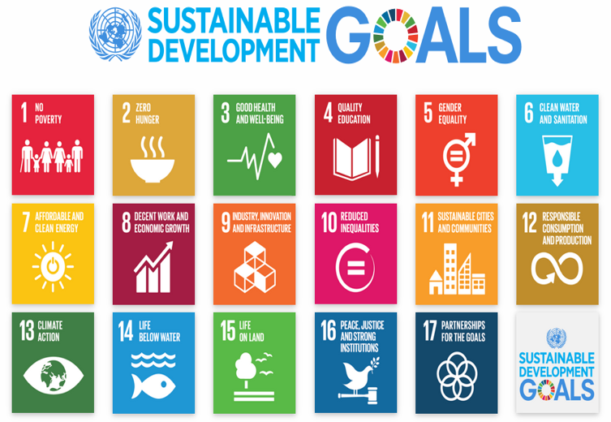
Sustainable development requires ensuring women and men equitable participation in decisions that affect their lives and communities.
Achieving Gender equality is a precondition to achieve Agenda 2030.
The achievement of all SGDS requires a stable and peaceful environment and effective institutions.
Peace and citizen security and “leaving no one behind” are directly related to the achievement of the 2030 Agenda.
Notes:
Efforts to foster inclusive governance, improve institutional processes and build specialized capacity to improve policies and services in Ministries of Finance and tax administrations will ultimately have positive spillovers on revenue mobilization as well.

Slide 30


Why is the Seal different?
It has been specifically developed and tailored for public institutions.
It puts all pieces together, from the working environment to the institutional policies.
It is an accelerator, it sets up a continuous improvement process.
It is not an audit, the Seal is not a final point, is not a checklist.
It is an UNDP global flagship program, it is a program to stay in.
It builds a global community of champions and practitioners.

Slide 31
What does the Seal bring to Public Institutions?
Making public institutions more efficient places: better internal articulation and innovation.
Making public institutions better places to work for all, thriving the best talent.
Improved knowledge based action.
Increasing public institutions’ impact in sustainable development and being able to better show that contribution.
Increasing their national, regional and global recognition.
Attracting more donors.

Slide 32
Theory of Change, Dimensions and Standards

Slide 33







A comprehensive systemic approach
Political
commitment
Civil society
Technical
Capacities
ACCOUNTABILITY
Results and
impacts
of public
policies and
services
PUBLIC
INSTITUTION​
INTERINSTITUTIONAL
COORDINATION
Organizational Culture
Gender machineries
INSTITUTIONAL TRANSFORMATION TOWARDS GENDER EQUALITY​

Slide 34

The Seal Standard
5 DIMENSIONS
20 STANDARDS
40 BENCHMARKS
1. Planning and
Management for
Gender Equality
4. Participation,
partnerships &
accountability
5. Results &
impacts of
public policies
Based on international commitments on gender equality and women’s empowerment
3. Enabling
Working
Environment
2. Gender
Architecture
and Capacities

Slide 35




The Seal Standard
5
DIMENSIONS
20
STANDARDS
40
BENCHMARKS
Interinstitutional coordination
Engagement with civil society
Accountability to women’s movement
Treating citizens with respect and fair treatment
Gender Equality objectives in institutional planning and institutionalized gender mainstreaming mechanism
Budget allocated and executed
Sex disaggregated data base and gender monitoring systems in place
Women owned SMSs access to institutional procurement
1. Planning and
Management for
Gender Equality
4. Participation,
partnerships and
accountability
5. Results and
Impacts of
public policies
Work and life balance for all
Zero tolerance against SH and GBV
No gender discrimination
Understanding gender salary gaps
Equal opportunities for professional development and gender parity in decision making
In house gender expertise
Gender equality architecture in place
Staff equipped with tailored gender capacities
Senior leadership for gender equality
Gender responsive communication
3. Enabling
Working
Environment
2. Gender
Architecture
and Capacities

Slide 36
How?
Steps and methodology

Slide 37
Implementation process
Estimated timing: 18-24 months
5. Get the Seal
3 years validity
4. External assessment
  1 month
3. Learn and improve
  11 months
2. Set the baseline
  3 month
1. Engage
  1 month
Continuous improvement cycle

Slide 38
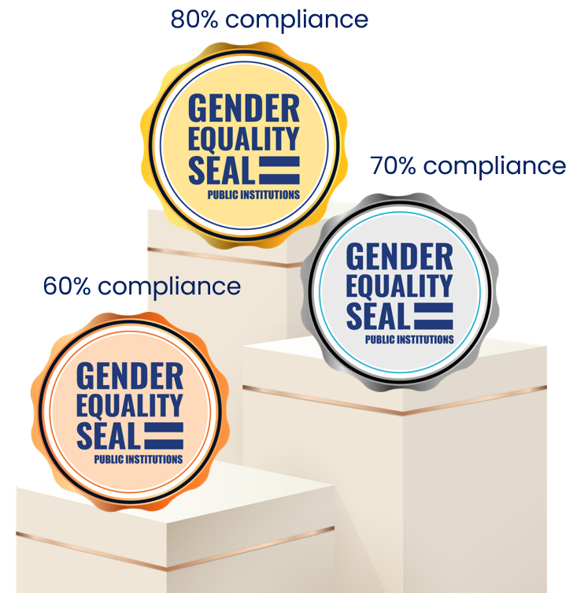
Awarding levels
PUBLIC ADMINISTRATION REFORMS FOR GENDER EQUALITY
GENDER EQUALITY RESULTS & IMPACTS

Slide 39





Methodology
LEARNING driven
ONLINE based
Permanent SUPPORT
Inter-national and sectorial COMPARABILITY
EVIDENCE based
Notes:
Evidence based: Systemic approach to ensure advancing gender equality and women’s empowerment in public policies.
Learning driven: Institutions will integrate the Seal community of practice and will have access to an extensive set of tools and other resources that have been adapted to the taxonomy and institutional mandates of MOFs and tax administrations
Online based: Process is supported by an online platform where evidences are uploaded and individual and group support is provided.
International, national and sectorial comparability: One standard for all allows national and international comparability

Slide 40
1. Engage
Setting up Gender Equality Committee.
2. Set the baseline
Support self assessment Baseline.
3. Learn and improve
Support development of action plan for improvement.
4. External assessment
5. Awarding
Independent high quality external evaluation with recommendations to keep improving.
Facilitated engagement with civil society.
Policy and program advisory.
Communities of practices peer to peer support.
Capacity building of public officials + technical tools.
Global UNDP certification.
Global, regional and national visibility.
Capacity building of public officials + technical tools.
Seal online platform.
Validated Baseline Report with recommendations.
Dedicated national gender advisor.
UNDP service to institutions

Slide 41
Implementing partners

Slide 42
Key actors
Implementing public institution
National Co-Lead Institution/
Women’s Machinery
UNDP
Apply for the Seal
Follows the Gender Equality Seal process
Make changes and improvements
Dedicates specific technical and financial resources
Leads the programme with the national co-lead institution
Ensures integrity of the programme implementation
Provides access to the online platform
Dedicates resources, staff and technical support
Co-leads and promotes the programme in the country
Dedicates specific resources and staff
TORs available for the
co-lead institution

Slide 43
UNDP coordination
UNDP GES Global Team
Trains, guides and supports the CO and advisors
Provide tools, working aids and other resources
UNDP Country team
1. Appoints a Project coordinator
3. Engages with the PI at leadership and technical level
3. Hires and supervises a gender advisor
4. Monitors and reports advances
2. Integrates GES in its existing portfolios
Provides trainings for public institutions
Recruits and deploys an external assessor in STEP 4
UNDP Regional experts
Advises the process Supports implementation

Slide 44
The role of the Seal external advisor
A. Support MOF/tax administration in the development of the Gender Seal process throughout all its steps:
          1) Online self-assessment baseline:
            Accompany PIs in the implementation of staff surveys and the collection of quantitative data.
            Provide permanent advice and technical assistance to the PI in the collection of evidence.
            Support PIs in the use of the GES online platform
          2) Development, implementation, and monitoring of the Action Plan for Improvement: accompany the development and implementation of the gender equality policy and action plan.
          3) Preparation for the external evaluation: Support the PI in the evaluation process to obtain the Gender Equality Seal, working on the requirements of evidence and necessary documentation of the institution.
B. Participate in all capacity building activities organized by the Gender Equality Seal Team, necessary for the advisor to provide adequate support to the institutions advised.
TOR template has been shared!
C. Conduct training sessions on gender equality and the Gender Equality Seal for Public Institutions, to institutional staff, under the coordination of the Global Gender Equality Seal Team.
D. Any other activities required to ensure support to the participant public institutions.
Notes:
Not the external assessor – but the advisor that COs hire to support the process.

Slide 45
Seal Branding Guidelines
Notes:
What about EQUANOMICS branding?

Slide 46
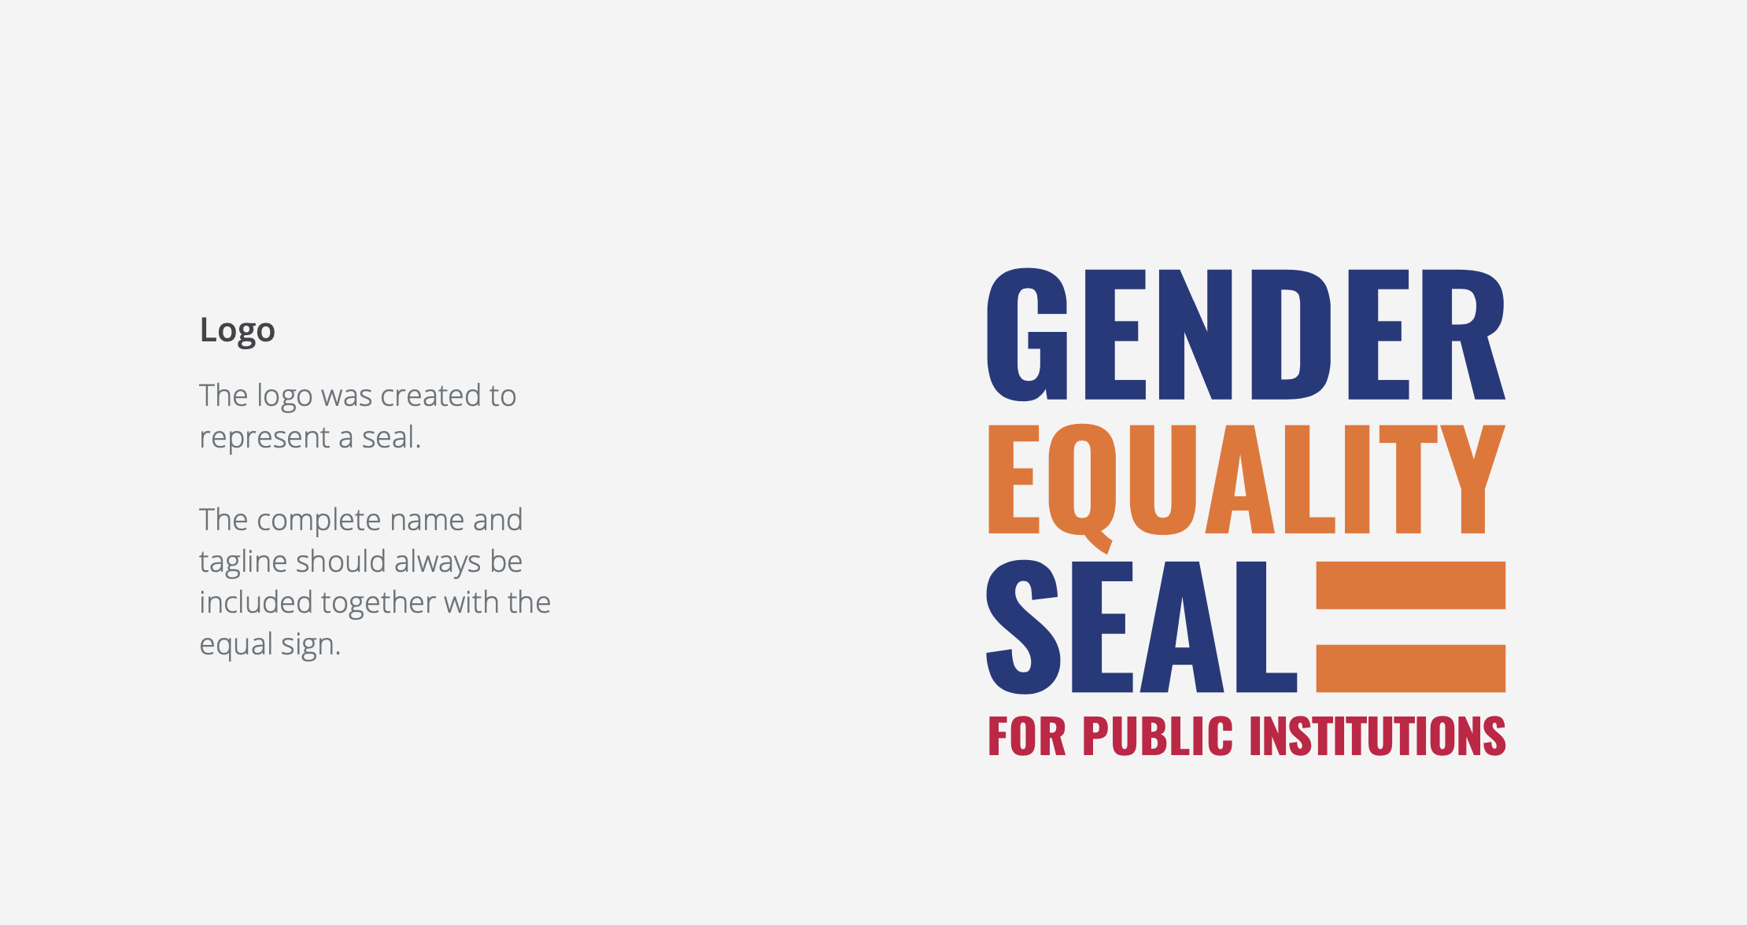
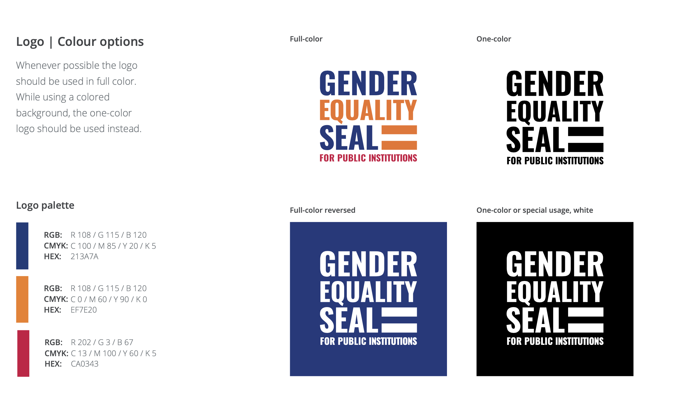
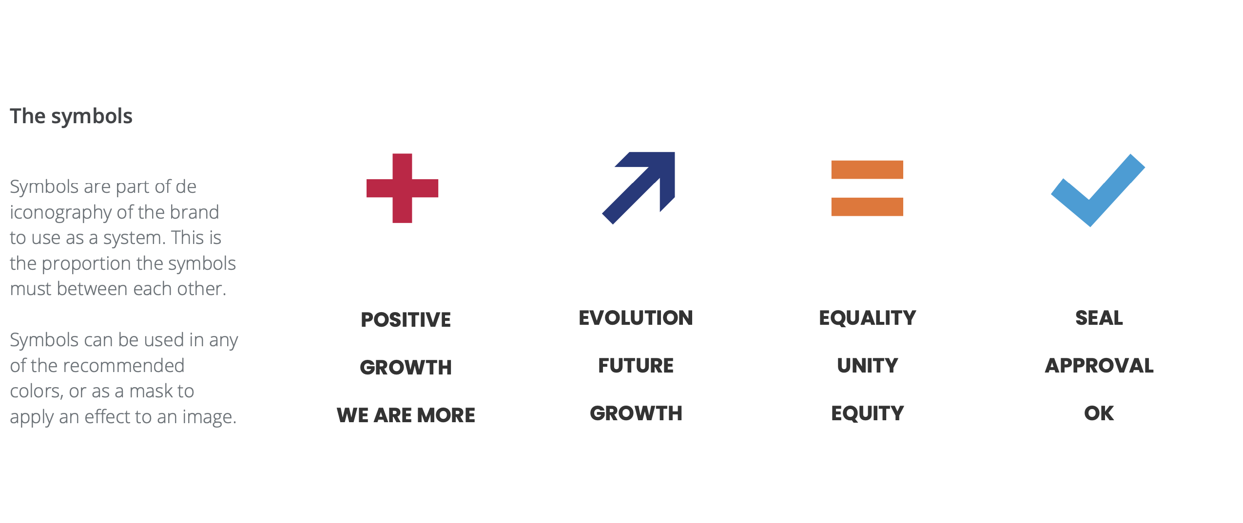
Seal branding
Notes:
If you are already awarded

Slide 47
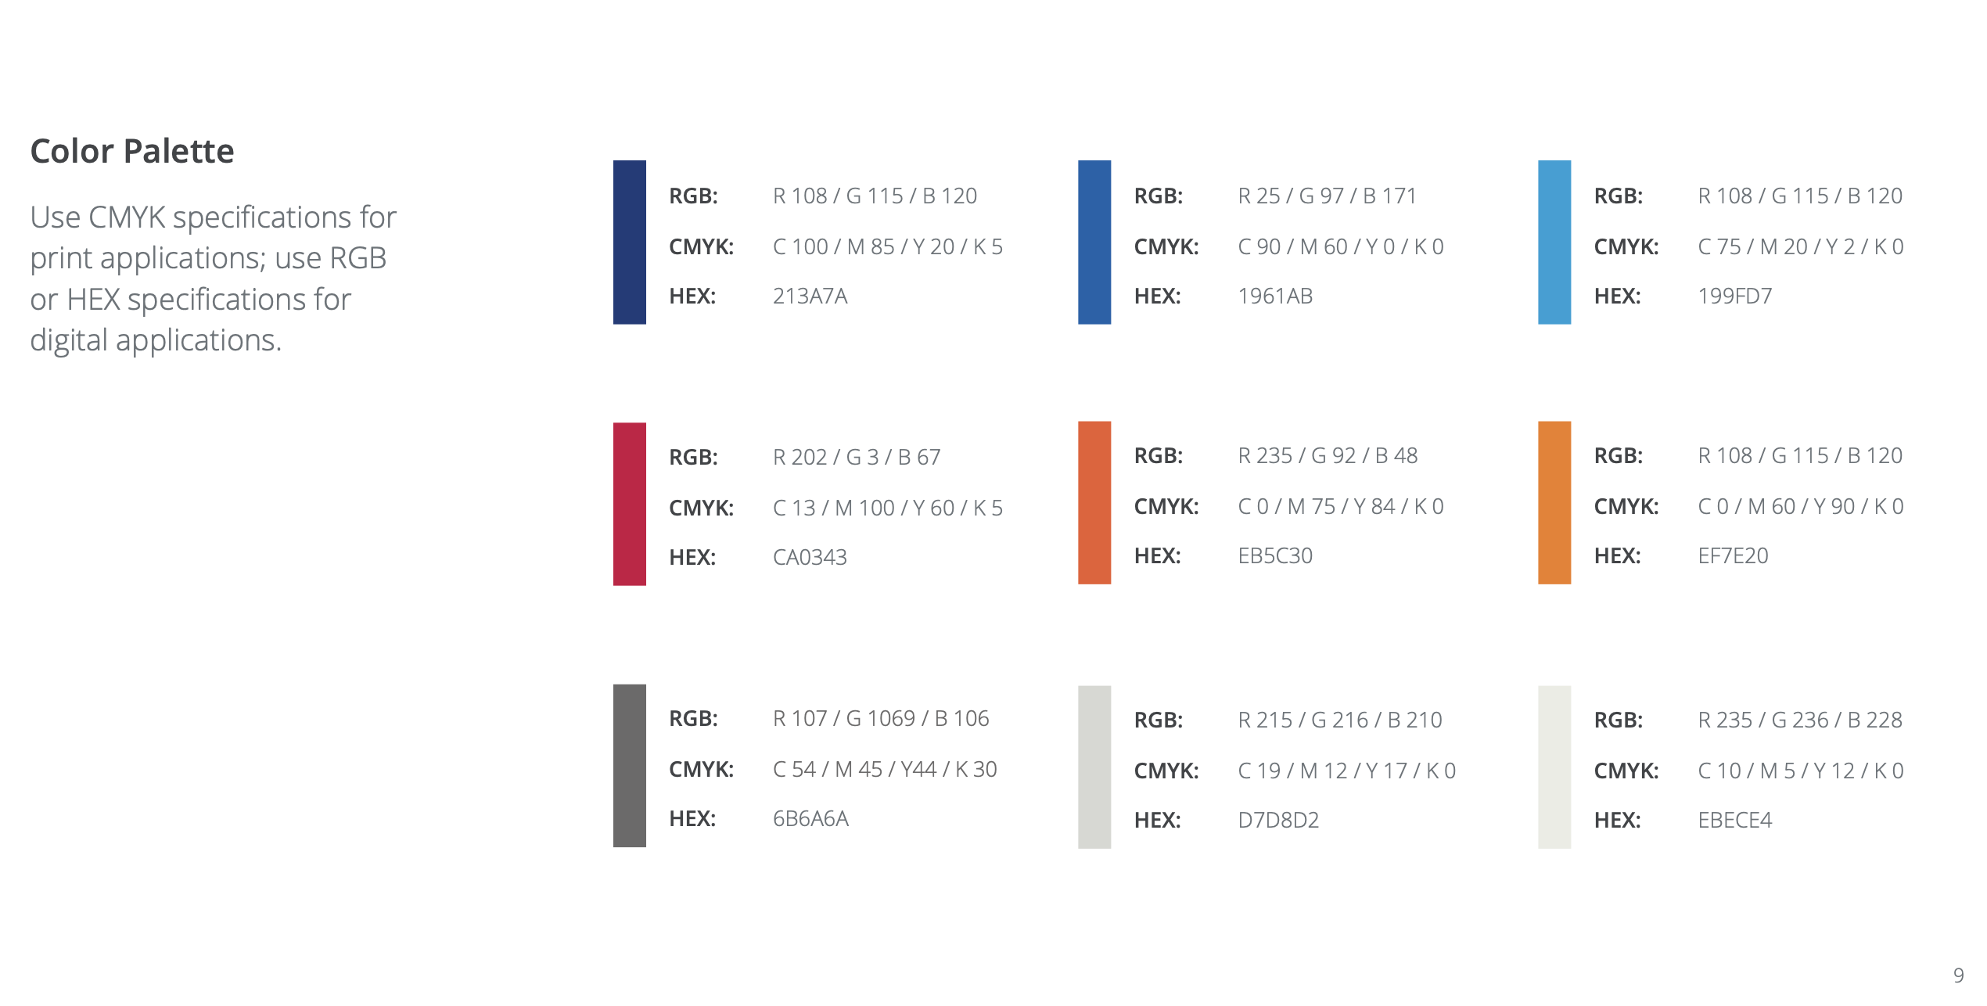
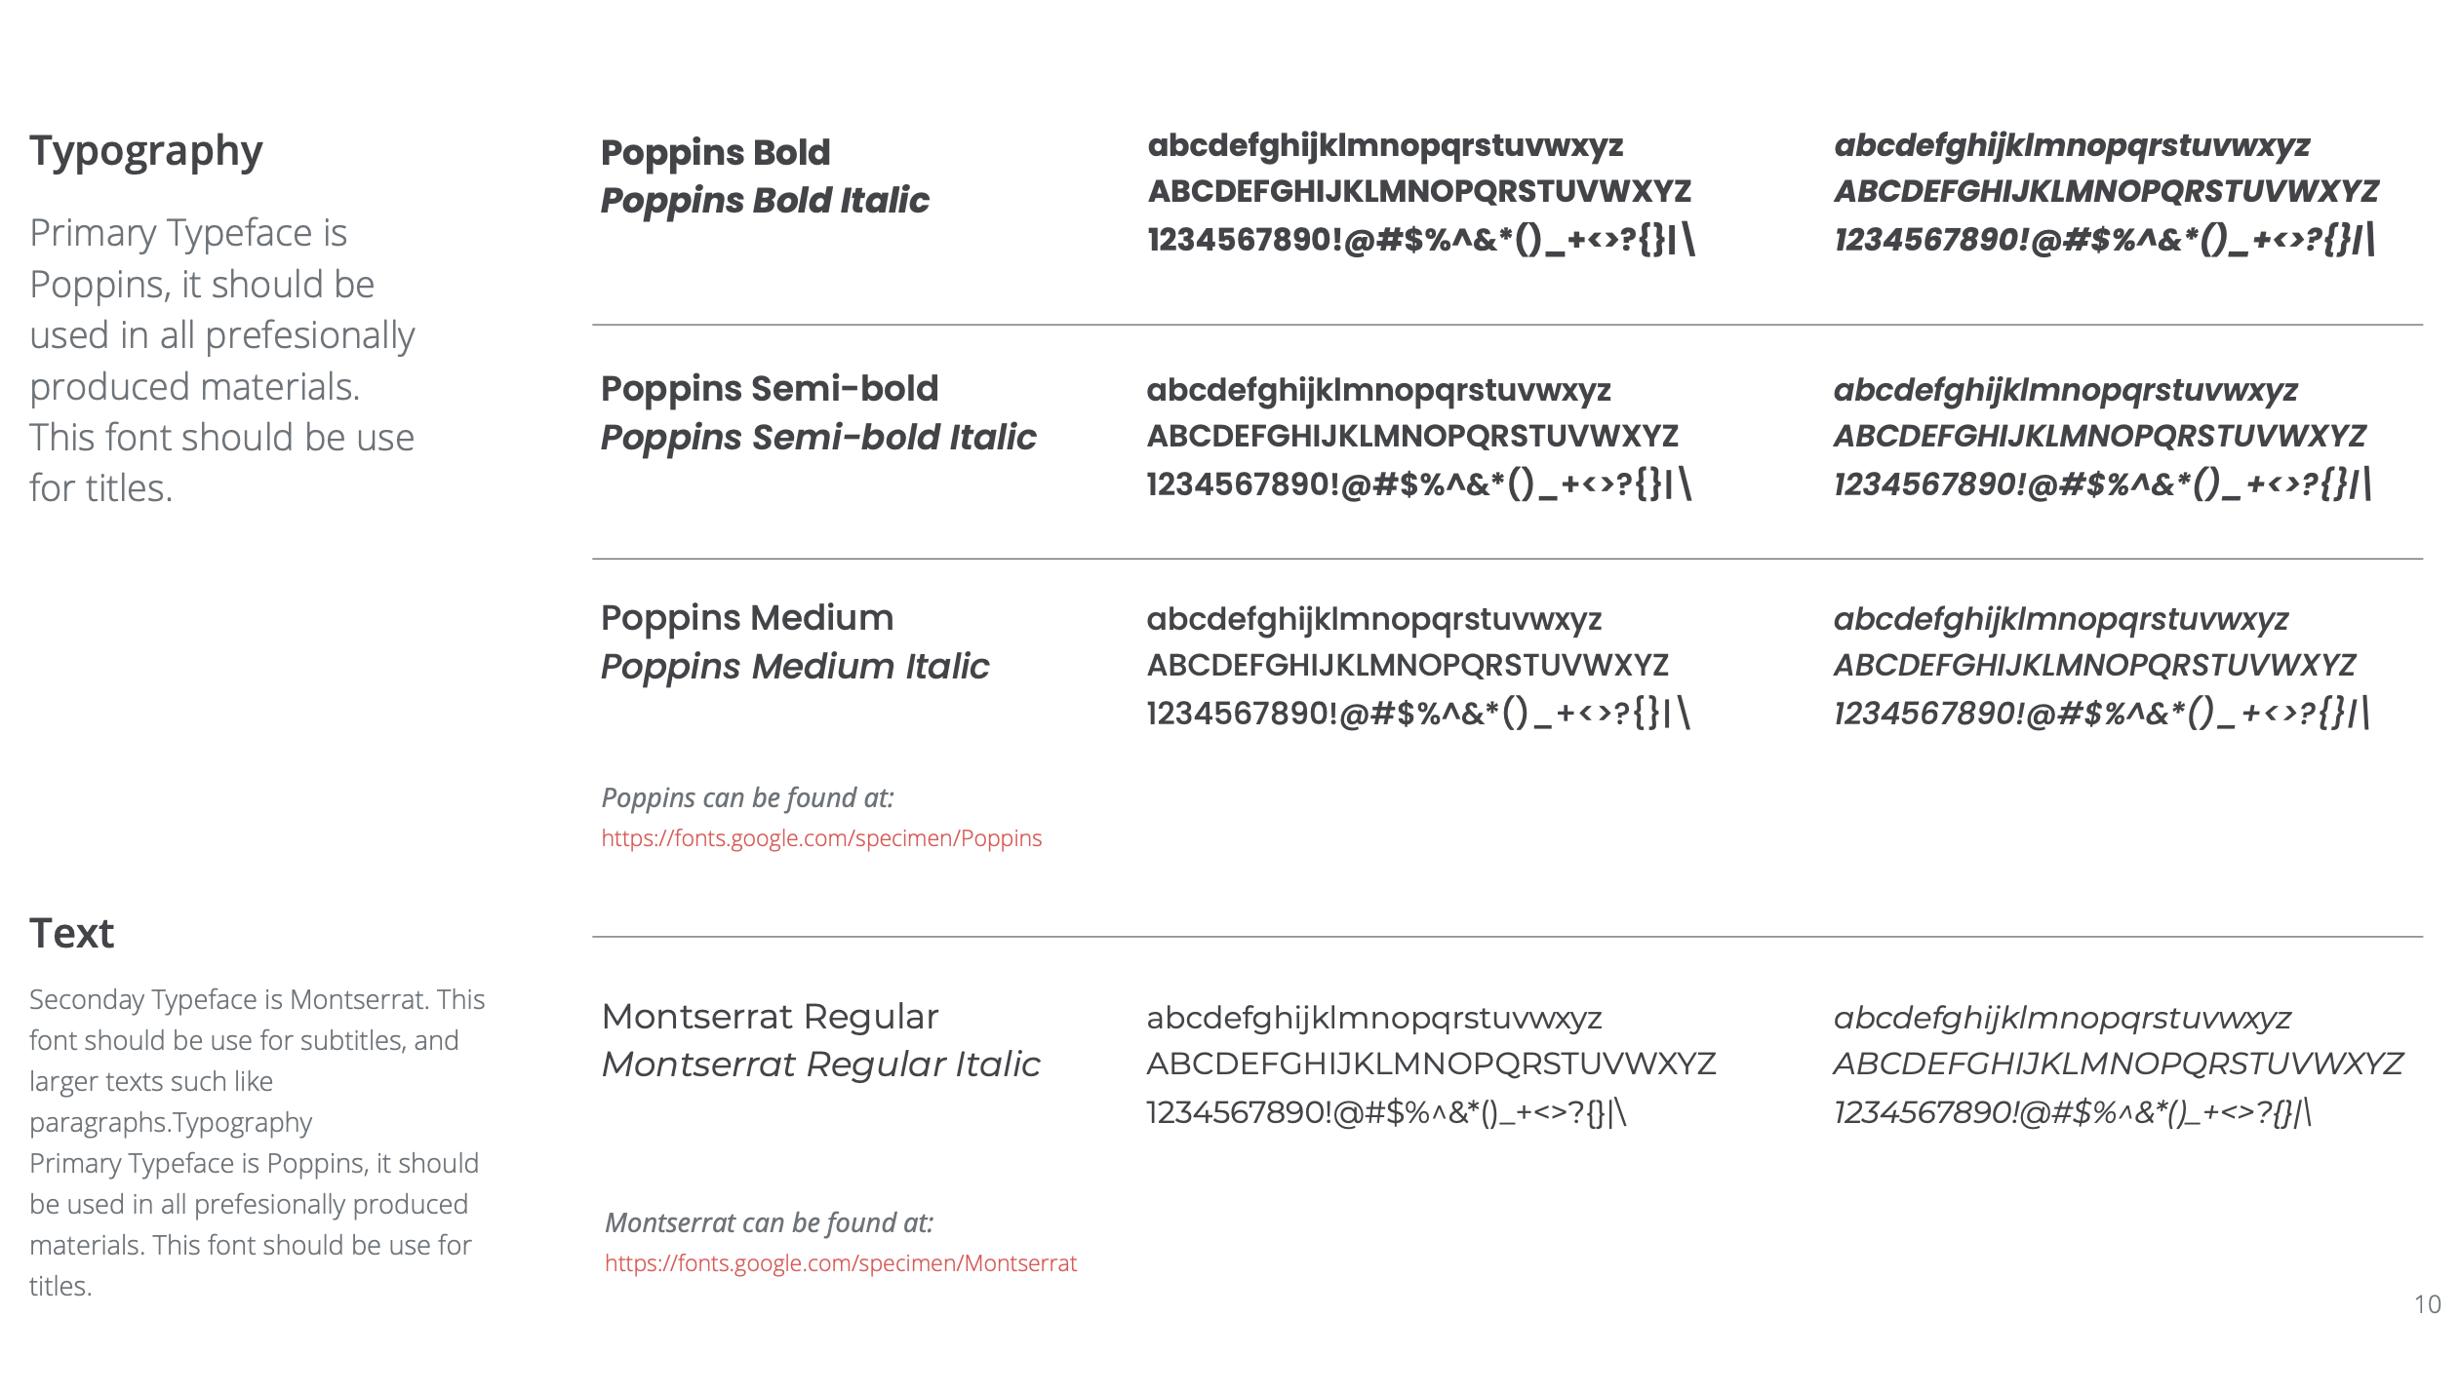
Seal branding (ii)

Slide 48



Thanks!

