Slide 1

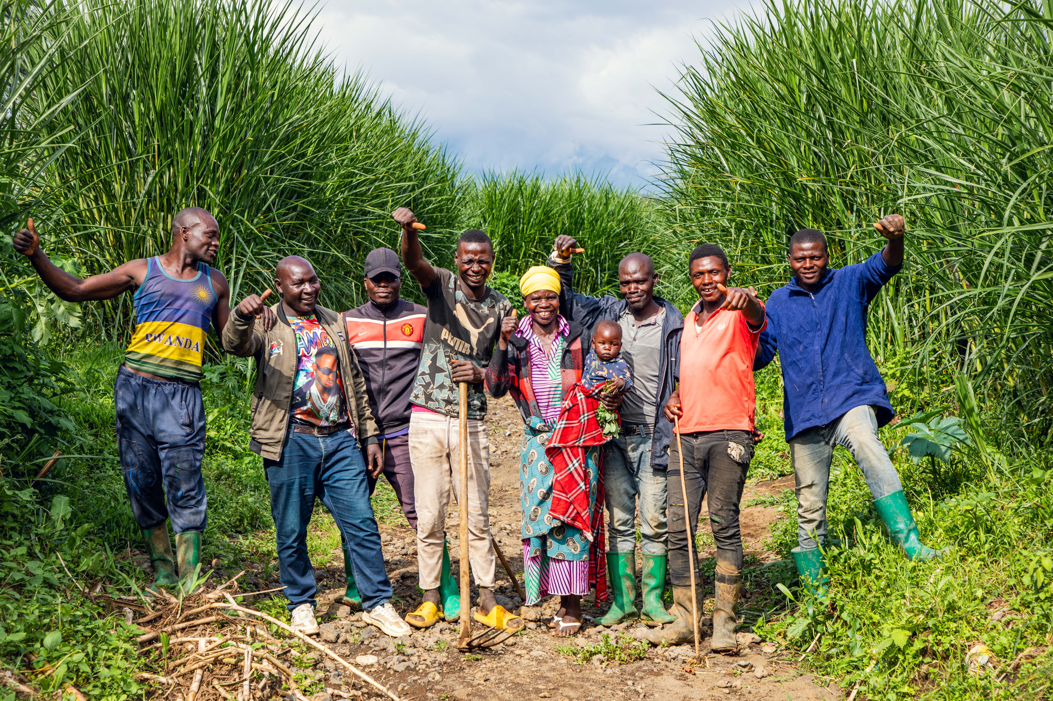
UNDP
Annual Report
2023
Crisis Bureau
Disaster Risk Reduction & Recovery for Building Resilience

Slide 2
Contents
Integrated Risk Governance
  Global, Africa, Arab States, Asia and the Pacific, Europe and Central Asia, Latin America and the Caribbean, Cross-cutting
Disaster & Climate Risk Information
  Africa, Arab States, Asia and the Pacific, Europe and Central Asia, Latin America and the Caribbean
Sustainable Recovery
  Global, Africa, Arab States, Asia and the Pacific, Europe and Central Asia, Latin America and the Caribbean
Early Warning, Preparedness & Anticipation
  Global, Africa, Arab States, Asia and the Pacific, Europe and Central Asia, Latin America and the Caribbean
Partnerships & Resource Mobilization
Global & Regional Processes
The report reflects the achievements accomplished in 2023 by UNDP’s Global Disaster Risk Reduction and Recovery for Building Resilience Team (DRT) and Advisors/Specialists outposted in the regions.
It was developed based on inputs provided to UNDP corporate reporting, as well as donors’ or UN agencies' reports.
The PowerPoint slides highlight three key achievements per pillar and region.
The Power BI dashboard provides a comprehensive overview of all results reported.

Slide 3
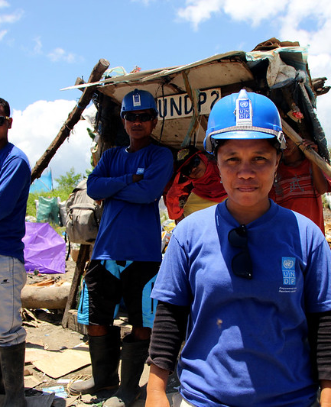
UNDP Added Value
In DRR and Recovery
Lead UN agency in DRR and recovery
  UNDP is among the top four UN agencies reporting UN resources dedicated to DRR
Comprehensive UNDP Approach to Risk-Informed Development (RID) that spans different risk management practices, including DRR, CCA, conflict, prevention, health risk, environmental risk etc.
Unique role in Post Disaster Needs Assessments (PDNA) and recovery programming
Transformative role in UN reform through joint assessments & planning (CADRI)
Notes:
Among top WHO, WFP and WMO

Slide 4
Notes before moving to the next slide
The next slide is an embedded PowerBi dashboard, displaying results by country. The map will be displayed properly in your Desktop App, or directly in PowerBi. If you are viewing the PPT in your browser, make sure to download the file and open it with your PowerPoint Desktop App.
How to use the PowerBi dashboard:
You can click on a region and/or a thematic area of work to get an overview of the countries where the DRT had activities. Then you can click on a country to view specific results below the map.
You can select a country by clicking on the map or by selecting it in the list.
In order to get back to the home dashboard, you have to unselect the buttons you chose. You can do so by clicking again on the button or by clicking in the right top corner of the relevant building block (region, thematic area or country) “Clear selections”. Note: You have to unselect all selections you made to get back to the home dashboard. If you selected a country on the map, you have to also unselect it on the map. If you selected a country in the list, you have to also unselect it in the list.

Slide 5
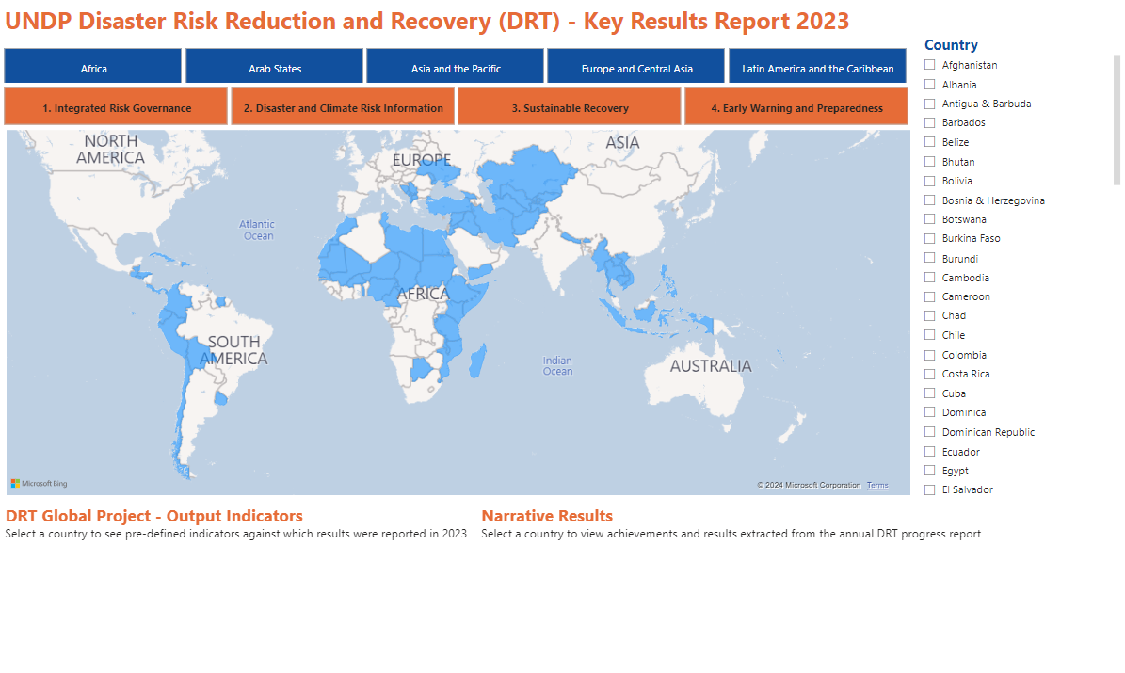
If you encounter problems accessing the Power Bi dashboard, click here.

Slide 6
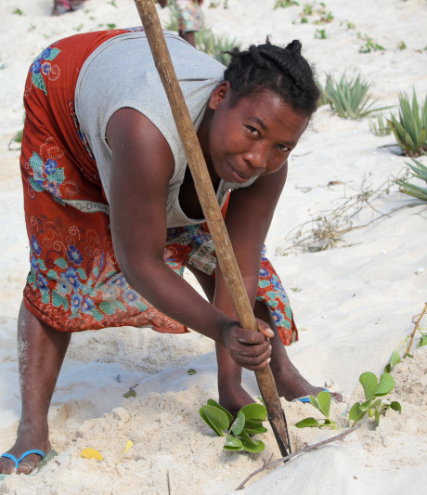
1. Integrated Risk Governance
Risk-informed development solutions
Policy coherence & risk governance
Foresight & futures
Urban resilience
Scaled-up community-based risk management

Slide 7
Integrated Risk Governance
GLOBAL
The global DRT has actively supported the seamless integration of DRR and CCA into development planning through a series of interdisciplinary learning experiences tailored for key stakeholders in planning, finance, DRR, climate change, and various sectors. This comprehensive learning offer, now available in four languages, was successfully implemented in diverse locations:
  Chisinau, Moldova (May): Partnering with the National Adaptation Planning Project-Phase 2, the global DRT facilitated learning experiences for 26 participants, including representatives at the federal level, Local Planning Authorities (LPAs) at the district and community levels, and civil society organizations.
  Panama City for the Latin America and the Caribbean Region (June): Engaging 37 high- and mid-level decision-makers from Colombia, Costa Rica, Cuba, Ecuador, and Panama.
  Addis Ababa, Ethiopia (October): Collaborating with the Government of Ethiopia, the global DRT conducted sessions for 41 mid-level government officials from the Federal level and Regional States of Amhara, Oromia, and Somali.
Furthermore, the global DRT took the lead in organizing the "Resilient Urban Systems Webinar Series" in collaboration with UNDRR, WHO, and FAO. This series focused on risk-informed urban development, health resilience, food security, and initiatives to avert disasters.
In collaboration with UN-Habitat, the global DRT orchestrated a Partners' Meet on Integrated Urban Resilience, bringing together Member States, regional inter-governmental organizations, International Financial Institutions (IFIs), international organizations, and other key stakeholders. The aim was to disseminate and mobilize partnerships and resources for the Integrated Urban Resilience-Small Island Developing States (IUR-SIDS) Program.
Additionally, in cooperation with various partners, the global DRT developed a concept note on the "Application of Digital Technologies for Heatwave Resilience." This initiative reflects a collective effort to harness digital solutions in enhancing resilience to heatwaves.

Slide 8
Integrated Risk Governance
AFRICA
UNDP’s DRR & Recovery Team (DRT) in Africa has significantly bolstered the capacity for institutionalization of resilience at continental level by fostering strategic partnerships with the African Union Commission (AUC). This collaborative effort aimed at supporting the AUC in spearheading the development of a comprehensive ‘Common Guidance on Resilience’, grounded in extensive research conducted by UNDP and UNRISD on resilience in Africa, as outlined in ‘The Roots of African Resilience’. To execute the Africa Urban Resilience Programme, UNDP, in conjunction with the AUC and UN-Habitat, successfully concluded the Joint Regional Programme on Smart Urban Resilience.
UNDP has made substantial strides in enhancing knowledge management related to integrated approaches to Disaster Risk Reduction (DRR) and Climate Change Adaptation (CCA). Key achievements include the finalization of knowledge products in three critical areas:
  UNDP in partnership with UN Women developed a practical guide for gender sensitive disaster risk assessment and a training manual for collecting sex, age, and disability disaggregated data.
  Under the Sahel Resilience Project, UNDP conducted public expenditure and institutional reviews as well as training manuals related to DRR and climate action in Burkina Faso and Niger aiming to guide public financial management reform and climate change negotiations.
  Under the EU-OACPS project, UNDP conducted webinars in Kenya, Ethiopia, and Cameroon on the new guidance on community-based resilience building and the strategy tool for integrating DRR and CCA into development.
The successful continuation of the Sahel Resilience Project into its second phase (June 2023 to March 2025) is noteworthy. This phase, generously supported with a funding infusion of USD 7.3 million from the Government of Sweden, underscores the commitment to sustaining and expanding resilience-building efforts in the region.

Slide 9
Integrated Risk Governance
ARAB STATES
In collaboration with the Consultative Group on International Agricultural Research (CGIAR), WFP, and Adelphi, UNDP finalized the report “Climate Security Pathways”. The report informs policymakers on cost-benefit-analyses for Somalia, Iraq, Yemen, Jordan, and other countries in the region, to integrate DRR, CCA, and climate security. These investments help to prevent climate-induced disasters and negative impacts on peace and human security.
Together with UNEP-Finance Initiative, UNDP contributed to the “Adaptation and DRR Arab states Gap Report” outlining concrete actions and recommendations to steer finance towards DRR/CCA in the Arab States, including insurance.
To mainstream gender and displacement in DRR/CCA interventions in the Arab states, with focus on Yemen, Jordan, Lebanon, and Iraq, UNDP, in partnership with UN Women, UNHCR, and the Arab Water Council, developed a practical guide for policy makers and practitioners.

Slide 10
Integrated Risk Governance
ASIA AND THE PACIFIC
In the pursuit of aiding climate-vulnerable nations and contributing to the preparatory processes for COP28, the DRT in the Bangkok Regional Hub (BRH) employed a comprehensive systems approach to tackle loss and damage across three focal areas:
  Taxonomy Research: Collaborating with the International Institute for Environment and Development (IIED), UNDP BRH conducted research on a taxonomy of climate-attributable loss and damage in three areas: DRR, health, and human mobility.
  Community of Practice (CoP): To fortify UNDP's proficiency in identifying integrated and scalable solutions for addressing loss and damage, a dedicated Community of Practice (CoP) was established.
  Data: The collaborative efforts of UNDP, UNDRR, and WMO are directed towards the development of a new disaster losses and damages tracking system. This system facilitates countries in documenting the impacts of both slow- and rapid-onset hazards. The overarching goal is to enable countries to plan and implement coherent strategies that seamlessly integrate DRR and CCA for the effective reduction of losses and damages.
In a joint initiative, the BRH DRT and UNFCCC co-hosted two regional collaboration meetings in Bangkok, Thailand, in April and June. These sessions, part of the Santiago Network on Loss and Damage, brought together representatives from ESCAP, IOM, UN-Habitat, and UN Women. The meetings served as vital platforms for in-depth discussions and validation of core areas requiring technical and other relevant support to effectively address loss and damage.
UNDP collaborated with the Coalition for Disaster Resilient Infrastructure (CDRI) to produce a comprehensive working paper titled "Towards Resilient Infrastructure Systems." This collaborative effort lends support to the G20 DRR Working Group, contributing valuable insights and recommendations for advancing resilient infrastructure systems on a global scale.

Slide 11
Integrated Risk Governance
EUROPE AND CENTRAL ASIA
In May, UNDP Istanbul Regional Hub (IRH) in cooperation with UNDP North Macedonia organized a Regional Urban Resilience Forum in Skopje, North Macedonia, which focused on earthquake preparedness and urban resilience. The conference brought together a diversity of stakeholders who could inspire action and propose policies and examples to enhance the resilience of cities in the region.
UNDP IRH finalized a study on risk financing for the Western Balkans.
In October, UNDP IRH, in cooperation with UNDP/IRRF and the Asian Development Bank, organized a Regional Risk Financing Forum attended by more than 120 representatives from 20+ governments, international financial institutions, development partners, and private sector. The Conference served as a multi-stakeholder platform for sharing knowledge and coordinating actions to foster the development of insurance and risk financing for building resilience and realizing the SDGs in the region.

Slide 12
Integrated Risk Governance
LATIN AMERICA AND THE CARIBBEAN
Within the framework of ECHO regional working groups, UNDP’s DRT in Latin America and the Caribbean (LAC DRT) played a pivotal role in orchestrating regional dialogues on urban resilience and preparedness, engaging with over 200 practitioners. The insights gleaned from these dialogues significantly contributed to the discussions at the subsequent ECHO Regional Workshop. Subsequently, recognizing the expertise of LAC DRT, UNDRR sought their support to lead the session on Climate Resilience in Urban Systems at the Global Urban Resilience Forum in Dubai in October 2023.
In June, the LAC and Global DRT collaborated to organize a comprehensive training workshop on UNDP's DRR-CCA Integration Tool in Panama. The event brought together 35 participants, including representatives from governments and UNDP in Cuba, Costa Rica, Colombia, Ecuador, and Panama. During the workshop, participants shared their advancements in incorporating disaster risk reduction and climate change adaptation (DRR-CCA) into development processes.
Noteworthy progress has been made by UNDP offices in Cuba, Costa Rica, Ecuador, and Colombia in integrating DRR-CCA into development processes. This includes the development of harmonized instruments, as well as active engagement with national DRR governing entities and relevant ministries such as Environment, Financing, Planning, and sectoral bodies.
  Costa Rica, for instance, has devised a municipal index to monitor the integration of DRR-CCA within local development plans.
  Cuba has crafted a harmonized DRR-CCA municipal tool and is presently in the process of formulating a sector-specific policy focused on water management.
  Ecuador is adapting global guidelines to train local governments, collaborating with the Latin American Faculty of Social Sciences in this initiative.

Slide 13
Integrated Risk Governance
CROSS-CUTTING
The global DRT unveiled the Policy Brief “Shaping a Resilient Future for All: Advancing Disability Inclusion in Disaster Risk Reduction and Recovery for Building Resilience and Leaving No One Behind”. This brief serves as a comprehensive guide for UNDP staff and partners, offering principles and best practices for incorporating disability inclusion into both Disaster Risk Reduction (DRR) and recovery efforts. Emphasizing inclusive approaches that respect and address the diverse rights, needs, and opportunities of individuals with disabilities, the Policy Brief is a collaborative endeavor developed in consultation with the International Disability Alliance (IDA), involving extensive input from UNDP practitioners, partners, and representatives of persons with disabilities and their organizations.
In a joint effort with the Permanent Missions of Australia and Finland, UNICEF, and UN Women, the global DRT on behalf of UNDP spearheaded the organization of the public advocacy event commemorating the 2023 International Day of Persons with Disabilities on December 5 in Geneva. Themed “Shaping a Resilient Future for All: Advancing Disability Inclusion for Building Resilience” the event aimed to highlight the importance of disability inclusion in building resilience. The culmination of this initiative resulted in a compelling photo story and a digital exhibition featuring the finalist photos.

Slide 14
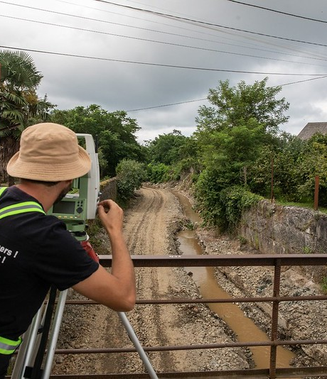
2. Disaster & Climate Risk Information
Damage & loss accounting systems
Monitoring of DRR strategies
National risk information systems
Digital solutions to access risk information

Slide 15
Disaster & Climate Risk Information
AFRICA
In March, Member States. UNDP and AGRHYMET Regional Centre published the “AGRHYMET Regional Centre: Capacity assessment” highlighting AGRHYMET’s partnership opportunities and development prospects, with a focus on information exchange capacities, existing services and databases, and upgrading needs for the Centre to best serve its role as a regional climate and disaster risk data facility for the Sahel.
In March, the Sahel Resilience Project organized its sixth multisectoral national workshop in Nouakchott, Mauritania, in collaboration with the Délégation Générale de la Sécurité Civile et Gestion des Crises. The aim was to engage national stakeholders and build capacities in Burkina Faso, Chad, Mali, Mauritania, Niger, Nigeria, and Senegal for establishing national disaggregated disaster damage and loss databases. Following in November, UNDP delivered a joint training on disaster and climate statistics in Cameroon together with UNDRR, UNEP, and UNDS, through the EU-OACPS project. The training looked at improving capacities of national institutions in collecting, sharing, and processing statistics for decision making as well as for international reporting.
In collaboration with GIZ and SADC, UNDP piloted the adaptation of the Index For Risk Management (INFORM) to analyze risks in Eswatini. Based on the pilot, UNDP and GIZ developed a roadmap for scaling up to the SADC region.

Slide 16
Disaster & Climate Risk Information
ARAB STATES
UNDP played a pivotal role in assisting Jordan to finalize its “Fourth National Communication on Climate Change”. This comprehensive report delves into critical factors amplifying the impacts of climate change and presents a set of key recommendations for actionable measures. Emphasizing the crucial role of disaster and climate risk information, the report underscores the necessity for effective strategies to mitigate climate-induced disasters.
UNDP, in partnership with the Arab Water Council and League of Arab States, spearheaded the development of the “Arab Geographical Information Room” (AGIR). This innovative platform is dedicated to collecting and analyzing information pertinent to DRR. With a specific focus on reinforcing and analyzing targets outlined in the Sendai Framework for DRR, AGIR addresses key areas such as water governance, floods, droughts, and information crucial for informed decision-making in Arab countries. This collaborative effort underscores the commitment to enhancing resilience and preparedness in the face of climate-related challenges which collects and analyzes information related to DRR. A focus is put on strengthening and analyzing targets under the Sendai Framework for DRR especially on water governance, floods, droughts, and information to support decision-making in Arab countries.

Slide 17
Disaster & Climate Risk Information
ASIA AND THE PACIFIC
The collaborative efforts of UNDP, UNDRR, and WMO are currently underway to shape the future of disaster losses and damages tracking systems. Two significant workshops have played a pivotal role in this initiative:
  In May, they hosted a technical workshop titled, “Validation of the prototype for the new hazardous events and disaster losses and damages tracking system” in Bonn, Germany. Building on the insights gained from the Technical Expert Forum held in November 2022, this workshop facilitated the integration of collected feedback into the prototype and specifications, refining the system design.
  In November, they hosted a “Workshop on assessing the impact of Slow-Onset Events” in Bonn, Germany. Participants engaged in discussions to identify gaps, opportunities, and diverse approaches for assessing and tracking the impacts of slow-onset events. The outcomes of this workshop contribute significantly to the ongoing development of the new system, enabling countries to systematically record the impacts of hazards.
The BRH DRT developed a Strategy Paper titled, “Lessons from the DX4Resilience Project: Strategy Paper to Inform Programming on Digital Transformation for Building Resilience”. This document distills key insights from the DX4Resilience project and proposes strategic areas for UNDP's future interventions in the realm of digital transformation for resilience building.
Under the BRH DRT leadership, the broader BRH and the UNDP Data Futures Platform work on a geospatial model for an interconnected and consolidated information system that integrates data across dimensions. The collaboration encompasses two actions:
  Development of a global framework/data architecture for a scalable and comprehensive taxonomy to help countries analyze the biophysical impacts of climate change and socio-economic impacts to human mobility, health, and loss and damage.
  Support to countries that are vulnerable to climate change and “data rich” (possibly the Maldives and Indonesia) to help them expedite their data collection and build national ownership of the products.

Slide 18
Disaster & Climate Risk Information
EUROPE AND CENTRAL ASIA
In September, UNDP IRH convened a regional meeting as part of the regional project “Climate Change and Resilience in Central Asia” in Bishkek, Kyrgyzstan. The meeting placed a particular emphasis on climate information management, fostering collaboration and knowledge exchange among regional stakeholders.
In November, UNDP IRH in cooperation with the Innovation Team organized a regional training on green transition and resilience in Batumi, Georgia. This comprehensive training not only addressed key aspects of the green transition but also delved into the critical areas of climate and disaster information. The event served as a platform for enhancing regional capacity and promoting sustainable practices in the face of evolving climate challenges.

Slide 19
Disaster & Climate Risk Information
LATIN AMERICA AND THE CARIBBEAN
The LAC DRT offered vital technical assistance to UNDP El Salvador in the realm of climate change losses and damage. To assess the costs of losses and damages and identify recovery needs, a comprehensive evaluation is initiated by the end of 2023. This assessment employs the Post Disaster Needs Assessment (PDNA) methodology and considers two distinct scenarios: one with the implementation of climate and disaster policy measures and the other without.
Leveraging the support of UNDP Crisis Bureau’s Anticipate & Prevent Mechanism, the LAC DRT extended its support to four countries (Guatemala, Colombia, Ecuador, and Peru). Together, they focus on implementing El Niño monitoring systems, a crucial endeavor aimed at proactive disaster preparedness. Collaborating with the El Niño International Research Centre, the team diligently tracks climate information and monitors sector-specific impact indicators in crucial areas such as Agriculture, Water, and Energy. This coordinated effort is essential for enhancing resilience and preparedness in the face of potential climate-related challenges.

Slide 20
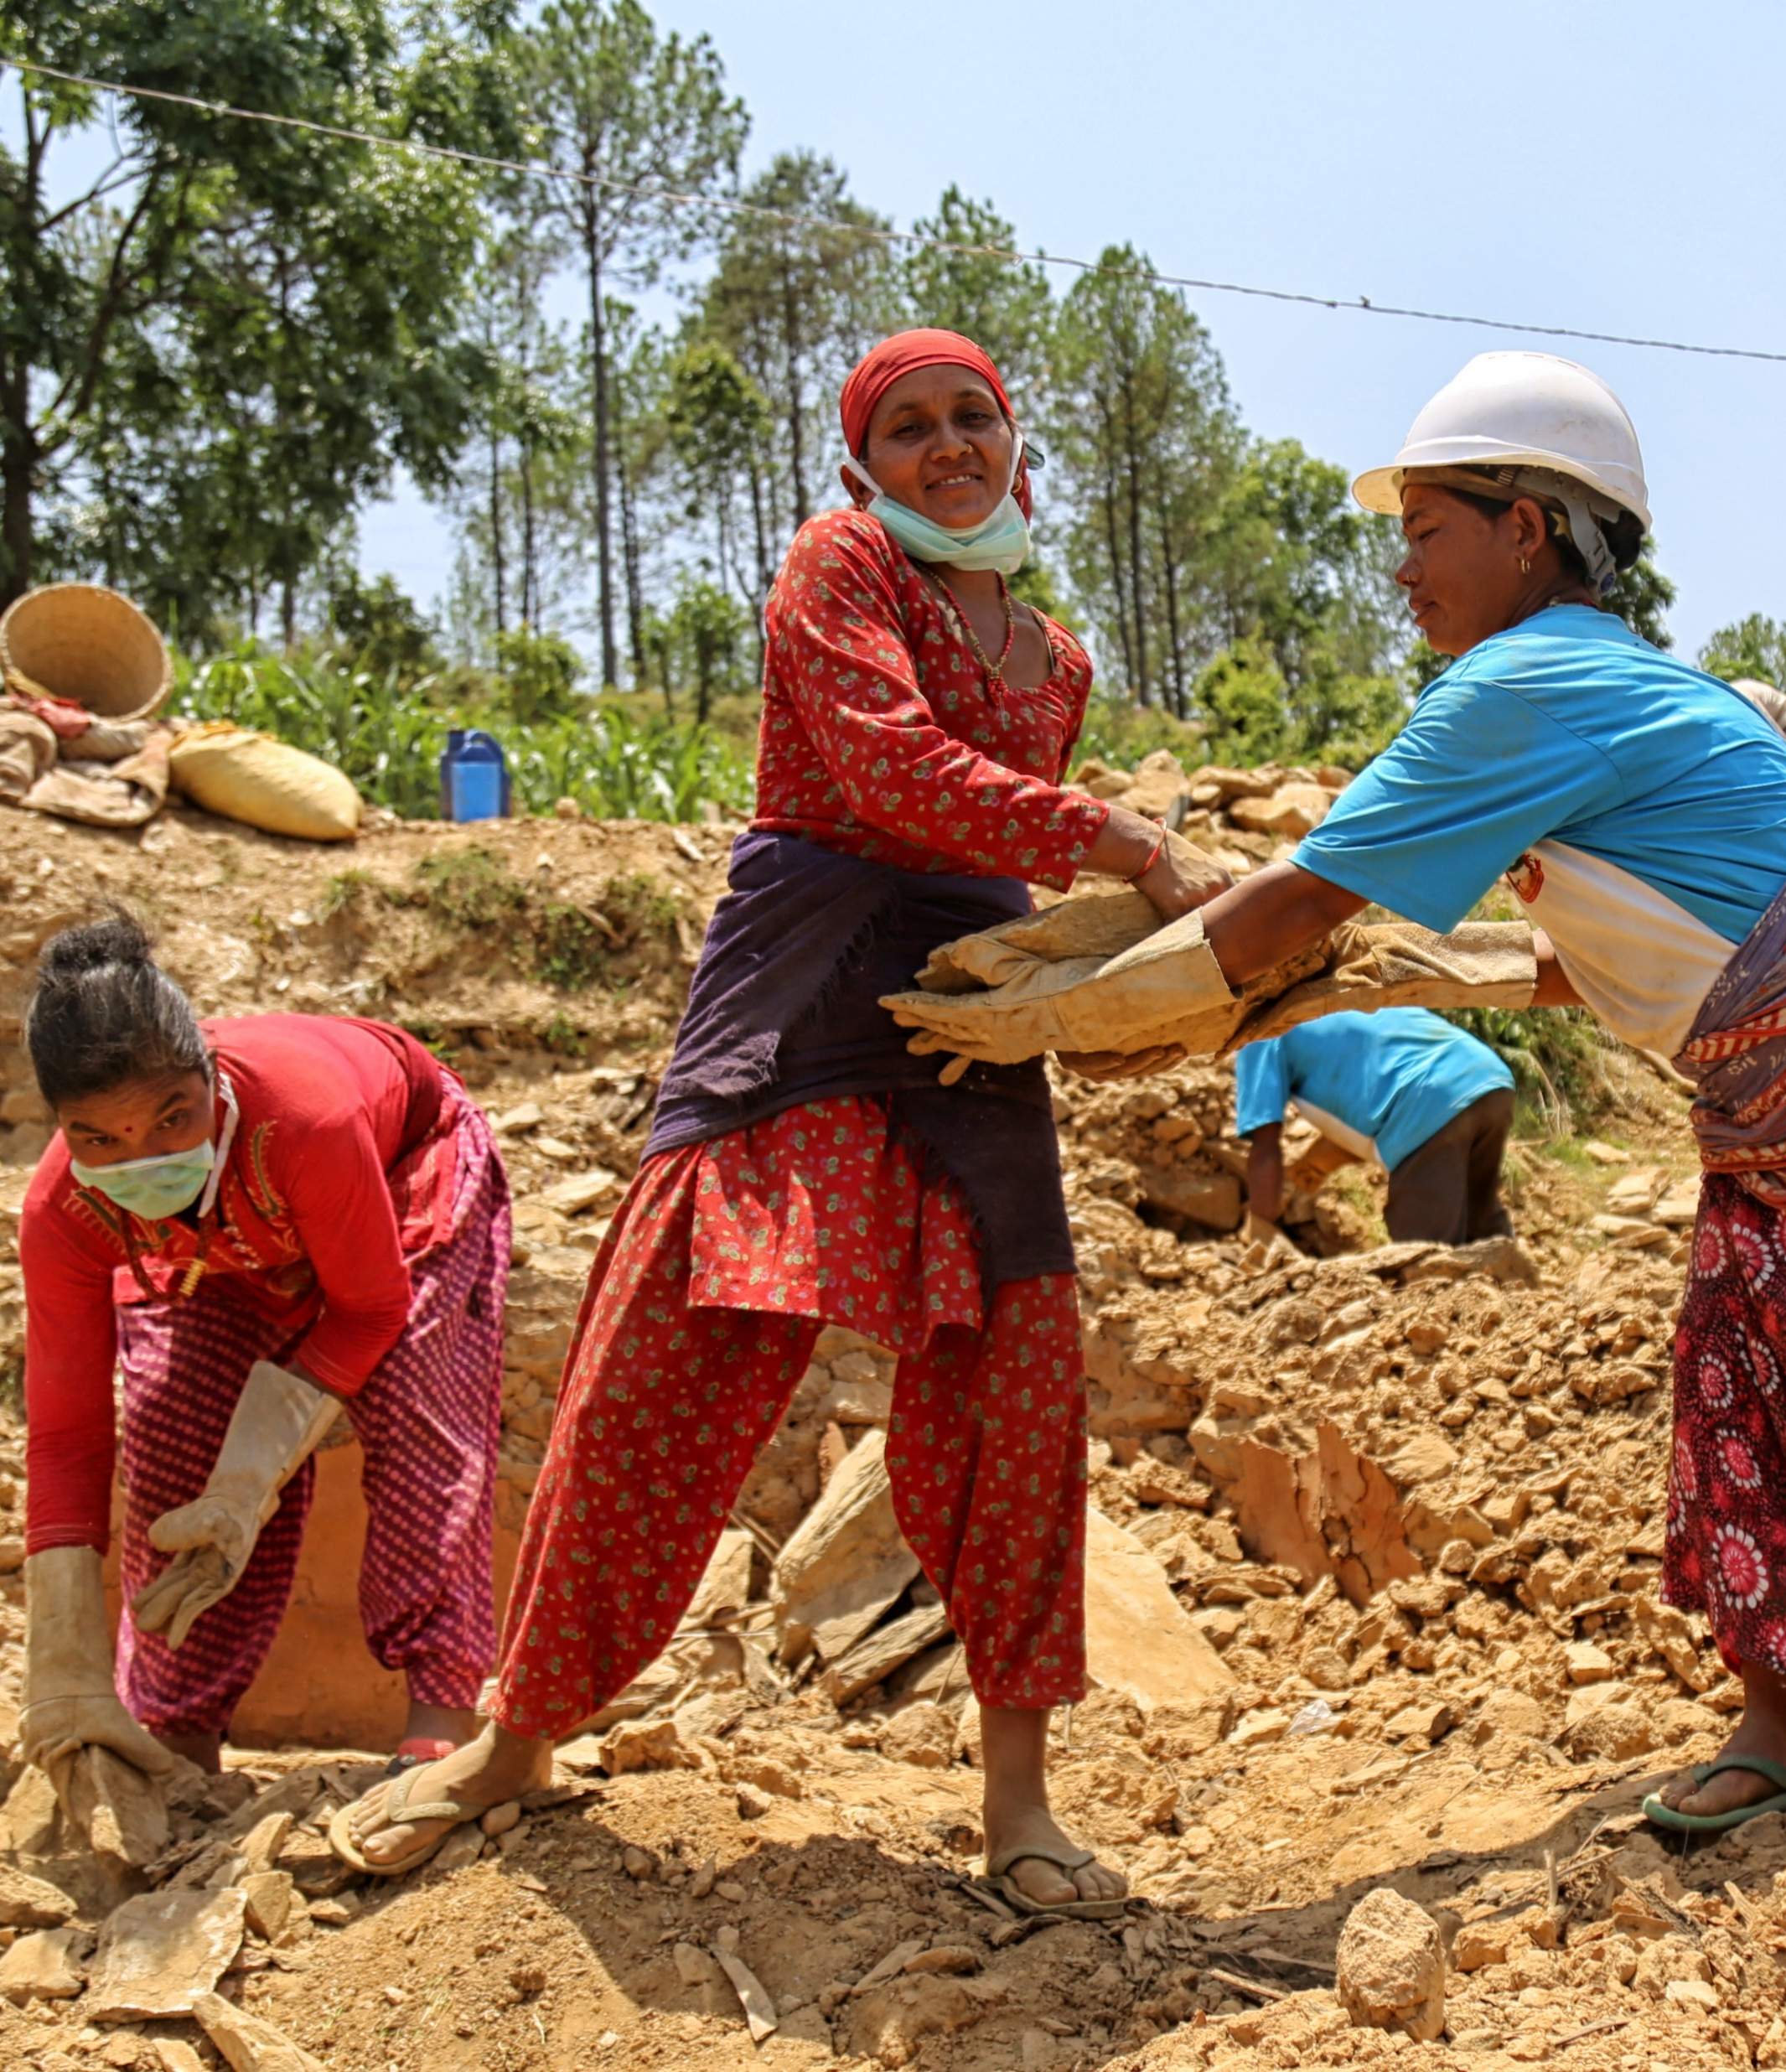
3. Sustainable Recovery
Post Disaster Needs Assessment (PDNA)
Recovery preparedness
Recovery planning & programming
Recovery financing

Slide 21
Sustainable Recovery
GLOBAL
The global DRT supported seven countries in assessing post disaster needs: In Myanmar, Syria, Mozambique, Vanuatu, and Afghanistan the team conducted PDNAs, in Ukraine a Rapid Damage and Needs Assessment (RDNA) and Dam Burst Support, and in Libya a RDNA. The team conducted joint missions with AUC and SADC to Cyclone Freddy affected countries Madagascar, Mozambique, and Malawi. As a follow up to these missions, the team developed a joint concept note on Cyclone Freddy Resilient Recovery and Resilience Building.
The global DRT advanced the development of key knowledge products to strengthen recovery planning, including environment, tourism, and health PDNA sector guides, and culture guide underway. In collaboration with the EU and WHO, the team developed the Pandemic Recovery Needs Assessment (PRNA) toolkit for guiding countries in assessing the socio-economic impacts of a pandemic.
The global DRT supported UNDP’s technical role in the UNFCCC’s Loss and Damage Technical Support Unit to the Transitional Committee and finalized UNDP’s Recovery policy.

Slide 22
Sustainable Recovery
AFRICA
In May, UNDP conducted two impactful regional trainings on PDNA and recovery planning in Lomé, Togo. A total of 64 participants from 15 ECOWAS Member States actively engaged in these sessions, enhancing their expertise in effective PDNA methodologies.
In a strategic initiative, UNDP curated an annotated repository that serves as a comprehensive collection of tools and best practices in disaster recovery, specifically tailored to the context of West Africa. This resource has been developed for the ECOWAS Commission, providing a valuable knowledge base to support disaster recovery efforts in the region.

Slide 23
Sustainable Recovery
ARAB STATES
UNDP conducted PDNA’s and recovery strategies for Morocco, Libya, and Syria following disasters across the region.
UNDP organized trainings for over 20 participants from local NGOs in Syria on energy, DRR, and CCA. The trainings strengthened capacities for PDNA’s, recovery strategies, energy, and CCA integration.
Under the SDG-Climate Facility Project Egypt, UNDP conducted a workshop on climate security, DRR, and CCA, attended by government representatives from Somalia, Yemen, Iraq, Jordan, Tunisia, Sudan, among other countries, to support the financing gaps and capacity building gaps on DRR/CCA and Climate Security in the Arab States.

Slide 24
Sustainable Recovery
ASIA AND THE PACIFIC
In the collaborative efforts spanning 2023-2024, the BRH DRT and the ASEAN Secretariat are dedicated to elevating institutional improvements in disaster recovery across the ASEAN region. This collaboration focuses on knowledge sharing and learning in five key areas: (1) commemoration of the 20th anniversary of the Indian Ocean Tsunami; (2) publication on the 20th anniversary of the Indian Ocean Tsunami; 3) renewed political commitment for effective and cohesive post-disaster recovery; 4) digital solutions for post-disaster recovery coordination; and 5) strengthened knowledge generation, sharing, and application.
The ASEAN Disaster Committee on Disaster Management Working Group on Preparedness Response and Recovery has endorsed the concept note for the Commemoration of the 20th Anniversary of the Indian Ocean Tsunami, with the implementation slated to commence in 2024.
Additionally, the BRH DRT, the ASEAN Secretariat, and the AHA Centre have jointly formulated a comprehensive program titled "Preparedness for Response and Recovery for El Niño Associated Risks," with a budget of USD 6 million. This multi-year and multi-dimensional program is designed to facilitate the planning and implementation of various regional and national-level interventions. These interventions aim to enhance preparedness, response, and recovery capabilities, specifically addressing the hazards and potential impacts of the 2023 El Niño phenomenon on ASEAN member states and their populations.

Slide 25
Sustainable Recovery
EUROPE AND CENTRAL ASIA
From January to August, the IRH DRT played a pivotal role in supporting UNDP Kosovo* in responding to, developing, and implementing a robust recovery framework following the devastating floods in the northern regions.
In the aftermath of a destructive earthquake in Türkiye, the IRH DRT collaborated closely with UNDP Turkey, the World Bank, and the European Commission. Together, they conducted a meticulous damage and loss assessment as part of the PDNA exercise. The team provided support to the Turkish delegation in presenting the PDNA results at a critical donors' conference in April. Additionally, the IRH DRT facilitated the mobilization of experts for coordinated efforts in recovery planning and implementation.
In April, the IRH DRT organized two national PDNA trainings in Bishkek and Cholpon Ata offering valuable capacity-building opportunities for national counterparts in Kyrgyzstan. This initiative bore fruit as UNDP Kyrgyzstan subsequently initiated the development of a national disaster recovery framework. The framework is currently under thorough review and approval in collaboration with the government.

Slide 26
Sustainable Recovery
LATIN AMERICA AND THE CARIBBEAN
Panama and Costa Rica advanced in recovery management through the development of the national recovery frameworks.
  In Panama, the National Recovery Framework was completed, aligned to the Disaster Risk Management Policy and Strategic Plan, and endorsed by the Ministerial Cabinet in DRM (October).
  In Costa Rica, a draft proposal has been prepared in coordination with the DRM National System and the Recovery Management Committee. In November, this proposal was validated at the National DRM Forum.
In March, the LAC DRT developed a PDNA and DRF training in the Caribbean attended by multi-sectoral Government representatives from nine countries. As a result, the LAC DRT delivered three national PDNA trainings in Belize (June), Antigua & Barbuda (September), and Suriname (September).
From September to November, in coordination with the Central American Institute of Public Administration, the LAC DRT implemented an online specialization programme in sustainable recovery and trained 52 government officials from seven countries in PDNA and disaster recovery frameworks. The best participants consolidated their knowledge and formed a regional PDNA team.

Slide 27

4. Early Warning, Preparedness & Anticipation
Multi-hazard EWS
Preparedness Planning
Community-based EWP
Innovation, technology and digital solutions
Anticipatory action

Slide 28
Early Warning, Preparedness & Anticipation
GLOBAL
The UNDP Preparedness Toolkit, an interactive platform to better anticipate and prepare for uncertainty, risk, and crisis, has been completed and launched. The Toolkit is an enabler for UNDP to support countries to enhance their institutional, strategic, and operational capabilities for preparedness and anticipation, improve the speed and efficiency of UNDP’s programmatic solutions, and apply foresight to inform its development work.
The global DRT developed a practice note “Getting Ahead of the Crisis Curve: UNDP’s Approach to Early Warning and Preparedness” drawing insights from UNDP country, regional, and global teams (CPPRI, CPET, BPPS/NCE). It provides key enablers and principles that can lead down a path of long-term sustainability that can minimize the impacts of crises.
The global DRT in collaboration with UNDP’s Resilience Hub for Africa undertook a joint research project titled “What if we could prevent the next famine in the Horn of Africa?” The team developed an iterative approach, using hindsight, insight, and foresight to address drought-related food insecurity in the Horn of Africa. Over 50 participants from regional bodies, civil society, academia, and national governments were involved in the project. The outcome report "Beyond drought: Systems Thinking for Food Security in the Horn of Africa" presents the research findings, while a separate guidance note that explores the process the team used is also available.

Slide 29
Early Warning, Preparedness & Anticipation
AFRICA
In partnership with Italy, Sweden, and UNDRR, UNDP supported the AUC to publish “The Framework for Multi-Hazard Early Warning and Early Action System for Africa” (June), aiming to increase the availability of and access to multi-hazard early warning and disaster risk information.
UNDP and the AUC jointly developed the project document for “Strengthening capacities for operationalization of AMHEWAS to foster anticipatory action in Africa”. The project aims to strengthen capacities of existing situation rooms and establish interoperable situation rooms in the regional economic communities and AU Member States to increase availability and access to early warning and risk information for early action.
The Africa DRT supported UNDP Madagascar in implementing a drought early warning system (EWS) and anticipatory action project financed by ECHO and led by UNDP with UNICEF, WFP, and FAO as partners. In June, the team completed an initial mapping of existing EWS. Ongoing activities include the assessment of existing sectoral and thematic EWS and Information Systems (including interoperability), the set-up of a harmonized drought risk profile using the INFORM Risk sub-national model, and the development of an integrated EWS that aggregates existing relevant EWS for a multi-sectoral perspective for improved early warnings that trigger early and anticipatory actions.

Slide 30
Early Warning, Preparedness & Anticipation
ARAB STATES
The Arab States DRT collaborated with UNDP Somalia to develop supporting documents and concept notes for the Early Warning For All (EW4All) Initiative financed by the GCF and led by UNDP with WMO, UNDRR, among other important partners. The Arab States DRT completed an initial mapping of existing EWS in Somalia, along with a workshop with the Somalian government. Activities are ongoing to assess the existing sectoral and thematic EWS and information, with the goal of setting-up a harmonized system.
In partnership with FAO, WFP, IFRC, and others, the Arab States DRT provided support to UNDP Djibouti in developing concept notes and PISC documents for an EWS project, linking it with anticipatory action. UNDP is set to lead on the implementation and ensuring close interlinkages with the EW4All Initiative.
The Arab States DRT extended its support Tunisia to organize workshops with development banks, private sector, and donors on the importance of EWS in the country to enhance preparedness.

Slide 31
Early Warning, Preparedness & Anticipation
ASIA AND THE PACIFIC
In March during the World Bosai Forum, UNDP and Tohoku University jointly held a 90-minute session to increase tsunami awareness titled, “From Victims to Survivors: Tsunami Stories of Hope”. The panelists discussed different tsunami preparedness approaches and the aspects that need to be further strengthened for better preparedness. The session featured champions of tsunami awareness identified under UNDP’s Tsunami project, which were compiled into a series of “Tsunami Story Books.”
In June, the BRH DRT organized a peer-learning event on tsunami preparedness in Bali, Indonesia. This event targeted at government officials and UNDP colleagues from Indonesia, Thailand, Timor-Leste, and Viet Nam to share their experiences in supporting local communities and schools to build tsunami preparedness. The video capturing peer-learning event on tsunami preparedness was posted on UNDP Asia Pacific Twitter.
To mark the World Tsunami Awareness Day 2023, the BRH DRT, in collaboration with the UNDP Tokyo Representation Office, prepared a blog titled, “Leaving no child behind: how UNDP is promoting equality and resilience through its inclusive tsunami preparedness programme”. Additionally, UNDP in Bangladesh, India, Maldives, Sri Lanka, Thailand, and Vietnam have posted blog articles/videos on their X accounts.

Slide 32
Early Warning, Preparedness & Anticipation
EUROPE AND CENTRAL ASIA
In November, UNDP IRH, in cooperation with GIZ, UNDRR, and CESDRR organized a Central Asian Ministerial DRR meeting in Almaty, Kazakhstan, on urban resilience and EWS. The five governments want to raise the importance of EWS for the region and seek support from the UN and international community.
In May, the IRH DRT conducted a DRR CoP meeting and crisis preparedness and response training in Skopje, North Macedonia. To support, the global DRT conducted a series of sessions focused on complex risks, risk-informed development, and the latest technologies and organizational aspects of EWS.
On September, in Bishkek, Kyrgyzstan, IRH has organized a regional high- level conference on EWSs. More than 150 participants representing national, regional, and international organizations, government entities, academicians from national research institutes, representatives of the private sector and civil society, youth and women organizations attended the conference.

Slide 33
Early Warning, Preparedness & Anticipation
LATIN AMERICA AND THE CARIBBEAN
The LAC DRT finalized a multi-hazard EWS assessment in Uruguay, as a first step in the integration and enhancement of the EWS in the country. The results will be used for the preparation of an inter-institutional action plan.
UNDP, in partnership with OCHA and CEPREDENAC, implements a Swiss funded project (USD 1.2 million) to improve response capacity in six member states: Panama, Guatemala, Honduras, El Salvador, Costa Rica, and Dominican Republic. UNDP activities are oriented towards improving the transition from response to short-term recovery, particularly through the integration of variables to assess effects, impacts and recovery needs into the humanitarian information systems.
In coordination with UNDP LAC, the LAC DRT delivered two trainings for 130 government and UNDP officials in disaster preparedness. In the first training 60 UNDP officials were briefed in disaster response corporate tools and mechanisms in preparation for the Hurricane season. In the second training 40 UNDP staff were trained as Surge members. In November, 30 Government officials and UNDP focal points received training under the El Niño Anticipate & Prevent Mechanism in climate monitoring and El Niño impact indicators

Slide 34
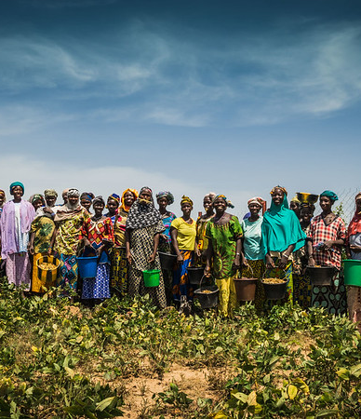
5. Partnerships & Resource Mobilization

Slide 35
Partnerships
Besides leading in and contributing to several partnerships with UN agencies (UNDRR, UN-Habitat, etc.), the DRT represents UNDP in a variety of inter-agency fora and partnerships, including the UN DRR FP Group, the Risk-informed Early Action Partnership (REAP), the Early Warning for All (EW4A) initiative, the MCR 2030 and others.
Strengthening disaster risk governance and recovery capacities (EU-OACPS)
Capacity for Disaster Reduction Initiative (CADRI)
The joint project “Strengthening Disaster Risk Governance and Recovery Capacities”, signed in December 2021 with the EU, is being implemented with UNDRR for a total of USD 21.5 million (signed in EU 21.3 million). This is a component of the Intra-ACP Natural Disaster Risk Reduction Programme funded under the 11th European Development Fund (EDF) which aims to reduce the impact of disasters, including those related to climate change (CC) and biological hazards, and increase resilience in African, Caribbean and Pacific (ACP) countries. In 2023, the project team developed with governments, and started the implementation of Annual Work Plans with five UNDP Country Offices: Togo, Cameroun, Burundi, Kenya and Ethiopia. A workplan with Vanuatu is being developed as a follow up on the PDNA and recovery framework.
CADRI is a global partnership composed of 20 organizations working towards the achievement of the SDGs by providing countries with capacity development services to help them reduce climate and disaster risk. As the CADRI Partnership moves into the next phase of the Joint Programme 2024 – 2030, an inter-agency core group has been established to guide the design of the next phase, in which UNDP plays a key steering role.
With regards to country engagements, the Tanzania capacity diagnosis report “Disaster and Climate Risk Management: A Capacity Diagnosis” was validated and published. The Maldives capacity diagnosis report is ready for validation while the capacity diagnosis reports for Zambia, Mongolia, and Costa Rica have been finalized.

Slide 36
Partnerships
Get Airports Ready for Disaster (GARD)
Coalition for Disaster Resilient Infrastructure (CDRI)
GARD is a public-private partnership between UNDP, DHL Group, and Airports Council International (ACI) to address the need for enhanced airport preparedness and response capacity in disaster situations. Since its setup in 2009, GARD has been implemented in more than 60 airports across 28 countries and trained over 1,650 professionals including airport managers and operations staff, civil aviation authorities, and national disaster management officials.
GARD was rolled out at three airports in 2023:
Languindingan Airport, the Philippines (GARD)
Sarajevo International Airport, Bosnia and Herzegovina (GARD Plus)
Paro International Airport, Bhutan
The DRT was instrumental in supporting the Coalition for Disaster Resilient Infrastructure (CDRI) based in India in establishing its Multi-Partner Trust Fund. The operationalization of the Fund, launched at COP27, marks a successful completion of the inception phase, boasting a Manual of Operations, a functional Trust Fund Management Committee co-chaired by India, the USA, and UNDP Crisis Bureau, and a staffed Secretariat by the global DRT and India/CDRI.
The Fund's first financing agreements have been signed with UK and EU for a total amount of USD 14,2 million out of which 4,3 million was received, and additional commitments were secured from India and Australia. The Fund aims for capitalization of USD 50 million in 2025 and USD 100 million in 2027.
The Fund launched its first call for proposals which resulted in the approval of 11 project proposals totalling USD 5.8 million to support resilient infrastructure system development in housing, water, transport, education and health and the application of early warning services to infrastructure systems, with UNDP mobilizing USD 1.2 million under this first call. UNDP supports CDRI Secretariat to develop its programmatic and operational capacities to design new funding windows for resilient urban infrastructure development, high mountains areas, energy/transport/health critical infrastructure systems to prepare the launch of new calls for proposals in 2024.

Slide 37
Resource Mobilization
Regional and global DRT developed several proposals to respond to emerging needs and country demands along the lines of the four areas of work.
The global DRT organized a number of bilateral engagements with Permanent Missions in Geneva and government delegations as well as advocacy and donor events to present UNDP’s work on DRR, recovery, and resilience-building.
The global DRT supported 18 UNDP Country Offices to develop and submit proposals on DRR, urban resilience and community resilience to access resources from the Japan Supplementary Budget.

Slide 38
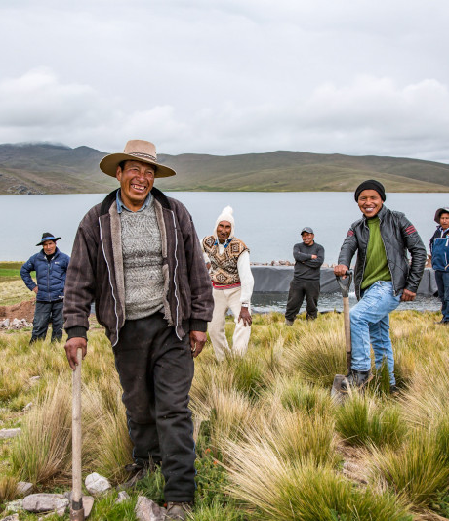
6. Global & Regional Processes

Slide 39
Global & Regional Processes
The global DRT co-authored the “Global Assessment Report: Special Report 2023 - Mapping Resilience for the Sustainable Development Goals”, including participation in the launch event, and organization of a webinar in collaboration with UNDRR.
The global DRT coordinated the UNDP consultation on the Mid-term Review of the Sendai Framework for Action, including the preparation of the summary report, inputs into the political declaration endorsed by the UN General Assembly at the high-level meeting in New York, and supporting the representation of UNDP at the high-level event in New York. An accompanying blog on “The Future of Risk Reduction – Reflecting on the Sendai Mid-term Review” was published for the International Day of Disaster Risk Reduction in October 2023.

Slide 40
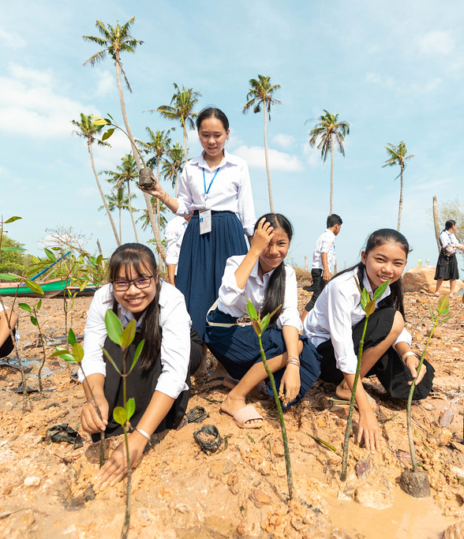


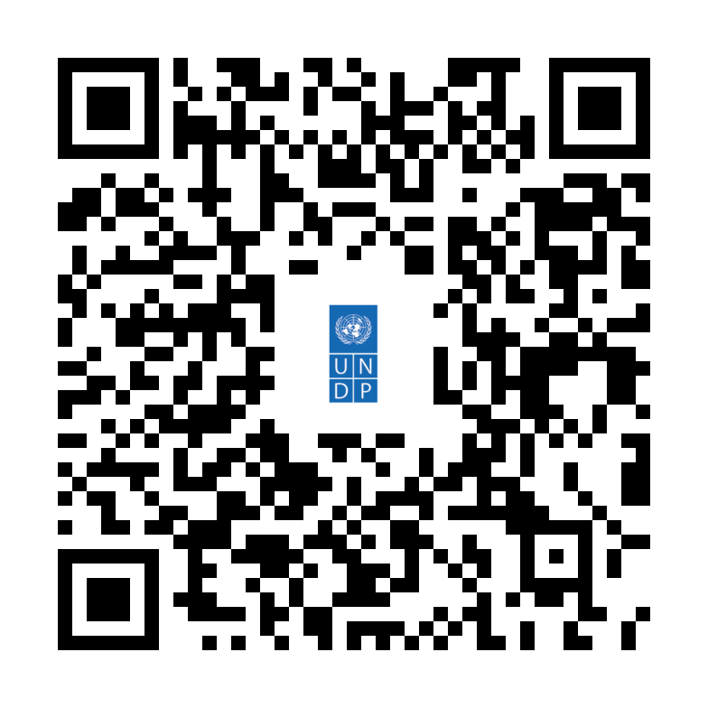

Thank You
Ronald Jackson
Head of DRR and Recovery for Building Resilience
Crisis Bureau, UNDP Geneva
ronald.jackson@undp.org
www.undp.org
Learn more about UNDP’s DRR & recovery work
The photos featured in this presentation are courtesy of UNDP

