Slide 1
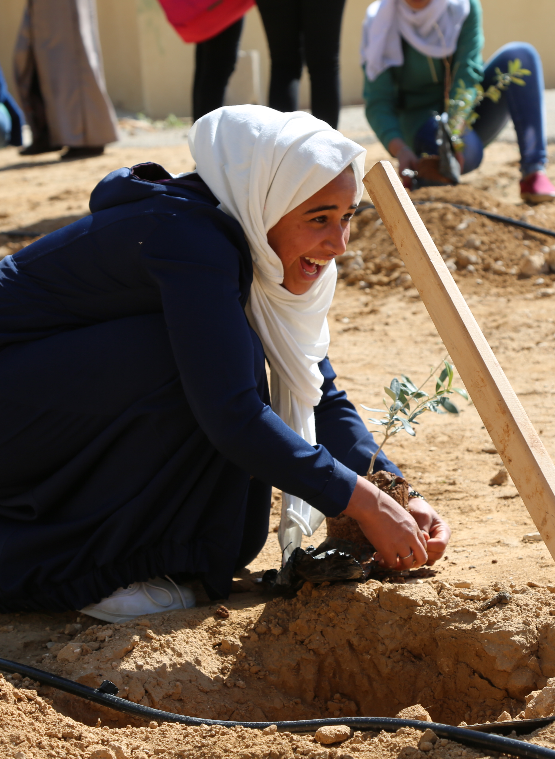




Picture fill: Insert square photo
Jordan
Focus Group Discussion
A healthy planet for the prosperity of all – our responsibility, our opportunity
In Amman and live streamed on UNDP Jordan Facebook page
12th of May, 2022 from 11:00 a.m. Jordan Time

Slide 2

Outline
Introduction: what is Stockholm +50?
Consultation process
Key topics to address
Our methodology
Outputs and next steps

Slide 3
Introduction
UN General Assembly → international meeting entitled “Stockholm+50”
“Healthy planet for the prosperity of all – our responsibility, our opportunity”
Stockholm on 2nd and 3rd of June
To commemorate the 50 years since the UN Conference on the Human Environment.
To help accelerate implementation of the SDGs during the Decade of Action including through a sustainable recovery from the COVID-19 pandemic.

Slide 4
Consultation Process
Three main workshops followed by small workshops or focus groups
A Communication Plan is launched
SparkBlue to ease participation and communication nation wide
  www.sparkblue.org/stockholm50/consultation-jordan
Main highlights of communication plan:
1. To stimulate inclusive bottom-up whole-of-society and whole-of-government conversation about the Stockholm+50
2. Offer SparkBlue as the main communication hub for the Stockholm +50
3. Generate, and communicate necessary action and attention on topics at the National Consultations and beyond
→ UNDP social media platforms

Slide 5
Key Topics
1. Reflecting on the urgent need for actions to achieve a healthy planet and prosperity for all
2. Achieving a sustainable and inclusive recovery from COVID – 19 pandemic
3. Accelerating the implementation of the environmental dimension of sustainable development in the context of decade of action

Slide 6
محاور تقرير ستوكهولم ال+50
التفكير في الحاجة الملحة لاتخاذ إجراءات لتحقيق كوكب صحي ومزدهر للجميع
تحقيق الانتعاش المستدام والشامل من جائحة مرض فيروس كورونا
تسريع تنفيذ البعد البيئي للتنمية المستدامة في سياق العمل من أجل التنمية
:1 المحور
(Covid-19)
:2 المحور
:3 المحور

Slide 7
Our methodology for today
Opening up 3 Leadership dialogues and topics; each tackling one of the mentioned topics.
In “Marketplace” fashion, collaborate and join colleagues to present your feedback at each pin board.
Feedback will be provided using cards (3 colours) and pinned to the respective board
Time will be available to present and discuss
Institutional Frame
Technical Frame
Policy Frame

Slide 8
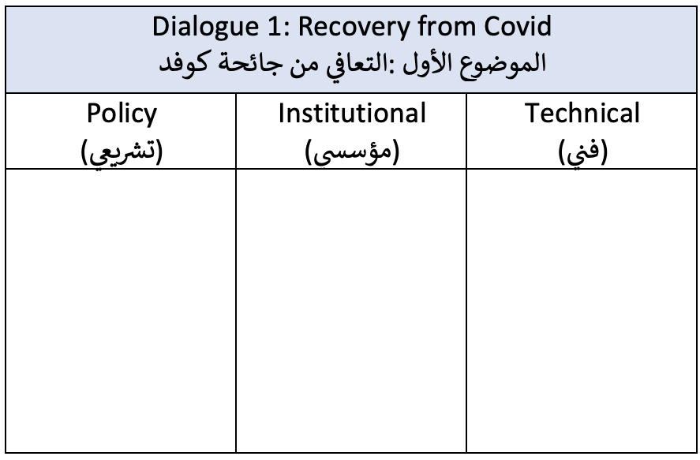
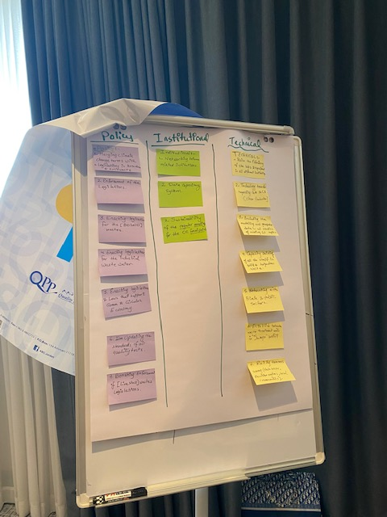
Amman, Jordan - Consultation Session

Slide 9
Outputs and next steps
The outputs from this meeting and the coming ones will be collected
      Your voice and engagement is integral
Data analysis and interpretation
Reporting: a national report will be drafted in May 2022
The report will be presented at the World Environment Day, June 2-3, 2022.

