Slide 1

"Stockholm+50: A healthy planet for the prosperity of all – our responsibility, our opportunity" - Mauritius

Slide 2
Leadership Dialogue 1: Reflecting on the urgent need for actions to achieve a healthy planet and prosperity of all
Increase awareness and practical action for environmental protection
Improving food resilience by encouraging our youth to engage in smart agriculture e.g., hydroponics
Increase youth engagement in sustainability policies at national level

Slide 3
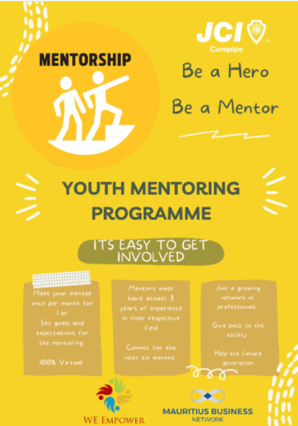
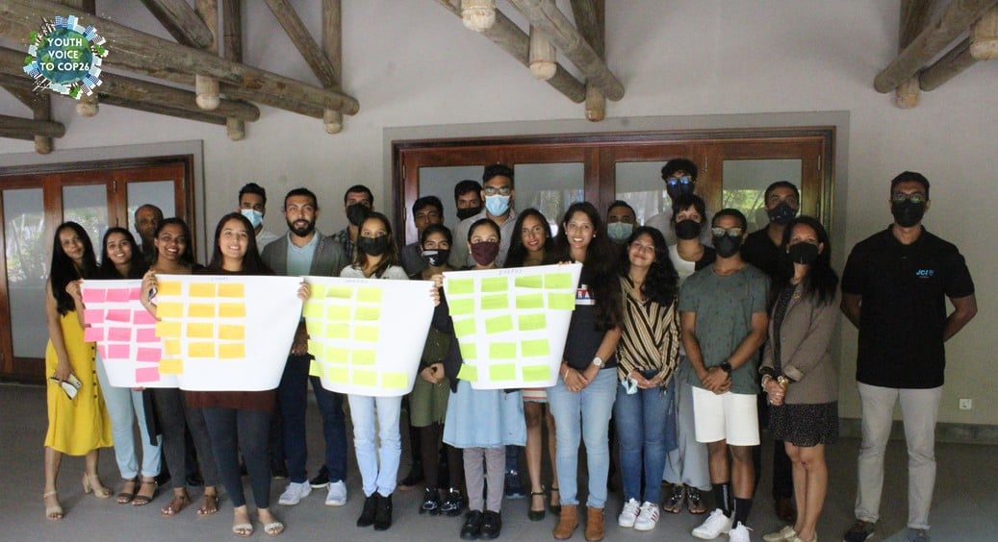
Exemplar Project
Youth Mentoring Programme
Youth Voice to COP26

Slide 4
Leadership Dialogue 2: Achieving a sustainable and inclusive recovery from the coronavirus disease (COVID-19) pandemic
Recovery from the pandemic can be based on more circular approaches e.g., encouraging cultivation of abandoned lands
Community engagement at grassroots level for all sustainability initiatives; promoting co-creation
Opportunity for a civic development in our youth

Slide 5
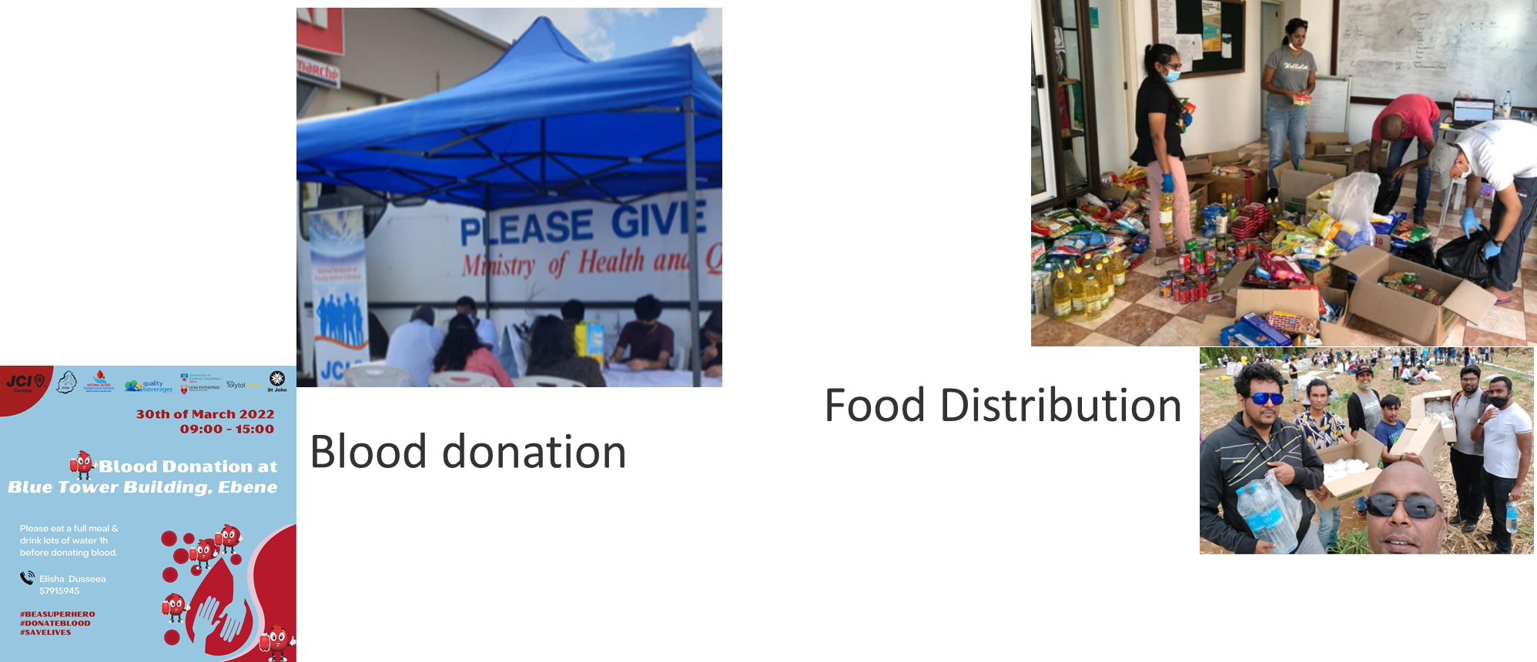
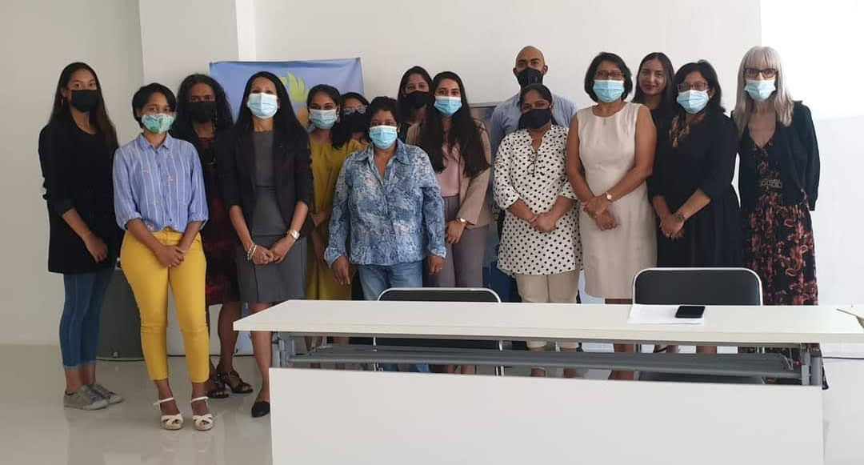
Exemplar Project
Econnect Training

Slide 6
Leadership Dialogue 3: Accelerating the implementation of the environmental dimension of sustainable development in the context of the decade of action and delivery for sustainable development
Capacity building in green skills e.g., training on sustainable waste management and circular design
Offering scholarship for green education
More focus on environmental protection instead of
economic development

Slide 7
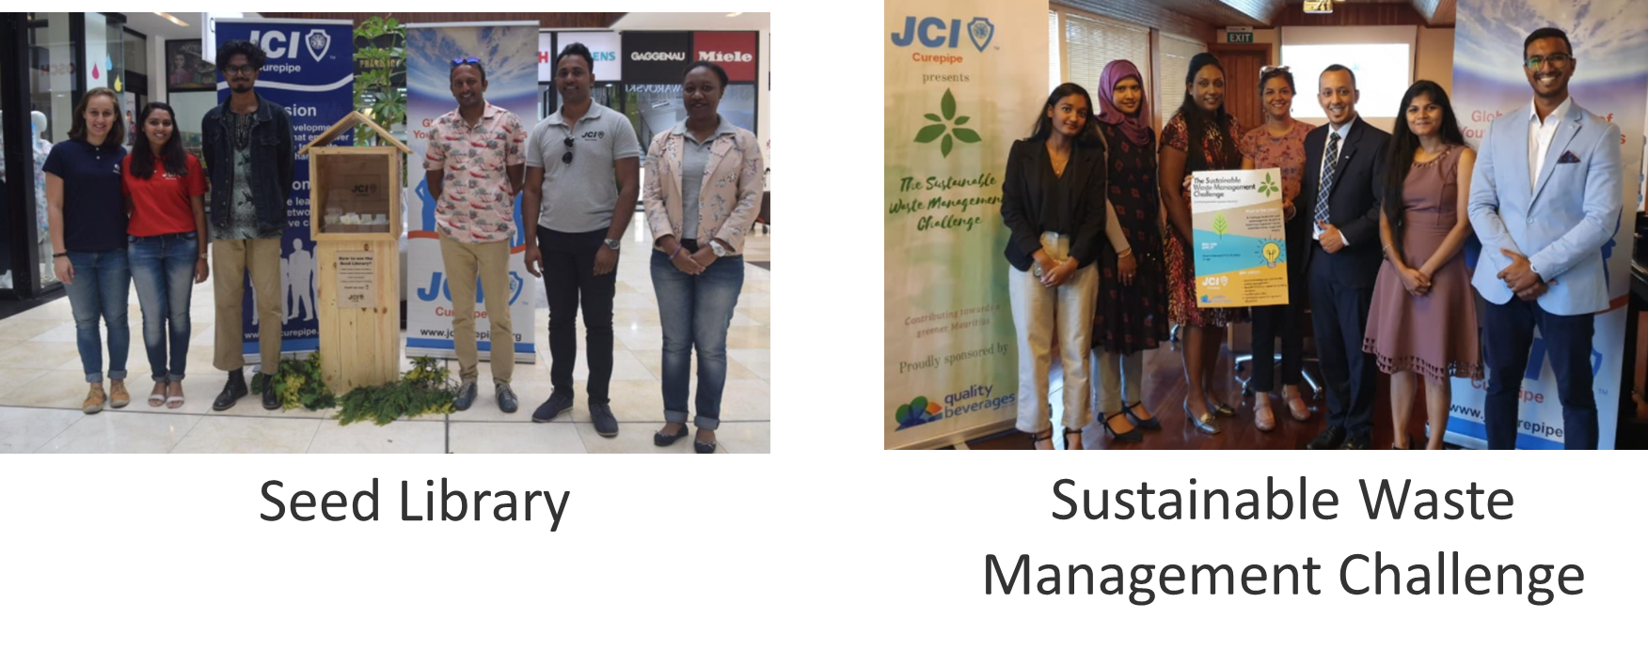
Exemplar Project

Slide 8

Thank you

