Slide 1



Dialogue 1 : Reflecting on the urgent need for actions to achieve a healthy planet and prosperity of all
Presented by: Sunkur keshita and Akeelesh
Hurnauth

Slide 2
5 Questions
How can we restore and regenerate a positive relationship with nature? List 2 or 3 good practices and pathways that you would like to see scaled up to enable a move to a healthy planet?
What are the actions that you (your group) would take to scale up the change towards a healthy planet? What policies/structures need to be in place for you to take such action?
How could marginalised and vulnerable groups benefit from policies and initiatives designed to restore a more sustainable and resilient relationship with nature (that mitigates nature risks)?
How can we safeguard the rights of people and nature, including among others, indigenous peoples and local communities, environmental defenders, women, youth, future generations?
What are the new or prioritized set of metrics and indicators needed for tracking our progress towards a healthier and more prosperous planet?

Slide 3
Q1: How can we restore and regenerate a positive relationship with nature? List 2 or 3 good practices and pathways that you would like to see scaled up to enable a move to a healthy planet?

Slide 4
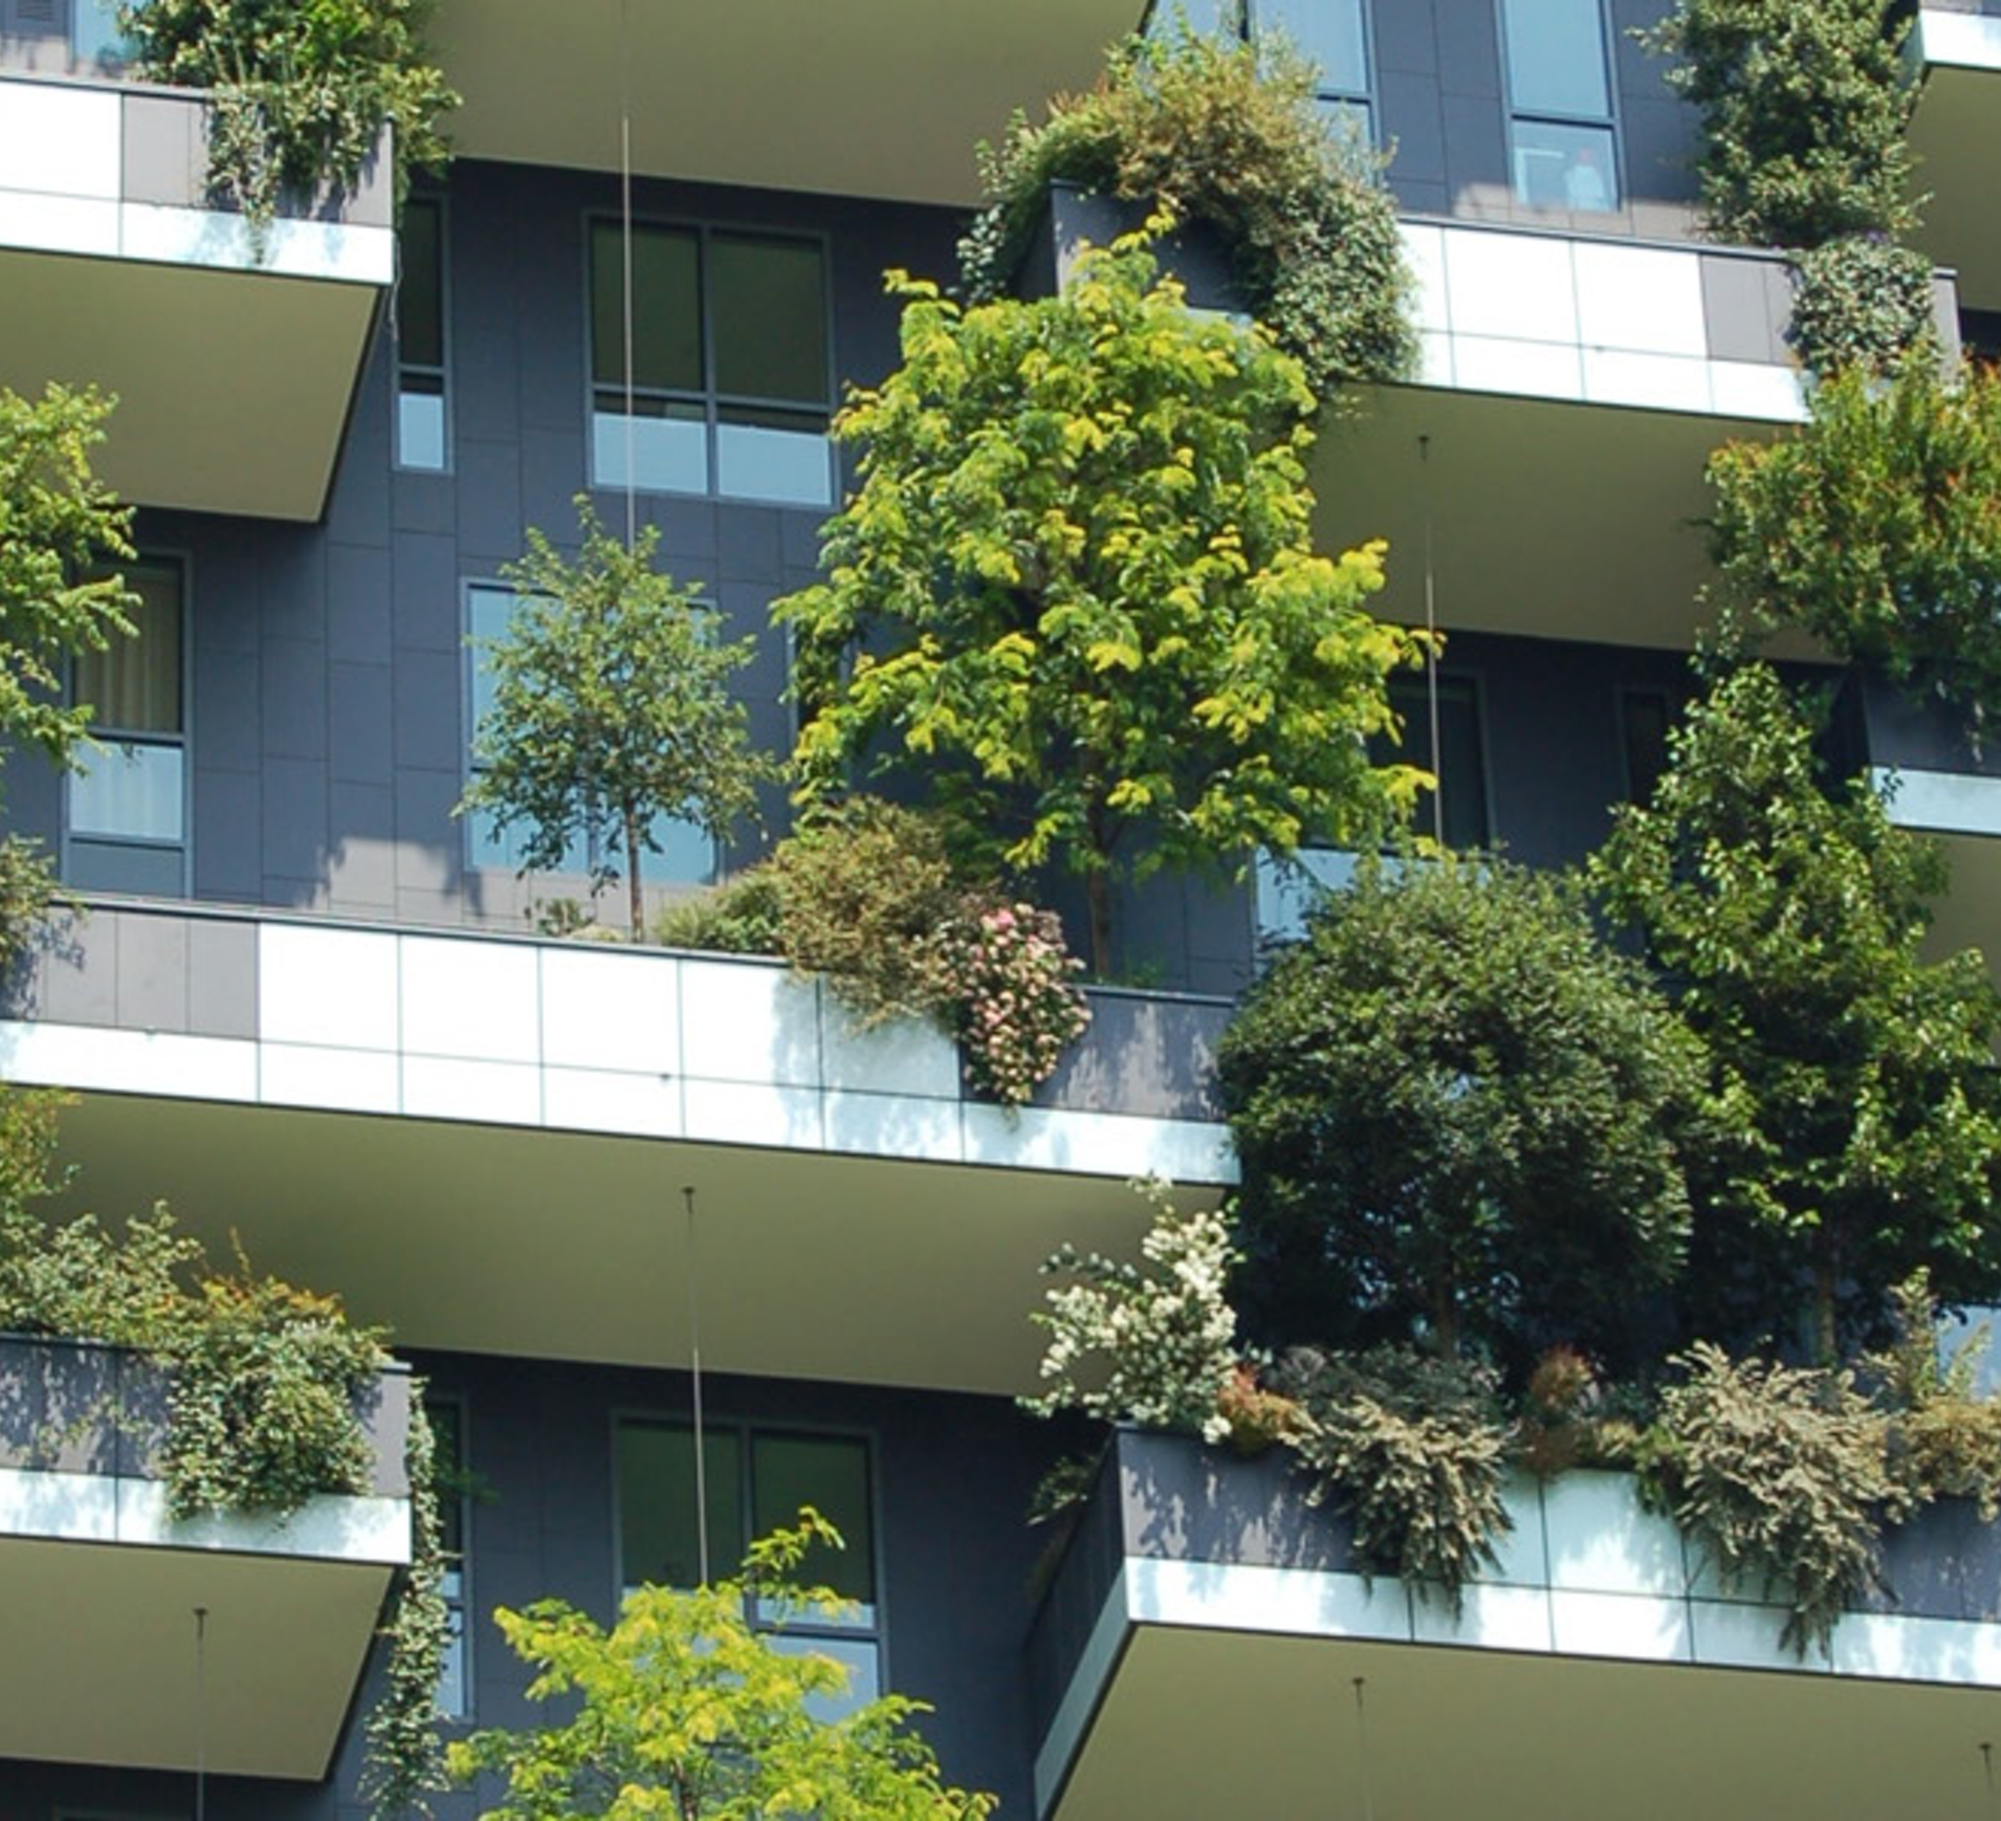
Urban Greenery
Contributes to reduce noise pollution and soaks up rain water
Land restoration
Reduces the amount of carbon emission by 3 billion tons annually
Encouraging the use of solar panels

Slide 5
Q2 :What are the actions that you (your group) would take to scale up the change towards a healthy planet? What policies/structures need to be in place for you to take such action?

Slide 6
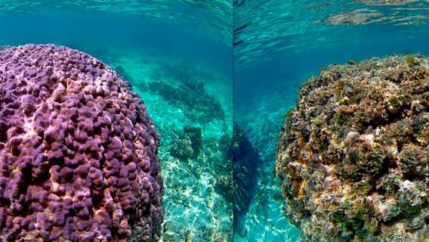
What are the actions that you(your group) would like to see scale up to change towards a healthy planet? What policies/structures need to be in place for you to take such action?
Switching to natural medicines (Ayurvedic)
Transition to clean energy
Policies:
Implementation of public health
Encouraging the use of electric cars

Slide 7
Q3: How could marginalised and vulnerable groups benefit from policies and initiatives designed to restore a more sustainable and resilient relationship with nature (that mitigates nature risks)?

Slide 8
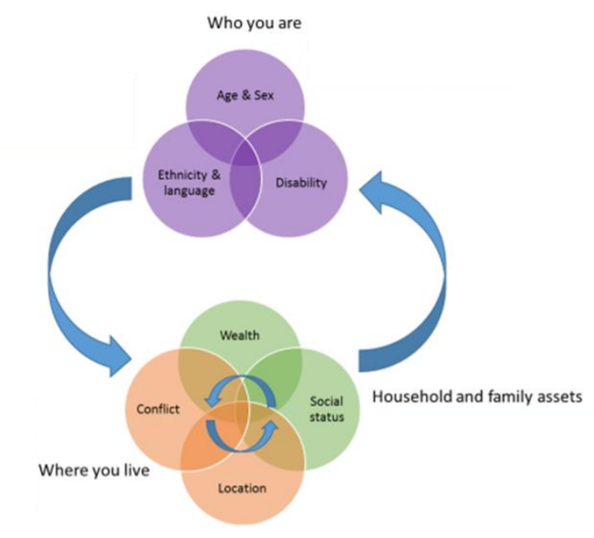
List of vulnerable/marginalized group
Ethnic & indigenous groups are in hard-to-reach areas. Language barrier
Reflected in cultural attitudes to gender
Environmental difficulties and discriminatory practices create significant barriers in academic & professional life
Nomadic group,
rural and remote areas,
Urban slums
Main disadvantage is caused by poverty
Refugees/ population impacted by conflicts
Stigmatized due to parental occupation, caste, immigration, religion & social group

Slide 9
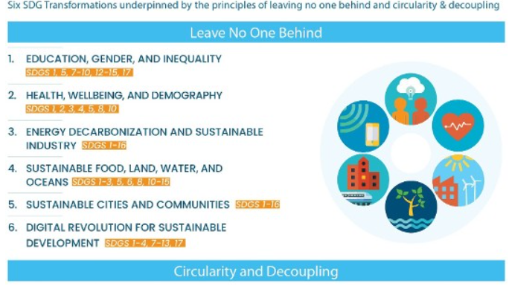
Six SDGs transformation underpinned by the principles
of leaving no one behind & circularity & decoupling
Source: Sachs J, Schmidt-Traub G, Mazzucato M, Messner D, Nakicenovic N, & Rockström J (2019). Six Transformations to Achieve the SDGs. Nature Sustainability DOI: 10.1038/s41893-019-0352-9 [pure.iiasa.ac.at/16045]

Slide 10
STEPS TO BE TAKEN & POTENTIAL BENEFITS
INVESTING IN AGRICULTURE
with known technologies and management practices
FOOD SECURITY
HUMAN HEALTH;
Lower mortality rates among children
lower risks of climate-sensitive health outcomes such as malnutrition, diarrhoea, and malaria.
CLIMATE MITIGATION
Investing in young children's education
Increases economic development
Stabilizes population growth
Improves human wellbeing
By providing legal identity
REDUCE POVERTY
Diversification of Economy; creation of jobs.
Proper distribution of wealth; address corruption
Better Human Security

Slide 11
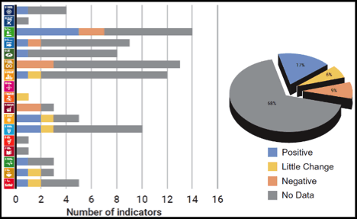
22% of the environment-related SDGs & 68% of the environment-related SDGs to be met
sufficient data at the global level to assess progress

Slide 12
Q4 : How can we safeguard the rights of people and nature, including among others, indigenous peoples and local communities, environmental defenders, women, youth, future generations?

Slide 13
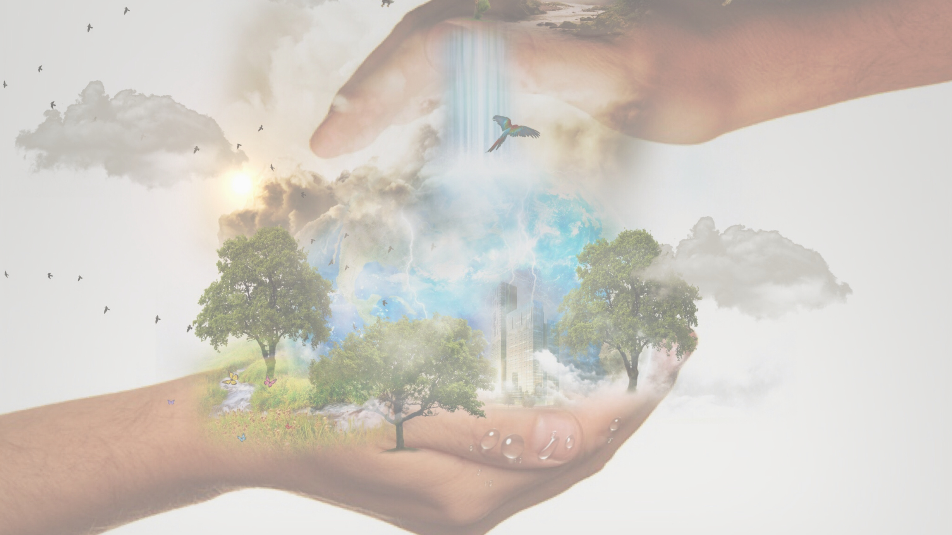
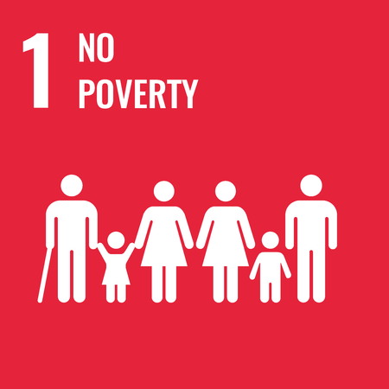


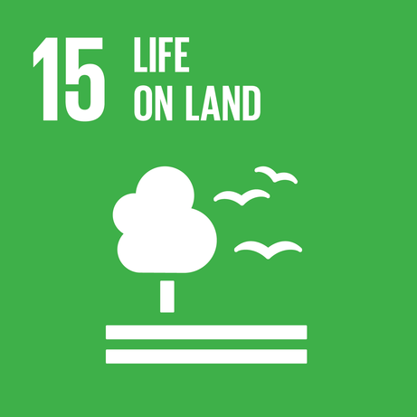
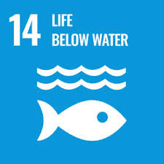
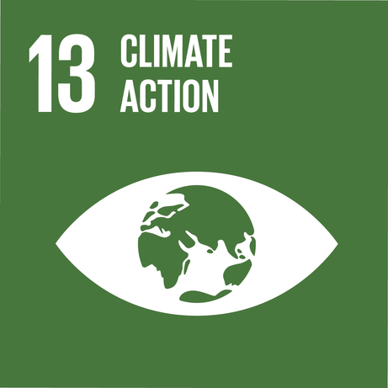




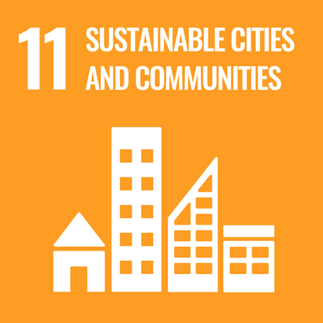



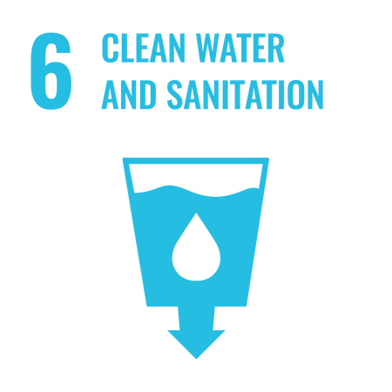

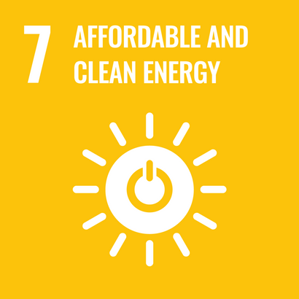


Slide 14
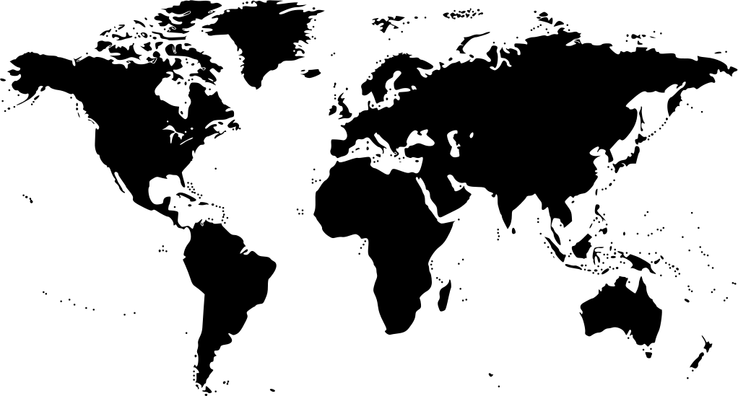
Preserving endangered species eg. protection programs
Implement severe laws against pollution
Supporting environmental defenders
Nature
Preservation of native's people Lands and Water
Ensuring Rights to education
Future Generation
WAYS TO SAFEGUARD
IPLCs
Empowering bodies such as the ombudsperson for children
Denounce attacks on IPLCs
Women
Creation of equal opportunities in the society e.g workplace
Promoting Mental Health facilities
Protection against Violence e.g Rape, Domestic Violence

Slide 15
Q5 : What are the new or prioritized set of metrics and indicators needed for tracking our progress towards a healthier and more prosperous planet?

Slide 16
Healthy life expectancy at birth
Healthy life expectancy at birth
Low Rate of Income
Percentage of population with access to health care facilities
High Life Cost
Morbidity of major diseases such as HIV/AIDS, Malaria and Tuberculosis
Lack of Opportunities (Professional and Academic Sector)
Health
Poverty
Set of Indicators
Land use - Deforestation
Nature Loss
Climate Change
Outdoor and Indoor air pollution
Decline in wetlands
Increase in Air Temperature
Freshwater pollution
Ozone Depletion

Slide 17
Set of Metrics
Health
Poverty
Nature Loss
Climate Change
Maternal mortality ratio; Births by skilled health professional
Provide access to medicines and vaccines for all, support R&D of vaccines and medicines for all
New HIV infections; TB, malaria, Hep B incidence rates; NTD interventions
Eradicate extreme poverty for all people everywhere, currently measured as people living on less than $1.25 a day
Increase in minimum wage system.
Subsidies by government to alleviate high life cost.
Diversification of Economy
Reverse the loss of forest cover worldwide through sustainable forest management, including protection, restoration, afforestation and reforestation, and increase efforts to prevent forest degradation
Formulate and implement their planning so as to promote the conservation of the wetlands
Intensify water pollution prevention to reduce health hazards and protect ecosystems by introducing technologies for affordable sanitation and industrial and domestic wastewater treatment
Enhance cooperation at the international, regional and national levels to reduce air pollution, including transboundary air pollution [and] acid deposition
Assist developing countries in providing affordable energy to rural communities, particularly to reduce dependence on traditional fuel sources for cooking and heating
taking precautionary measures to control equitably total global emissions of substances that deplete it, with the ultimate objective of their elimination

Slide 18
What kind of follow-up activities would you like to see from Stockholm+50?

