Slide 1




National Consultation – 28 April 2022 Caudan Arts Centre
Leadership Dialogue Overview
by Pamela Bapoo-Dundoo

Slide 2
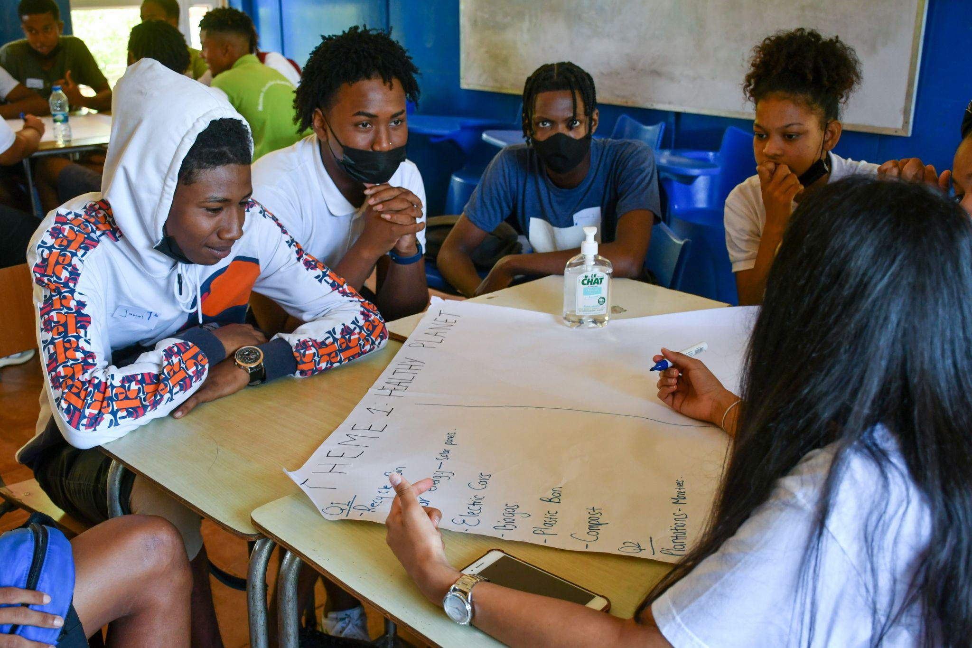
3 LEADERSHIP DIALOGUES (LD)
LD 1 : Reflecting on the urgent need for actions to achieve a healthy planet and prosperity for all
LD 2: Achieving a sustainable and inclusive recovery from the Covid-19 pandemic
LD3: Accelerating the implementation of environmental dimension of sustainable development in the context of the decade of action and delivery for sustainable development.

Slide 3
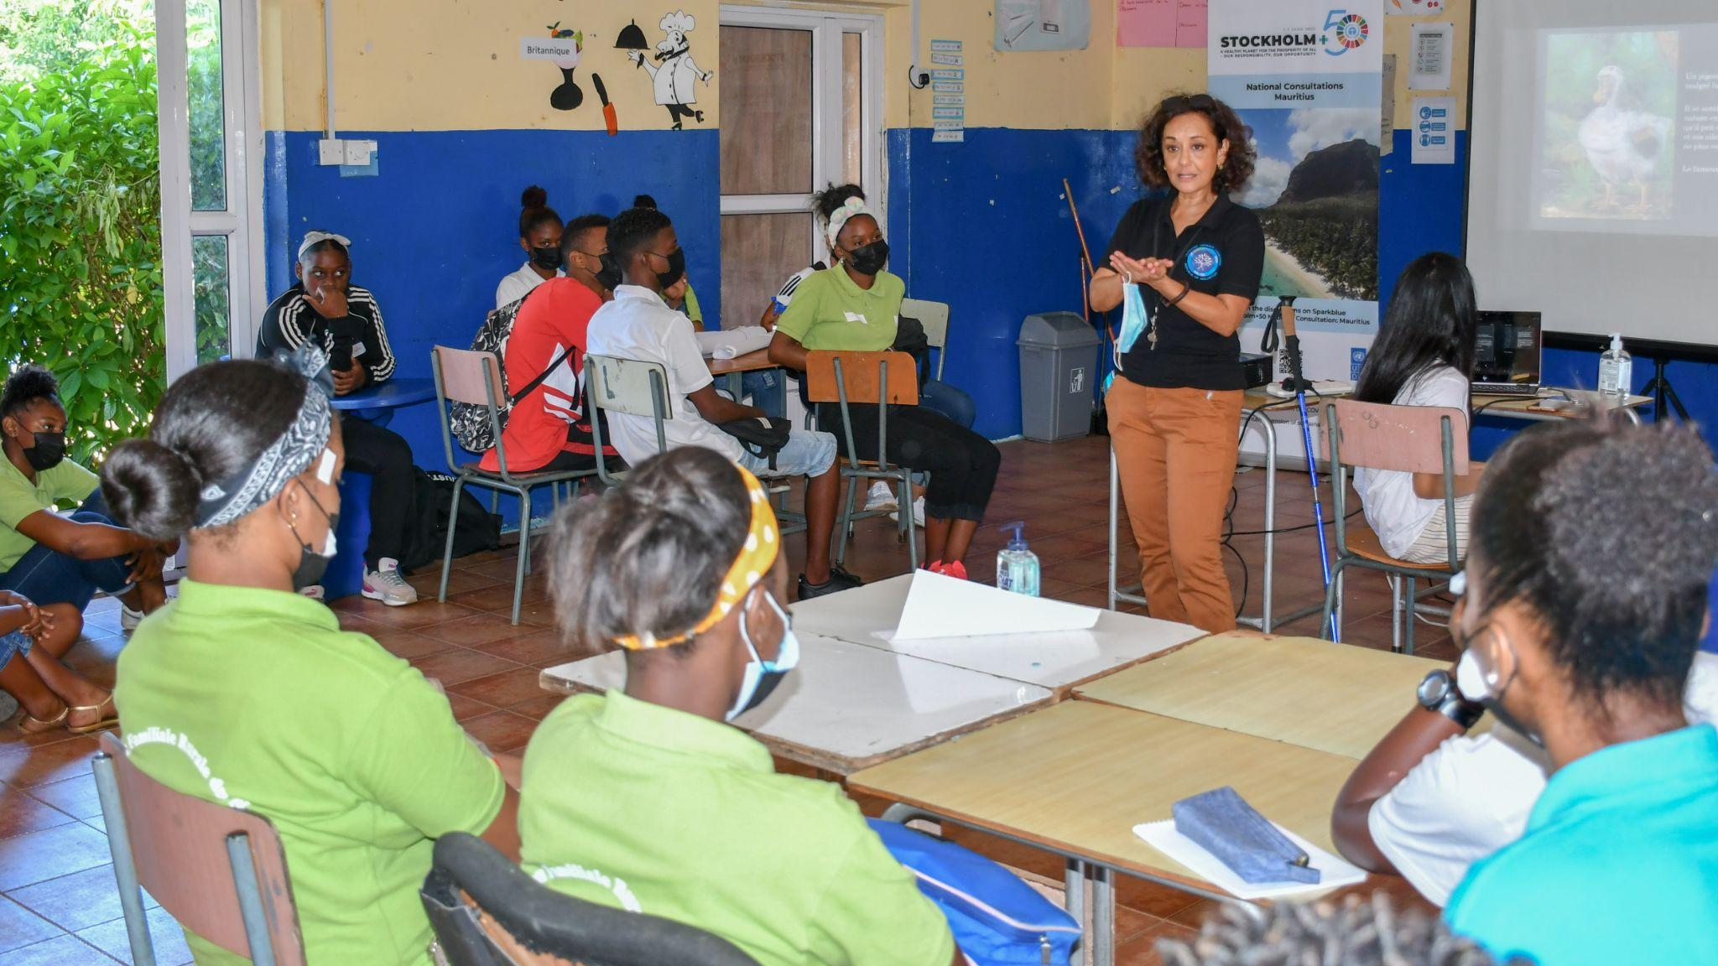
LD 1: Healthy Planet and Prosperity for All
How can we restore and regenerate a positive relationship with nature? List 2 or 3 good practices and pathways that your partners would like to see scaled up to enable a move to a healthy planet?​
What are the actions that your country/partners would take to scale up the change towards a healthy planet? What policies/structures need to be in place for you to take such action? ​

Slide 4
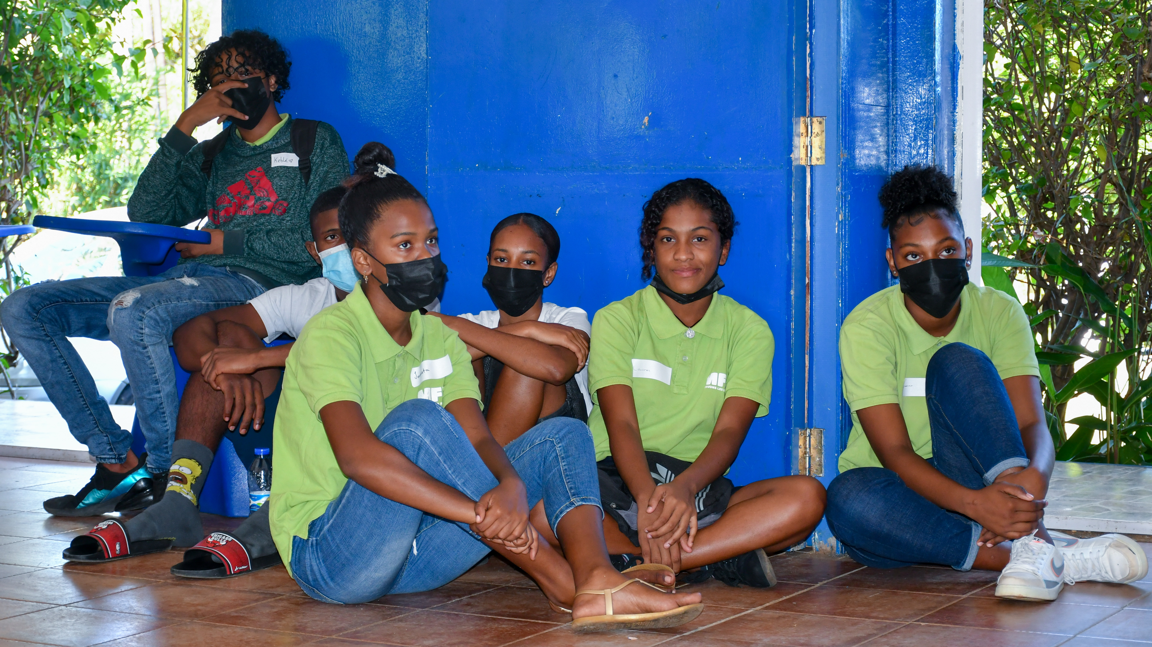
LD 1: Healthy Planet and Prosperity for All
How could marginalised and vulnerable groups benefit from policies and initiatives designed to restore a more sustainable and resilient relationship with nature (that mitigates nature risks)?​ (healthy planet)
How can we safeguard the rights of people and nature, including among others, indigenous peoples and local communities, environmental defenders, women, youth, future generations?​ (healthy planet)
What are the new or prioritized set of metrics and indicators needed for tracking our progress towards a healthier and more prosperous planet?​

Slide 5
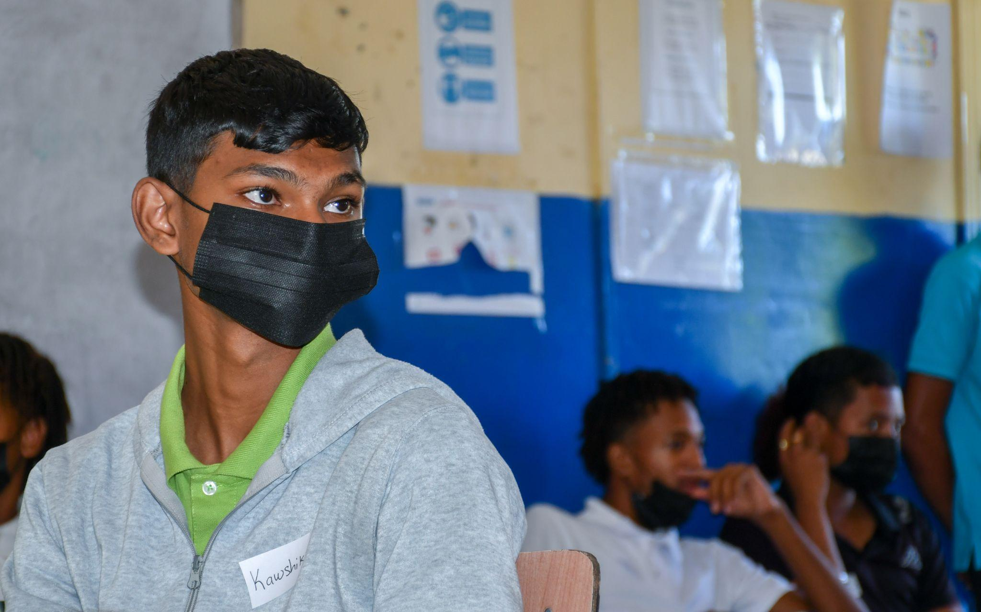
LD 2: Sustainable and Inclusive Recovery from COVID-19
What are the most promising sustainable and inclusive recovery practices currently being applied by public, private and civil society groups at individual, community, city, regional, country level? And how could we scale them up? ​(Covid 19 recovery)
What recovery and pre-existing practices need to be changed to ensure an inclusive and sustainable recovery?​ (Covid 19 recovery)
How do we ensure that all countries/communities can benefit from opportunities stemming from a sustainable and just transition?​ (Covid 19 recovery)

Slide 6
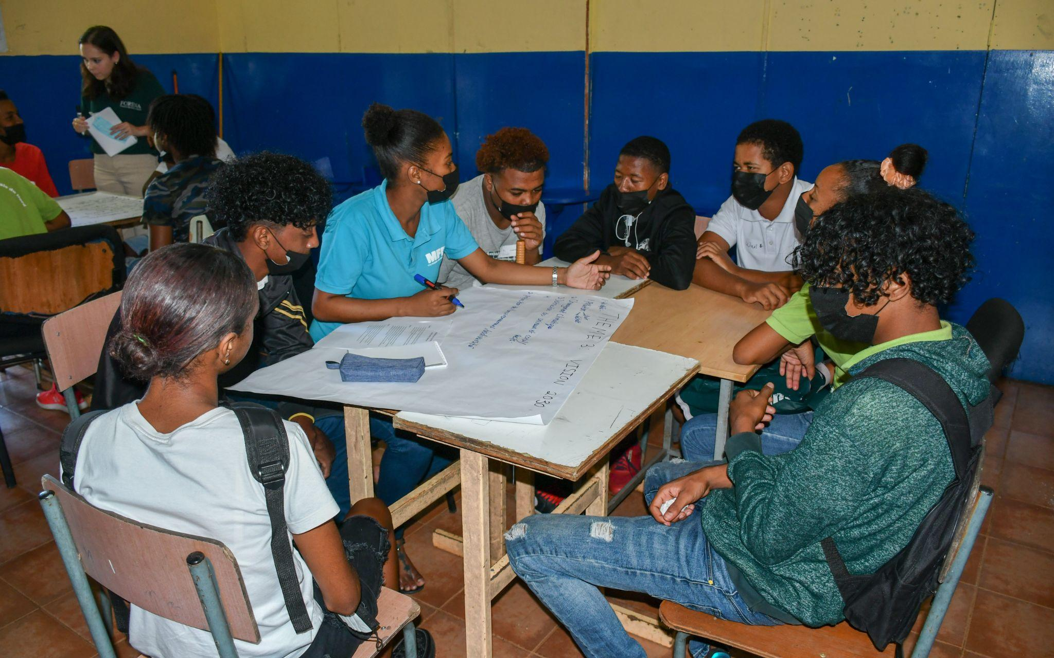
LD 2: Sustainable and Inclusive Recovery from COVID-19
How can we create better performing industries and supply chains for a just transition to more sustainable economies? which sectors are most critical?​ (Covid 19 recovery)
​What are some of the commitments and “responsible” principles that need to be made by key industry sectors and by finance and investment institutions?​ (Covid 19 recovery)
What are the decent green jobs of the future? What are the new skills needed, what is needed from business? from government? from academia? ​(Covid 19 recovery)

Slide 7
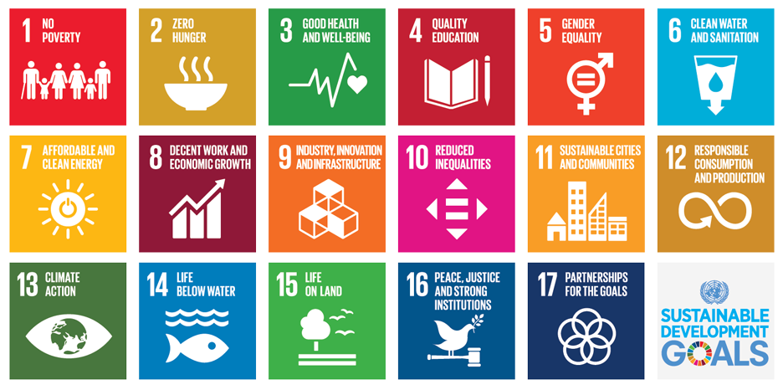
LD 3: Implementation of Environmental dimensions of SDGs
Decade of Action – 8 YEARS LEFT

Slide 8
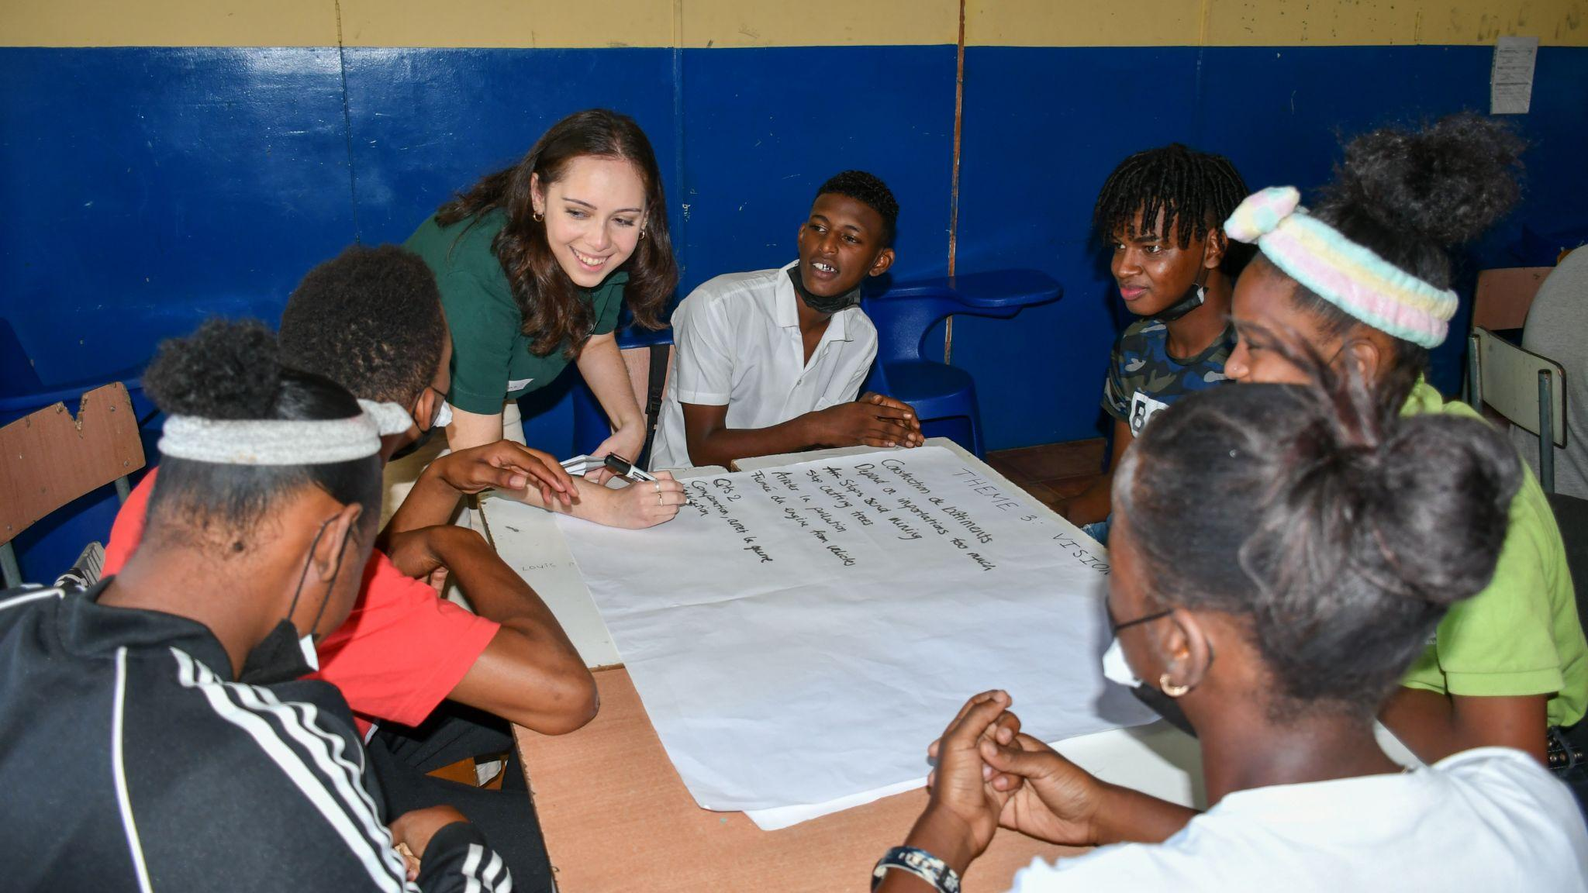
LD 3: Implementation of Environmental dimensions of SDGs
Decade of Action
What are the biggest challenges we are facing in implementing the commitments to the 2030 Agenda and other environmental commitments (MEAs)? How do we create an enabling environment for delivery on the ground?​
What are the good practices and pathways that you would like to see scaled up to accelerate the implementation of the environmental dimension of Sustainable Development in the context, of the Decade of Action?​
How to transform governance and legal systems that maintain long-term economic stability and ecological and social wellbeing for all?​

Slide 9
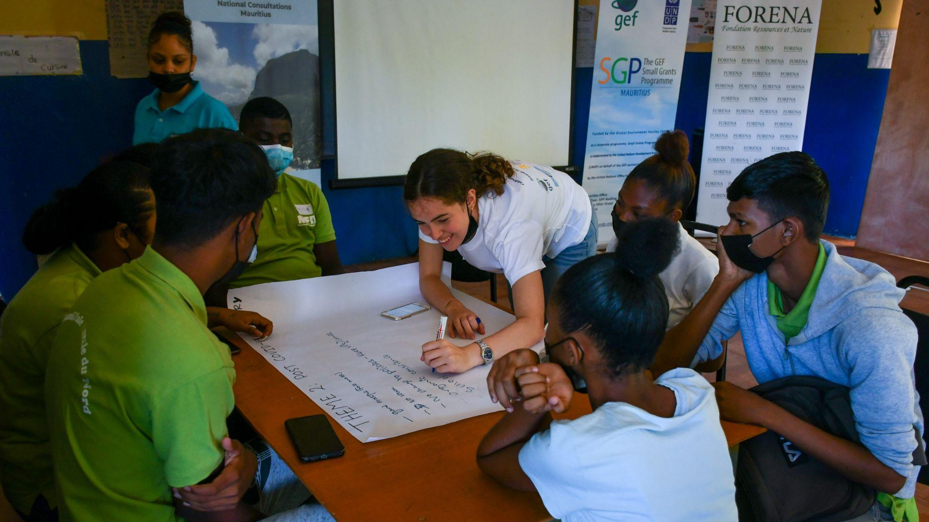
LD 3: Implementation of Environmental dimensions of SDGs
Decade of Action
What measures are needed to align public, private and development finance with existing commitments and priorities? (Decade of Action)
What type of partnerships from the UN and beyond are needed to accelerate a green and sustainable economic transformation that leaves no one behind?​ (Decade of Action)
​What capacities and technologies are needed to improve human wellbeing in harmony with nature, including digital technologies? (Decade of Action)

Slide 10
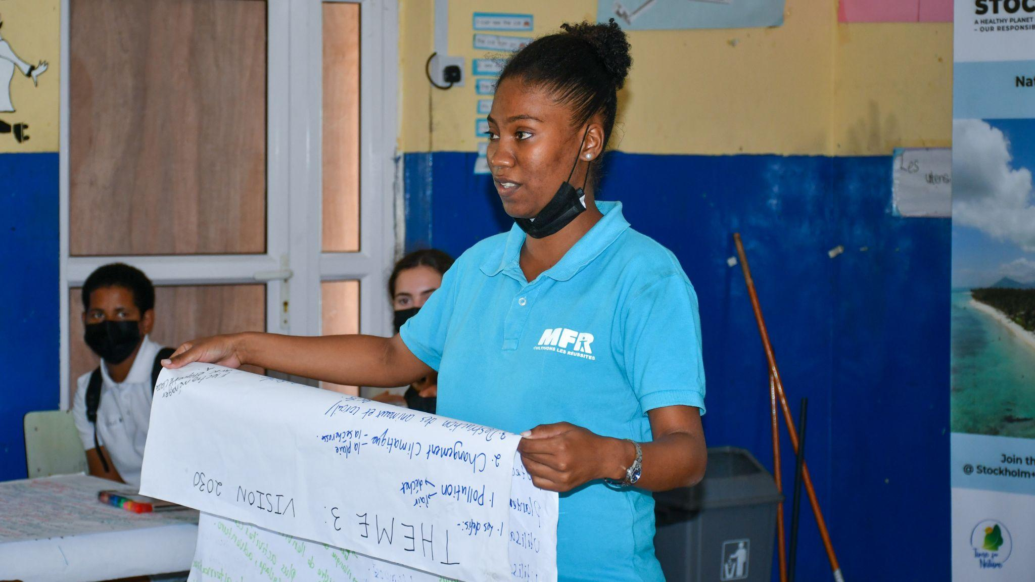
QUESTION FOR ALL
What kind of follow-up activities would you like to see from Stockholm+50?

Slide 11
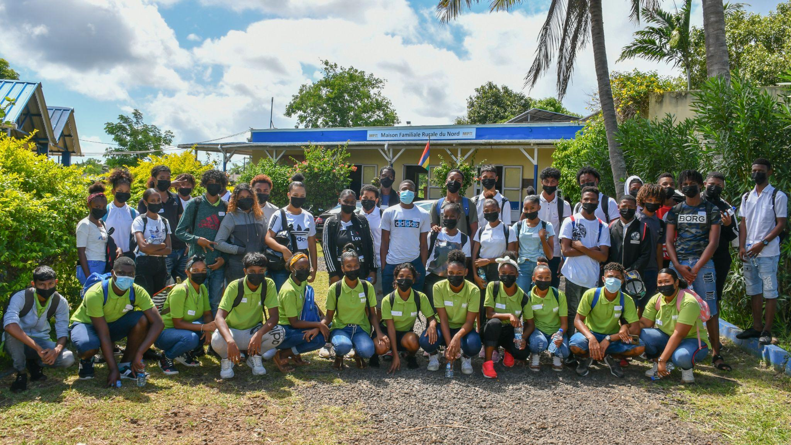
THEY DID IT!

