Slide 1
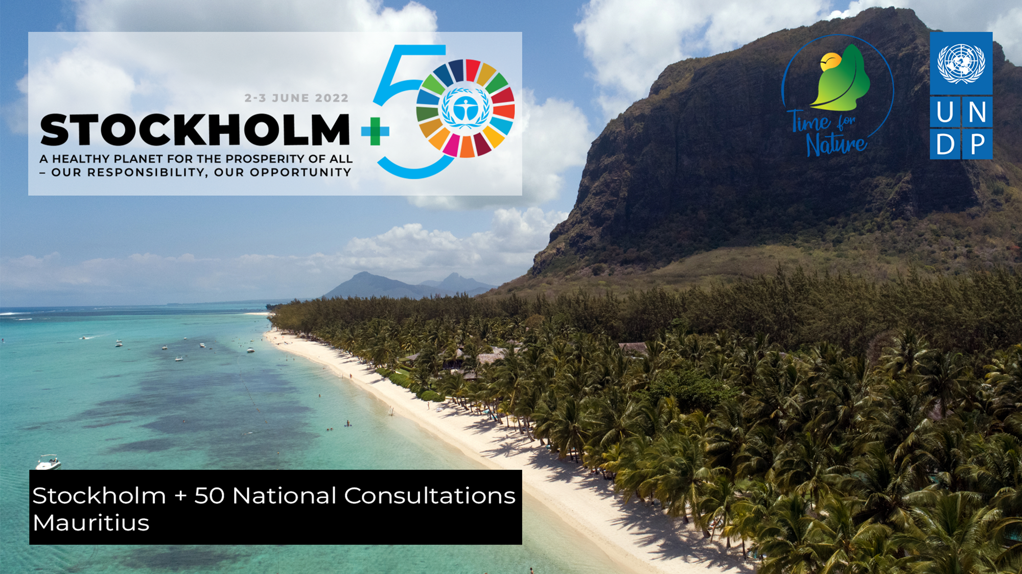
Stockholm+50: a healthy planet for the prosperity of all – our responsibility, our opportunity”

Slide 2
Climate change adaptation provides a global opportunity to increase health equality for people with disabilities as required by the UN Sustainable Development Goals, using the human rights principles of participation, inclusion, empowerment, non-discrimination, and accessibility.
The Convention on the Rights of Persons with Disabilities offers a guiding framework for actions related to persons with disabilities, including the building of inclusive climate change responses and resilience.
According to the preamble of the Paris Agreement, States parties should respect, promote and consider their respective human rights obligations, including the rights of persons with disabilities, when addressing climate change.

Slide 3
The State of Mauritius has come up with a comprehensive policy for the safety of all individuals in times of humanitarian emergencies and situations of risks and disasters.
The National Disaster Risk Reduction and Management Act was proclaimed on 1 July 2016 and a National Disaster Risk Reduction Management Centre (NDRRMC) was set up to coordinate efforts of various agencies responsible for disaster mitigation

Slide 4
SDGs adopted by UN in 2015 with 17 Goals & 169 Targets.
Addressing three dimension of development; Social , Economic & Environmental
An agenda for shared prosperity, peace and partnership.

Slide 5
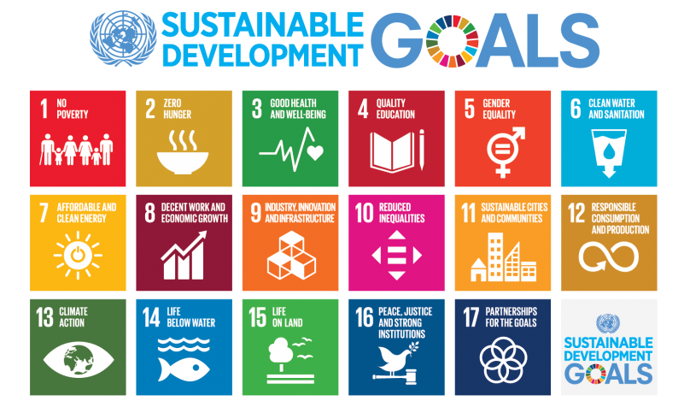

Slide 6
Climate Change threatens all of humanity
Everything is impacted: food production, natural disasters, public health
Persons with disabilities are the vulnerable groups
Persons with disabilities are involved in adaptation planning in addressing the problems of climate Change.

Slide 7
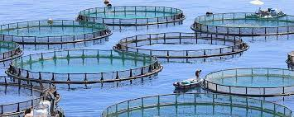
Aquaculture

Slide 8
Aquaculture
Aquaculture is farming of fish, shellfish and aquatic plants in fresh or salt water. Aquaculture products are grown in earthen ponds, freshwater lakes and bays, or in the open ocean.

Slide 9
Aquaculture is disability friendly
The Southern Handicapped Association among other NGOs in Mauritius has initiated the project of aquaculture

Slide 10
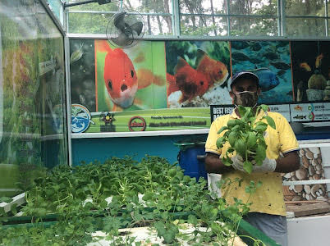

Slide 11
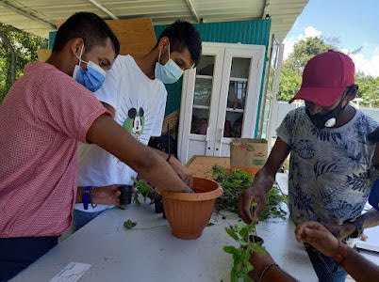

Slide 12
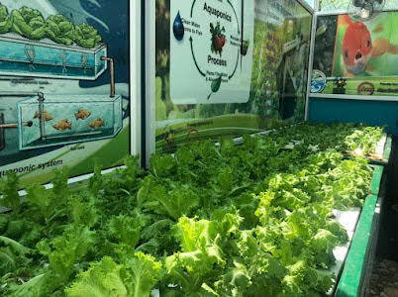

Slide 13
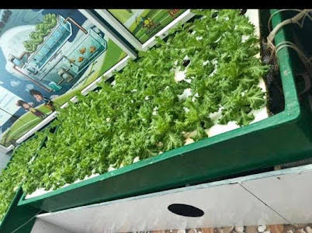

Slide 14
The recent COVID-19 pandemic has changed the way people live in an unprecedented way.
This includes severe impacts on people's health and wellbeing such as stress, reduced physical activity and loneliness due to confinement.

Slide 15
Gardening is a healthy, stimulating activity that can be enjoyed by people of all abilities.
Gardening can have many health benefits for people with disabilities, and can provide a source of exercise, friendship, stimulation and relaxation.

Slide 16
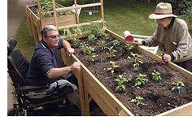
the practice of home food gardening have increased during this the Covid 19 pandemic

Slide 17
