Slide 1
WELCOME
Stockholm + 50 – Service Clubs Consultations
Presentation by Mrs A. Bolakee - Bhowon
Rotary Club Haute Rive
Wednesday 13 April 2022

Slide 2
Good Practices & Pathways for A Healthy
Planet (Leadership Dialogue 1)
Sensitisation Campaigns
Awareness through Education
Adapted Curriculum
Family Involvement
Innovative Policies

Slide 3
Our Involvement (Leadership Dialogue 1)
Engagement at School Level
Eco Club & Agricultural Youth Club
Renewable Sources of Energy
Solar Panels
Rain Water Harvest
Compost Making
Collection of Plastic Materials
Segregation of Wastes
Sustainable Climate Smart Agricultural Practices

Slide 4
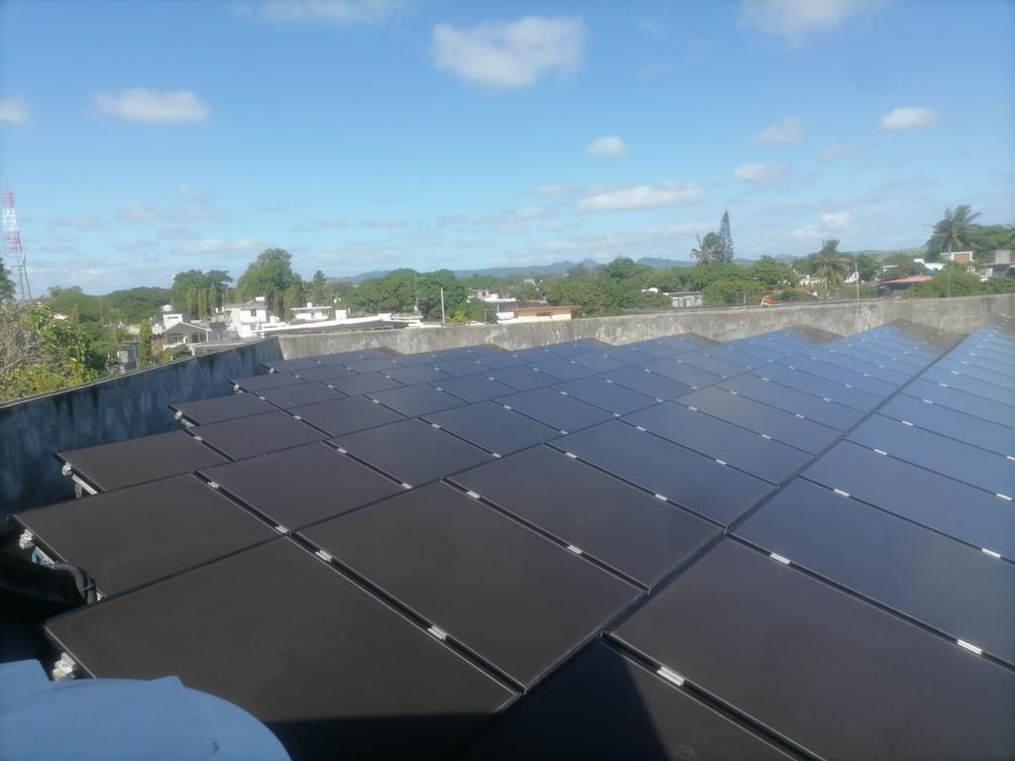
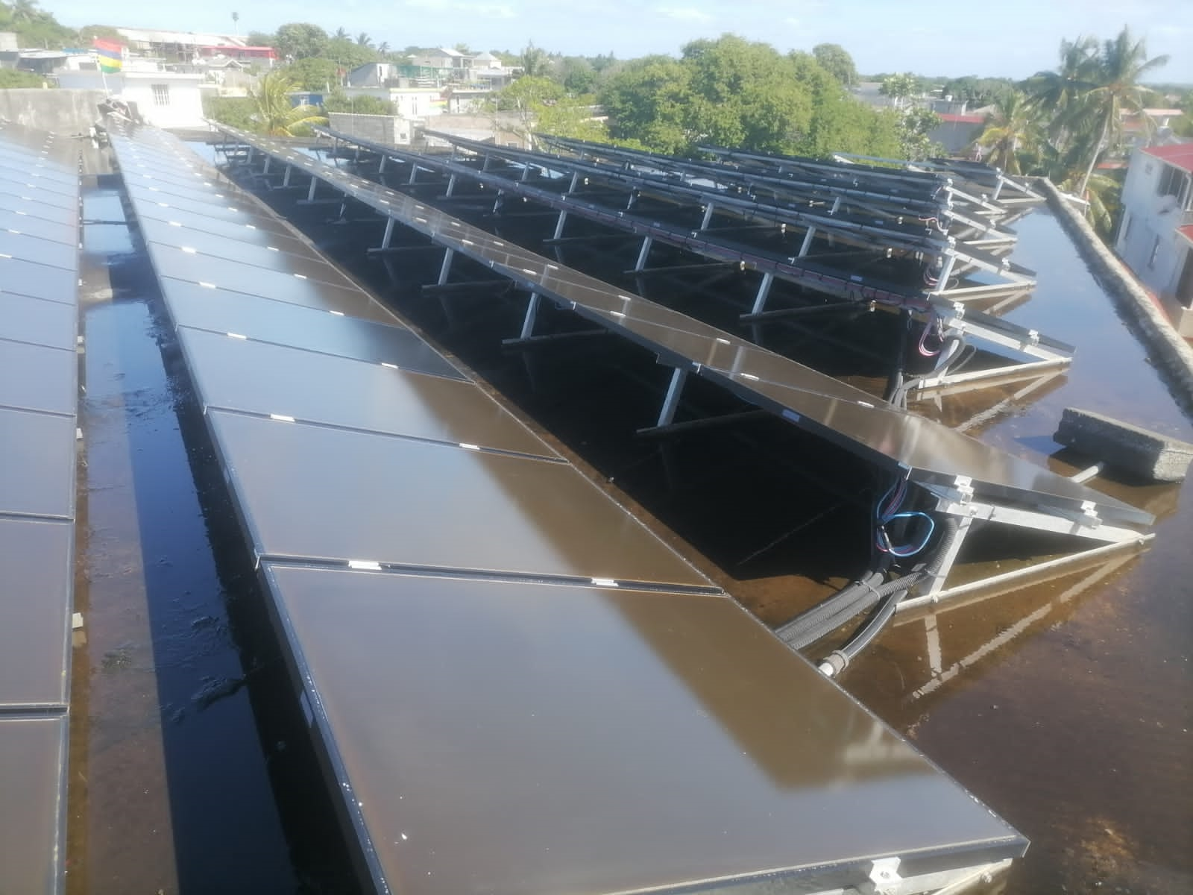
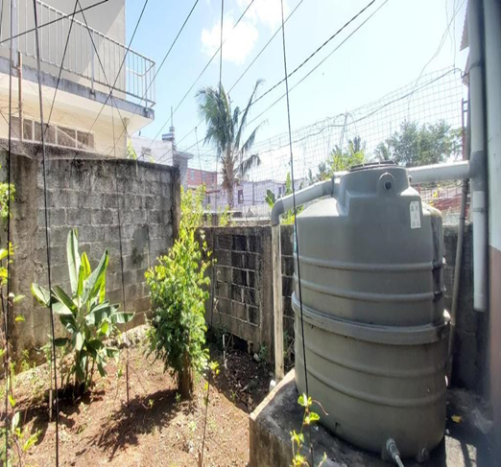
SOLAR PANELS
RAIN WATER HARVEST

Slide 5
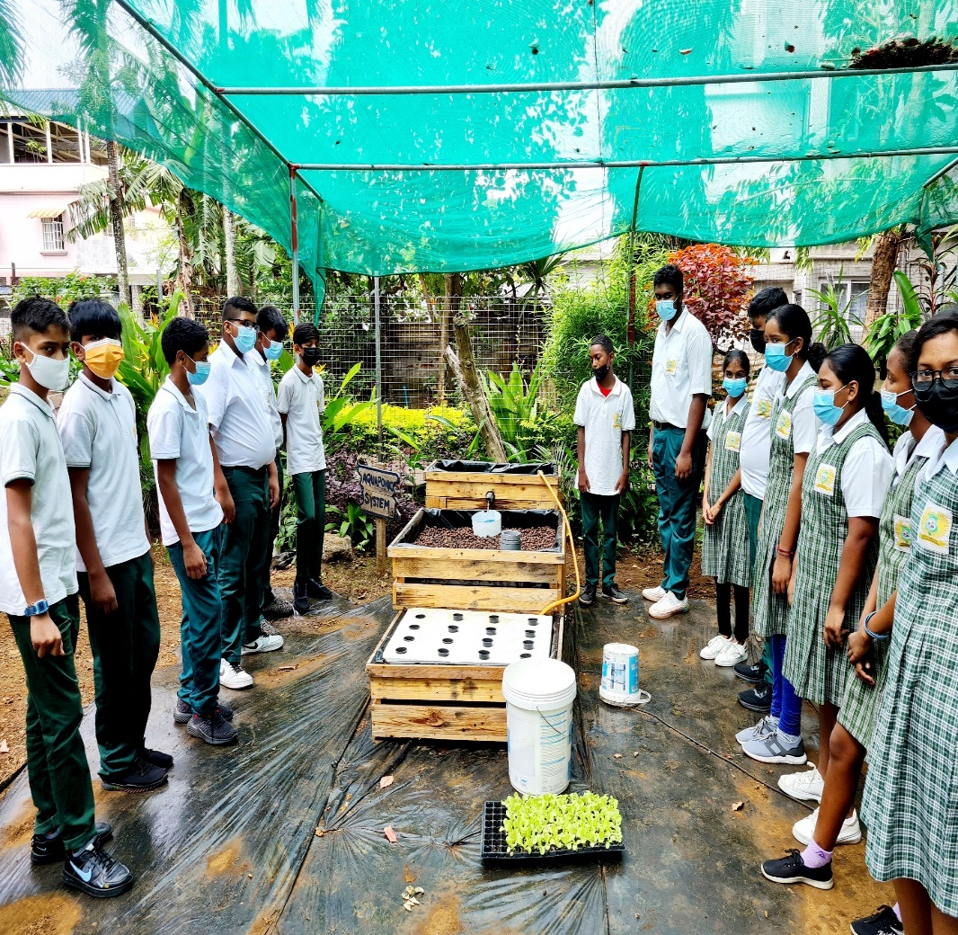
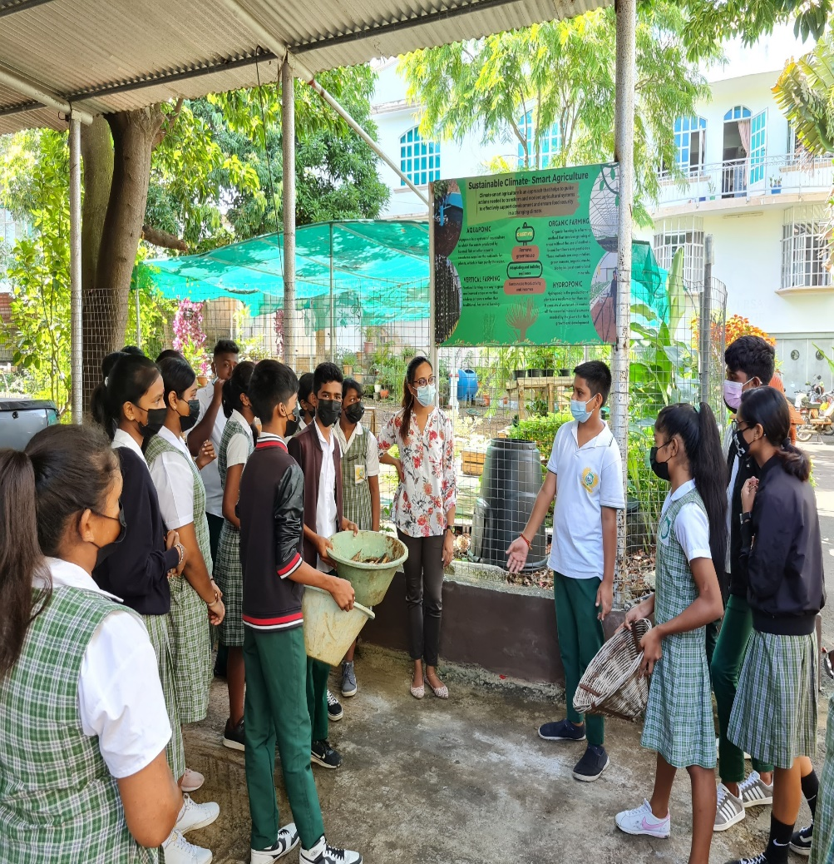
Sustainable Climate Smart Agricultural Practices

Slide 6
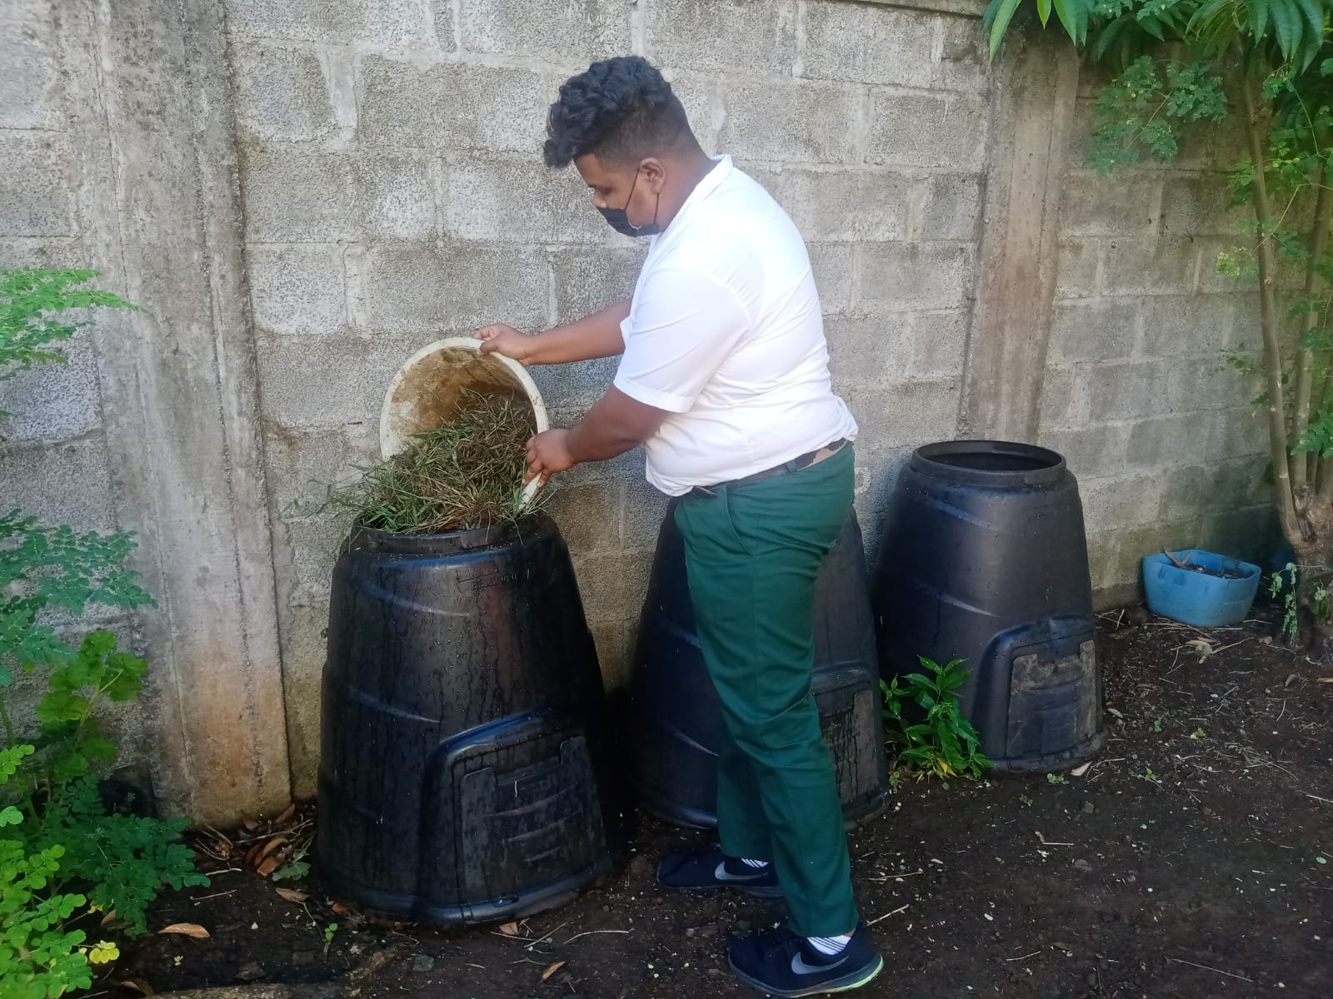
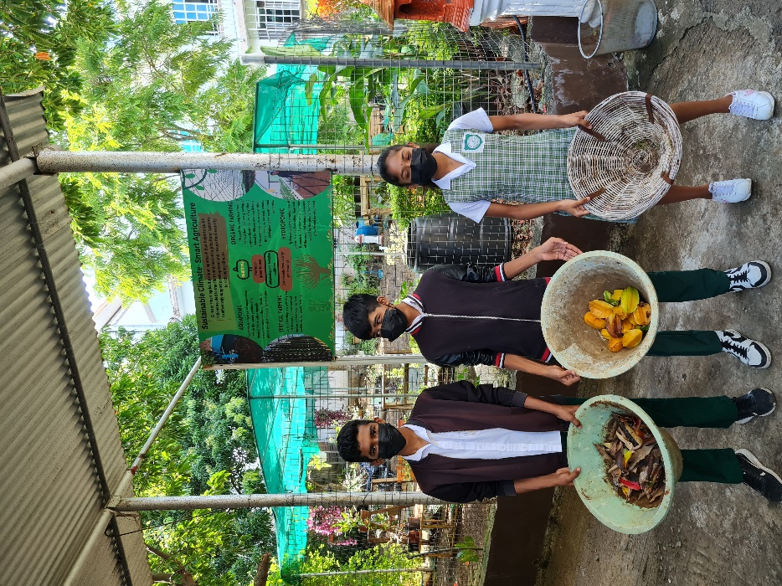
COMPOST MAKING

Slide 7
Our Involvement (Leadership Dialogue 1)
Activities at Community Level
Tree Planting
Planting /Embellishment of Gardens in the Community (Riviere du Rempart Area Health Centre , Promenade)
Planting of Endemic Plants
Distribution of Medicinal & Decorative Plants
Cleaning of Public Beaches

Slide 8
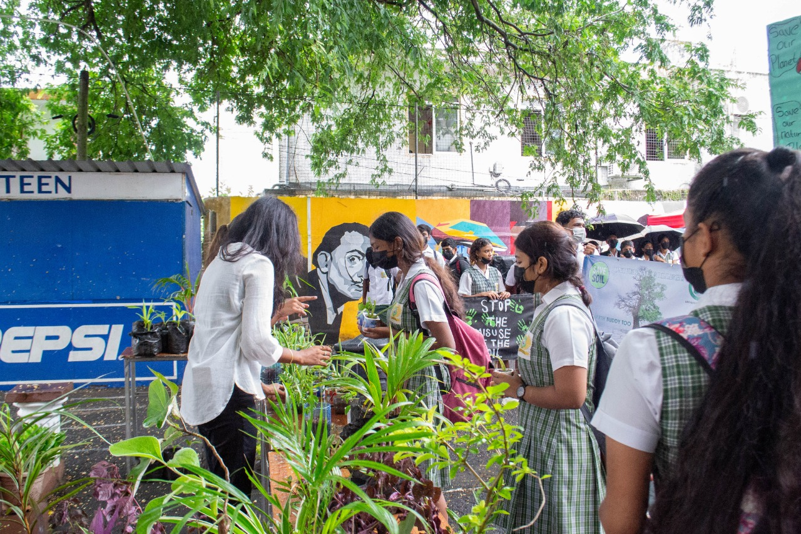
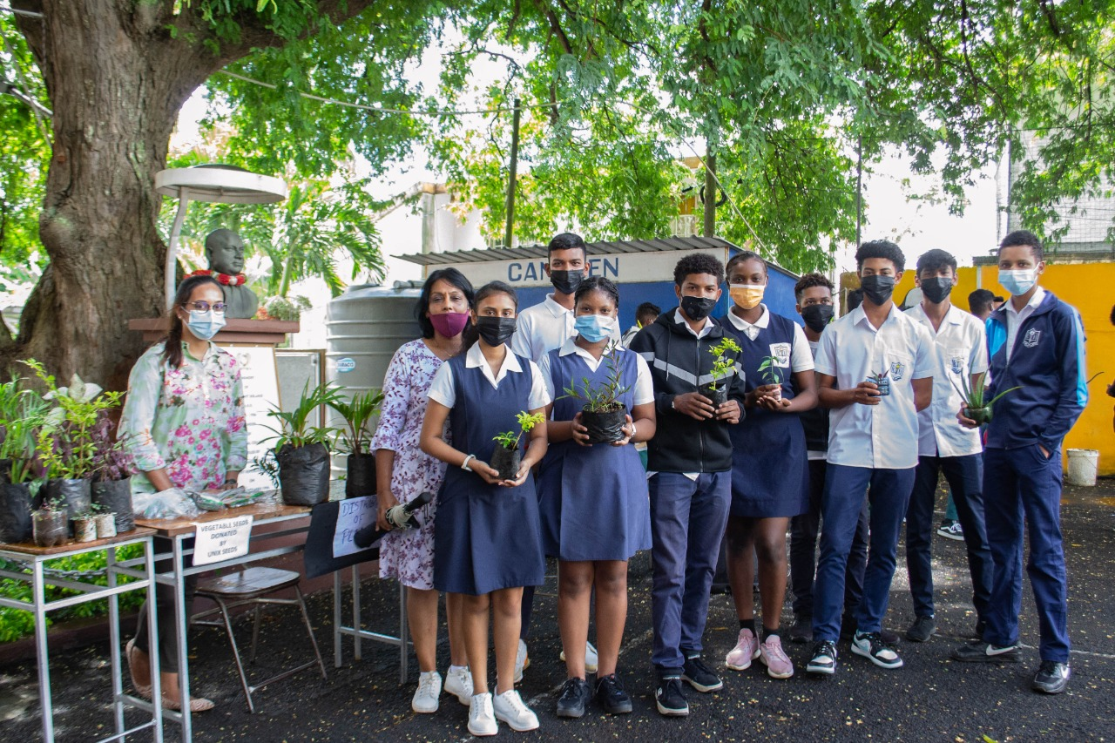
DISTRIBUTION OF PLANTS

Slide 9
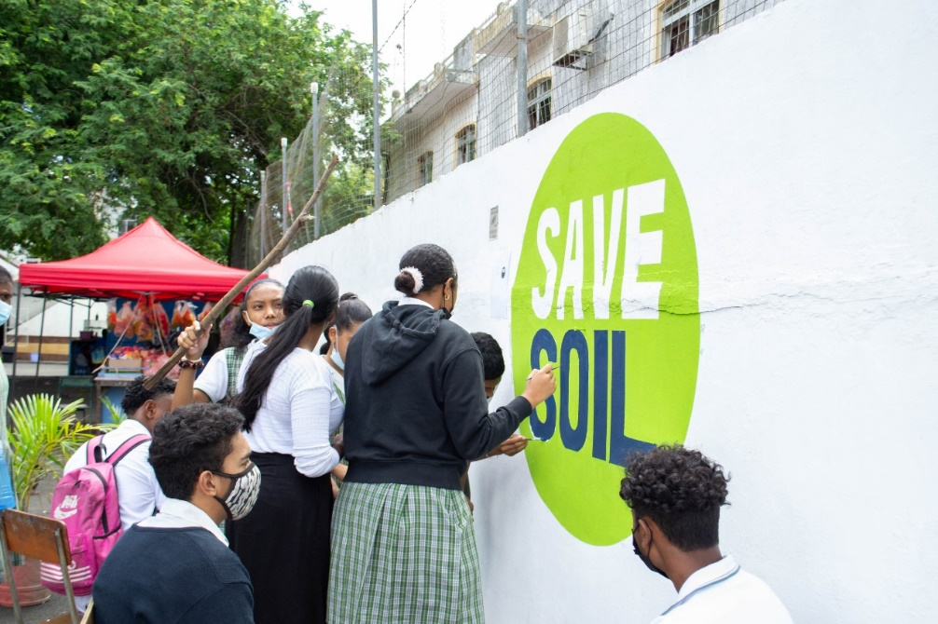
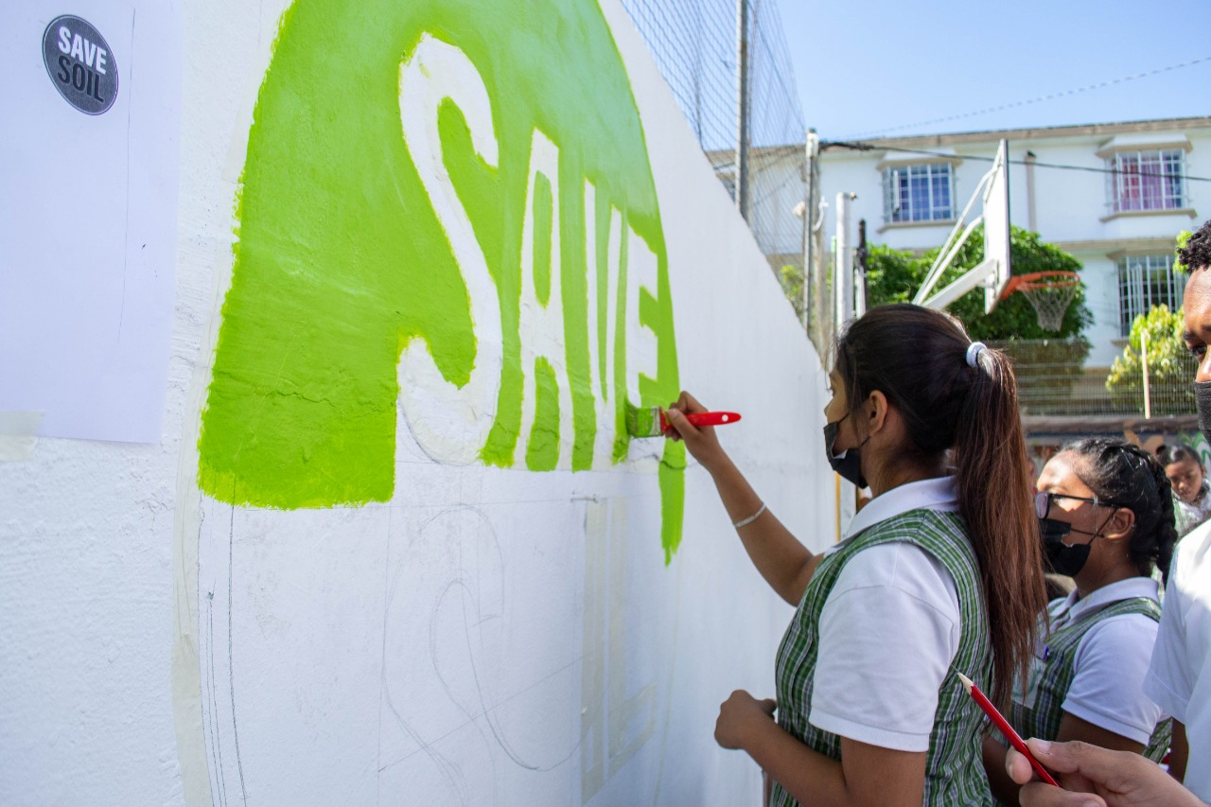
MURAL PAINTING

Slide 10
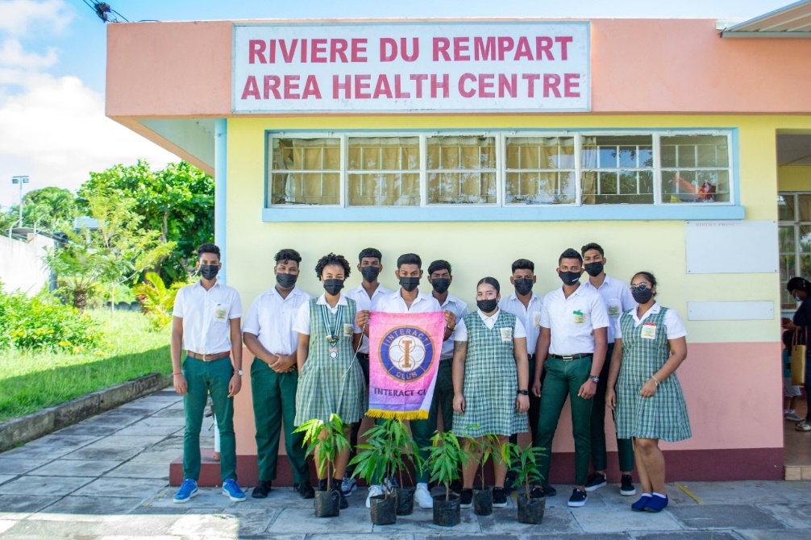
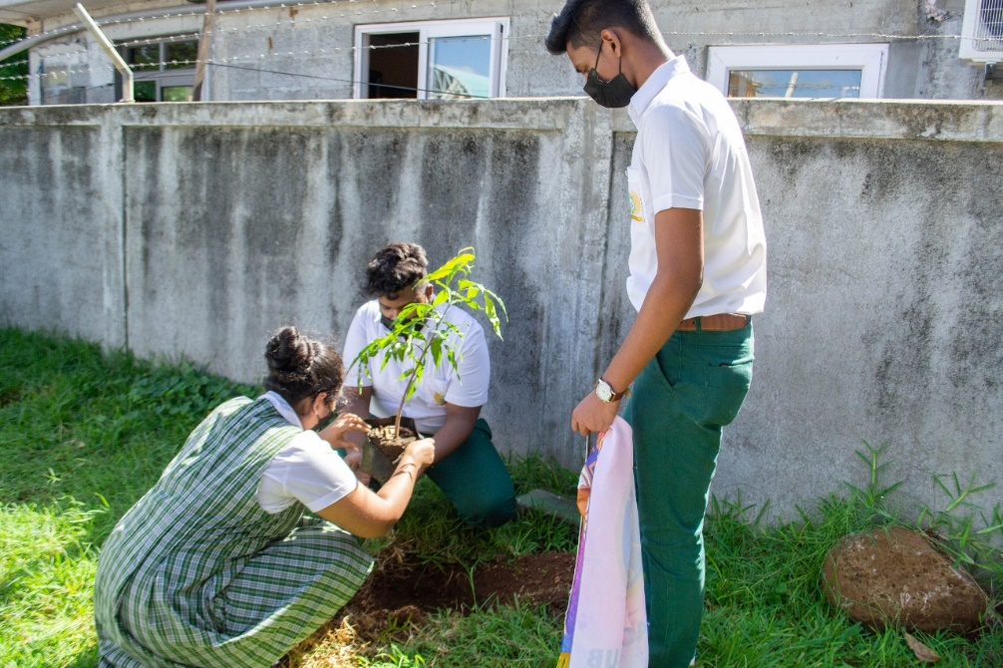
PLANTING & EMBELISHMENT OF THE COMMUNITY

Slide 11
Leadership Dialogue 2
Sustainable & Inclusive Recovery from
Covid-19
Continuous Sensitisation at National Level
Continual Motivation of the Population
Effective Communication
Proper Education of our Youth
Notes:
-

Slide 12
Leadership Dialogue 3
Challenges To Achieve The Commitments (2030 Agenda & Other Environmental Commitments)
Intensive Awareness on SDGs
Special Attention to :
SGD 2 : To end hunger, achieve food security and improved nutrition and promote sustainable agriculture.
SDG 4 : To ensure inclusive and equitable quality education
and promote lifelong learning opportunities.
SDG 15 : To protect, restore and promote sustainable use of terrestrial ecosystem , sustainably manage forests, combat desertification and halt and reverse land degradation and biodiversity loss.

Slide 13
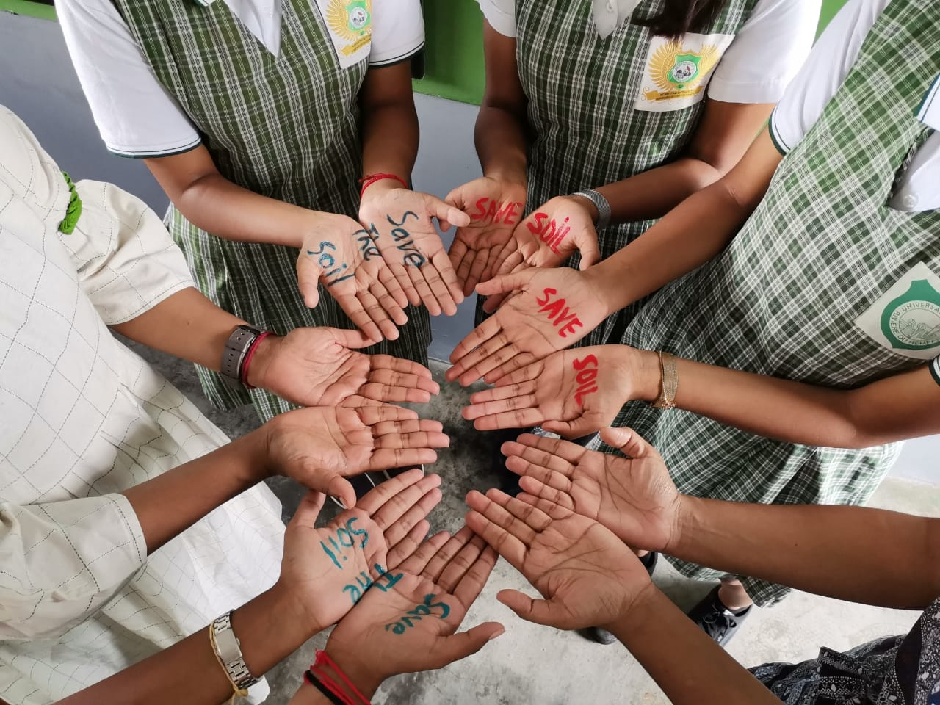
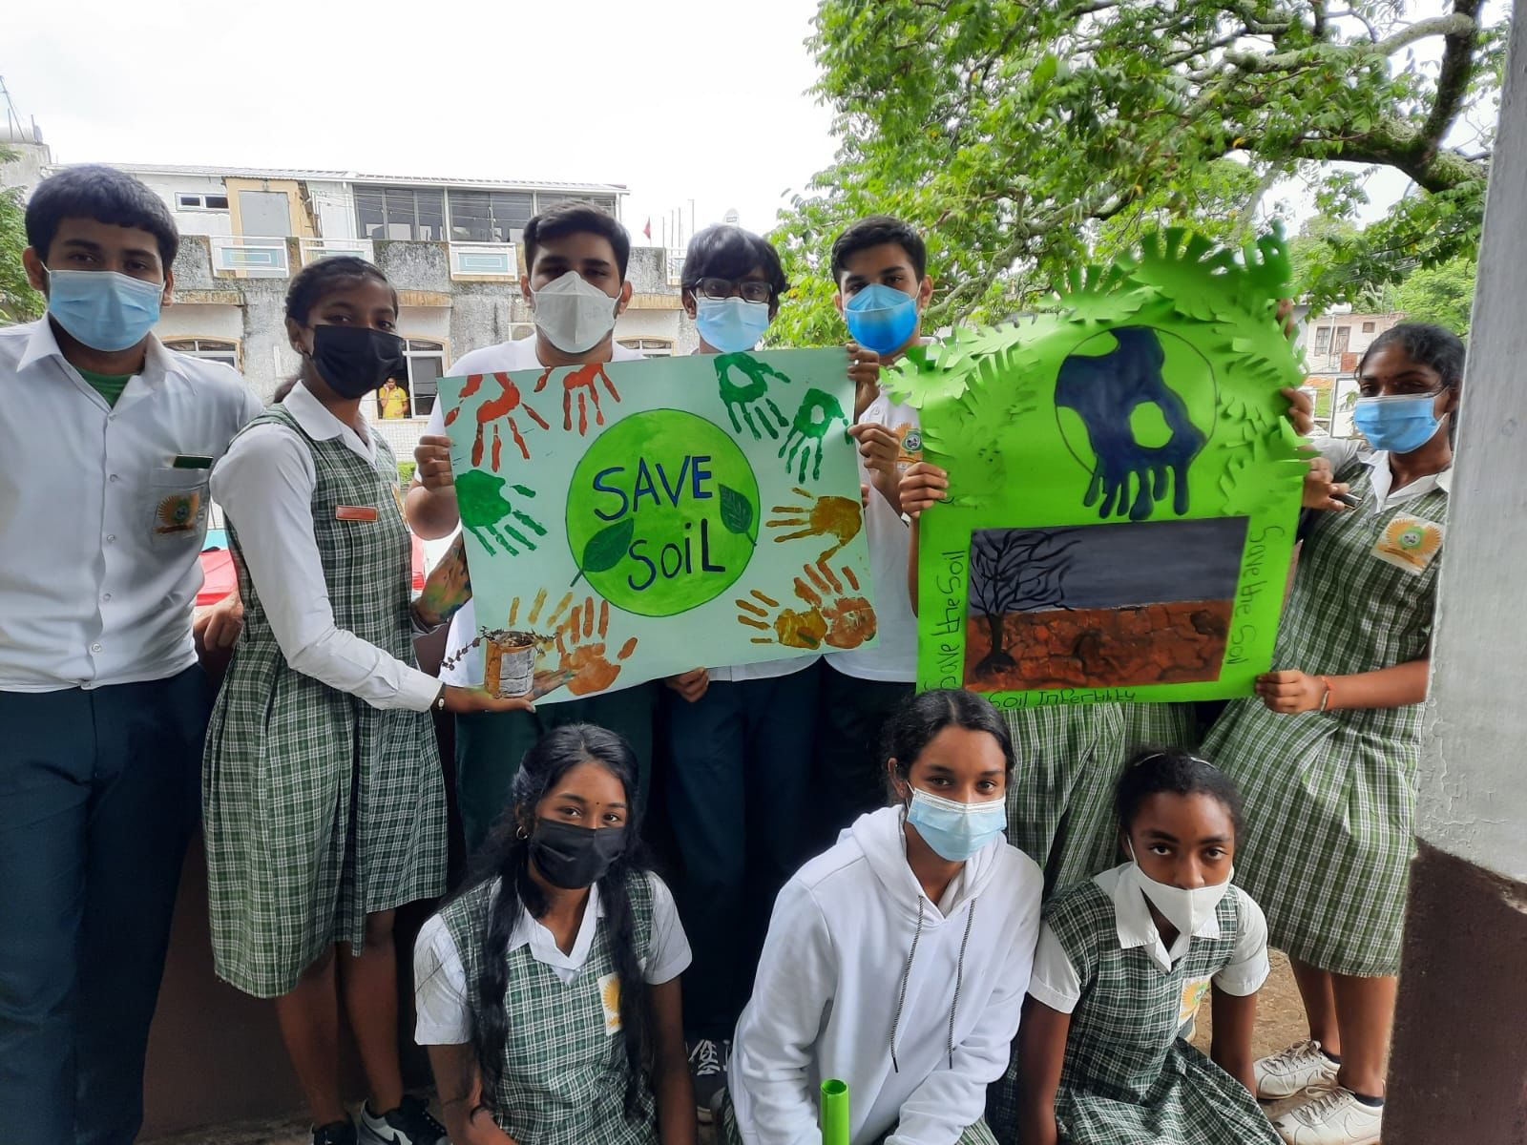
SAVE SOIL PROJECT

Slide 14
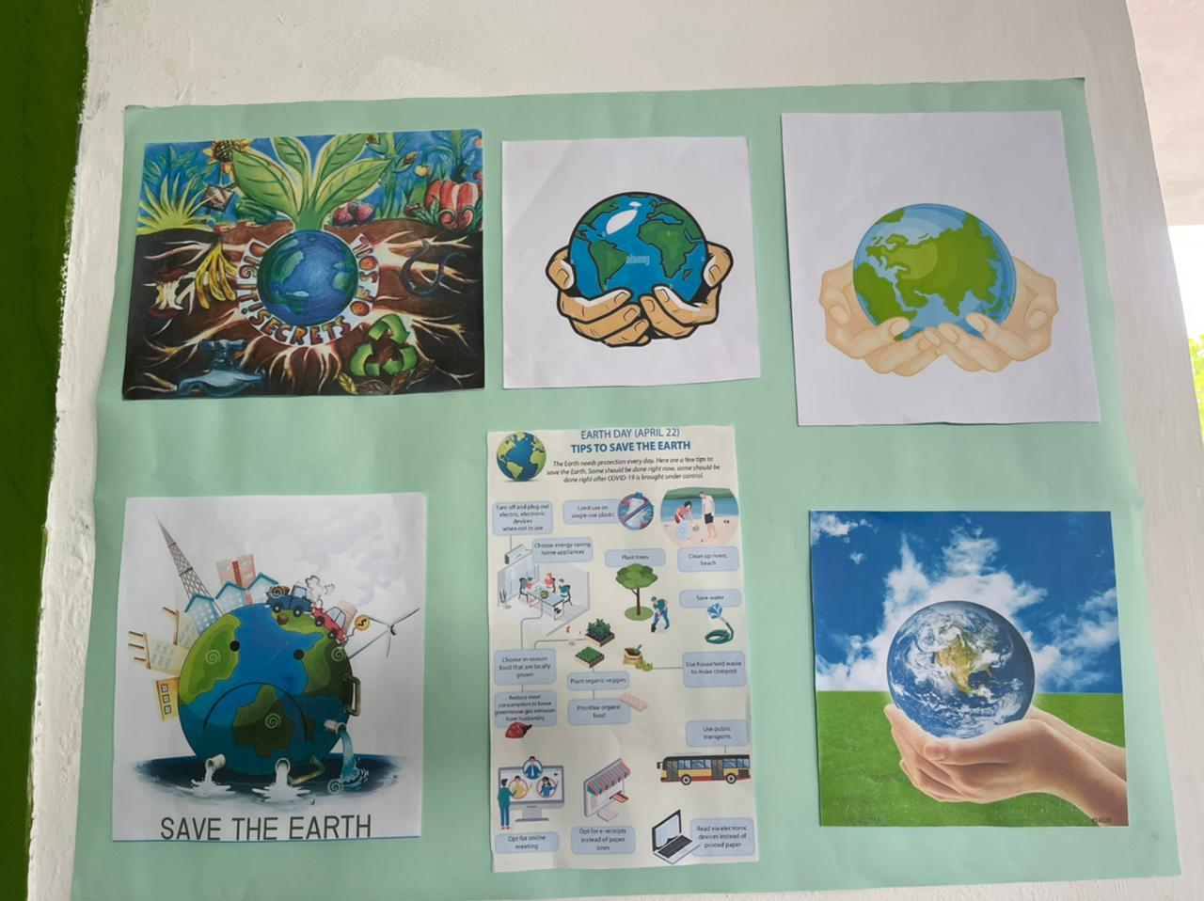
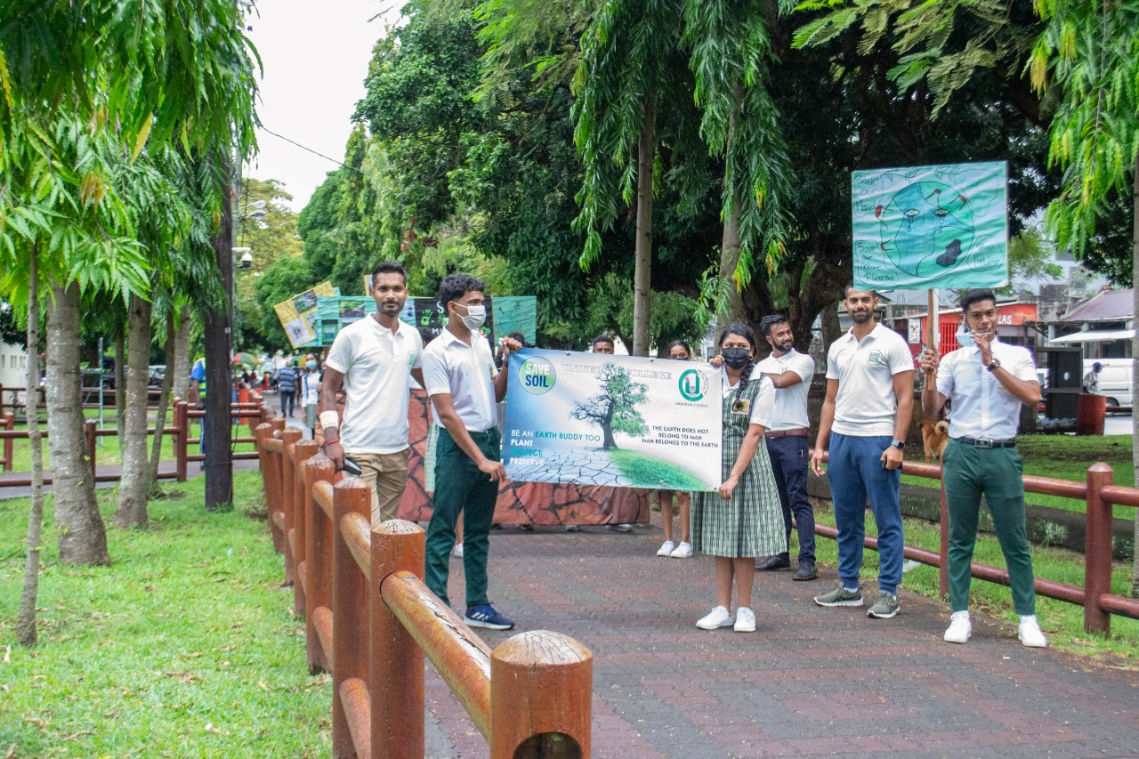
SAVE SOIL PROJECT

Slide 15

Thank You

