Slide 1

Ministry of Environment, Solid Waste Management and Climate Change
Key Messages from Stockholm +50 Consultations
28 April 2022

Slide 2

Ministry of Environment,
Solid Waste Management
and Climate Change
Contents
Consultation Process
LD 1: Healthy Planet and Prosperity for All
LD 2: Sustainable and Inclusive Recovery from COVID-19
LD 3: Implementation of Environmental dimensions of SDGs
Vulnerable Groups & Grassroots specific feedback

Slide 3
Ministry of Environment,
Solid Waste Management
and Climate Change
Sectoral Consultations
Consultations carried out in close collaboration with Min of Environment (MESWMCC)
In compliance with guidelines provided by Stockholm + 50 Team
Inclusiveness & give the voice to those who would not have had the opportunity
Youth and Persons with disabilities
Women and Elderlies
Vulnerable persons
Large proportion of Youth
National Consultations session of today – whole range of stakeholders

Slide 4
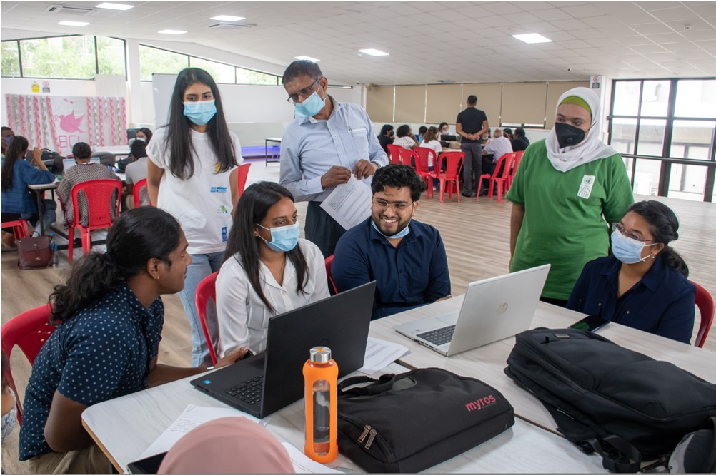
Ministry of Environment,
Solid Waste Management
and Climate Change
University of Mauritius
Over 30 students from several faculties
Staff members as facilitators
Launching session of Stockholm +50 Consultations held on 30 March 2022

Slide 5
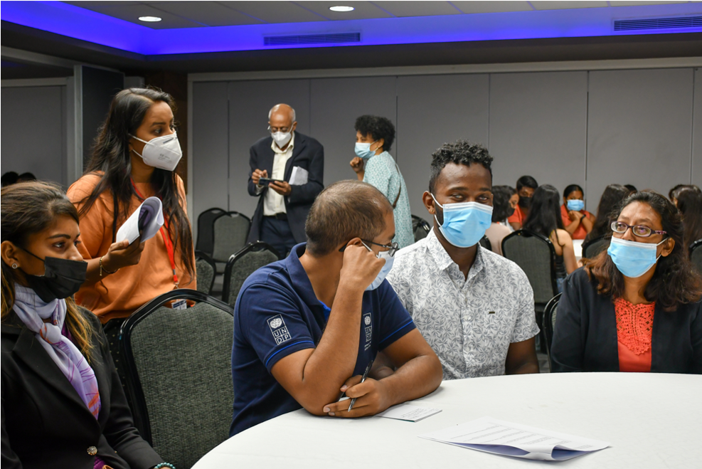
Ministry of Environment,
Solid Waste Management
and Climate Change
Youth and Persons with Disabilities
Min of Youth Empowerment, Sports and Recreation Cadres
Regional Youth Empowerment Teams
Regional Youth Councils
National Youth Environment Council
Min of Social Integration, Social Security & National Solidarity
Association of Disability Providers, Lizie dans la main & Other NGOs
40 present & 60 youths online
6 April 2022

Slide 6
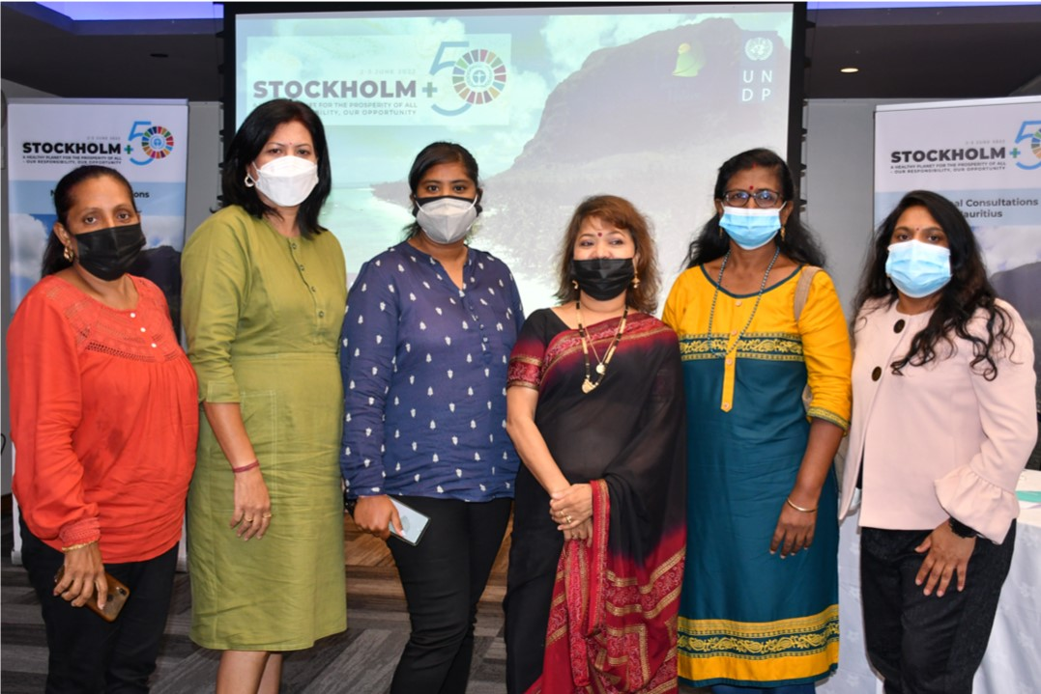
Ministry of Environment,
Solid Waste Management
and Climate Change
Women and Elderlies
Min of Gender Equality & Family Welfare
National Women Council
National Women Entrepreneur Council
Women Associations
Social workers & Village Councillors
Min of Social Integration, Social Security & National Solidarity
Senior Citizens Representatives across the island
Hybrid session – 50 participants
7 April 2022

Slide 7
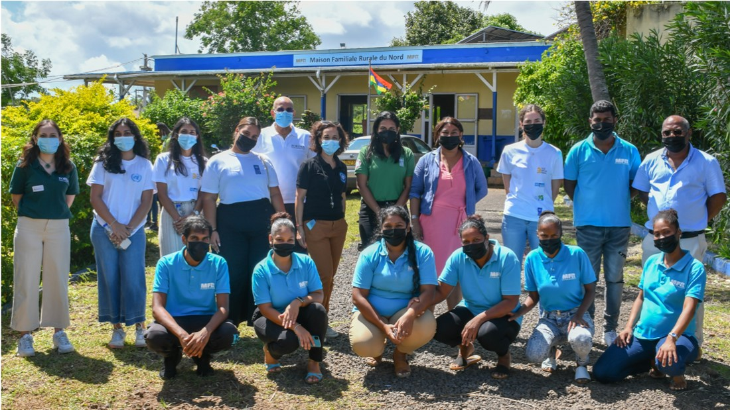
Ministry of Environment,
Solid Waste Management
and Climate Change
Students of Maison Familiale Rurale, Calebasses
36 Youths representing vulnerable population & vulnerable youths of Mauritius.
MFR Instructors
Facilitated by UNDP GEF Small Grants Programme & Fondation Resources et Nature (FORENA)
11 April 2022

Slide 8
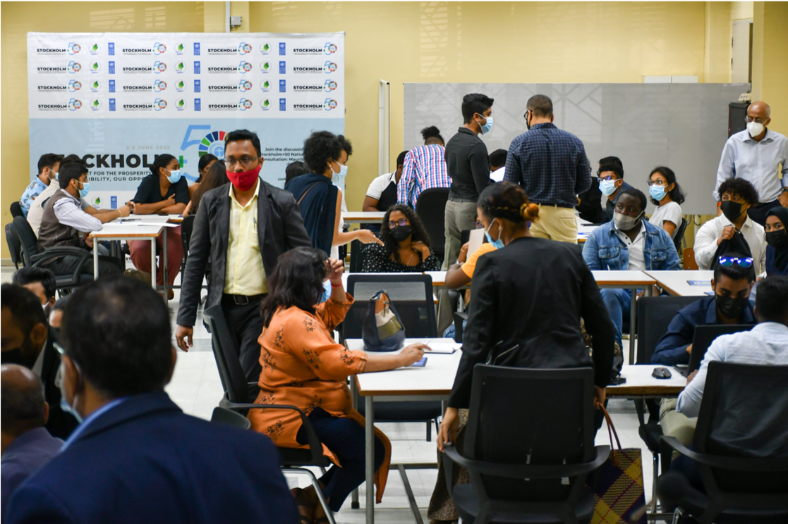
Ministry of Environment,
Solid Waste Management
and Climate Change
Universite De Mascareignes
Over 70 students present in two rooms
From three campuses
Facilitated by UDM staff
12 April 2022

Slide 9
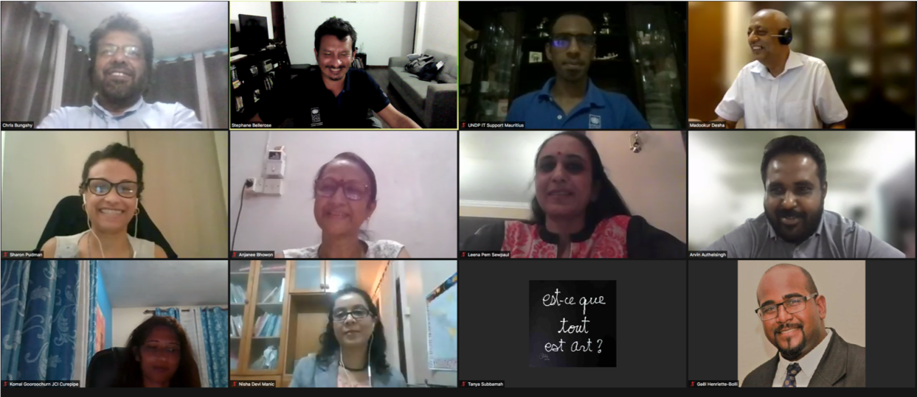
Webinar with Service Clubs
Ministry of Environment,
Solid Waste Management
and Climate Change
Rotary Clubs
JCI
Over 60 participants in this virtual session
13 April 2022

Slide 10
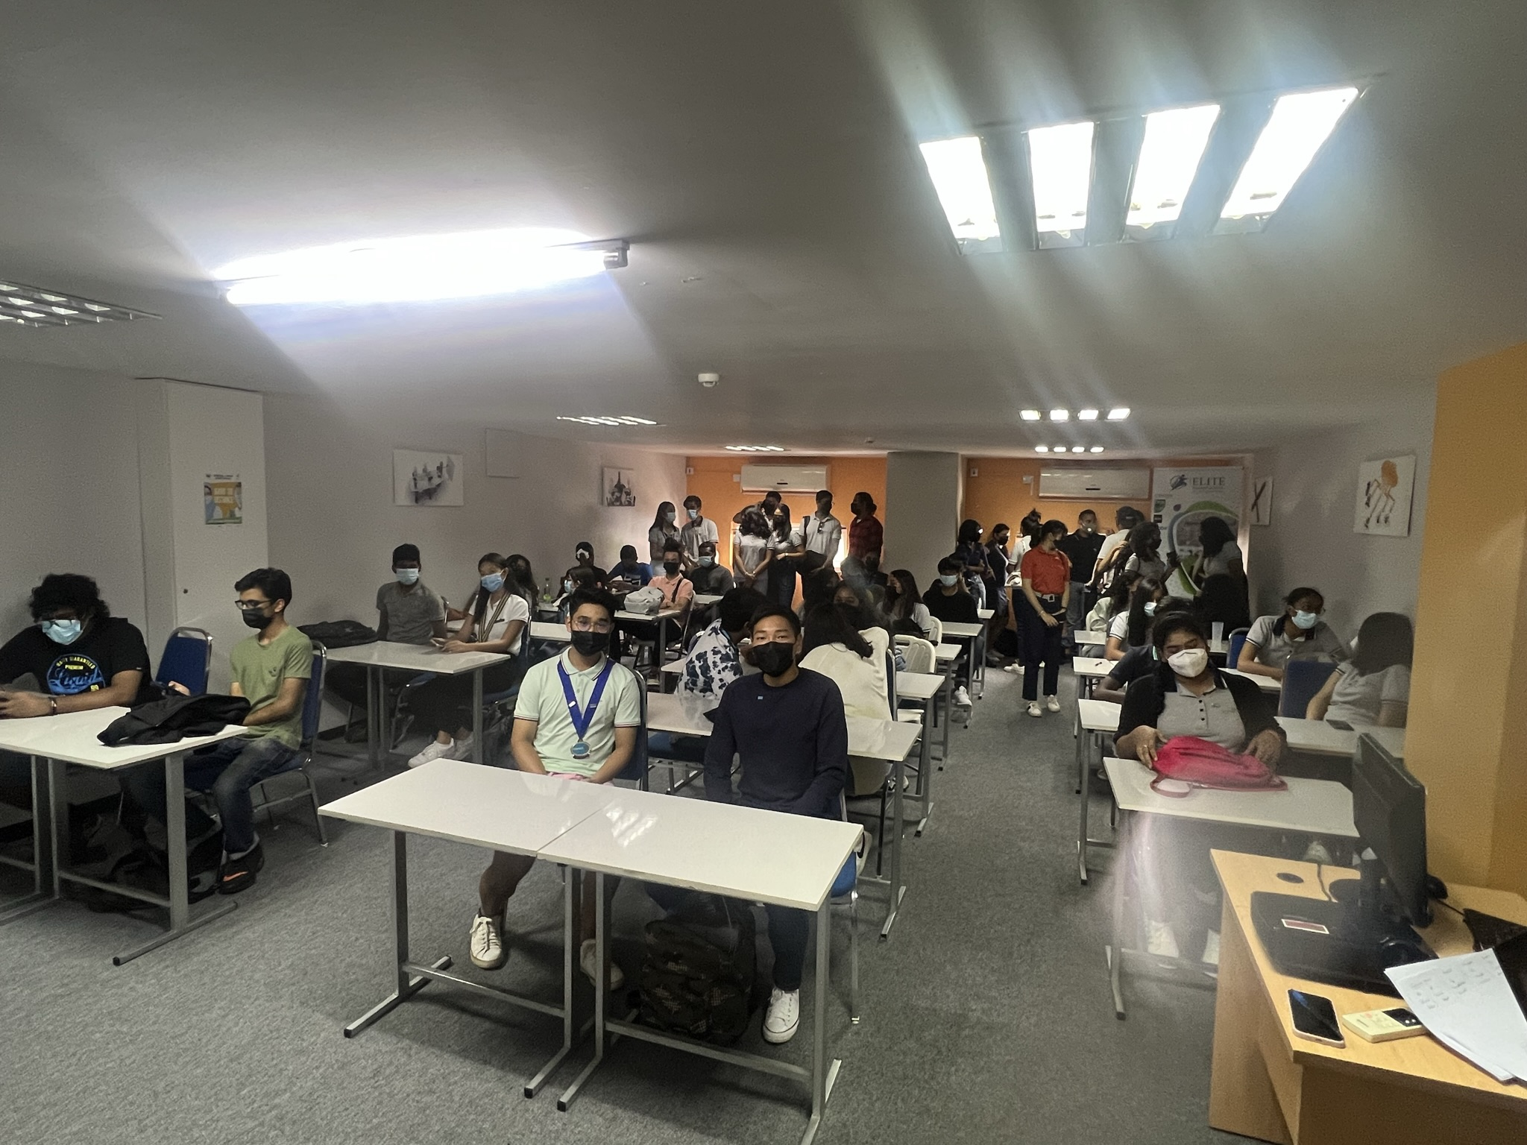
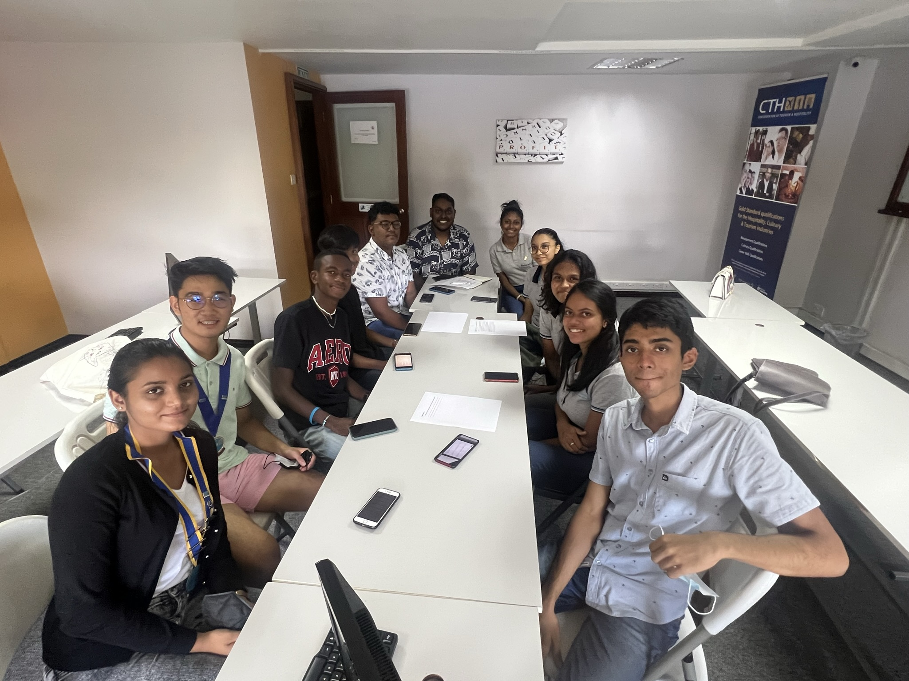
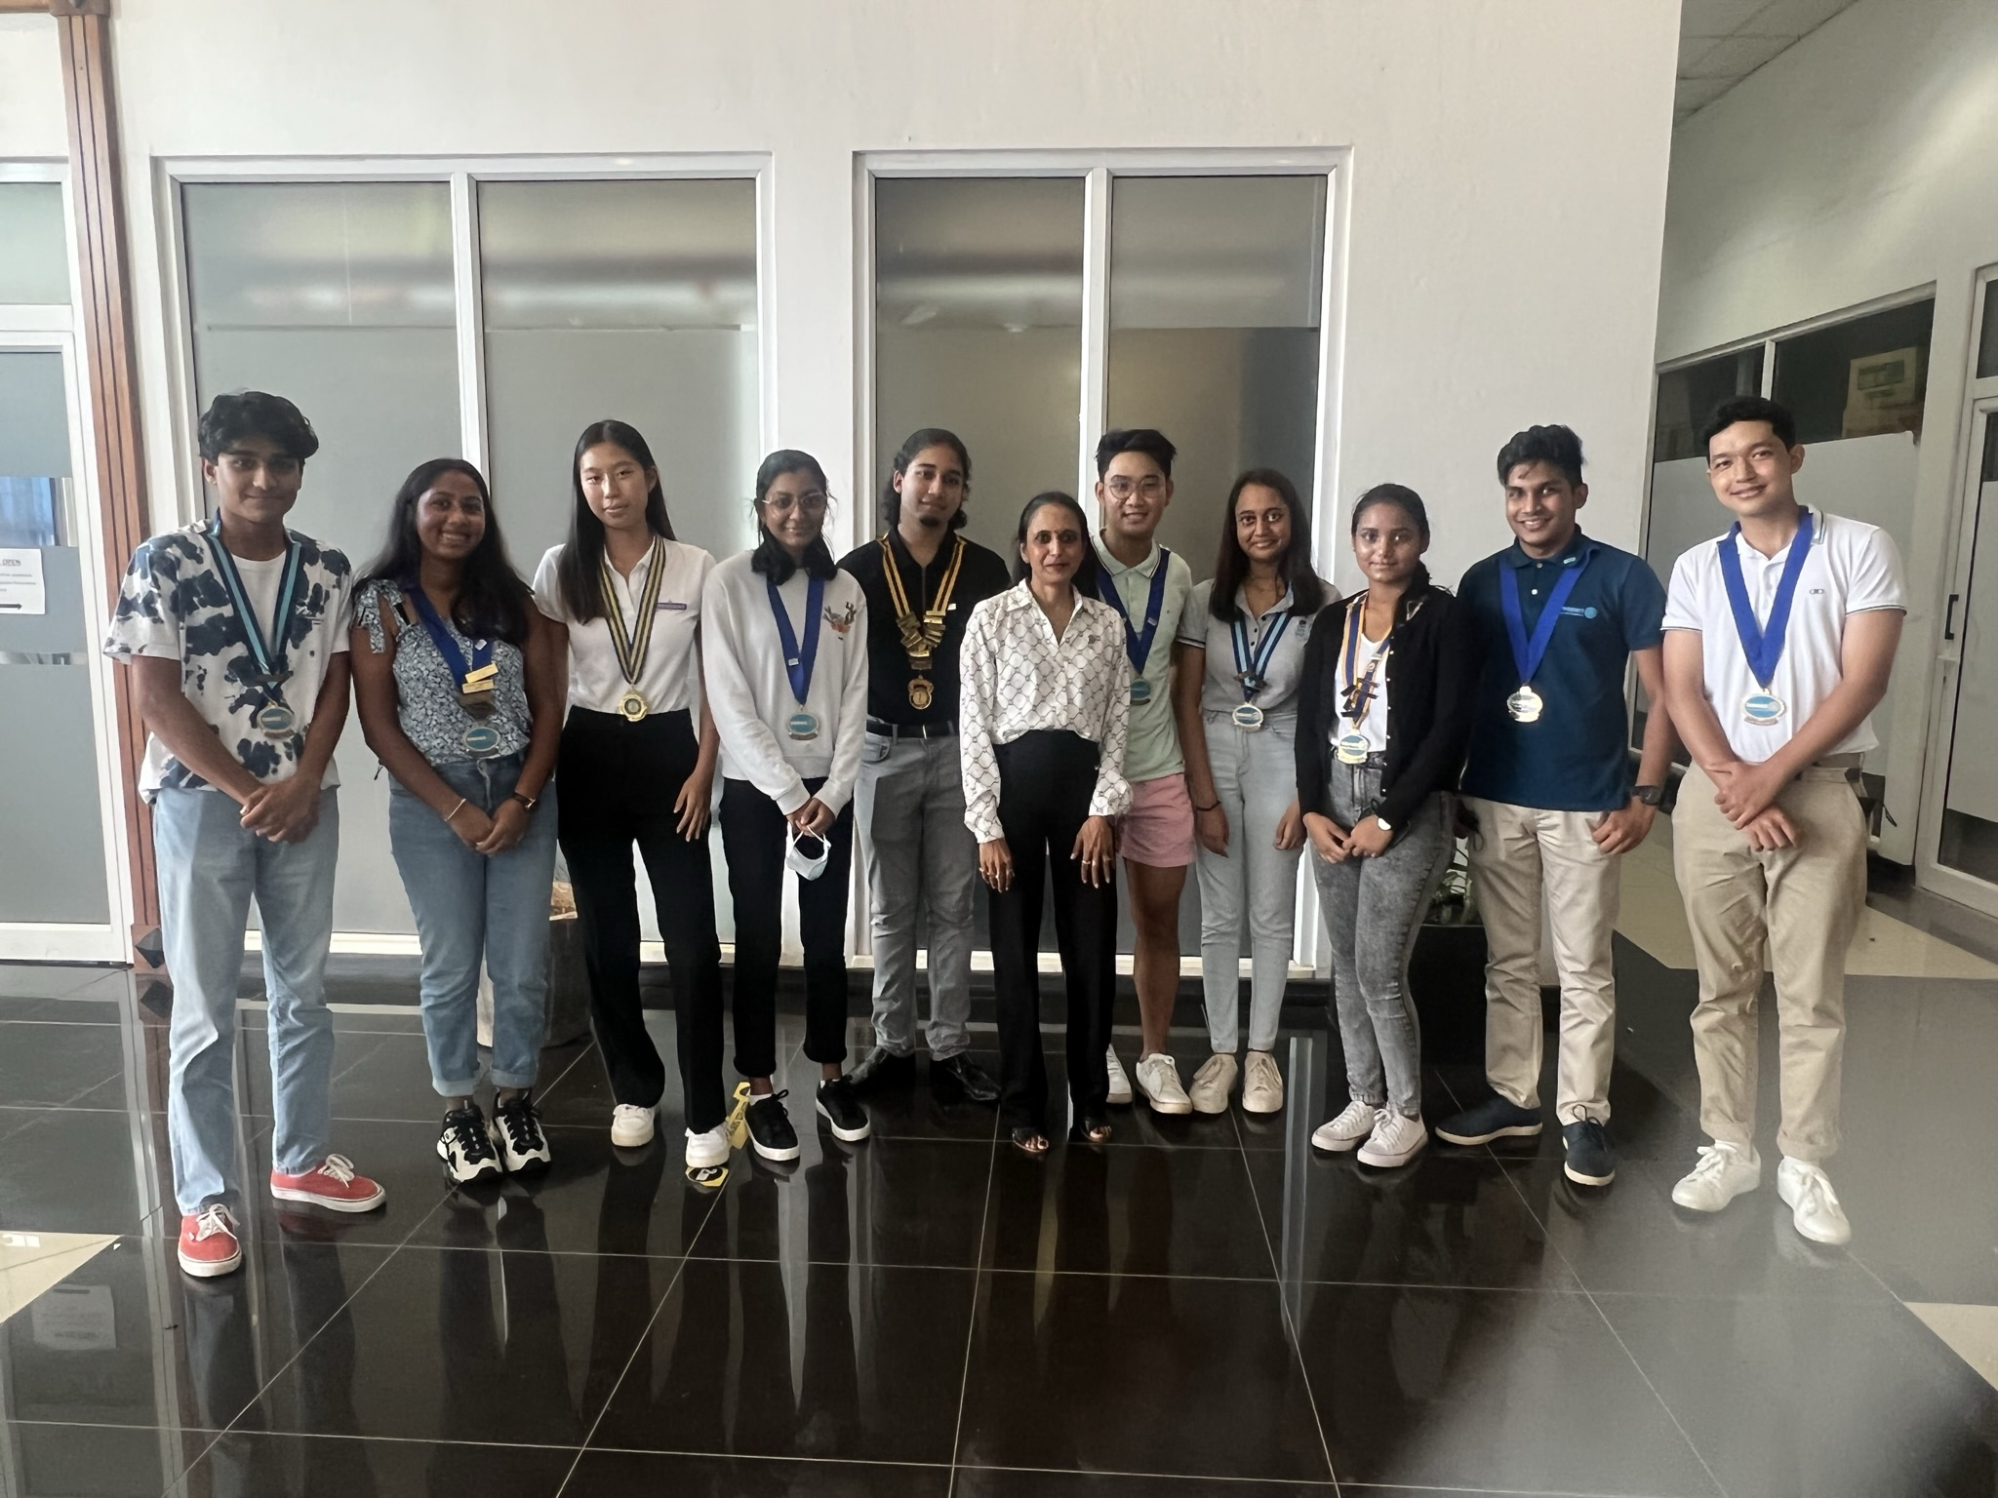
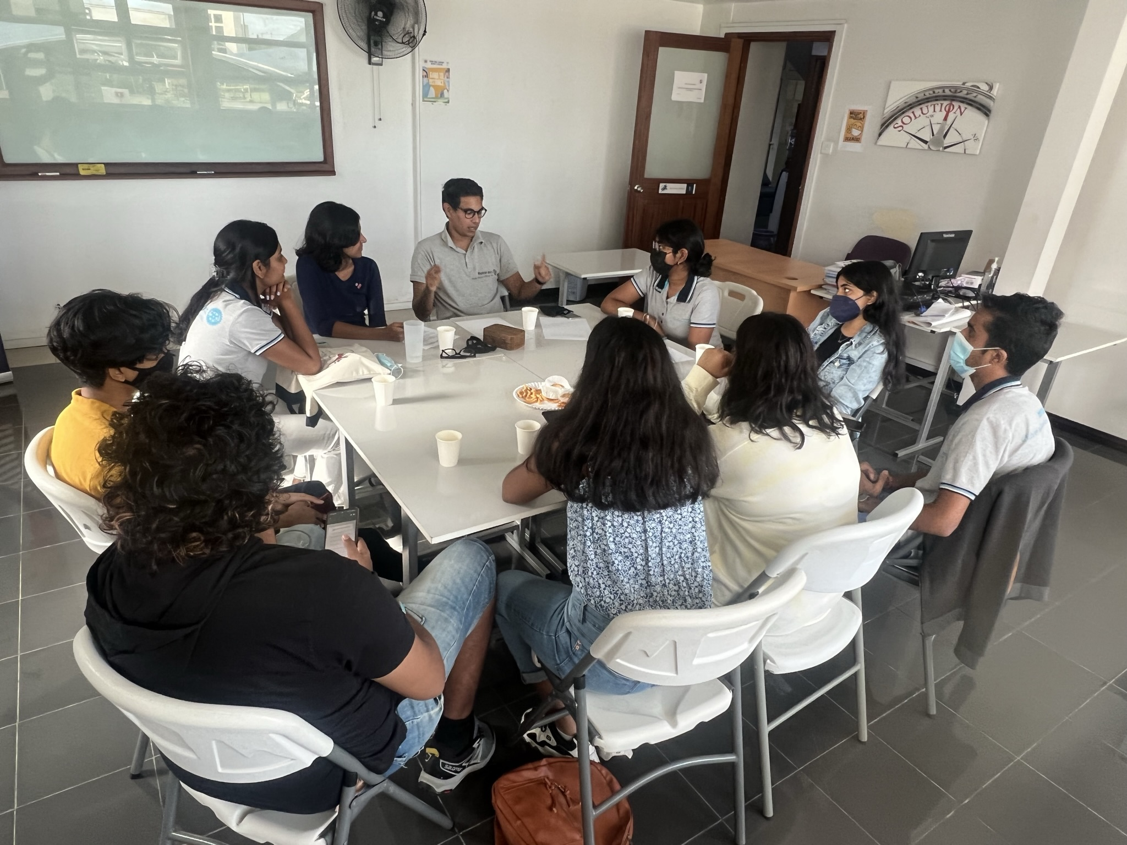
Interactors &
Rotaractors
Ministry of Environment,
Solid Waste Management
and Climate Change
Working session - group of 60
Interactors (14-18 years) and Rotaractors (18-30 yrs)
Facilitated by a District Officer
3 April 2022

Slide 11
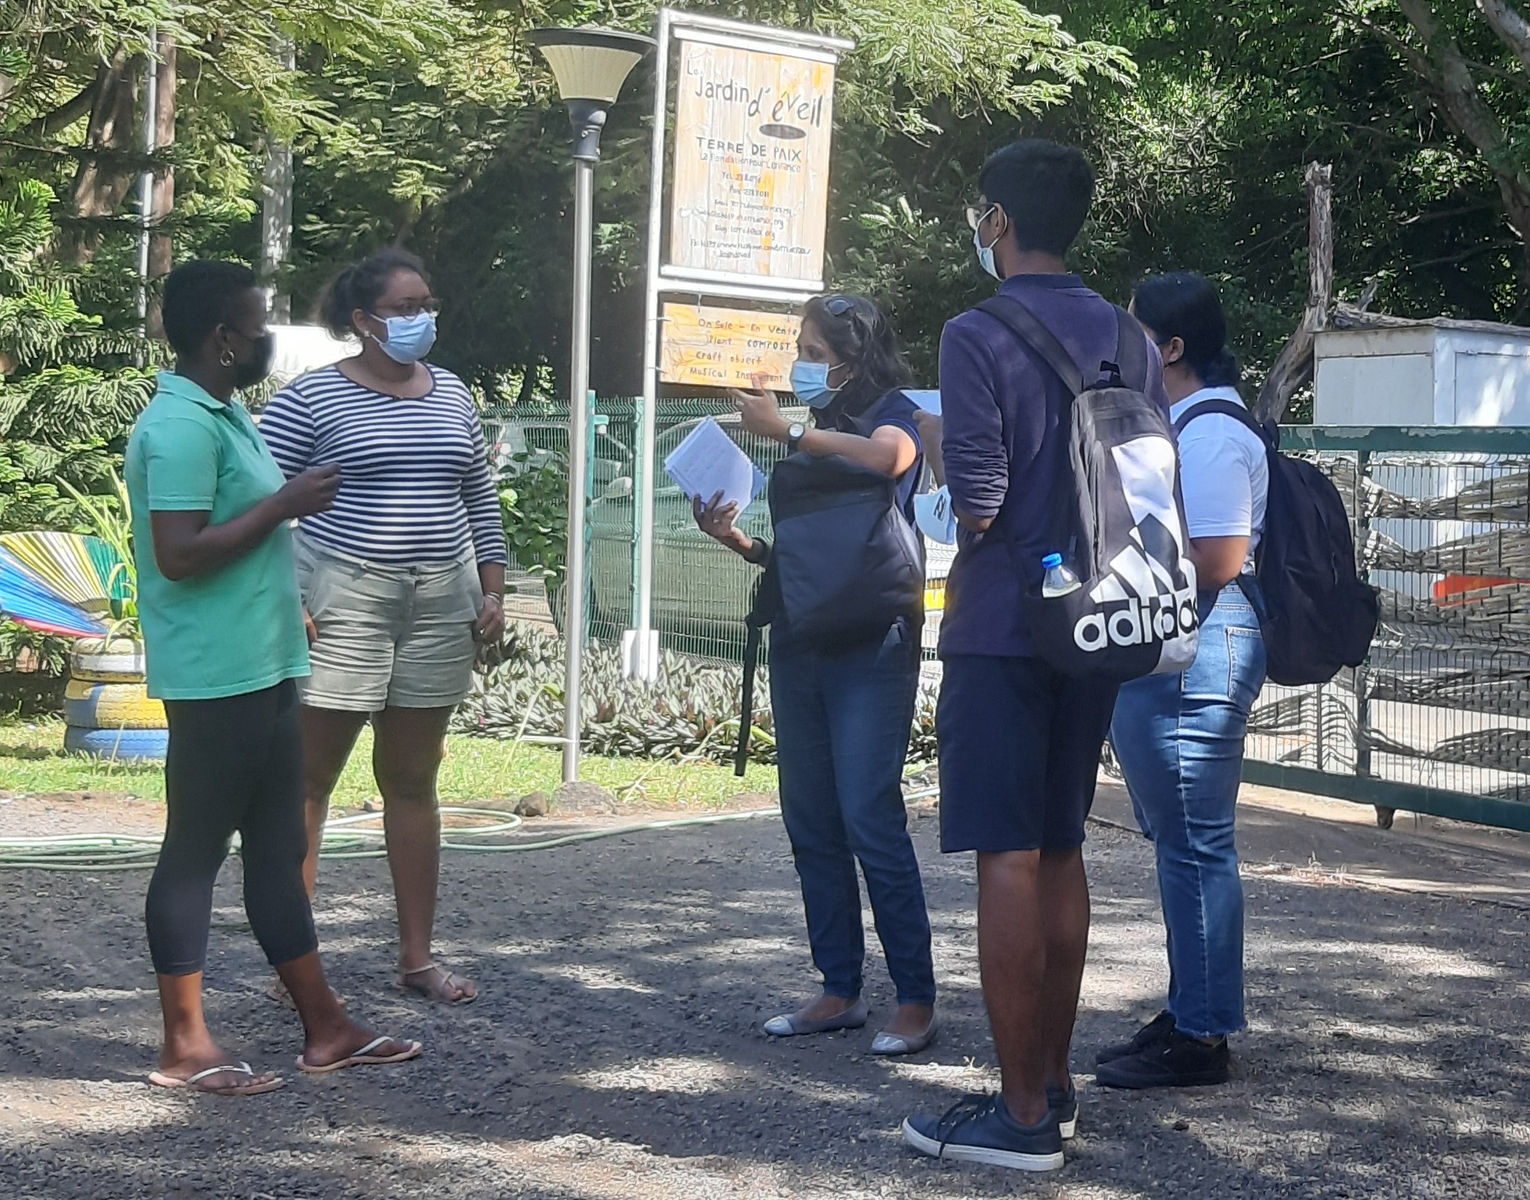
Grassroot Consultations
Ministry of Environment,
Solid Waste Management
and Climate Change
Facilitated by UNDP Accelerator Lab
15 Mch - 15 Apr 2022
Random selection of 49 interviewees at different locations.
Inclusive, bottom-up approach

Slide 12
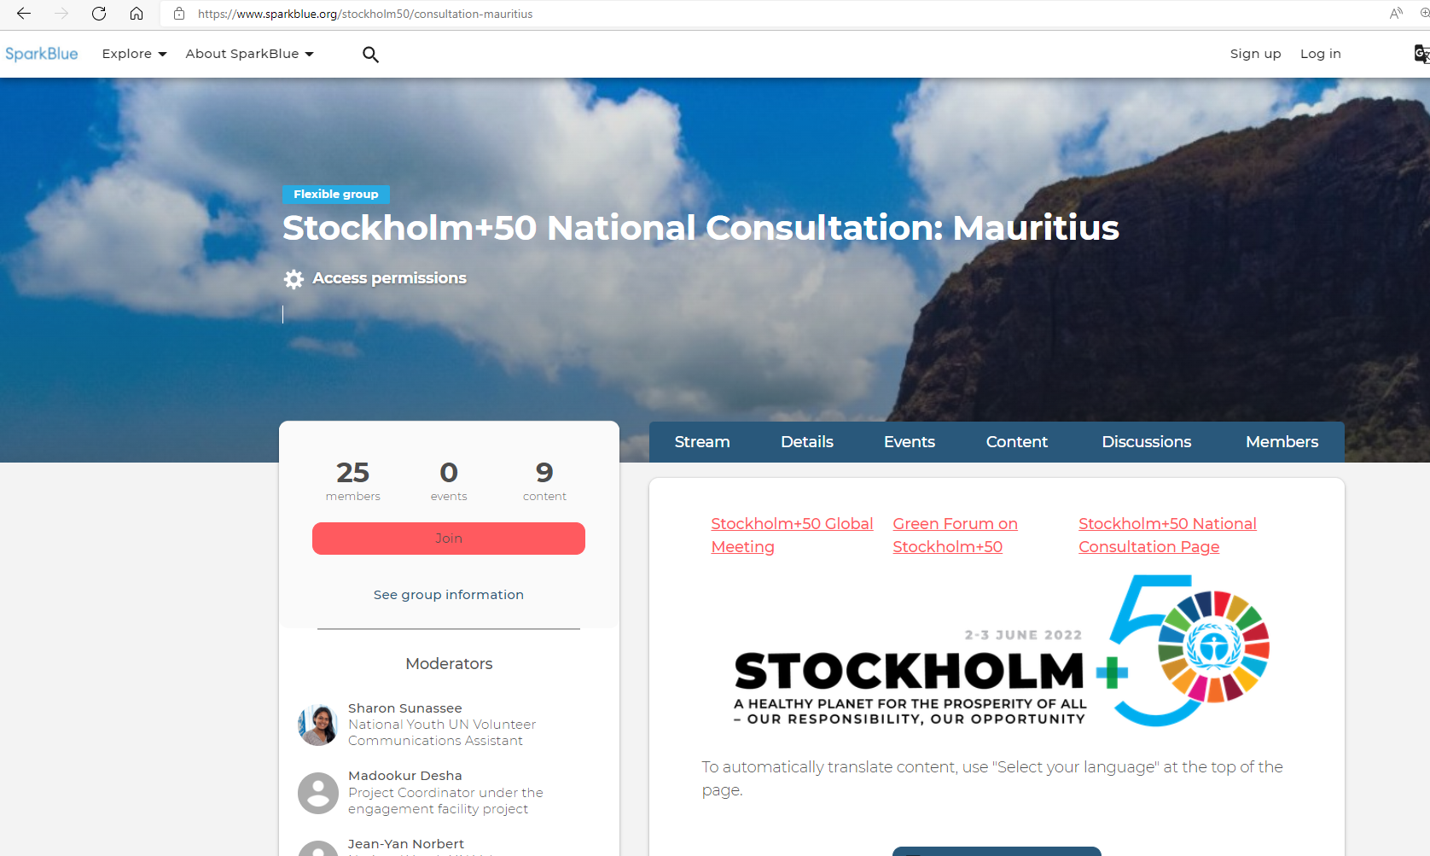
Survey and Sparkblue
Ministry of Environment,
Solid Waste Management
and Climate Change
Questionnaires sent to 140 stakeholders
Invitation to stakeholders to participate in discussions on Sparkblue, through social media.
Global Survey:
State of the Planet: Global Public Survey | Stockholm+50

Slide 13
Ministry of Environment,
Solid Waste Management
and Climate Change
LD 1:Healthy Planet and Prosperity for All
Urgent action - social and environmental protection measures & nature-based solutions
Waste management measures – segregation, infrastructure, 5 Rs, awareness
Food security proposals – domestic gardening & composting, exploit unused lands, national strategies for self sufficiency. Reduce food wastage.
Sustainable Consumption and Production - improved sensitization and behavioral changes
Tree planting at domestic, regional and national levels. Urban greenery

Slide 14
Ministry of Environment,
Solid Waste Management
and Climate Change
LD 1:Healthy Planet and Prosperity for All (contd)
Afforestation. Positive impacts bio-diversity, soil protection & flood prevention. Water conservation, promote agriculture, agro-forestry & land restoration.
Protection of terrestrial & marine biodiversity. Negative impacts of fertilizers, pesticides and insecticides.
Renewable energy, resource efficiency & energy efficiency measures. Promote public transport and electric vehicles.
Proper bicycle tracks to cycle around freely and securely.

Slide 15
Ministry of Environment,
Solid Waste Management
and Climate Change
LD 2: Sustainable and Inclusive Recovery from Covid-19
Recovery – Work and study from home. Business Continuity Plans in public & private sectors. Further Digitalisation
Continue Vaccination and sanitary protection measures
Changes - encourage local production. Sustainable procurement practices in public and private sectors. Support sme’s (esp Youth & Women msme’s).
Need major changes in behavioural patterns. Build back better, leave no one behind & special consideration for people with disabilities.

Slide 16
Ministry of Environment,
Solid Waste Management
and Climate Change
LD 2: Sustainable and Inclusive Recovery from Covid-19 (contd)
Improved international cooperation. Address trade barriers for easier access to vulnerable populations of medications.
Enhanced Skills and lifelong learning to improve the livelihoods of vulnerable workers and small-scale farmers,
Local industries to decarbonise supply chains & modernise operations thr’ ICT
Critical sectors: Public Utilities, Water & Sanitation, Health, Manufacturing, Energy, Transport, Wastes, Agriculture & Tourism.
Circular economy development model. Extended Producer Responsibility.

Slide 17
Ministry of Environment,
Solid Waste Management
and Climate Change
LD 3: Accelerate Implementation Environmental Dimensions of SDGs
Challenges - Availability of finance, technology transfer, capacity building & training to achieve SDG targets and climate change resiliency measures.
Increasing energy requirements and waste generation.
Enabling Envt – Need collaborative partnerships, knowledge-sharing & application of best practices. Acquisition of new & innovative technologies.
Good practices - Circular economy, ecological transition, adoption of nature-based solutions. Eliminate single use plastic products & reduce plastic wastes.
Pathways - lifestyle changes, engagement of youngsters and participation of all

Slide 18
Ministry of Environment,
Solid Waste Management
and Climate Change
LD 3: Accelerate Implementation Environmental Dimensions of SDGs (contd)
Improved governance practices, eradicate corruption, more transparency, greater participation of women and youngsters in policy-making process.
Adapt educational system to the needs of industry.
Align finance: Monitor Key Performance Indicators & tracking expenditure for better transparency.
UN agencies: expertise and capacity building e.g. to practise new agricultural methods - aquaponics, vertical culture, permaculture,
Peak demand shaving, cheaper and more efficient vertical-axis wind farms, resource efficiency, smart agriculture, modern healthcare, regenerative solutions

Slide 19
Ministry of Environment,
Solid Waste Management
and Climate Change
Vulnerable Groups Specific feedback
Important to tackle the drug issue
Educate youth, environment friendly activities – to stay away from drugs
Organise activities for youth in poverty-stricken areas
More collaboration with NGO’s & Organs to help families in poor areas
More unbiased law enforcement by the police
Environment often not a priority – due to issues as poverty, lack of food & water

Slide 20
Ministry of Environment,
Solid Waste Management
and Climate Change
Vulnerable groups (contd)
Village / District Council to engage further its inhabitants
Environment awareness, clean up groups, and collective garden projects
More flexibility regarding vaccination policies
Additionally, similar issues as mentioned in other consultations e.g.
Zero plastic - especially in supermarkets

Slide 21
Ministry of Environment,
Solid Waste Management
and Climate Change
Grassroot Interviewees
Drug abuse perceived as pressing problem by grassroot interviewees.
Feel insecure as growing number of youth involved in drug seen as a growing public health problem.
“Drug issue due to lack of job opportunities for the younger generation?”
Generally not aware of 2030 Agenda and the SDGs.
Need for environmental innovation education for grassroots & community.

Slide 22
Ministry of Environment,
Solid Waste Management
and Climate Change
Thank You

