Slide 1
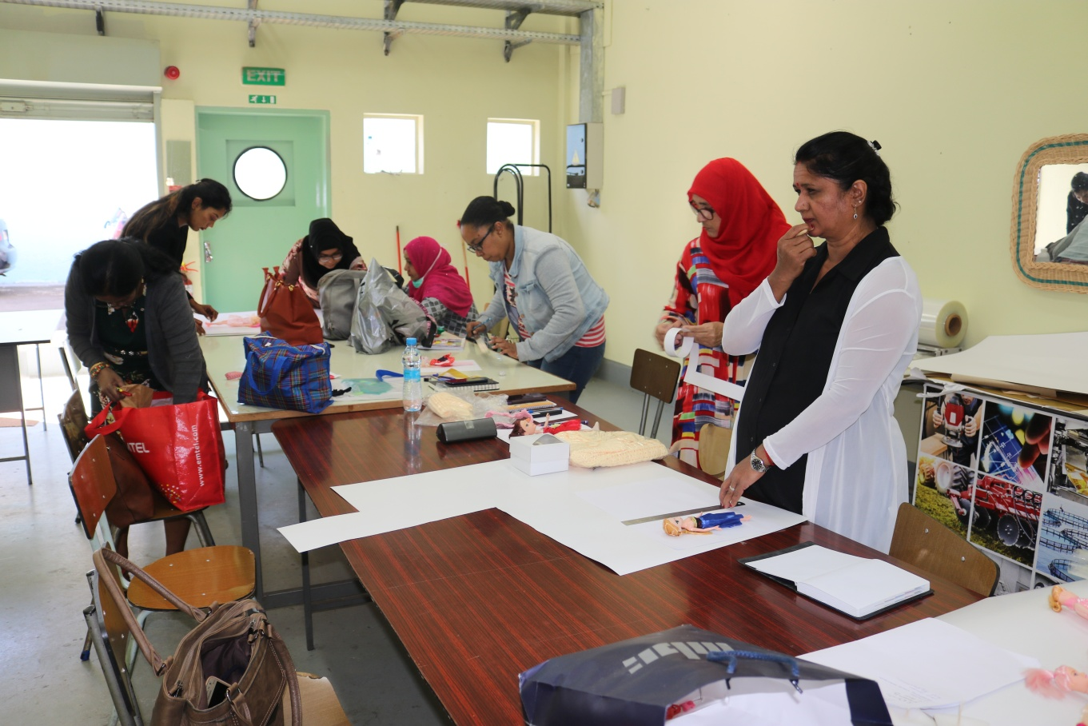
Women empowerment

Slide 2
Women empowerment
Social
Economic
Political / decision making

Slide 3
Beijing declaration on women conference 1995
Platform for action for:-
Women development and empowerment
Promotion for gender equality
Eliminate all forms of discrimination against women

Slide 4
12 key areas
Women and poverty
Education and training of women
Wmen and health
Violence against women
Women and armed conflict
Women in power and decision making
Institutional mechanism for the advancement of women
Human rights of women
Women and the media
Women and the environment
The girl child

Slide 5
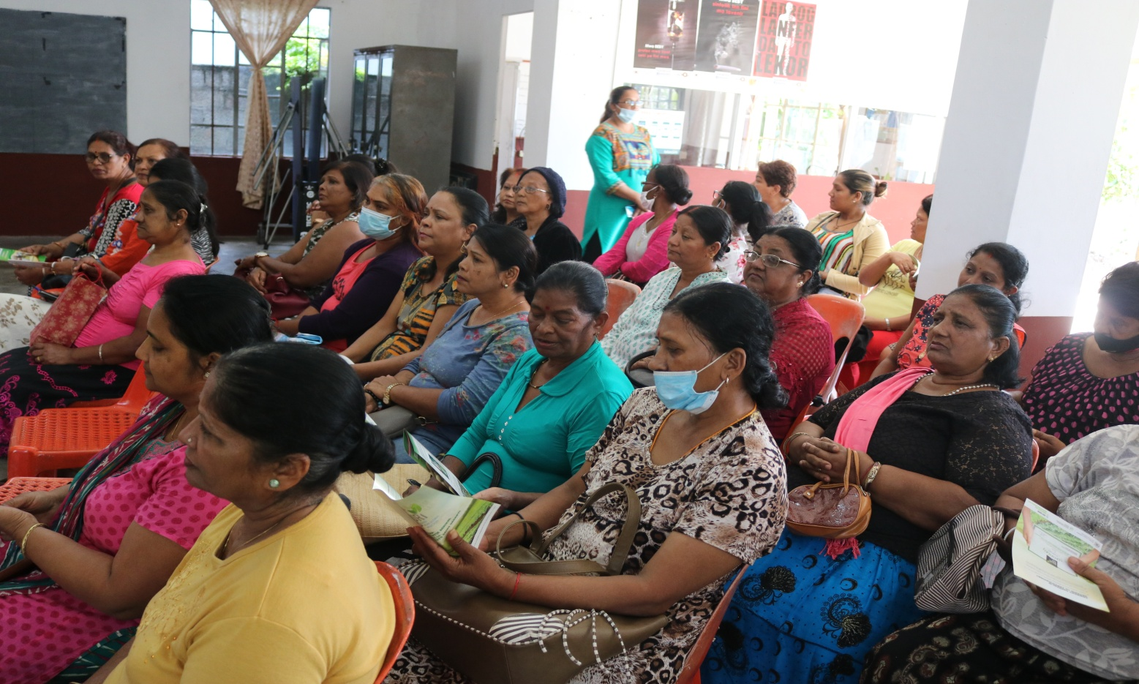
Impact of accelerated efforts towards women empowerment has been impressive and could be a show case for the region

Slide 6

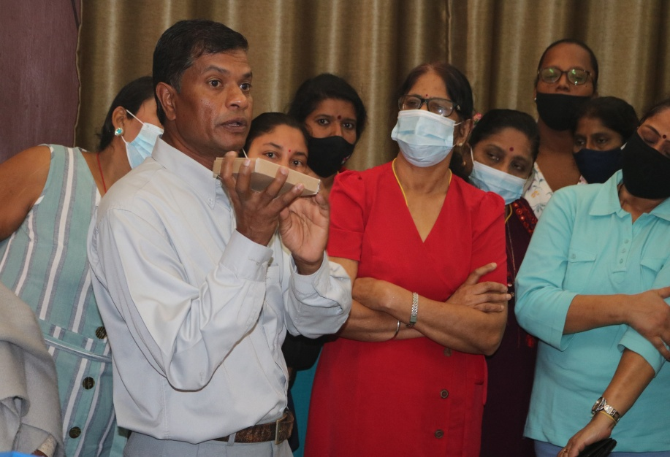

Environmental conservation and rehabilitation
Capacity building
Skills development
Product prototyping
Standardisation
New ideas

Slide 7
Practical projects
Distribution of compost bins
Production of compost
Solid waste management
Kitchen gardening
Vertical gardening
Roof gardening
Hydrophonic
Bio farming

Slide 8
Social empowerment
Projet LESPWAR
PNA PARTICIPATORY NEEDS ASSESSMENT
WOMEN NETREPRENEURSHIP DEV PROG

Slide 9
DECISION MAKING
EMPOWER WOMEN AT ALL LEVEL
CAPACITY BUILDING
PUBLIC SPEAKING
COMMUNITY PROJECTS

Slide 10
VISION 2030

