Slide 1


National Measures towards a healthy planet
Presented by
Mr J. Seewoobaduth
Ag Director of Environment
Ministry of Environment, Solid Waste Management and Climate Change
Caudan Arts Centre, Port Louis
28 April 2022

Slide 2
Presentation Outline
Where are we now?
Where we want to go?
How do we reach there?

Slide 3
Where are we now?
Position of Mauritius in terms of the 4 key international ranking/ indices
Human Development Index
Environmental Performance Index
World Risk Index
Earth Overshoot Day

Slide 4
Human Development Index
Between 1990 and 2019, Mauritius HDI value increased from 0.624 to 0.804, an increase of 28.8 %
Mauritius is now in the very high development category positioning it at 66 out of 189 countries.

Slide 5
Environmental Performance Index (EPI)
Year Rank (out of 180) EPI Score
2016 77 77.85
2018 90 56.63
2020 82 45.1
EPI 2020 for Mauritius
Air quality *¹ Rank - 53 EPI score - 51.1
Waste Rank - 7 EPI score - 98
Biodiversity*² Rank – 170 EPI score – 19.3
*1 – Figures for PM 2.5 are taken whereas in Mauritius we measure PM10
*2 – It is based on Biodiversity Habitat Index, Species Habitat Index, Marine protected Areas, Terrestrial Biome Protection
EPI customized for Mauritius being developed under ‘Observatoire de L’Environnement’

Slide 6
World Risk Index
Year Rank
2015 13th
2018 16th
2021 51st

Slide 7
Earth Overshoot Day
International - Earth Overshoot Day was 29 July 2021
Mauritius had attained its overshoot Day much earlier - 10 July 2021
A clear sign of overconsumption
.

Slide 8
Where we want to go?
Some of the key measures
Air quality in Mauritius
Plastic pollution
Solid Waste Management
Coastal Protection and Rehabilitation works
Climate Actions

Slide 9
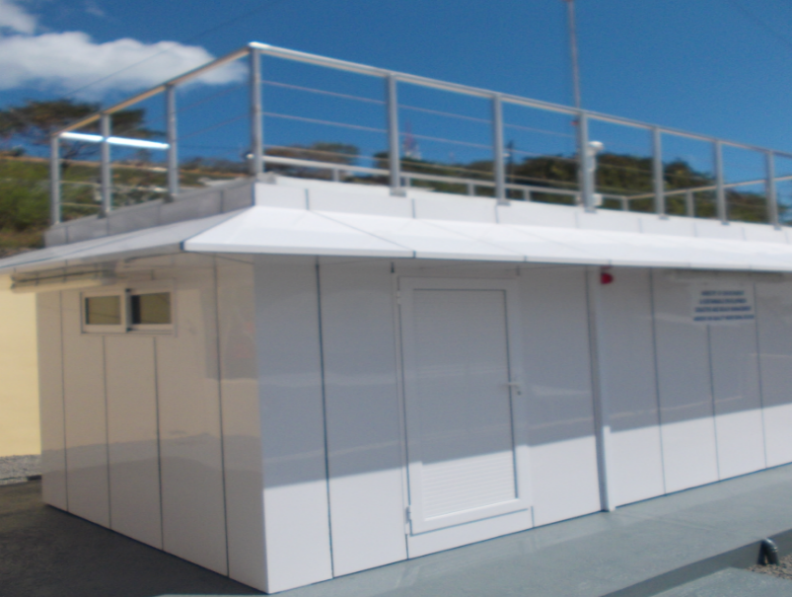
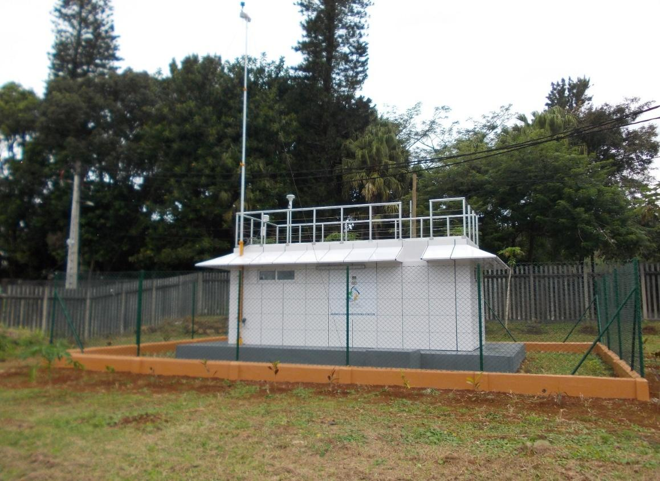
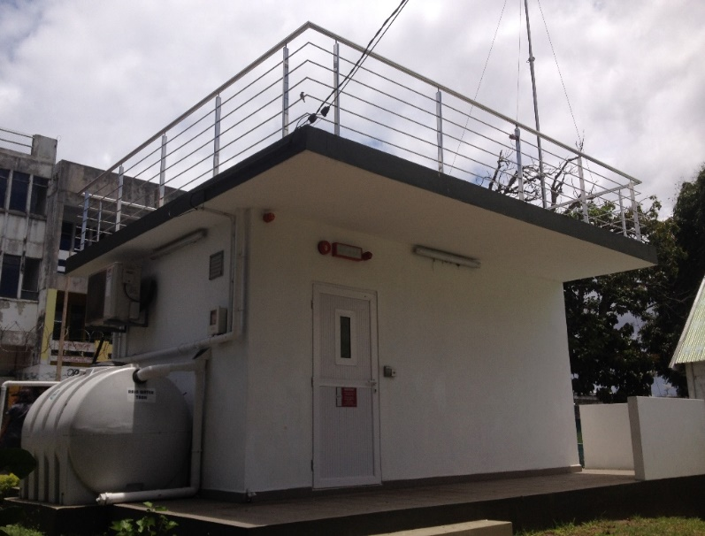
Ambient Air Monitoring
Two urban background fixed ambient air monitoring stations at Port Louis and Vacoas
One urban roadside fixed (near major road) ambient air monitoring station at Rose-Hill

Slide 10
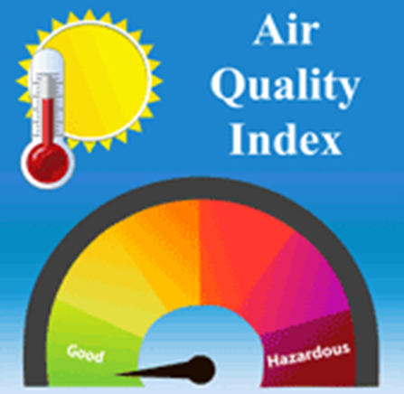
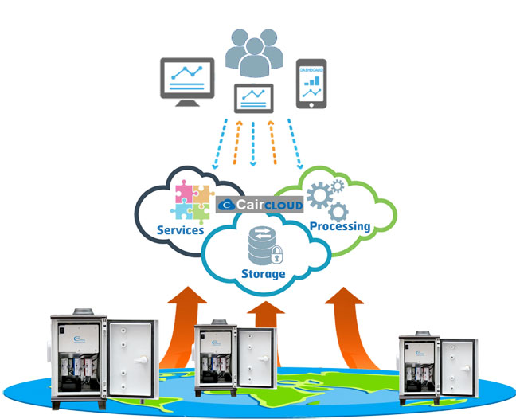
Air Quality Index
Acquisition of 3 additional Fixed stations and 4 Internet of Things (IoT) sensors by Mid-June 2022 which will be installed around the island.

Slide 11
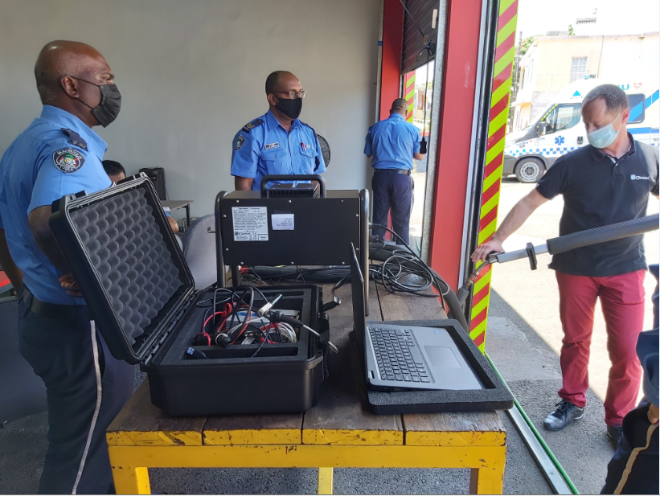
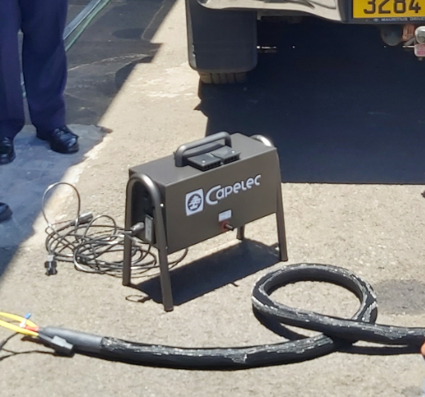
PORTABLE SMOKE METERS TO MONITOR VEHICULAR EMISSIONS
Acquisition of 15 portable smoke meters from France;
Handing over to concerned stakeholders (PDE, Traffic Management, NTA, MNI) followed by on-site training

Slide 12
Plastic Pollution
About 76,000 tons of plastic wastes generated annually (14 % of total wastes)
2000 – 3000 tons of plastic waste is recycled yearly (<4%)
128 million PET bottles are commercialised by the beverage industry annually
Around 40% of PET bottles are collected for recycling / exportation annually
Review of PET Regulations 2001 (underway)
Promulgation of the Environment Protection (Banning of Plastic Bags) Regulations 2020;
Environment Protection (Control of single use plastic products) Regulations 2020.

Slide 13
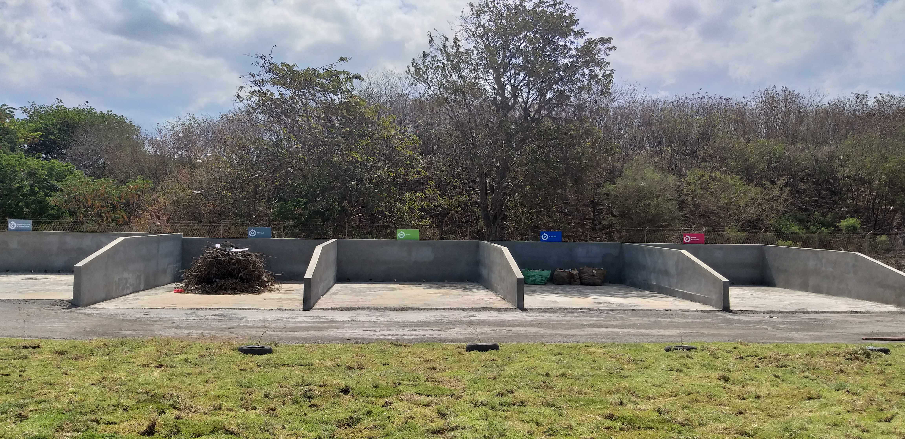
Solid Waste /Circular Economy-linear to circular
Setting up of civic amenity centres (déchetteries)
Integrated (Solid and Hazardous) Waste Management Bill
to promote circular economy amongst others
Application of Extended Producer Responsibility approach
for e-wastes
La Chaumiere, La Laura – operational
Poudre D’Or, Roche Bois – in the pipeline
2020 - 509 094 tonnes of waste landfilled
2018 - 543,196 tonnes of waste landfilled

Slide 14
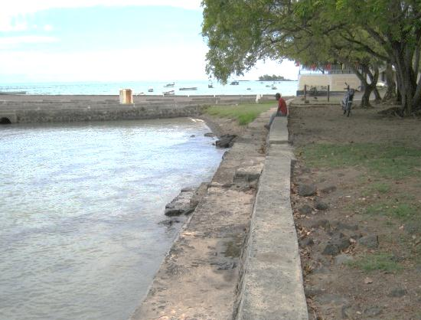
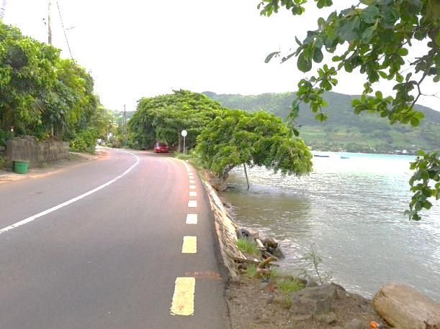
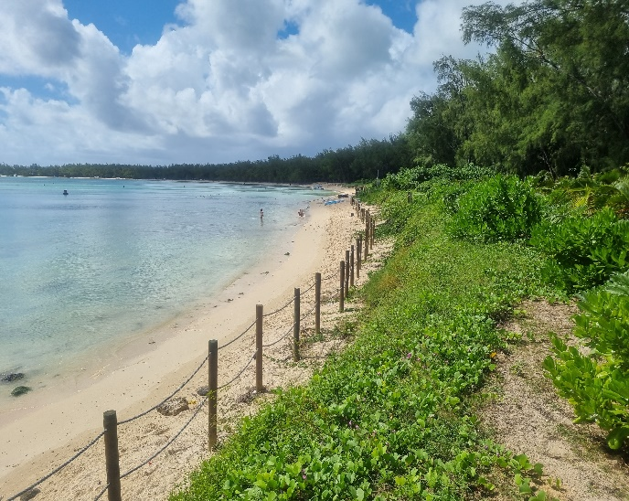
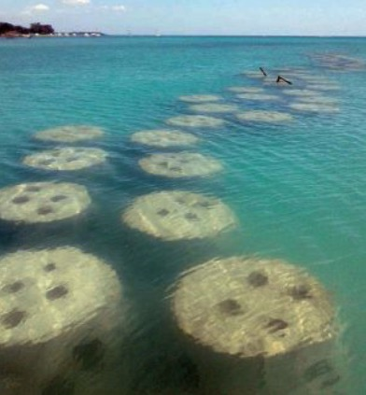
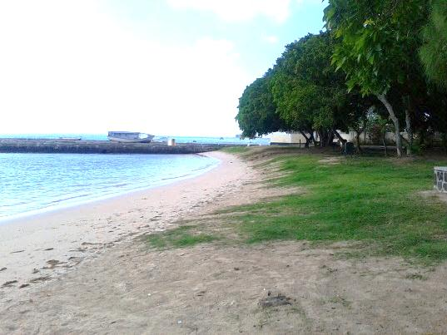
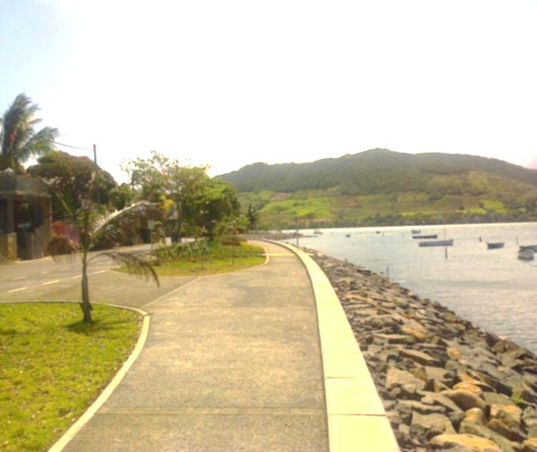
Examples of Coastal Protection & Rehabilitation Works
⬅
Gravel Nourishment
Sand Nourishment
Rock Revetment
Artificial reef

Slide 15
Some of the key Climate Actions in Mauritius
Climate Change Act 2020 which entered into force in April 2021
Setting up of a Department of Climate Change
Nature based solutions at the core of adaptation and mitigation
Commitments under NDCs:
  Reduction of GHG emissions by 40% by 2030;
  Meet the target of 60 % renewable energy by 2030;
  The total phasing out of use of coal before 2030

Slide 16
How do we reach there?
Transition écologique / Promotion of SCP / Circular economy
Master Plan on Environment
Environment Protection Act
Forthcoming Conference on Circular Economy
Environmental Quality Index

Slide 17
Master Plan on the Environment ( 2020-2030)
8 thematic areas:
Culture environnementale
Le changement climatique
Zones côtières et environnement marin
Biodiversité et ressources naturelles
La gestion des déchets
Contrôle des déchets plastiques
Lutte contre la pollution
Urbanisme et politique environnementale
10 year Policy & Strategy
5 year Action Plan
Total Estimated Cost for implementation of Mauritius Action Plan: Rs 15 Billion
Total Estimated Cost for implementation of Rodrigues Action Plan: Rs 1 Billion

Slide 18
Environment Protection Act (EPA) currently under review
Observatoire de l’Environnement and Science-to-Policy platform
Environmentally Sensitive Areas (ESAs)
Strategic Environmental Assessment (SEA)
Oil spill and environmental emergencies
Enforcement and compliance mechanisms

Slide 19
Forthcoming Conference on Circular Economy
National Conference on Circular Economy on 6 sectors namely:
Food System
Construction and Demolition Industry
Energy Sector
Solid waste Sector
Manufacturing Sector
ICT
Finance and Enablers

Slide 20
Environmental Quality Index
Air Quality Index
Lagoon Water Quality Index
Surface and groundwater - a real time online monitoring system will be implemented over the next two years at 28 sites.

Slide 21
Thank you for your kind attention

