Slide 1

Sustainability Initiatives at UoM
Stockholm+50: a healthy planet for the prosperity of all – our responsibility, our opportunity
Mahendra Gooroochurn
30 March 2022

Slide 2
Sustainability
Sustainability means meeting our own needs without compromising the ability of future generations to meet their own needs.
What would your own definition look like?
Sustainability relates to holistic, integrated thinking, ever more important as we are asked to deal with increasing complex phenomena.
Complex because everything is inter-linked in our ecosystem, so multidisciplinarity and transdisciplinarity are key.
2

Slide 3


Slide 4
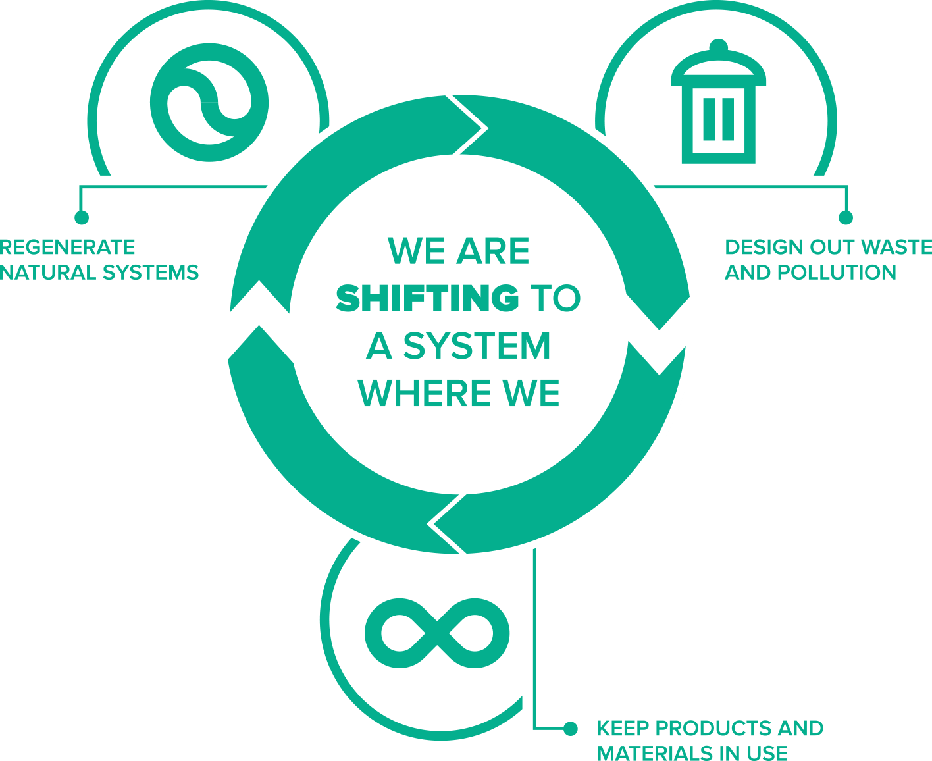
Sustainability – Circular Economy
Source: Ellen McArthur Foundation
4

Slide 5
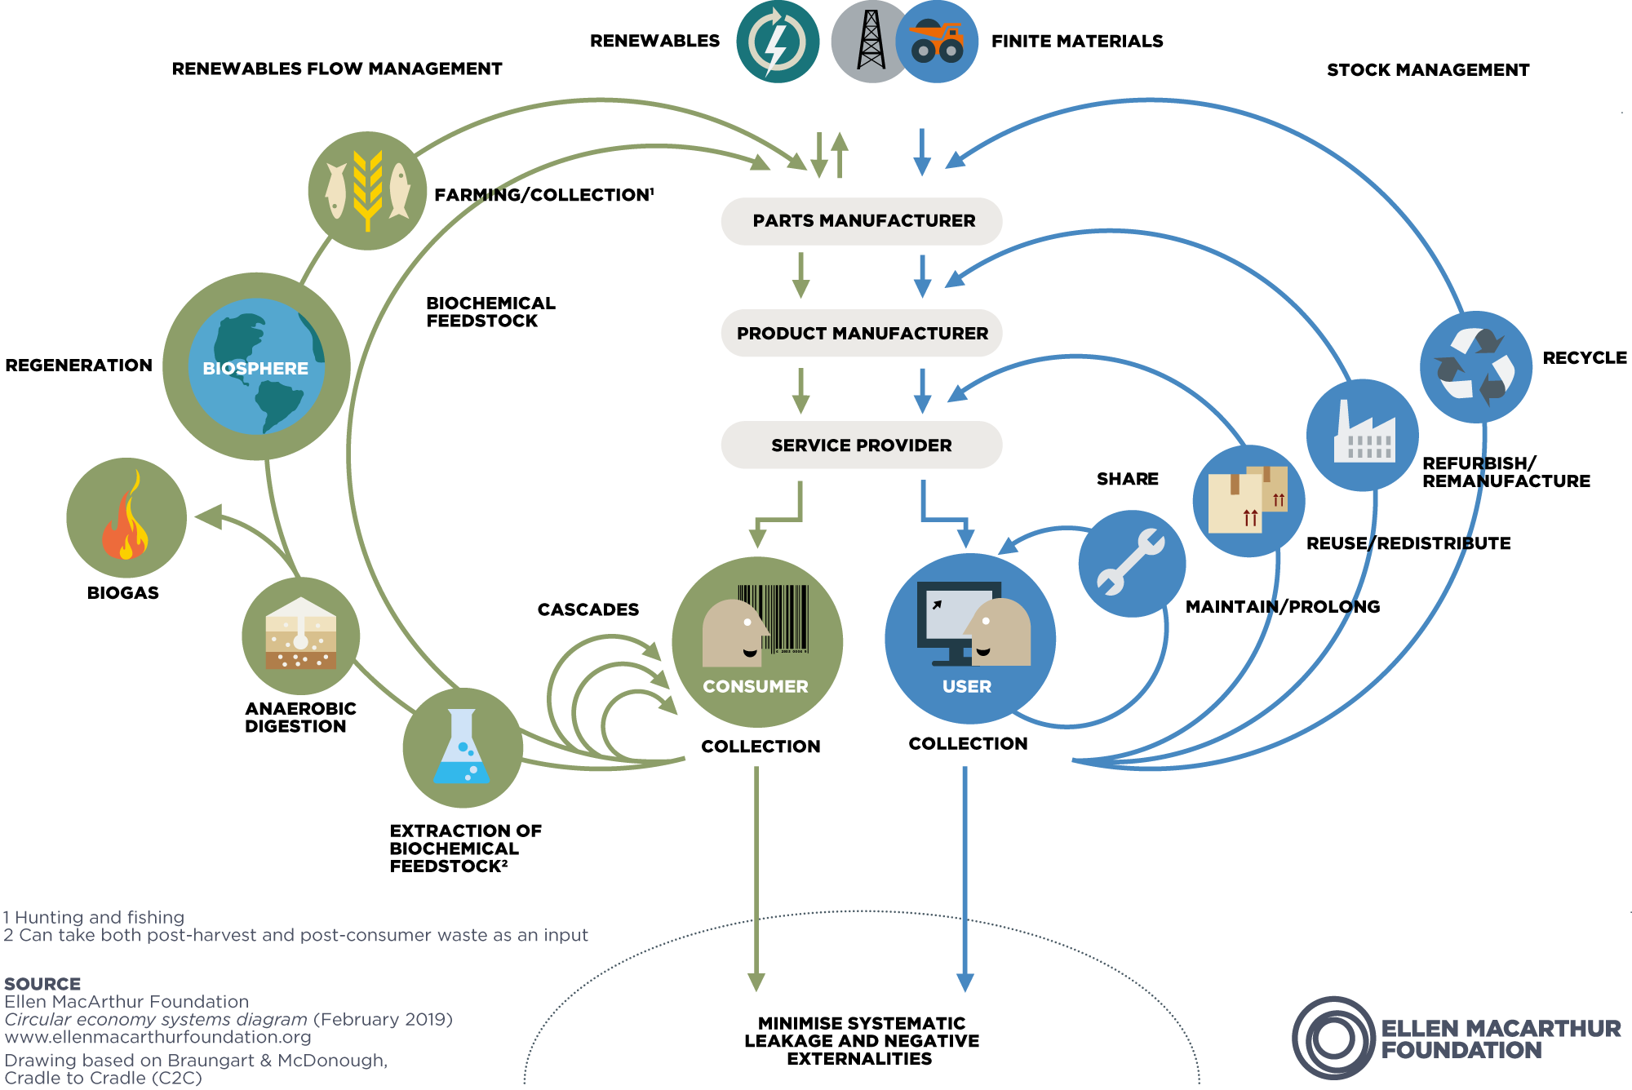
Sustainability – Circular Economy

Slide 6
Sustainability Initiatives
Integration of sustainability concepts into the curricula of degree programmes across the University, including dedicated undergraduate and postgraduate programmes in Sustainable Development, Climate Change and Heritage.
Students encouraged/required to think about the impact of their idea, concept, product or service on the environment through life cycle assessment (LCA).
Projects that have led to start-ups on sustainability offerings and circular economy.
6

Slide 7
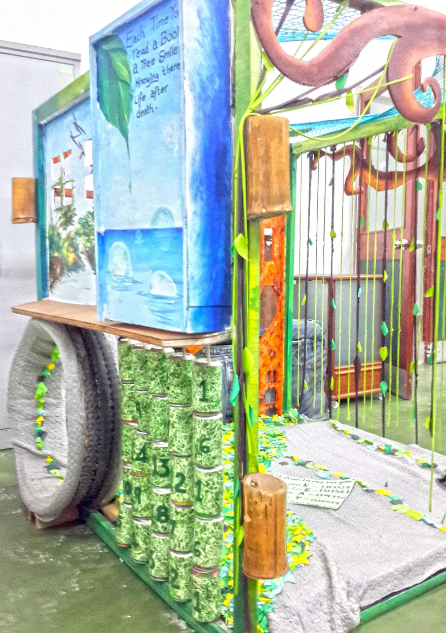
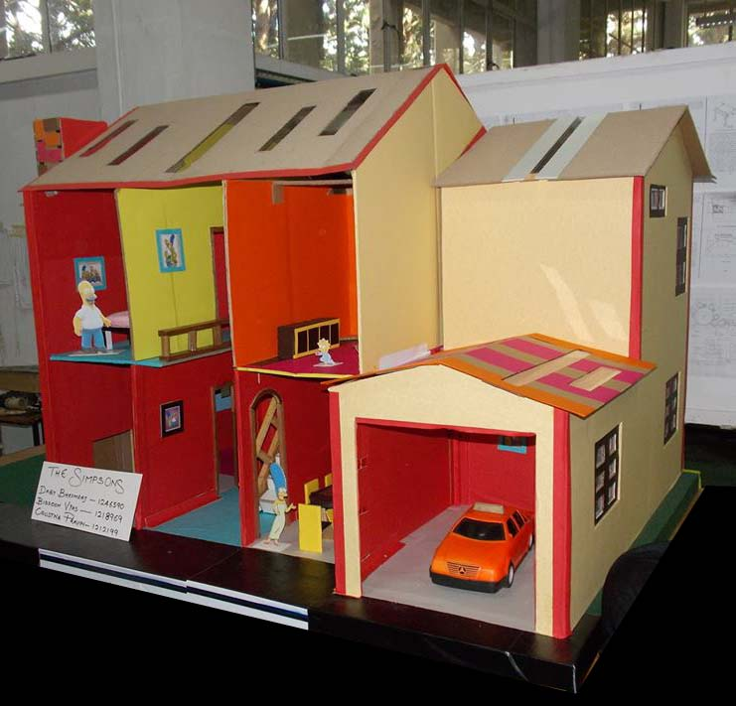
Sustainability Initiatives
7

Slide 8
Sustainability Initiatives
Research and publications focused on sustainability across faculties and disciplines, including multidisciplinary/transdisciplinary problems. Triple Helix Model to integrate Academia, Industry and Community.
Renewable energy integration through Solar PV, Agritech Park project to have a smart UoM Farm, solid waste management on campus, social and cultural aspects, Energy auditing and management to improve energy efficiency and reduce our carbon footprint.
8

Slide 9
Sustainability Initiatives
Contribution to national discussion and policies on sustainability agenda, including energy, water, environment, climate change, circular economy, culture, gender, language among others
participation of UoM staff in committees.
Organisation and collaboration in international conferences/workshops/symposia/forums promoting sustainable development, e.g. climate justice, circular economy, youth empowerment etc.
9

Slide 10
Green Week Organised in the build-up to COP26 by British High Commission in collaboration with University of Mauritius and Middlesex University.

Slide 11

In collaboration with JCI Curepipe

Slide 12
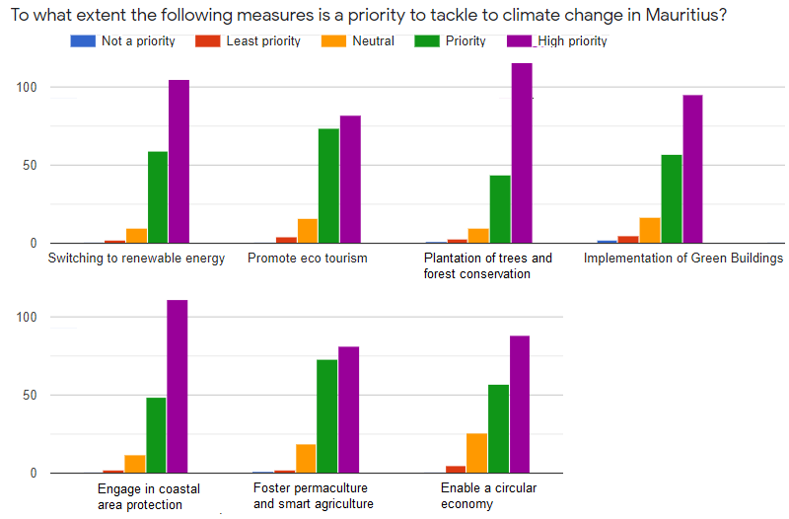

Slide 13
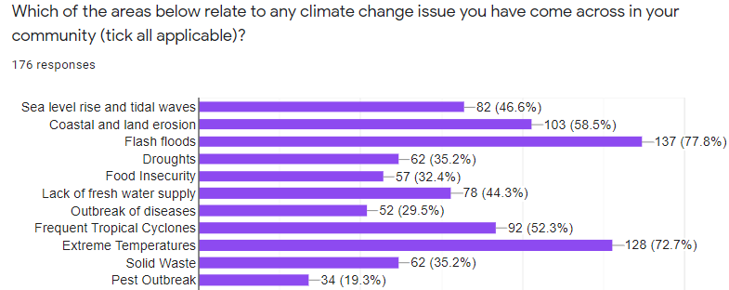

Slide 14



14

Slide 16
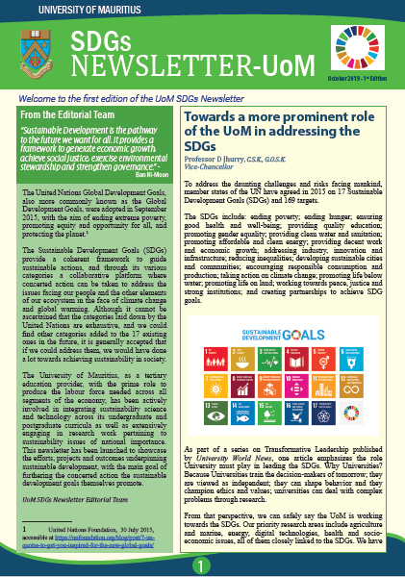
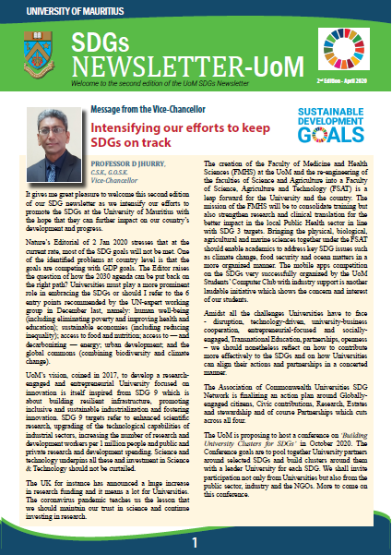
Sustainability Initiatives
Communication through SDG newsletters
16

Slide 17
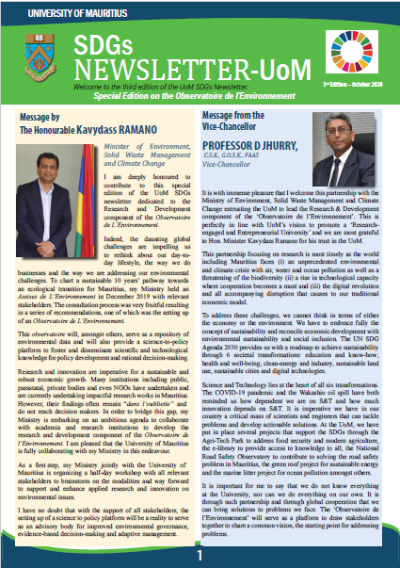
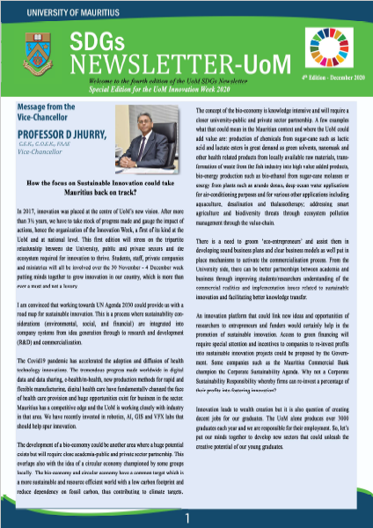
Sustainability Initiatives
Communication through SDG newsletters
17

Slide 18
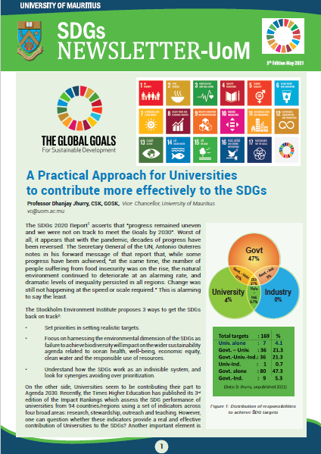
Sustainability Initiatives
Communication through SDG newsletters
18

Slide 19

19

Slide 20
Final Words
An Engaged and Unified Approach to Sustainability At All Levels
https://www.uom.ac.mu/index.php/sustainability
20

