Slide 1

Stockholm+50
Consultations

Slide 2
Reporting Process of Stockholm+50
Consultations

Slide 3

Contents
1
National Consultation at a Glance
Consultation Process: Gender Responsive and Socially Inclusive Consultation
Main Consultation Inputs, Insights and Innovations
An overview of the main themes, challenges, opportunities, solutions and recommendations
Summary of the consultation
Consultation Follow-up, Next Steps and Links to National Policies
Annexes
2
Report on the Stockholm+50 National Consultation
in Sri Lanka
3
Final Report
4
Submitted on: XX/ May/ 2022
5
Notes:
Add the two sub-section of Chapter 3

Slide 4




Reporting Process, Synthesizing & Space Constraints
1500 characters (including spaces) per question
Images:
http://clipart-library.com
www.shutterstock.com
Annexes

Slide 5
Validation
Country Level
Draft report – Reviewed by Ministry of Environment & UNDP Sri Lanka
Stakeholder Level
Plenary Session
Notes:
Final report will be added to the public domain (indicate this in the presentation)

Slide 6
Quality Assurance
Final Technical Report
QA in Sampling
QA in Data Collection
QA in Reporting
Whole-of-society
Whole-of-government
Translation & Interpretation
Validation

Slide 7
Evolution of
Sustainable Development Concept

Slide 8
Presentation Outline
Overview
Key global initiatives before and after 1972
Key national initiatives

Slide 9
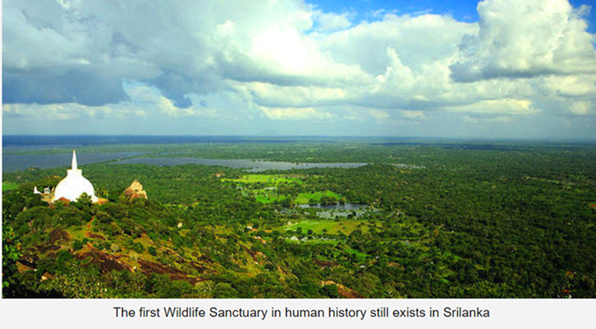
Early application of the concept
Concept of sustainability has been used historically – declaration of Mihintale as a wildlife sanctuary around 247 BC
Concept of sustainability is used in forestry in early 18th century “sustainable forest management”
Since early 19th century the concept being used in fisheries “maximum sustainable yield”

Slide 10
Some early contributions – before 1972
Establishment of institutions - Sierra Club (1892), WNPS (1894), UN Agencies (1945-1972), IUCN (1948), RFF (1952), WWF (1960), Amnesty International (1961), Club of Rome (1968), Friends of the Earth (1969), Greenpeace (1971) …
Rachel Carson, Silent Spring (1962) about the effects of pesticides—is often cited as the beginning of the modern environmental movement
Kenneth Boulding’s ‘Spaceship Earth’ (1965) (The Economics of the Coming Spaceship Earth)
The National Environmental Policy Act (NEPA) of 1969 (USA)
1st Earth Day to increase public awareness of the world’s environmental problems held on April 22, 1970

Slide 11
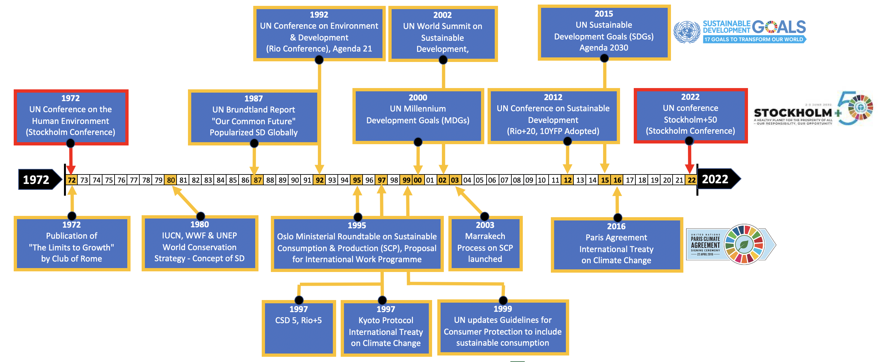
Evolution of Sustainability Initiatives from 1972 to 2022 (50 Years)

Slide 12
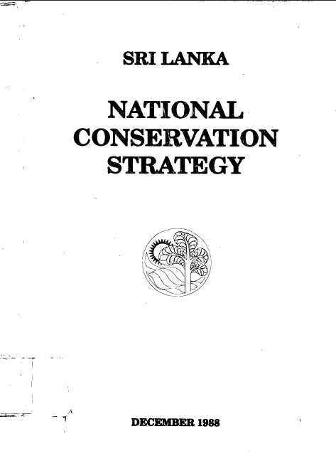
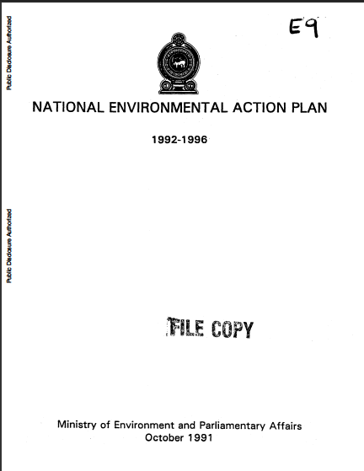
Sri Lanka’s SD guidance
1991
2009
1988

Slide 13
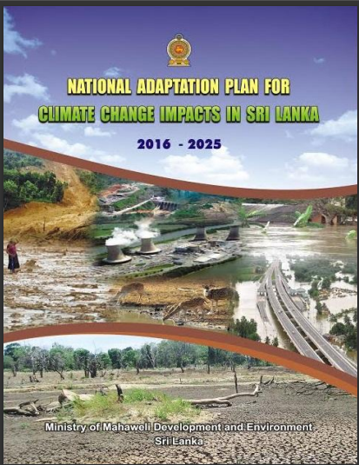

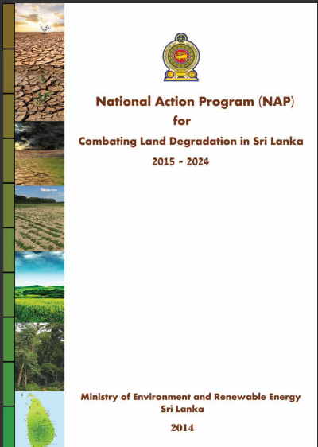
Some local guidelines from Rio Conventions
2016

Slide 14
Context Setting for Stockholm+50
Consultations

Slide 15
Presentation Outline
The Society, Economy and Environment
The 2030 Agenda for Sustainable Development & SDGs
The Paris Agreement on Climate Change & NDCs
National Environment Action Plan – NEAP
Green Recovery

Slide 16
The Society,
Economy
&
Environment

Slide 17
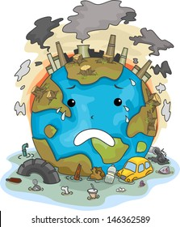
    Development & Environment
      Human Dominance in the Environment:
    Since the industrial revolution, the economies have delivered enormous socio-economic benefits.
    But this progress is increasingly threatened by the very economic models which made it possible.
    Overconsumption, damage nature and social bonds, and drive climate change, leading to multiple challenges for sustainability.
Linear Economy

Slide 18
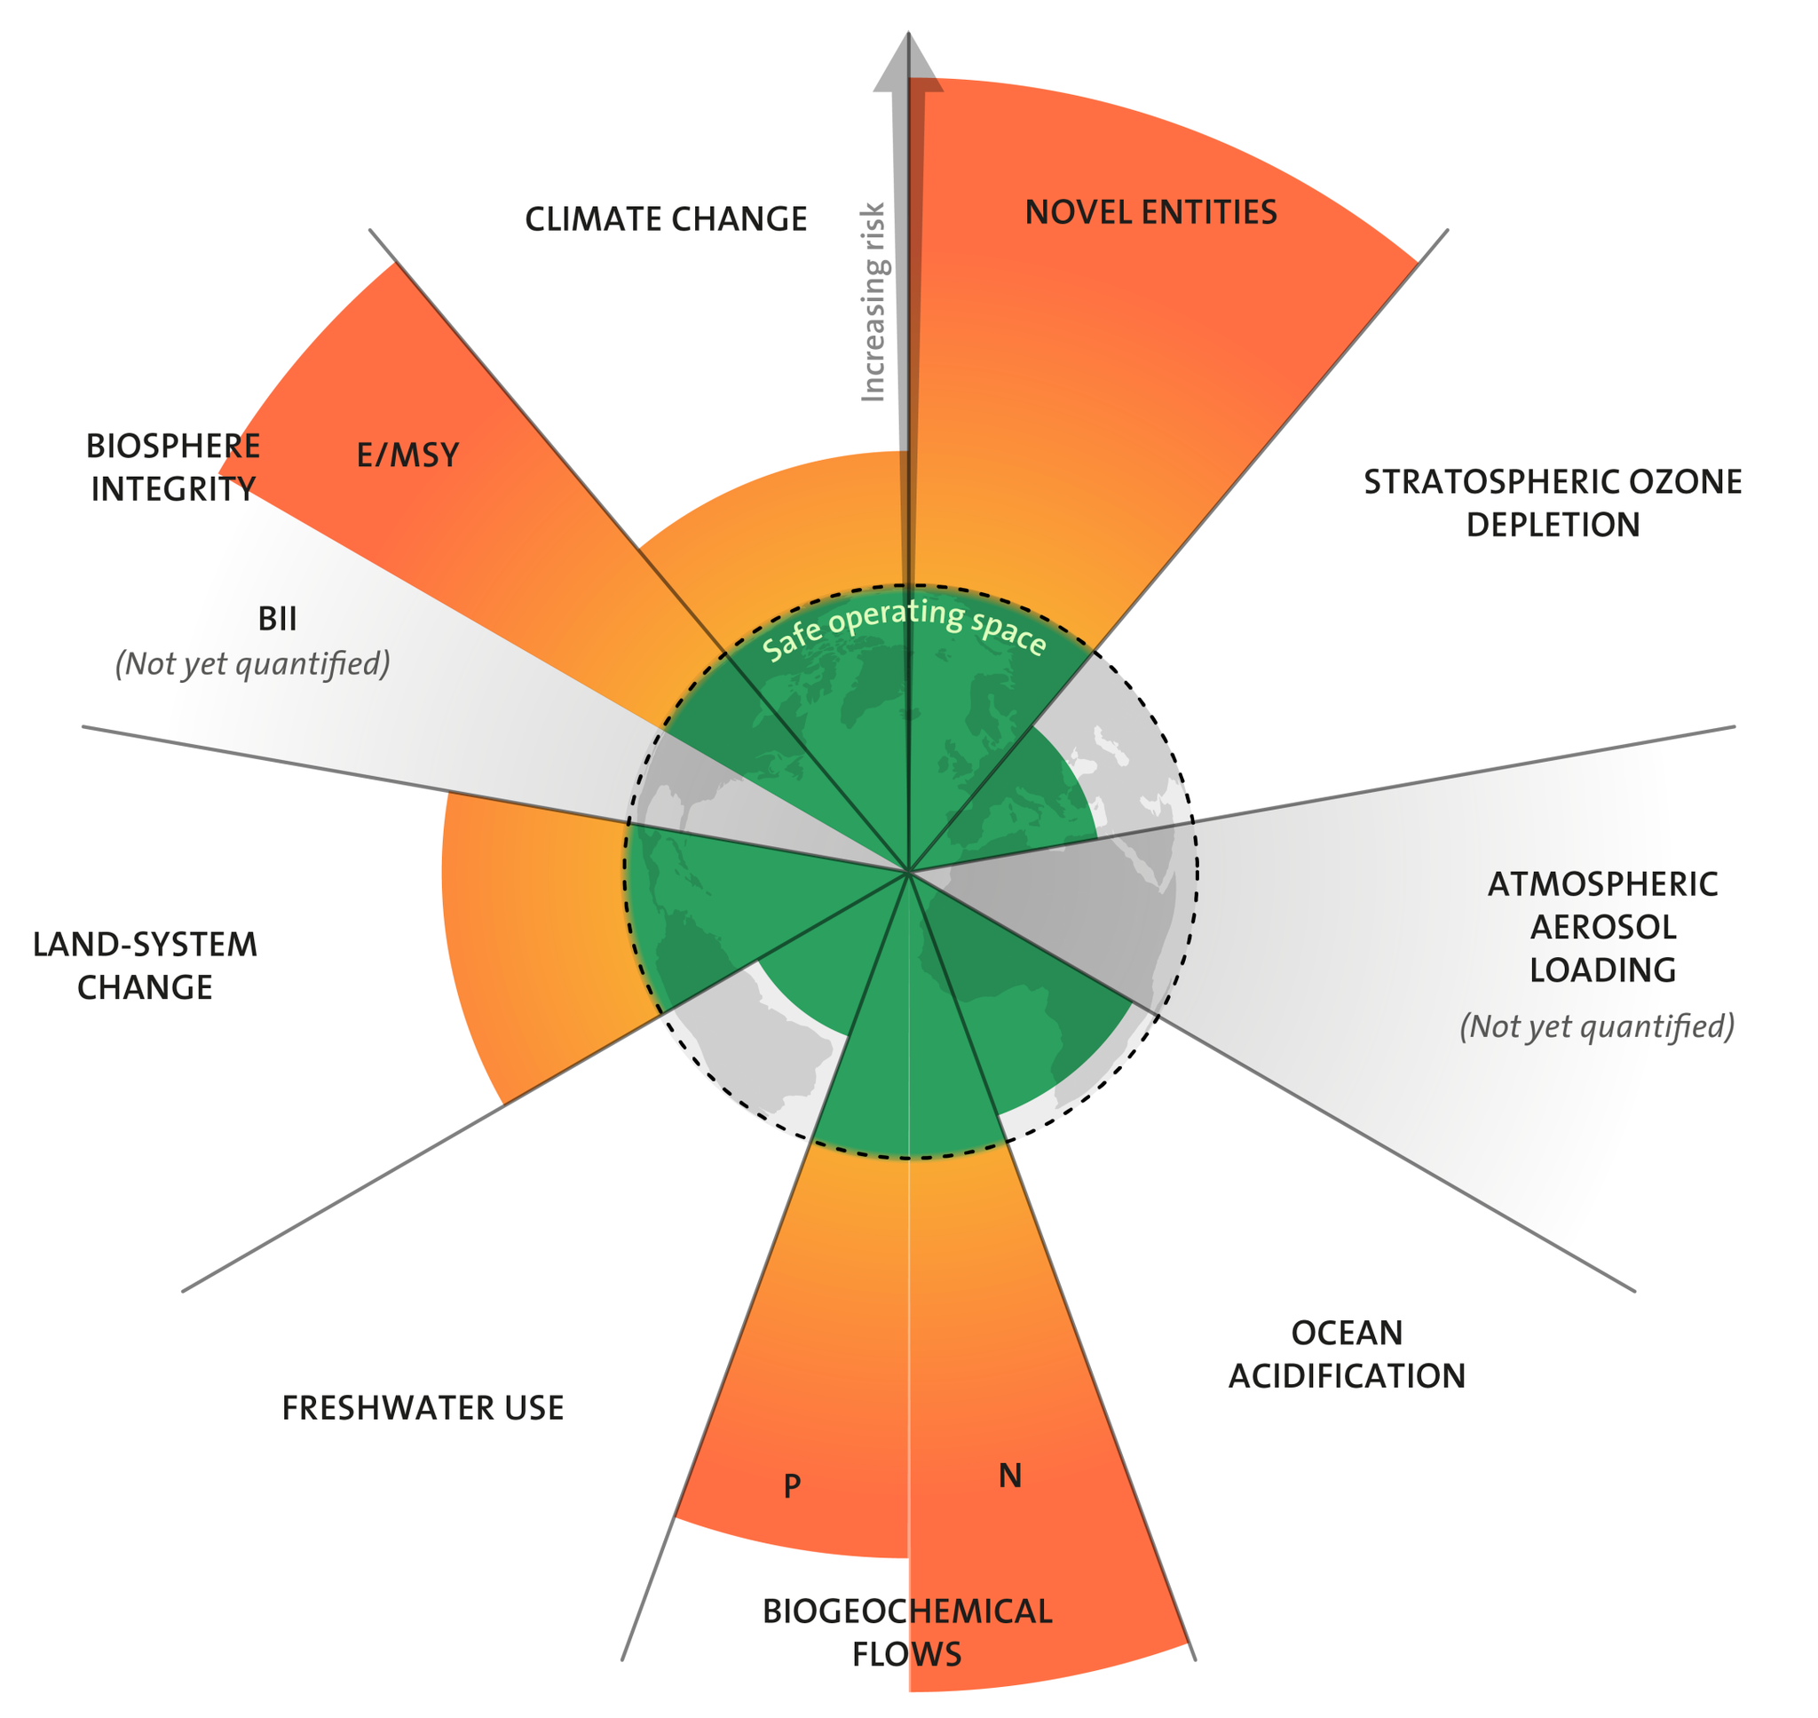
    Development & Environment
      Impacts on the Environment:
Novel entities
(Chemical pollutions)
Climate change
Increasing Risk
Biosphere integrity
Genetic diversity
Stratospheric ozone depletion
Living beyond ecological limits → Planetary Boundaries:
Functional diversity
Atmospheric aerosol loading
Land system change
Freshwater use
Ocean acidification
Source: Stockholm Resilience Centre,2022
Biochemical flows

Slide 19

The 2030 Agenda for
Sustainable Development

Slide 20

    Sustainable Development Goals
      The Solution Framework:
    Provides an inclusive approach to transform the world towards sustainable development, addressing multiple development challenges.
    Sets forth 17 Sustainable Development Goals (SDGs) with 169 associated targets and 240 indicators to be achieved in a 15-year period 2016 - 2030.
Transforming our world:
The 2030 Agenda for Sustainable Development
17 Goals
169 Targets
240 Indicators
193 Member States

Slide 21
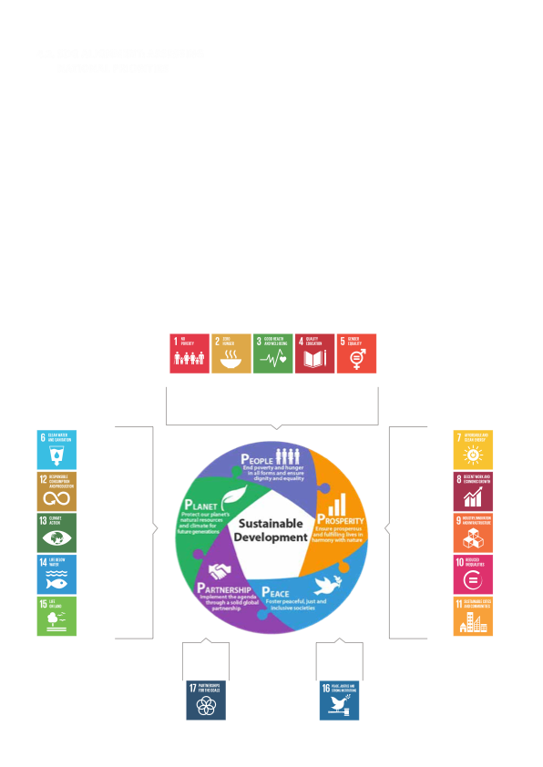
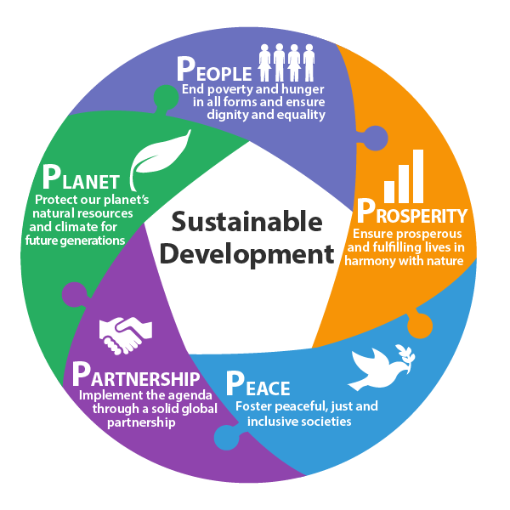
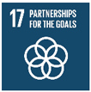

    Sustainable Development Goals
      Understanding SDGs:
  Core Principles and Intertwined Framework:
5Ps of SDGs
Poverty
Food
Health
Education
Gender
Clean & modern energy
Core Principles
Universal
Leaving no one behind
Interconnected & indivisible
Inclusive
Multi-stakeholder partnerships.
Water &
sanitation
Sustainable
Consumption & Production
Economic growth & descent jobs
Climate change
Industry & infrastructure
Life under water
Inequality
Life on earth
Cities
Global
Solidarity
Peace

Slide 22
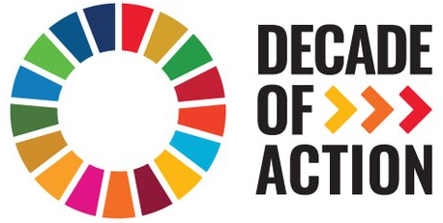
    Sustainable Development Goals
      Present Progression and Future Directions:
    Though a progress is being made in many places, in overall, action to meet the SDGs is not yet advancing at the speed or scale required.
    In Sept 2019, the UN Secretary-General called on all sectors of society to mobilize for a decade of action (2020-2030) to deliver SDGs by 2030, through three areas of actions at Global, Local and People levels:
More Commitments
Mobilize Everyone, Everywhere
More Ambition
Demand Urgency & Ambition
More Action
Design New Innovations & Solutions

Slide 23
    Sustainable Development Goals
      Local Progression:
    After becoming a signatory to the 2030 Agenda, the GoSL enacted the Sustainable Development Act No. 19 of 2017 and established the Sustainable Development Council (SDC) to provide the policy, regulatory and institutional framework for the implementation of SDGs.
    At present, the National Policy and Strategy on SD of Sri Lanka has been drafted; and the mainstreaming of SDGs into national, provincial and local authority levels is being implemented, with emphasis on localizing SDGs.
    Local indicator framework is being developed with data availability for about 100 indicators (among 240).
    The present progress shows that significant challenges still persist for the achievement of the 2030 Agenda, particularly for the environment related SDGs.

Slide 24


The Paris Agreement on Climate Change

Slide 25
    The Paris Agreement on Climate Change
      Implications of the Paris Agreement
    Commitments of member states and Global targets:
nations agreed to
hold global warming to well below 2℃,
and
preferably limit it to 1.5℃,
by the year 2100 compared to pre-industrial levels.
mitigation commitment
Effect from 2020

Slide 26
NDCs
Nationally Determined Contributions

Slide 27
    SRI LANKA NATIONALLY DETERMINED CONTRIBUTIONS
      National Approach to Climate Actions
    Sri Lanka has pledged its support to the global Climate Action:
    Intended nationally determined contributions (INDCs) in 2015
    NDCs in 2016 for the implementation period of 2020-2030, based on the Readiness Plan 2017-2019 for the Implementation of INDCs.
    Updated NDCs in July 2021 (and resubmission in September 2021).
    Sri Lanka’s NDCs comprise of following five areas:
        Mitigation (Six sectors: Energy, Transport, Industry, Waste, Agriculture & Forestry)
        Adaptation (Nine sectors: Health, Human Settlements, Water, Agriculture, Livestock, Coastal & Marine, Fisheries, Biodiversity, Tourism & Recreation).
        Loss and Damage
        Integrating SDGs and Gender to the NDCs
        Means of Implementation.

Slide 28
NEAP
National Environment Action Plan 2022-2030
Pathway to sustainable development in Sri Lanka

Slide 29
Thematic Areas of NEAP 2022-2030

Slide 30
Green Recovery

Slide 31
    Emerging Trends
      Green Development:
    Unprecedented backdrop of COVID-19 & Human Development Index
      Average change in HDI of the world
      (1991 – 2020)
Evolution from a health shock to an economic, social and political crisis
Build Back Better via Green Development
Shaping development pathways beyond a crisis and into opportunity in achieving SDGs
      The decline in HDI is equivalent to eradicating all the progress in human development of the past six years

Slide 32
Questions
Clarifications
Reflections
Comments
&
Suggestions

