Slide 1





Generating knowledge and communicating the evidence base to influence policy , practitioners and decision makers

Slide 2
Outline
Background on research communication
Research- Policy linkages in Ethiopia
Main achievements/Good Practices
Main challenges in research- policy linkage
Strategies to bridge the gap
Recommendations

Slide 3
Background
Generation of knowledge is the basis for informed decision-making process
Communicating research to policy-makers, practitioners, and other stakeholders is a complex affair where many fail to agree on any single mode or tool of communication among the groups.
For scientific information to become useful and applicable, mechanisms need to be established that facilitate communication, translation and mediation between researchers, policy-makers and practitioners(Groot, Hollander, and Swart (2014)

Slide 4
Research – Policy linkage in Ethiopia
Knowledge is generated in silos
Insufficient linkage between researchers and policy-makers
Ineffective communication, and dissemination strategies
Research at times lack relevance to the local context

Slide 5
Research – Policy linkage in Ethiopia
The Current status of research-policy linkage in Ethiopia
Unsatisfactory but picking up in recent years
No mechanism to know of research uptake by policymakers
Research is not readily available
Research is sought when the need arise – ad hoc
Conventional communication channels (i.e workshops ,conferences, reports etc.)not very effective
Limited attention to public awareness

Slide 6
Main achievements/good practices
Climate Resilient Green Economy mainstreaming
CRGE knowledge hub database/ website
CRGE Indicator assessment
MRV
NDC

Slide 7
Main achievements/good practices
Community projects and sectoral activities(SLM, watershed ,land restoration)
Network amongst key stakeholders/research collaboration
National communication tools on state of environment

Slide 8
Potential scalable practices
Community based research programmes by Universities
Thematic research funds(currently funded by development partners)
Knowledge sharing platforms at Ethiopian Institute of Agriculture Research (EIAR)
Environment youth clubs as that of Ethiopian Biodiversity Institute (EBI)
‘State of Ecosystem’ report by EBI
EPA newsletter
Good agriculture practices and resources from Ministry of Agriculture (MoA)

Slide 9





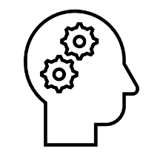



Main challenges in research-policy linkages
Most are academic research
Recommendations are too general
unbalanced research
No packaging
Policy-makers are not involved from the inception
Limited information on existing knowledge
Reports are at times too technical for policy-makers
The language barrier
Trust

Slide 10
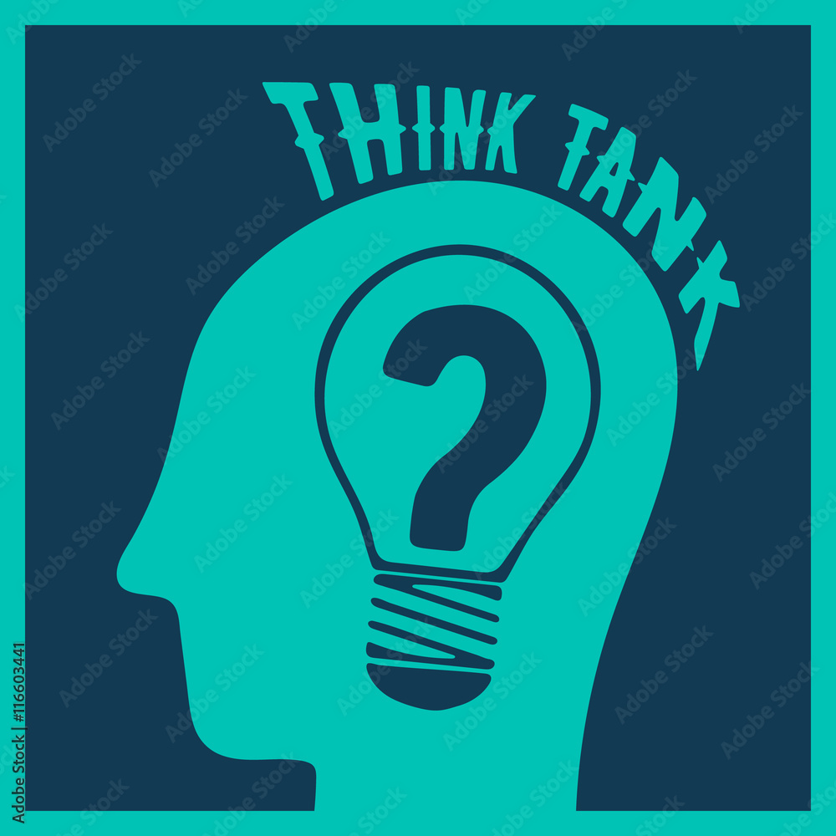



Main challenges…
No culture of Going to Think tanks
Availability of credible data
Duplication of efforts
Limited use of other tools such as infographs, videos ,audios, etc .

Slide 11
Possible solutions
Scoping/mapping on where researchers are (who is doing what)
Access to data and information
Policy-makers should demand information/research
Policy makers involvement in research process
Develop culture of meeting policy -researchers
Information about policy process
Capacity building and allocation of resources to research and academic institutes
Develop sense of ownership

Slide 12



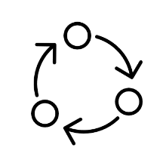





3. Strategy to Bridge the Gap
Synthesis report/policy/research briefs
Follow-up roundtable meetings
Regular formal and informal meetings
Involving policy-makers in research process
One pager/local language translation
Institutional framework for packaging research
Packaging existing knowledge
Establishing Credible publication platform
Aligning indigenous knowledge with science

Slide 13
Strategy to bridge the gap
Sector ministries
Policy Makers
Knowledge /Research Packaging Unit (translate science to policy)
Academic/Research Institutes
Int’l partners
Int’l collaborators
UN bodies

Slide 14
Recommendations
There is need for an institutional setup (a department or unit) to package and translate science to policy to enhance the interaction
There is a need for synergies and co- generation of knowledge (sector ministries ; national research institutes from within ;and global north institutions.
Policy interaction should be part of the research process starting from the inception of the research idea
Capacity building for research communicators and journalists linking policy and research for evidence-based policy making process

Slide 15
Thank you!!
Yitatek Kelemu Yitbarek
yitatek@gmail.com

