Slide 1

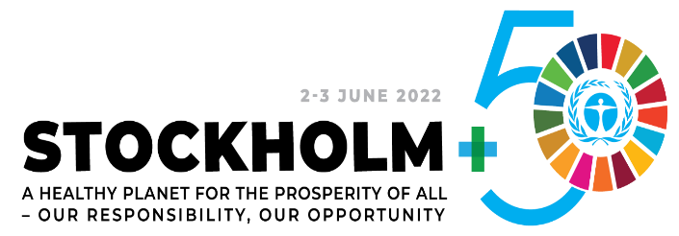


National Implementation Plan (NIP) for the Management of Persistent Organic Pollutant (POPs)
  Ethiopia's Effort for the Reduction and Elimination of Persistent Organic Pollutant (POPs)
Girma Gemechu
Director General,
Environmental Compliance Monitoring and Enforcement
Notes:
Thank you, Dr Kassahun, for the warm welcome
Good morning Colleagues, Ladies and gentlemen.
You were diving in the concepts, terminologies and data associated with Climate Change and Biodiversity for a day and half.
Now It is time and I am responsible to make you feel the flavor of terms and concepts of chemistry that I would hope you all had good memories of when you were at high school

Slide 2
Outline
  Introduction
  Background-POPs and Stockholm Convention
  The concern about POPs
  National Implementation Plan (NIP)
  POPs Management ( Global and Ethiopia's Context)
  Efforts to reduce and eliminate POPs
  Lessons learned
  The way forward and recommendations
Notes:
To begin with these are my presentation outlines
First I will take you to through the global need and trade of chemicals, then we will go through Background-POPs and the birth of the Stockholm Convention
Then we will see Ethiopia's effort for the reduction and Eliminate POPs and finally we will se the way forward and recommendation for POPs Management specifically and chemical and waste management in general

Slide 3
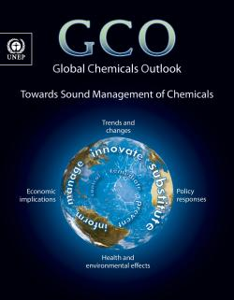
1. Introduction
Chemicals are integral part of daily life.
Global chemical output was valued at US$ 171 billion in 1970.
By 2010, it had grown to US$ 4.12 trillion.
Chemicals are unavoidable
Integrated and Sound Management of chemicals (LC) is very crucial
Notes:
Now a days Chemicals are integral part of daily life
70 per cent of manufactured chemicals are used as raw materials or intermediate goods to make products by other industries.
The Global trade value was estimated about 171B 1970 and this figure had grown to 4.12 trillion and very recent data shown more than 5t
They are unavoidable part of our daily life and we have to think the sound management associated with LC. when it comes to the adverse effect of chemicals on human and environment

Slide 4

2. Background-POPs and Stockholm Convention
Persistent organic pollutants (POPs) are organic chemical substances that are recognized as a serious, global threat to human health and to ecosystems.
Aims to protect human health and the environment from the effects of persistent organic pollutants
Signed on 22 May 2001 in Stockholm and effective from 17 May 2004
Ethiopia ratified the instrument on 2 July 2002.
Notes:
Policies for the sound management of chemicals are now recognized as essential components of overall public policy in countries at all stages of development.
Thanks to the 1972 United Nations Conference on the Environment in Stockholm and consecutive discussions on the adverse impacts of chemicals on human health and environment we came up the birth of SC on POPs

Slide 5
3. Why we are concerned ?
POPs are among the most dangerous pollutants
A study on pesticide knowledge attitude and practice survey on farmers and farm workers at the central Eastern part of Ethiopia showed that 85% of workers did not attain any pesticide-related training, 81% were not aware of modern alternatives for chemical pesticides, and 62% did not usually bathe or shower after work. (Negatu et al., 2016)
The levels of pesticides in several cases are substantially elevated the tolerance levels in many areas of Ethiopia (Loha.K et al 2020)
Persistent
Bioaccumulation
Long-range Transport
Adversely affect people’s health
Notes:
Of all the pollutants released into the environment every year by human activity, persistent organic pollutants (POPs) are among the most dangerous.
These are chemicals of different bevors , They persist in the environment that means it took them longer to get into there half-life but this alone is not a problem but they have Bio accumulative behaviors , they accumulate them selves in the upper level in the food chain. The third long range ( doesn’t end at the point of release) 4. Indeed, they can disrupt endocrine, reproductive, immune and nervous systems as well as cause behavioral problems, diabetes, thyroid problems, and even cancer

Slide 6
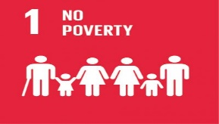

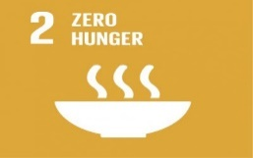



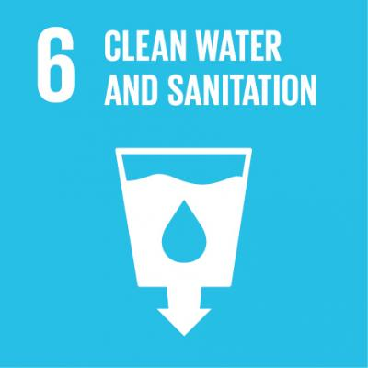
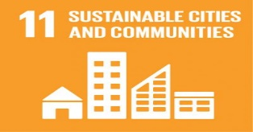
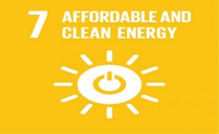
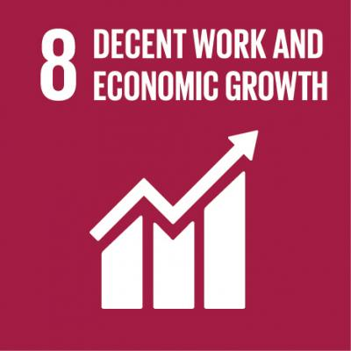
4. National Implementation Plan (NIP)
Article 7 of the convention requires member countries to develop and periodically update NIP
The NIP, is not a stand alone plan for the management of POPs
It is Part of national sustainable development strategy
Dynamic reviewed periodically and updated to address new obligations under the Convention.
NIP
Notes:
NIP one of the required tools which assess internal capacity in various factors
It is also a tool to communicate one of the obligations of parties
17 Achieving the ambitious targets of the 2030 Agenda requires a revitalized and enhanced global partnership that brings together Governments, civil society, the private sector, the United Nations system and other actors, mobilizing all available resources

Slide 7

  4.1. POPs Management
Chemical | Pesticides | Industrial chemical | By Products
Aldrin | +
Chlordane | +
DDT | +
Dieldrin | +
Endrin | +
Heptachlor | +
Toxaphene | +
Hexachlorobenzene PCBs | + + | + + | + +
Chlorinated Dioxins Chlorinated furans |  |  | + +
Initial list of 12 POPs
Notes:
Initial 12 POPs, the first groups of POPs , both Policy makers and Scientist agreed to eliminate and reduce or restrict there use to minims the adverse effect they were closing to human health and Environment

Slide 8
  4.2. New 16 POPs
Chemicals | Annex | Pesticides | Industrial chemical | By Products
Alpha hexachlorocyclohexane | A | +
Beta hexachlorocyclohexane | A | +
Chlordecone | A | +
Hexabromobiphenyl |  |  | +
Hexabromodiphenyl ether and heptabromodiphenyl | A |  | +
Hexachlorobutadiene | A and C |  | + | +
Lindane | A
Pentachlorobenzene | A and C | + | + | +
Pentachlorophenol and its salts and esters | A | +
Perfluorooctane sulfonic acid (PFOS), its salts and perfluorooctane sulfonyl fluoride (PFOSF) | B |  | +
Polychlorinated naphthalenes | A and C |  | + | +
Technical endosulfan and its related isomer | A | +
Tetrabromodiphenyl ether and pentabromodiphenyl ether | A |  | +
Decabromodiphenyl eth | A |  | +
Short-chain chlorinated paraffins (SCCPs | A |  | +
 |  | 6 | 9 | 3
Notes:
Then from 2009- 2011 16 groups of chemicals, Majority Annex A chemicals used In Industrial process and the 6 of them are pesticides
And here also we have group of chemicals from the by products

Slide 9
5. POPs Management – NIP Ethiopia's Context
  NIP Update, 2017
The First NIP 2006
  Endosulfan 199,797
  DDT 1,383,095
  948 g TEQ/a annual release PCCD/F
  PCB containing dielectric fluids in transformers and capacitors 1,031,661 kgs and 1,255 kgs
  Significant amount of PFOS; PFOSF and PFOS
  PBDE- E-waste 4300 tones stockpile = 19264.03 Kg.
  2505 PCB containing electrical transformers
  Uncontrolled domestic waste and forest burning PCCD/F
  2159 Aldrin, 2822 Dieldrin
  7043 Heptachlor, 2591 Chlordane
  Total Annex A 14615.08 Kg
Notes:
After the identification of POPs by the POPRC of the convention and endorsement by the COP, Parties are obligated to develop/ update the National implantation Plan, a tool used for identification at national level, take action for the reduction and elimination of those chemicals
2004-2011 Computers, Television sets, Mobile Phones and Refrigerators 2420893, 2369754, 2779363 and 618814

Slide 10
6. Efforts to reduce and eliminate POPs
  Solid Waste Management Proclamation 513/2007
  Pesticide Registration and Control Proclamation 674/2010
  Hazardous Waste Management and Disposal 1090/2018
  Industrial chemical registration and administration regulations 1075/2018
  Electric and electric waste management regulation 425/2018
  EPA, MoA, MoH and MoI
  Reduction and elimination including disposal 3050 tone Annex A POPs
Legal and Institutional frameworks that address chemicals at their life cycle
Notes:
Inventories of POPs and reduce or eliminate the chemicals’ use and release into the environment, as well as assisting with safe disposal requires a responsive legal and institutional framework.
The legal framework makes the institutions to paly a separate role ‘’ Common but differentiated responsibilities”

Slide 11
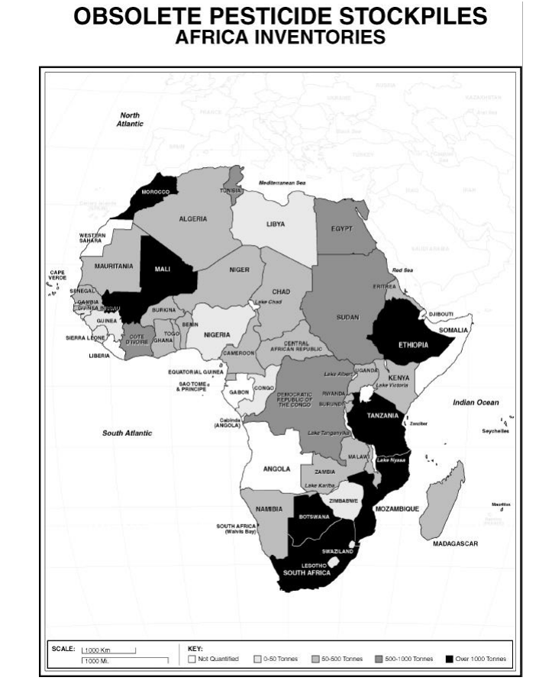
  Elimination POPs (Pesticides)
  Reduction from the manufacturing Process (Textile industry)
  African Stockpile Inventory and Environmental Sound Disposal of POPs and other HHPs
  More than 1000 tones
Notes:
When it comes to the elimination of POPs there was a significant efforts at global level and Africa was the beneficiary
As you can see the deep black countries, including our country Ethiopia, we are among the countries who had more than 1000 tones of obsolete Pesticide stockpiles.
The stockpiles were mainly POPs and other HHPs

Slide 12
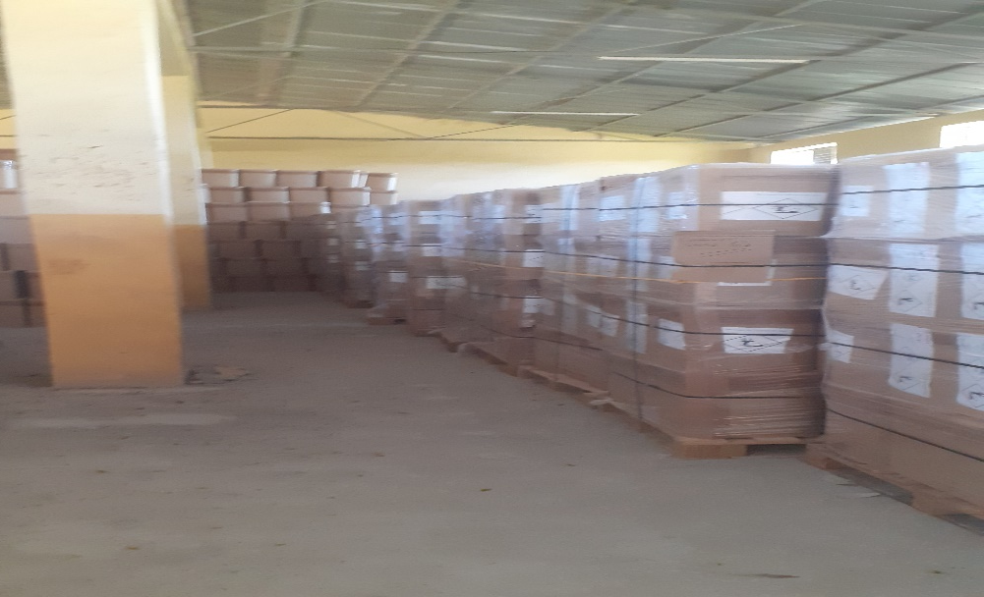
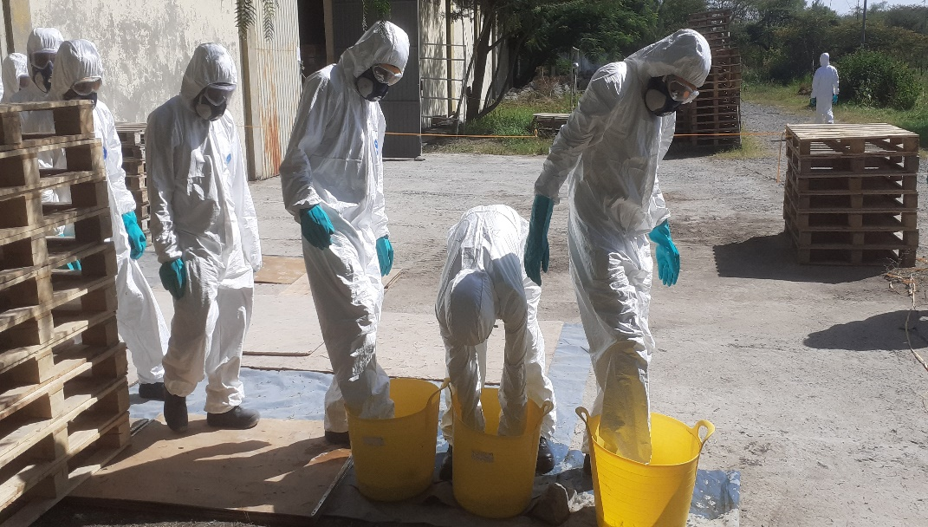
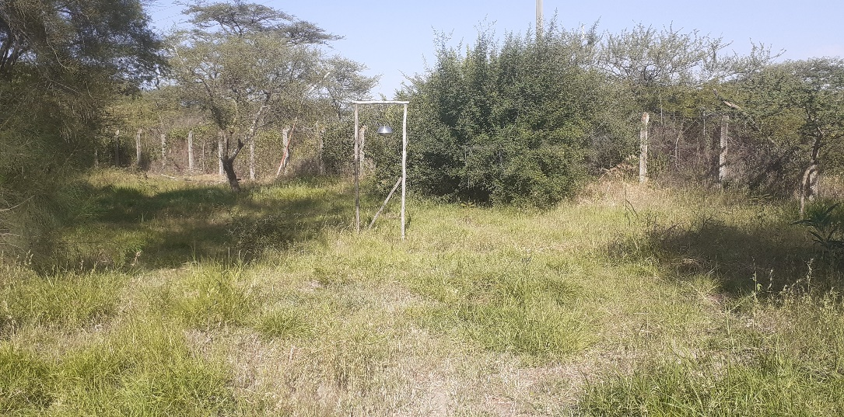
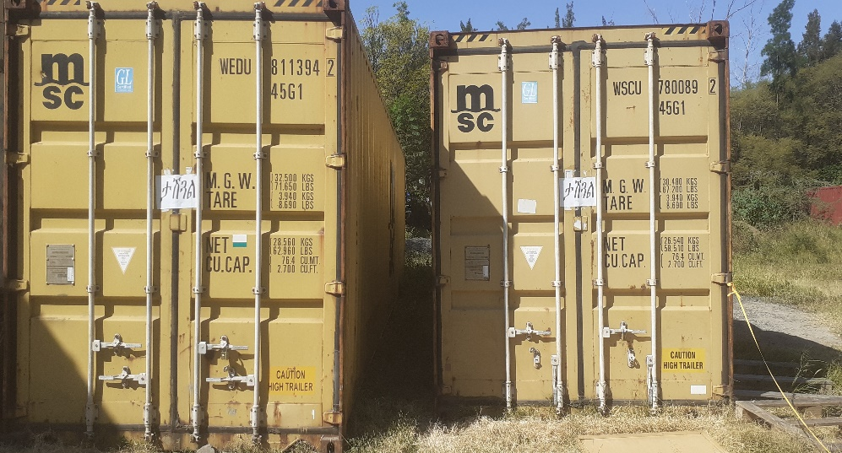
Ongoing Efforts following the recent update (Cont..)
Integrated Health and Environment Observatories and Legal and Institutional Strengthening for the Sound Management of Chemicals in Africa (African ChemObs)’
Safeguarding technicians end of day cleaning up in Zone two area
Air Monitoring equipment located 100 meters upwind of the DDT store

Slide 13
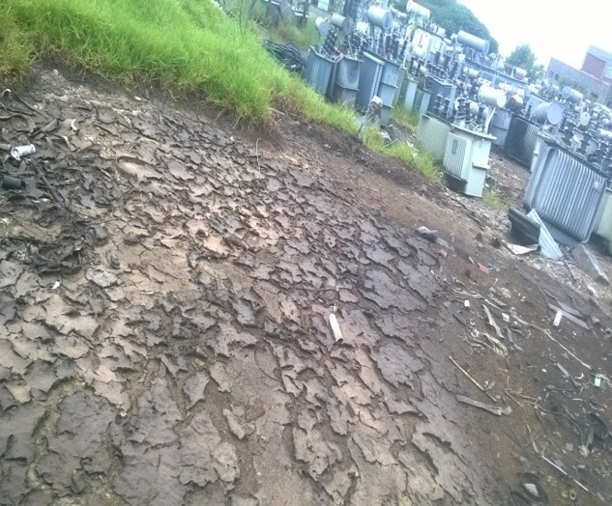

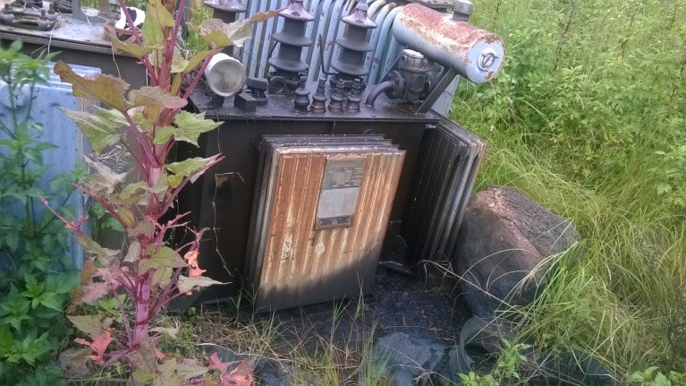
Ongoing Efforts following the recent update (Cont..)
PCBs Management in Ethiopia to meet the 2025 Stockholm Convention
Deadline – Phase 1
Gofa main store spilled oil and contaminated Soil
Notes:
This is a PCBs oil containing transformers are stored, we are doing a project to dispose a certain amount of PCBs oil to make Ethiopia to meet the 2025 Stockholm Convention Deadline – Phase 1

Slide 14
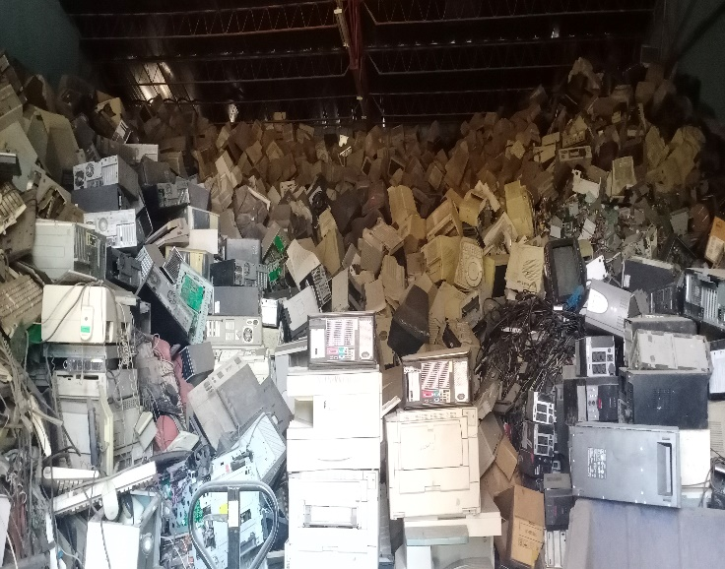
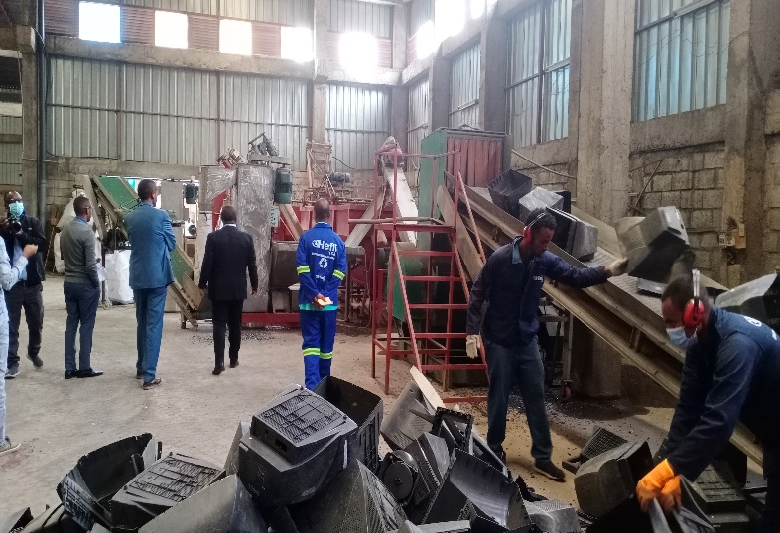
Ongoing Efforts following the recent update (Cont..)
E-waste management (Licensing scheme for private sectors )
Recycling to Reduce PBDE
Notes:
These other show of our effort, where we invited private sectors to lay their role in the recycling of E-waste
To reduce the release of PBDEs (polybrominated diphenyl ethers)

Slide 15
Phaseout of the Production, Import, Use, Stockpiles Wastes and Release of Annex A POPs Pesticides (Annex A, Part I Chemicals)
Multi stakeholders dialogue and Integration of chemical and waste management in the national development plan
Failure to phase out HHPs including POPs(LMICs) long and tedious process so working on registration and management LC better than disposal
7. Lessons learned
Notes:
We tried to put the lessons in 3 areas
It is possible Phaseout of the Production, Import, Use, Stockpiles of wastes to reduce the release and accumulation of POPs in every area
We developed experience, got knowledge through Multi stakeholders dialogue and tried to Integer chemical and waste management in the national development plan, we can build up on it to solve other problems

Slide 16
Strengthening chemical and waste management through strengthening the legal and Institutional framework should be part of our focus area
Increase Finance and Technology with improved, and sustainable mechanism
Strengthening human capacity ( laboratory testing and analysis) risk identification and Monitoring should be our focus area
8. The way forward and recommendations
Notes:
With this a came to end of my presentation and we have some discussion points which will be circulated during the breakout section.
I sincerely thank for your kind attention

Slide 17
Thank you for your Kind attention !

