Slide 1
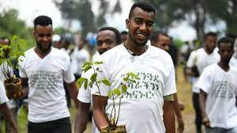
Meaningful Youth Engagement on Environment and Climate in Ethiopia
stockholm+50
Good Practices, Challenges and Recommendations

Slide 2

Hello!
I am Yared Abera
Global Youth Climate Leader from Ethiopia
You can find me at @YaredAberaInt

Slide 3

stockholm+50
Sweden, the host of the Stockholm+50 Conference, has expressed their intention to priorities the meaningful engagement of young people and stakeholders.
Future generations will be most impacted by the challenges we face today; therefore, it is pertinent to ensure that perspectives of children and youth are reflected in the highest levels of decision-making, and that collaboration with them reflects youth co-leadership, in line with the spirit of With and For Young People.
General Background.

Slide 4
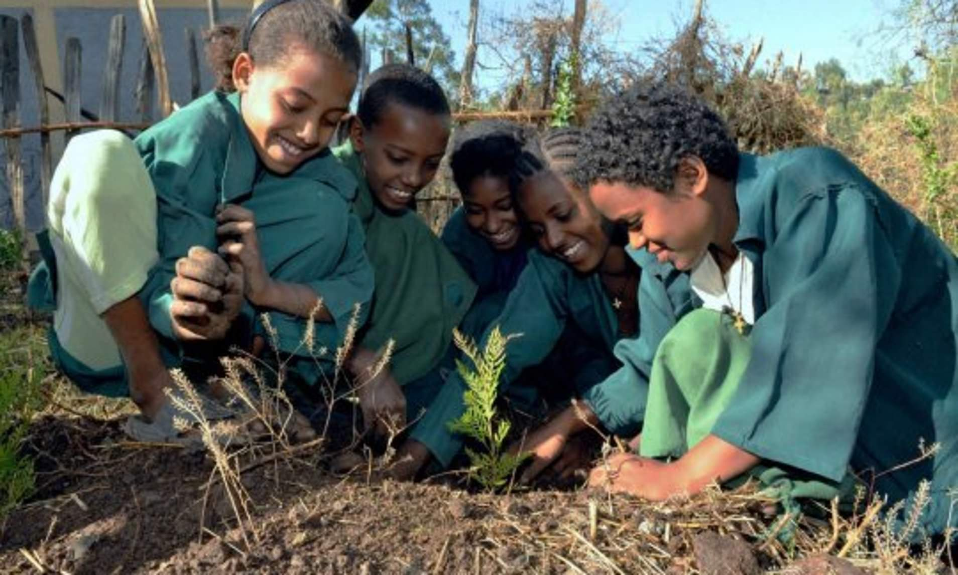
Objective
Issues to be Presented
Discuss the overview of youth agency as an actor of Environment and climate change agenda’s.
Assessing the current status of youth agency to engage on the agenda of climate change
Assessing opportunities and challenges posed for the meaningful engagement of youth on environmental governance
Forwarding practical recommendation to be applied for Stockholm 50+ and beyond

Slide 5
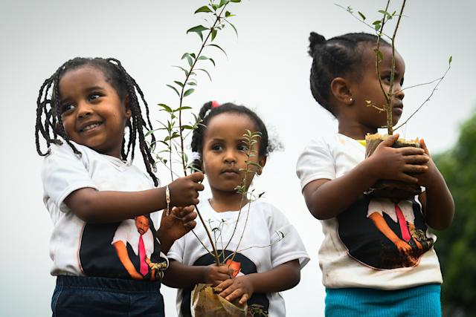
Why we need to engage youth ?
Discuss the overview of youth agency as an actor of Environment and climate change agenda’s.

Slide 6
Rationale
45 percent of Ethiopia Population is under the age of 15 and 71 percent is under the age of 30 .
Developing this great community is one of the important things that we as a county have to do.
Investing in Ethiopian youth is building a strong development that the country should expect in the future.
Future Generation
Climate Change is a youth issues
No segment of the population will be subject of ‘future generation’ other than the youth themselves. In general, the entire population in particular bears a responsibility for the youth.
Because most African countries including Ethiopia, the youth population accounts for a sizeable share of the total population also depend heavily on agriculture – a sector that is highly exposed to climate change

Slide 7
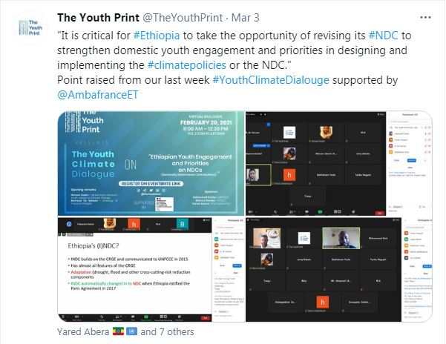
Good Practice’s
Assessing the current status of youth agency to engage on the agenda of climate change

Slide 8
Assessing the current status of youth agency to engage on the agenda of climate change
Existing Good Practices
Potential work to be capitalized
Awareness creation on Environment & Climate Change among the youth:
Environmental Clubs at Schools (Primary & Secondary)
Youth Participation:
Training:(Capacity & Awareness)
Youth Position papers:
Youth Voluntarism on Green Legacy
Including Youth in the National Delegation at COPs
Engagement of Youth during Consultation in updating NDC
Young people are organizing themselves as organization

Slide 9
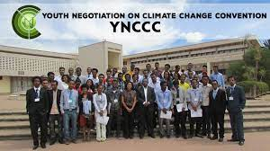
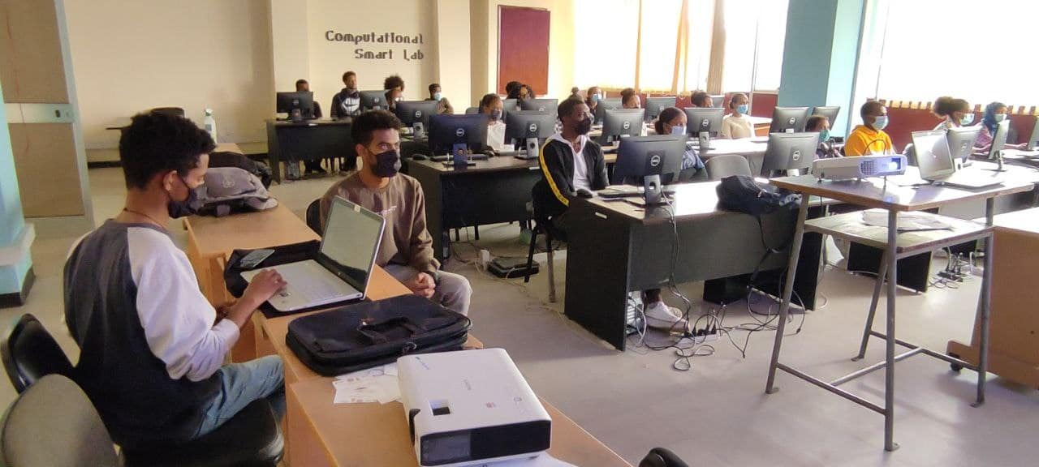
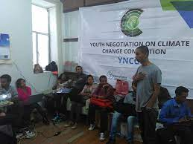
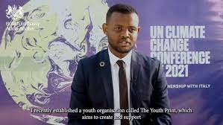

Assessing the current status of youth agency to engage on the agenda of climate change
Exicting Good Practices
Potential work to be capitalized
Awareness creation on Environment & Climate Change among the youth:
Youth Participation:
Training:
Position papers:
Youth Voluntarism on Green Legacy
Including Youth in the National Delegation at COPs
Engagement of Youth Consultation in updating NDC
Young people are organizing themselves as organization

Slide 10

Challenges
Assessing challenges posed for the meaningful engagement of youth on environmental and Climate Change

Slide 11
Main Challenges
Convenience
Insufficient funding for youth engagement:
Lack of Institutionalization:
Expensive
No meaningful Youth mainstreaming
Affordable
Unsatisfactory performance of
organization working on youth
Lack of youth engagement strategy
at the national level on Environment
and Climate Change
Inconvenient

Slide 12
Assessing challenges posed for the meaningful engagement of youth on environmental and Climate governance
Systemic Problems
Operational Problems
Lack of Consultative bottom-up process to understand the needs of young people
Most youth organizations engage voluntary = Lack of dedicated funding
Less understanding about policy process among young people
Youth left behind locally & Globally
Few “ resourceful organization are able to engage Vs Low level of grassroot engagement
Ad-hoc engagement leads to lack of long-term & sustained impacts
Solutions of meaningful youth engagement don’t have system- wide buy-in

Slide 13
Recommendations
Forwarding practical recommendation to be applied for Stockholm 50+ and beyond.

Slide 14
Forwarding practical recommendation to be applied for Stockholm 50+ and beyond.
Holistic recommendation
Functional Solutions
Strategic and early partnership with young people
Engagement of mandated youth constituencies, organization and network at national and sub-national level
Universal Engagement of Youth
Making the youth as change agent
Dedicated Support for Youth
Capacity-Building Program
Series of funded Consultation and Engagement
Support for Participation at the local and Global engagements and events
More Awareness Campaign

Slide 15
Large image
Promote structures for meaningful youth participation and, based on input from youth, demonstrate how young people can be involved in and affect discussions about their future

Slide 16





Thank You
Yared Abera
+251910884706
yared2012@gmail.com
Global Youth Climate Leader

