Slide 1


Federal Democratic Republic of Ethiopia
Environmental Protection Authority (EPA)
National Responses to the Multilateral Environmental Agreements (MEAs) in Ethiopia
Mensur Dessie Nuri
Director, MEAs Negotiation Coordination Directorate, Ethiopian EPA
April 11/2022

Slide 2
Objective of the Presentation
To briefly inform you Ethiopia’s actions in response to the environmental challenges focusing on the MEAs
To appreciate and renew ours commitment for better planning, implementation, coordination, reporting, and
To also appreciate and renew yours commitment and strengthen support for the implementation of MEAs in Ethiopia

Slide 3


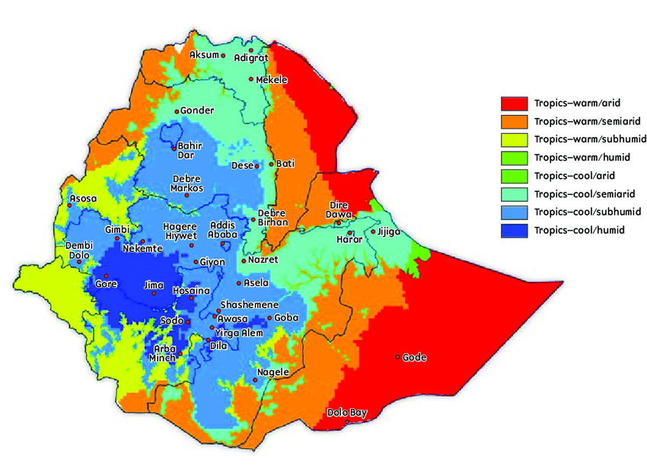
Background
Ethiopia:
Ethiopia: Diversified agro-ecology
is gifted with abundant natural resources of adequate landmass, fertile soil, favourable climate, water, wildlife, and others
has about 120 million people live in Ethiopia, and over 80% are living in rural areas
Ethiopia’s economy is highly dependent on natural resources

Slide 4
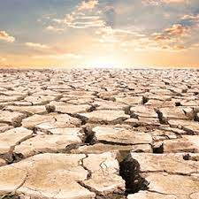
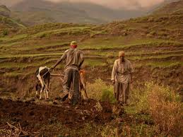
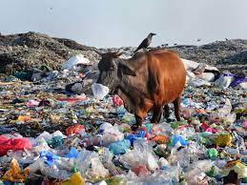
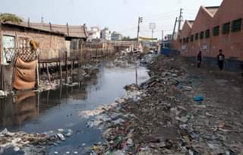
Background
Environmental Problems
Recurrent droughts, flooding,
Loss of biodiversity and associated severe degradation of ecosystem services,
Increased incidence of pests and diseases, and
Poor utilization of natural resources (forest, land) and
Pollution of land, air and water;

Slide 5
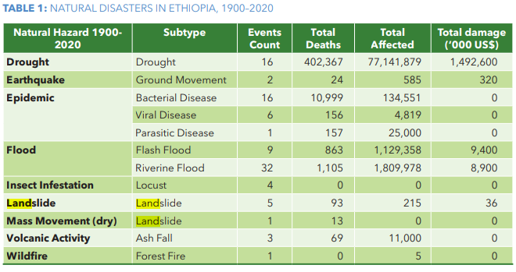
Background
Environmental degradation and climate change hampers Ethiopia’s economic growth & it results in increase cycle of poverty, food insecurity
Dramatic growth in chemicals production and trade across the world has potential risks posed by hazardous chemicals and pesticides

Slide 6
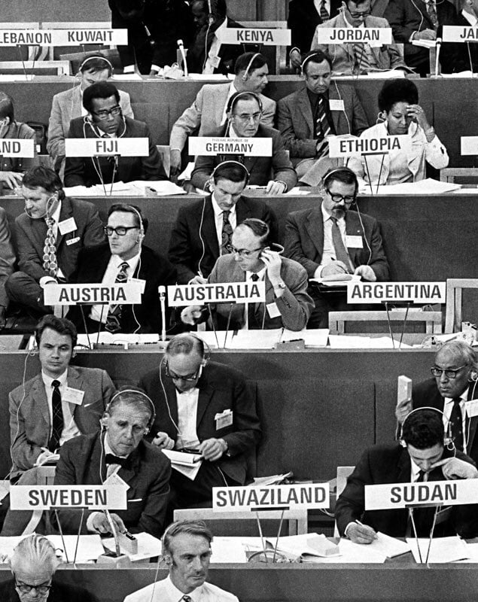
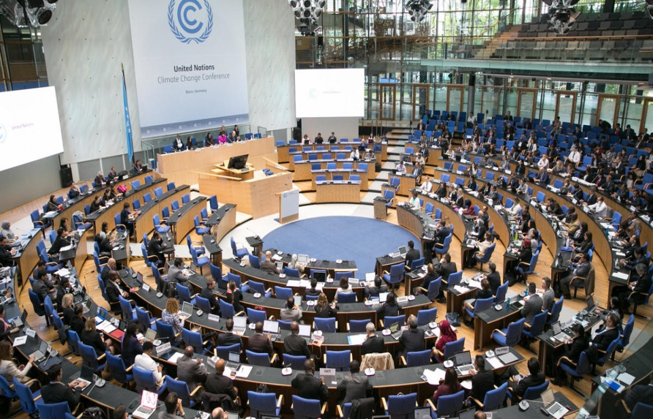
Why Ethiopia has been engaging in MEAs?
Unless natural resources are used sustainably and collaboratively, the survival of human kind on earth will be at stake
Developed counties comprising about 20% of the world's population consumes 80% of the total resources whereas the opposite is true for the developing world
Environmental problems are cross boundary in their nature
Multilateralism is the only way for bringing collaboration for sustainable utilization of these limited resources
Ethiopia@UN Conference on the Human Environment, 1972

Slide 7









Efforts made to address the environmental problems in Ethiopia
Ethiopia signed/ratified a number of MEAs (Source: University of Oregon)
MEAs to which Ethiopia has taken membership actions
Actions taken on 161 MEAs including:
  28 Signatures
  47 Ratification, Accession, Succession,
  49 Entry Into Forces
  Etc
  No withdrawal from any MEAs

Slide 8


Efforts made to address the environmental problems in Ethiopia…
MEAs to which Ethiopia has taken membership actions
Regional Agreements

Slide 9
Efforts made to address the environmental problems…
National Environmental Laws/Policies/Strategies
The Ethiopian Constitution, 1995
Environment Policy of Ethiopia, 1995
EIA Proclamation 299/2002
Pollution Control Proclamation 300/2002
Solid waste Management Proclamation 513/2007
CRGE strategy (2011)
NDC (2015 & 2021)
GTP-2 (2015 to 2019/20)
NAP-ETH (2017)
Hazardous Waste Management & Disposal Proc. 1090/2018
Electric & Electronics Waste Management Regulation 425/2018
Industrial chemical registration & admin regulation 1075/2018
10 YDP= 1 of 10 pillars (2020/21)
Sectoral green economy laws/strategies/plans

Slide 10

Efforts made to address the environmental problems…
National Environmental Laws/Policies/Strategies
Ethiopia tries to translate the international commitment in to local actions:
GOE recognizes sustainable development in the Constitution (art. 43, 44 & 92) (1995)
Environmental Policy of Ethiopia (1995)
CRGE/NDC are mainstreamed & implemented in the GTP-II & the 10 YDP -(soil, water, forestry) though community participation
GTP-II & the 10 YDP also recognizes CRGE/NDC as one of its 10 pillars
Environmental institutions are established at Federal, Regions & City Administration as well as line ministries

Slide 11
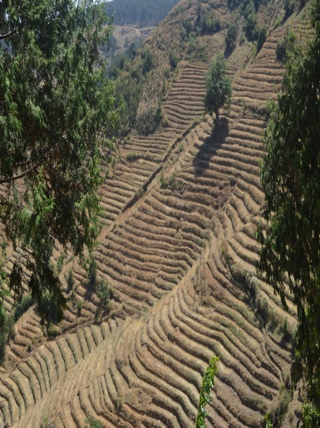
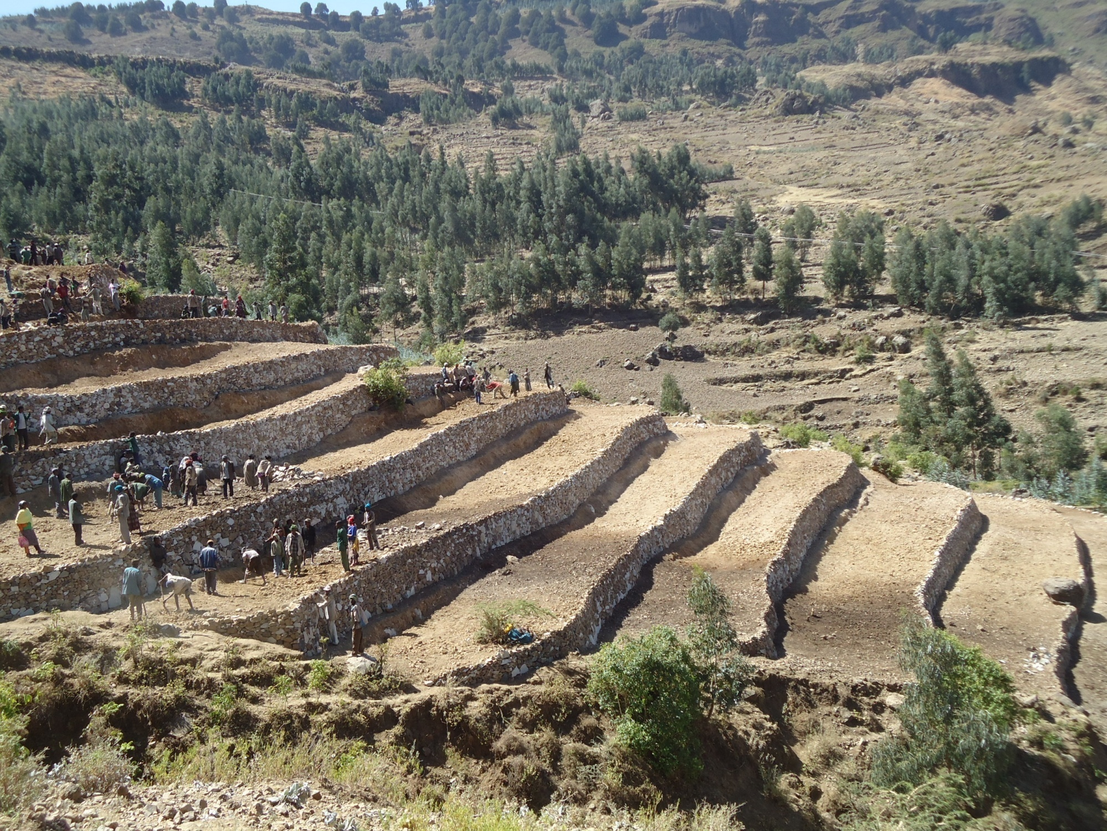

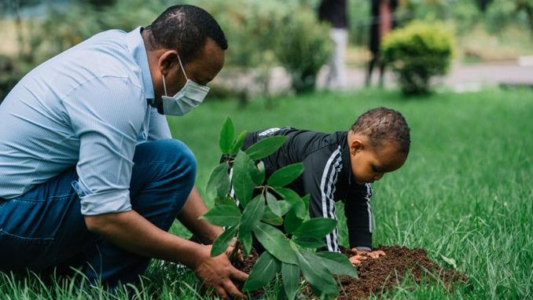
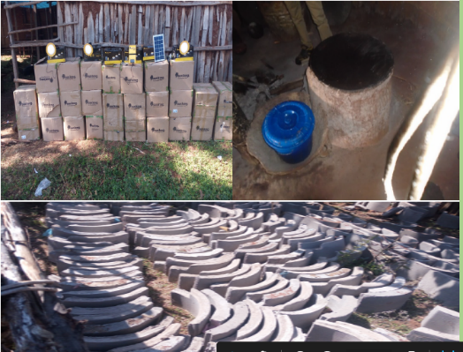


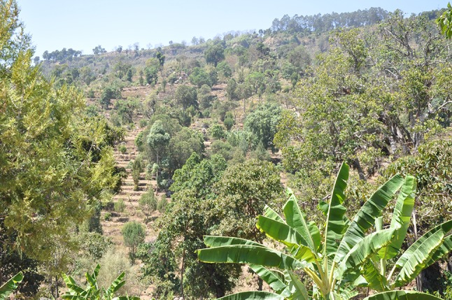
Efforts made to address the environmental problems….
  In effect, Ethiopia has done, and continues to do, a great deal on environment protection
Restoration
Waste management
Green Legacy Initiative
Alternative energy source
Urban greenery
E-mobility
Agroforestry-local knowledge

Slide 12
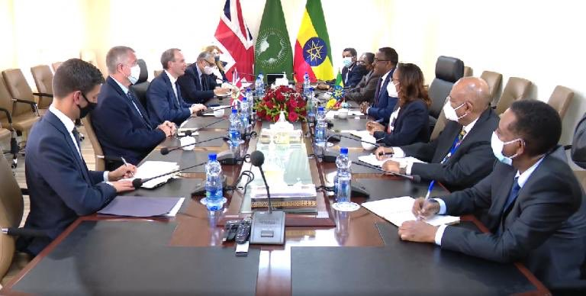

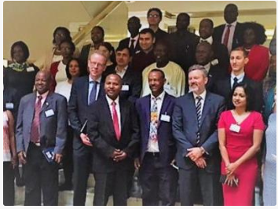


Efforts made to address the environmental problems….
Leadership in MEAs
Chair (2017-2018)
AFRICA=
CAHOSCC
Chaired in 2009 &for two terms
Pre-COP26@AA=H.E. Demeke, DPM vs H.E. Alok Sharma, COP26 President
LDC delegates at the LDC
Group Meeting (2017), AA
BRS/Bamako conventions
Bureau member/Rapporteur
Chair-CVF(2017-2018)
Ethiopia Voluntary National Review on SDGs, 2017

Slide 13
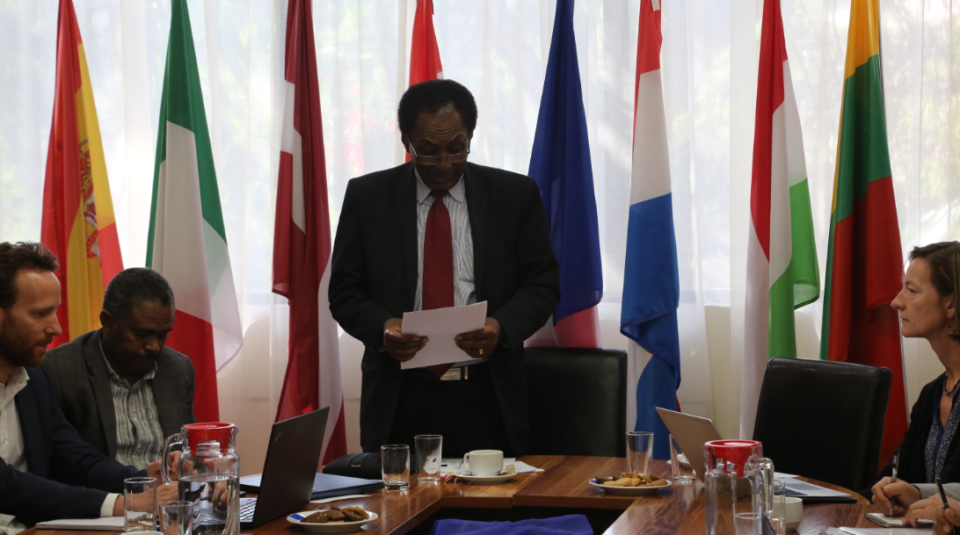
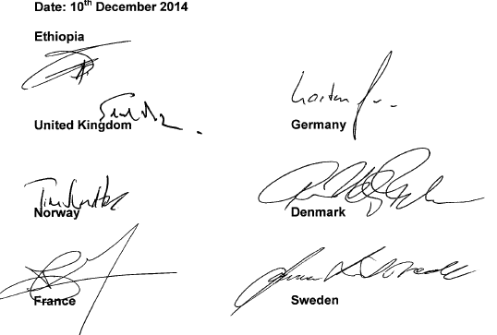

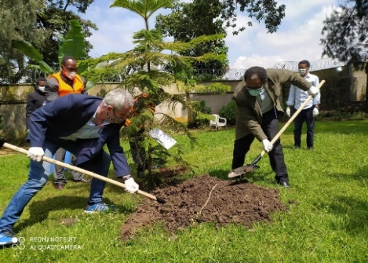

Efforts made to address the environmental problems….
Partnerships established for realization of MEAs
CRGE Forum
Partnership Mechanisms
LIMA Partnership
CRGE Facility
Establishing & Chairing (2018-now)
BILATERAL AGREEMENTS

Slide 14
Gaps in the implementation of MEAs
  Financial constraint is the main challenge: low flow of new and additional financial resources from relevant parties to the MEAs
  Weak capacity and technology know how in environmental management process
  Lack of robust flow of data and information for monitoring, reporting and verification/MRV at all level due to lack of modern knowledge management systems and communication means
  Coordination is still a challenge

Slide 15
Opportunities for implementation of MEAs
Availability of finance from different international mechanisms
Appreciation to Ethiopia’s ambitious environmental policies, plans and strategies followed by an increasing support from our dear development partners in recent years and hoping also to continue in future
The active engagement and efforts to fulfill the commitments of parties to the MEAs are progressing from time to time
Green economy and sustainable development gets attention against BAU way of development

Slide 16
Conclusion
GOE well recognizes that MEAs are very important to achieve national development goals of Ethiopia
Ethiopia well responds to the multilateralism by ratifying a number of MEAs where efforts are also made to realize their intimate goals where:
Government of Ethiopia has shown political environmental will by:
  formulating various environmental policy, laws and strategies
  establishing environmental protection agencies at federal and in regional states and beyond.
  The formulated environmental laws and the CRGE Strategy as well as provides an opportunity to promote sustainable development in Ethiopia

Slide 17
Conclusion…
The challenges for the implementation of MEAs are mainly inter-linked with financial constraints and other means of implementation (lack of human and financial capacity as well as green technology know-how and proliferation)
Environmental Protection Institutions are to be strengthened to ensure intended benefits and commitments thereon in each MEAs

Slide 18
Way Forward
There is a need to strengthen capacity (institutional & human) at all level if the ambitious goal of the environmental laws and strategies is to be met.
Developed countries and other development partners are to step-up their support (as per the provisions of the MEAs) if Ethiopia to fully operationalize the MEAs where the country is party to
Environmental governance needs to be improved at all level
Follow up on implementation of MEAs, national environmental policy & laws and strategies to track the progress is to be strengthened
There is a need to have a robust coordination mechanism to facilitate the implementation, and systems for flow of information, and reporting, monitoring & verification/MRV and M&E of these MEAs

Slide 19



Acknowledgement

Slide 20
Discussion Questions
How do you appreciate the multilateralism works in terms of MEAs to make solutions to the environmental problems?
Lack of human and financial capacity as well as green technology know-how and proliferation are the major challenges to implement MEAs in Ethiopia. Please share your thoughts and opinion on how they can be improved.
What should all stakeholders (national & international) do to improve the implementation, reporting, monitoring & verification of the MEAs where Ethiopia has already ratified?

Slide 21
Thanks
Thanks for your attention

