Slide 1




Ethiopia’s climate compatible development journey: updated NDC

Slide 2
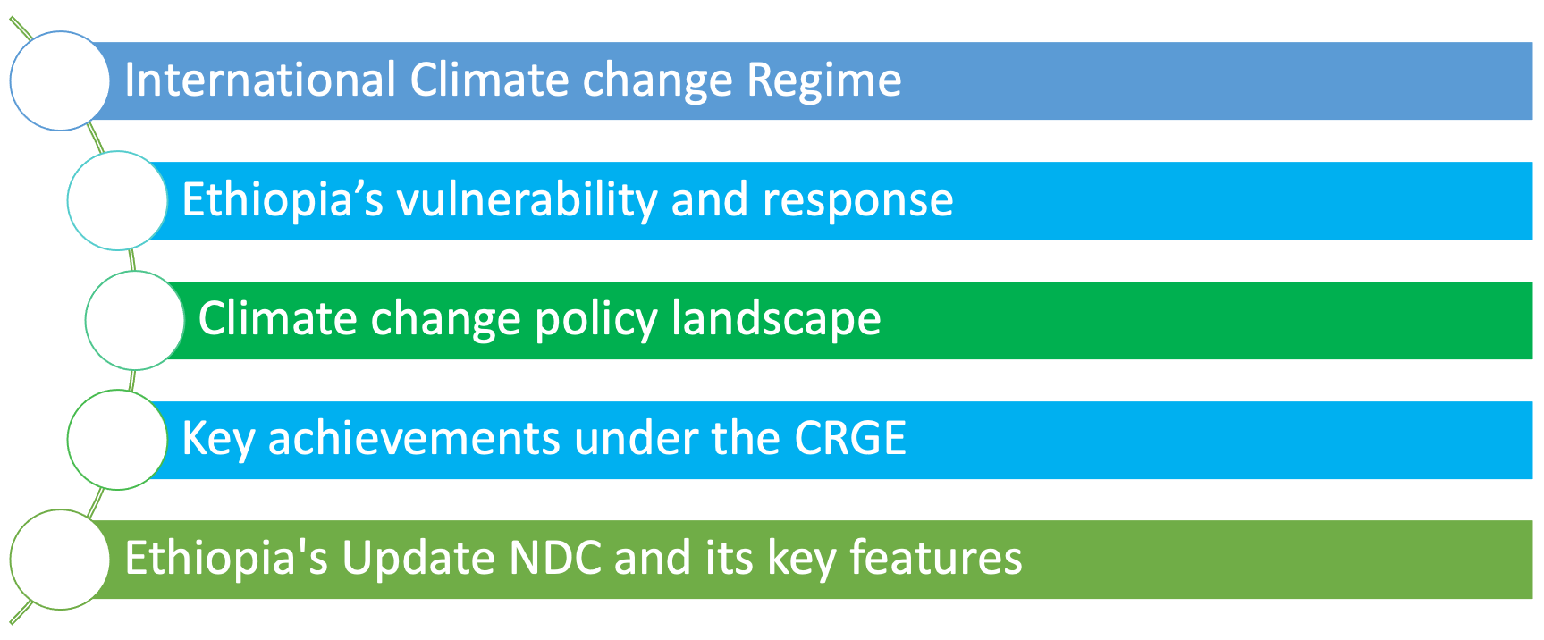
Outline

Slide 3
INTERNATIONAL CLIMATE CHANGE REGIME
IPCC
UNGA “common concern of mankind”
UN Conference on Environment and Development in June 1992
1970s
1988
1990
1992
1994
IPCC’s First Assessment Report
UNGA resolution 45/212 established an INC
UN Framework Convention on Climate Change
Climate change emerged as a scientific concern
Notes:
Add Kyoto pr

Slide 4
Ethiopia’s vulnerability and response to climate change

Slide 5
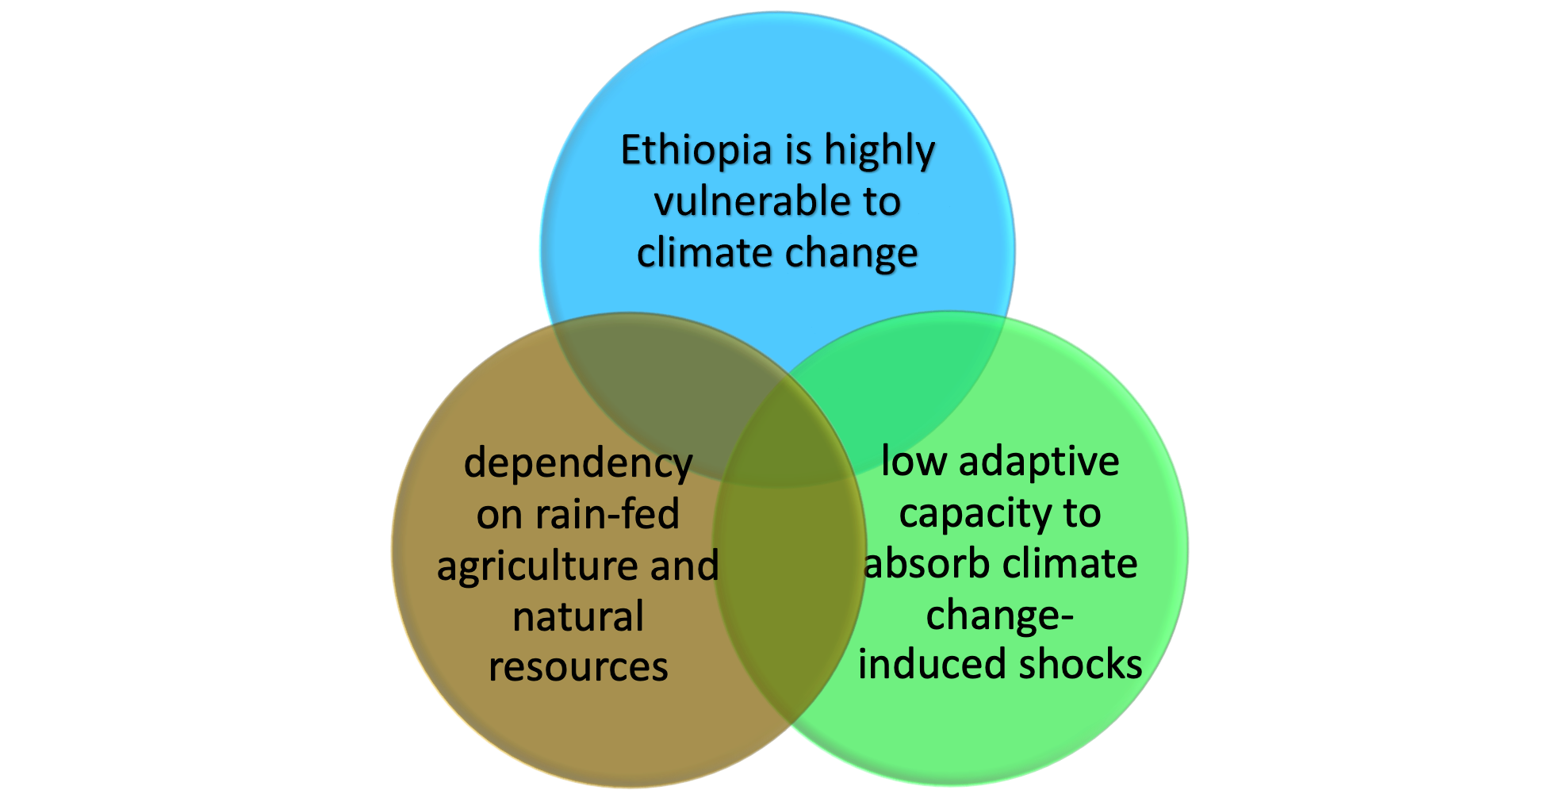

Slide 6
Climate Induced disasters
Frequent and extended droughts
Flash flooding
desert locust
Other extreme weather events

Slide 7
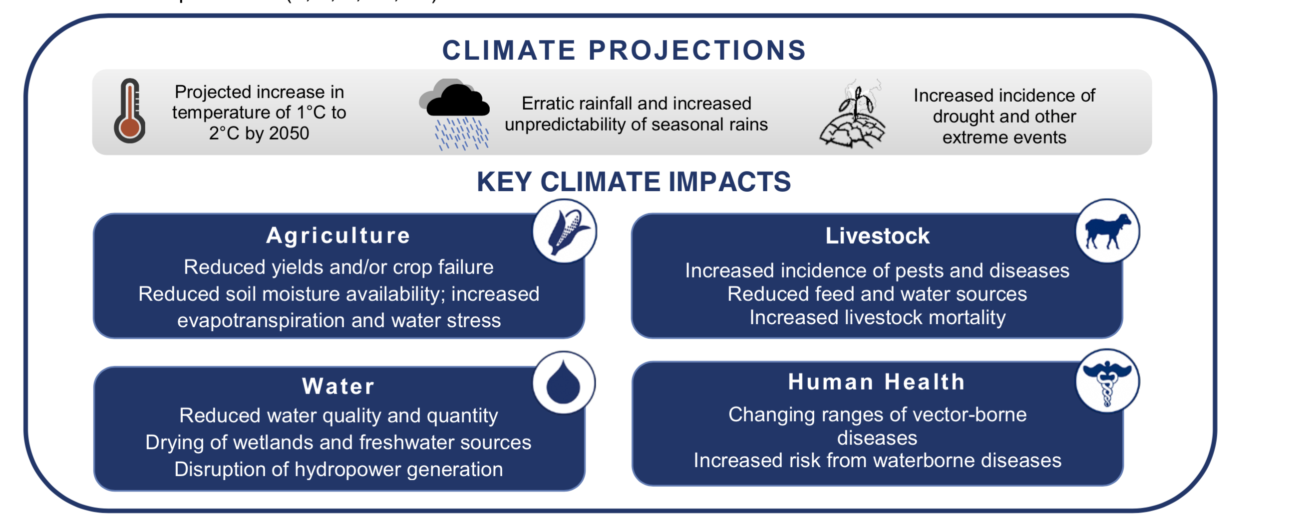

Slide 8
Ethiopia’s climate change policy landscape

Slide 9

CRGE strategy as a turning point

Slide 10
Pre 2011 milestones
2001/2005
2007
2010
2010
INC/Ratification of Kyoto Protocol
NAPA (National Adaptation Program of Action)
EPACC (Ethiopian Program of Adaptation on Climate Change)
NAMA (Nationally Appropriate Mitigation Actions)

Slide 11
Aftermath of 2011
CRGE Strategy
CR Strategies
INDC
GTP II
REDD+ Strategy
NAP-ETH
NFSDP
10 YDP
Updated NDC
.
2011
2015
2016/17/18
2021

Slide 12
Key achievements under CRGE

Slide 13
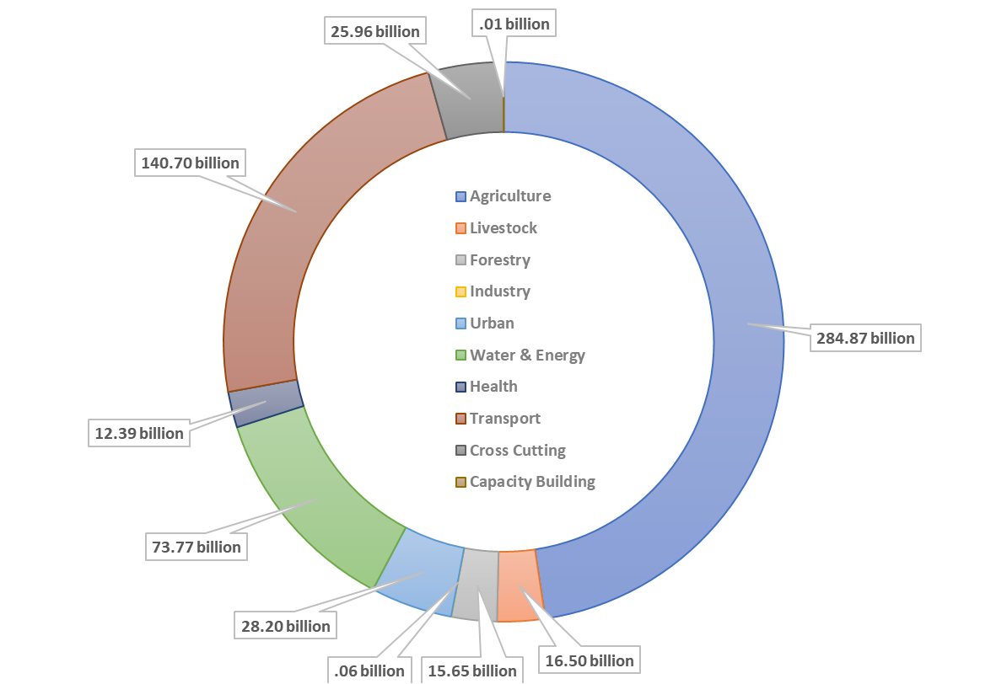
Climate investment (in ETB) by Sector (ETB 598.1 billion)

Slide 14
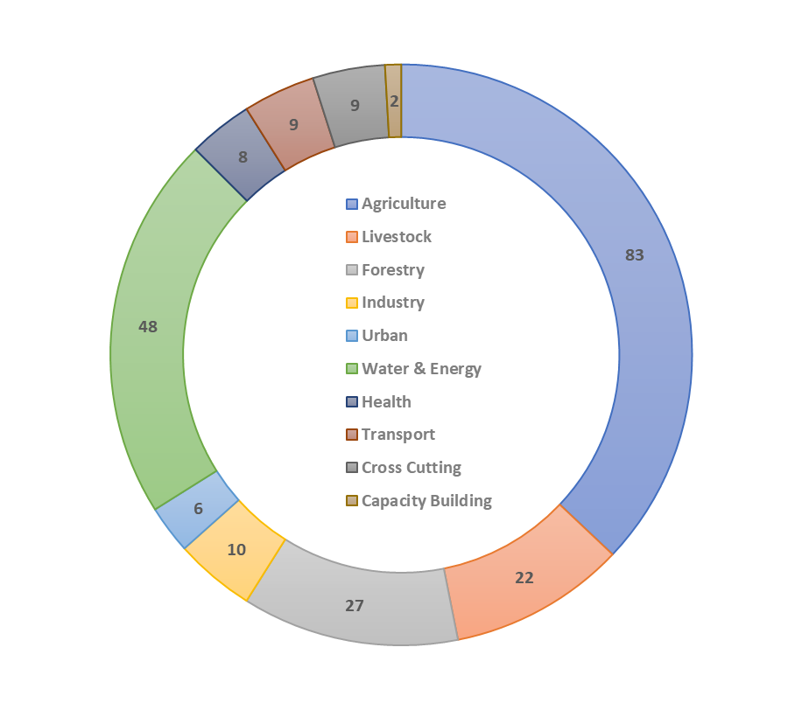
Number of Climate Projects by Sector

Slide 15
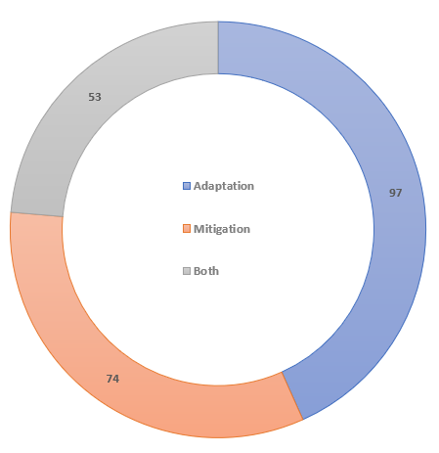
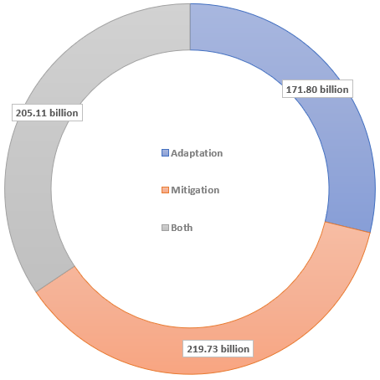
Number of Projects (left) and Total Value (in ETB) of Projects by Climate Impact

Slide 16
Ethiopia’s NDC

Slide 17
Ethiopia’s first NDC
Anchored on the CRGE Strategy (2011)
It was one of the most ambition NDCs (64%) with target year of 2030
Gases covered CO2, CH4 and N2O, which are considered priority gases
YOUR TITLE
Green marketing is a practice whereby companies seek to go above and beyond traditional.

Slide 18
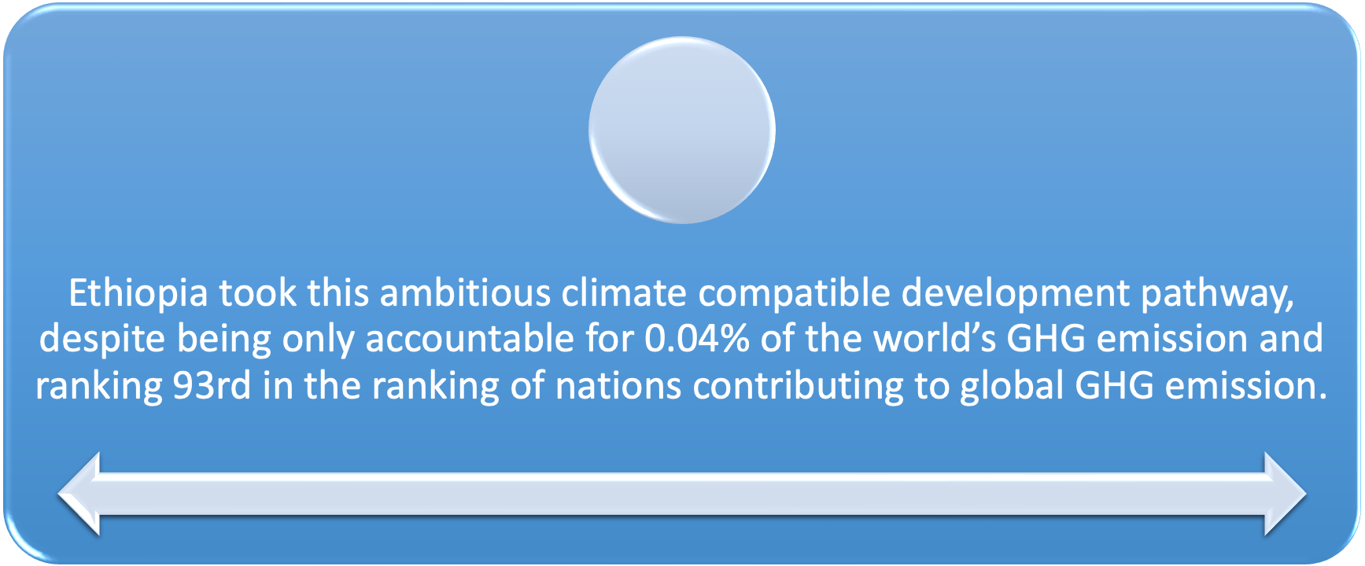

Slide 19
Ethiopia’s Updated NDC
(2020-2030)

Slide 20
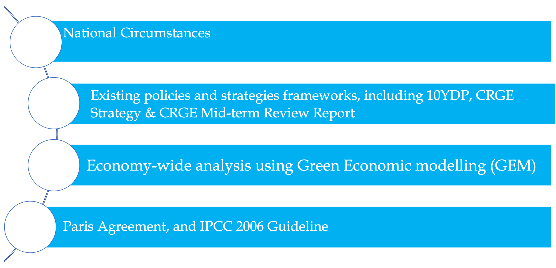
Key considerations for Ethiopia’s NDC Update

Slide 21
Mitigation contribution

Slide 23
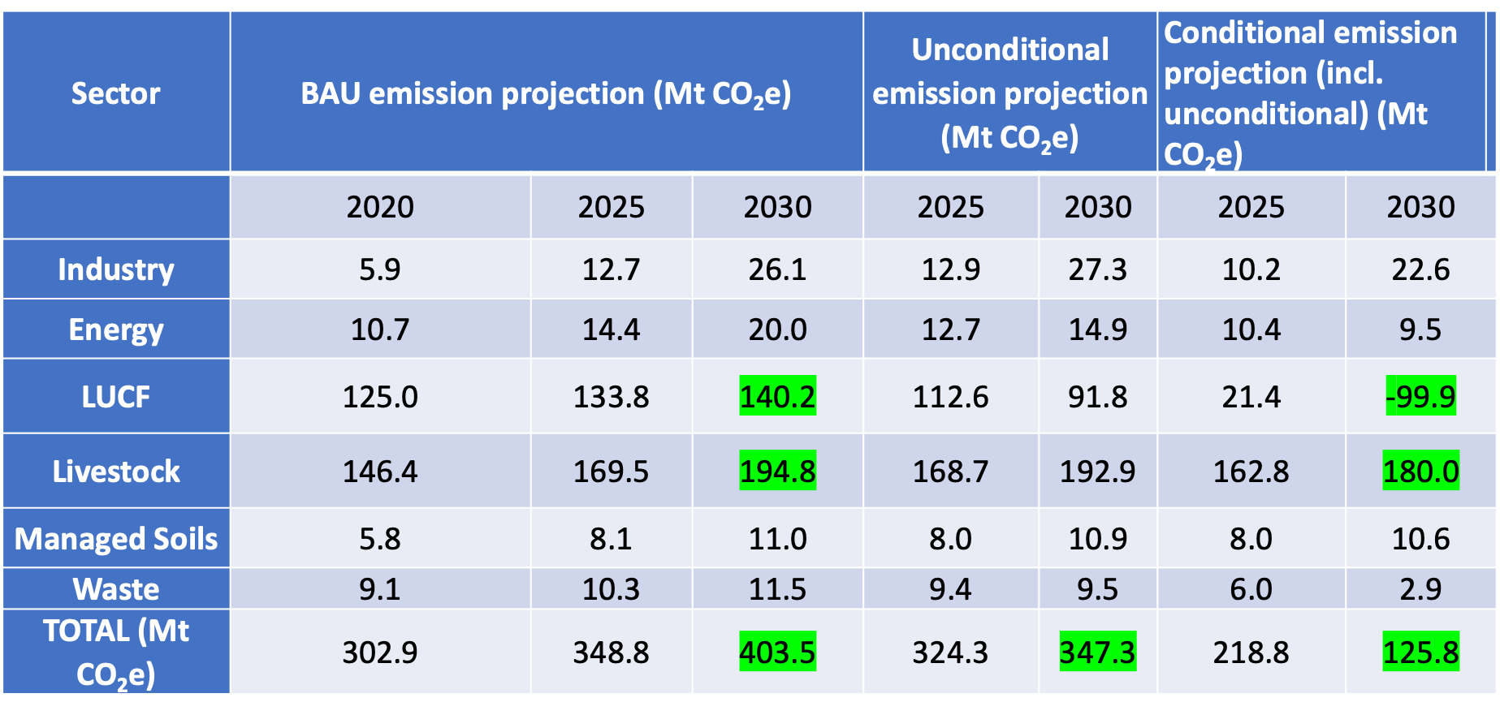
GHG emission projections in BAU, unconditional and conditional pathways

Slide 24
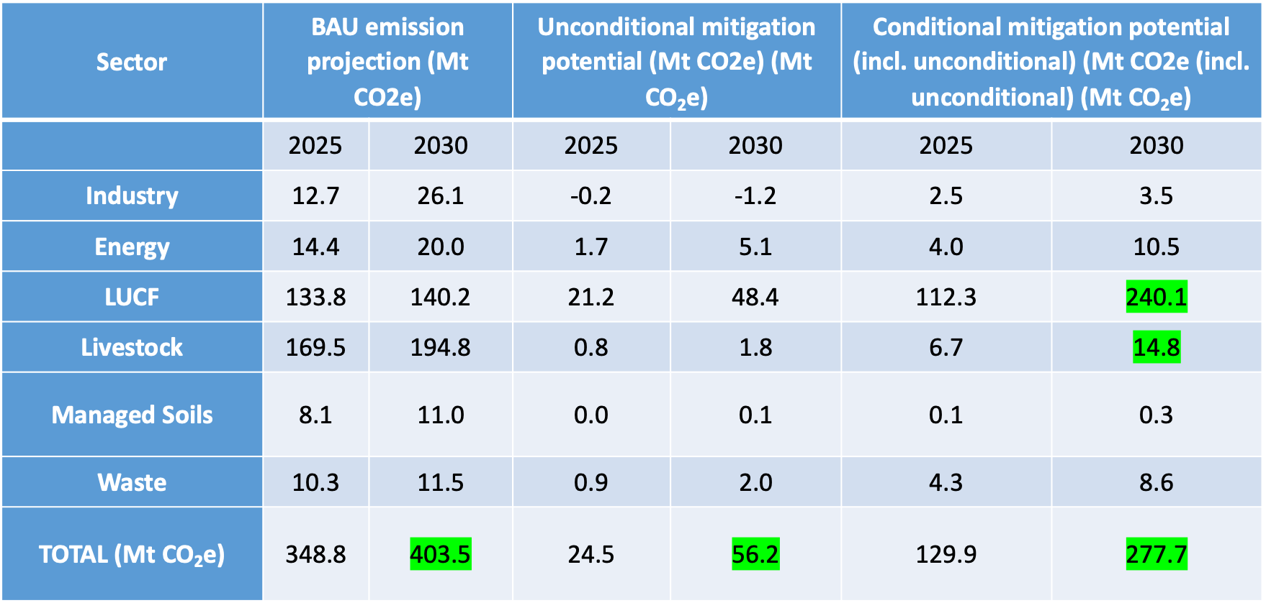
Mitigation potentials by sector and conditionality

Slide 25
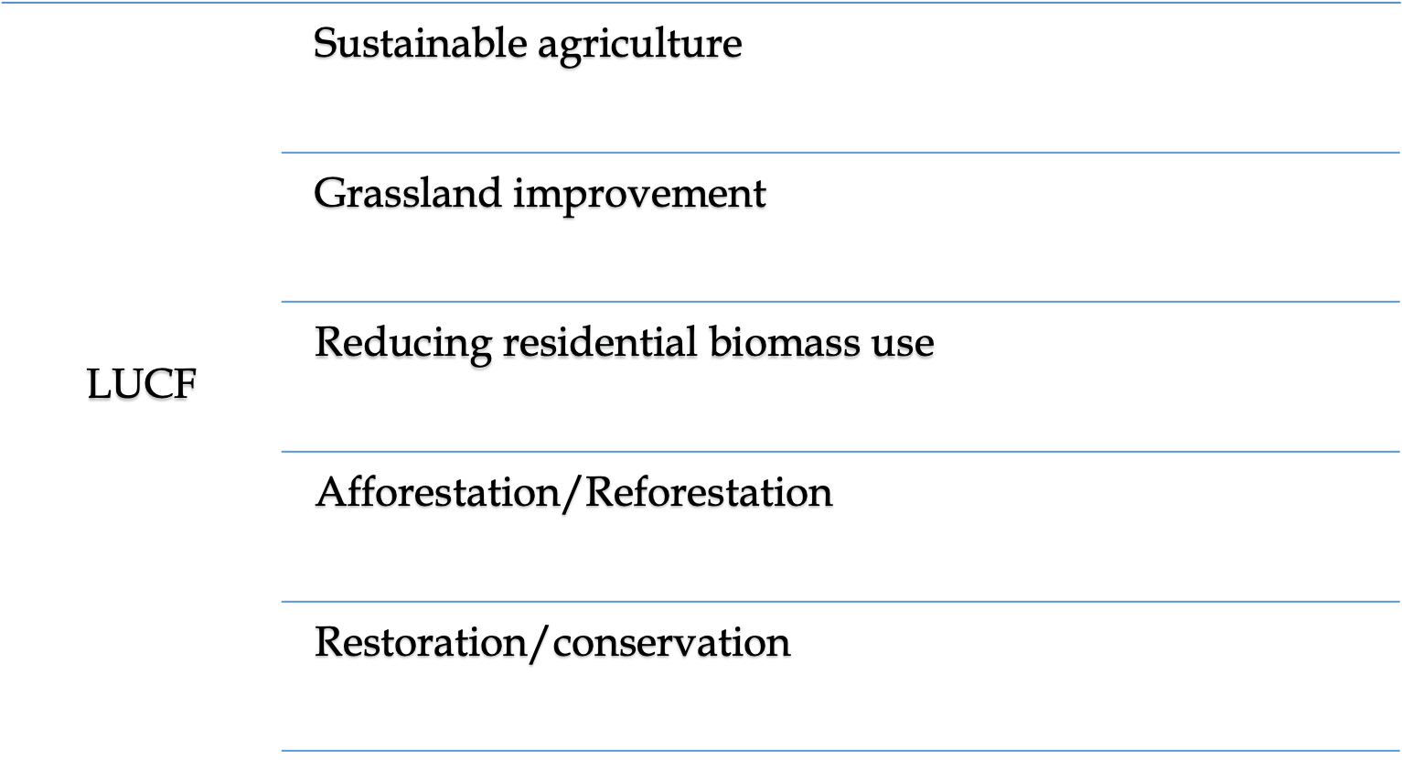

Policy interventions-LUCF

Slide 26
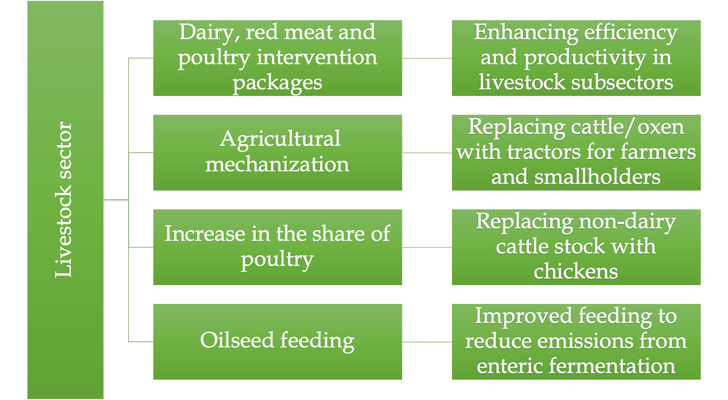

Policy Interventions-Livestock
:

Slide 27
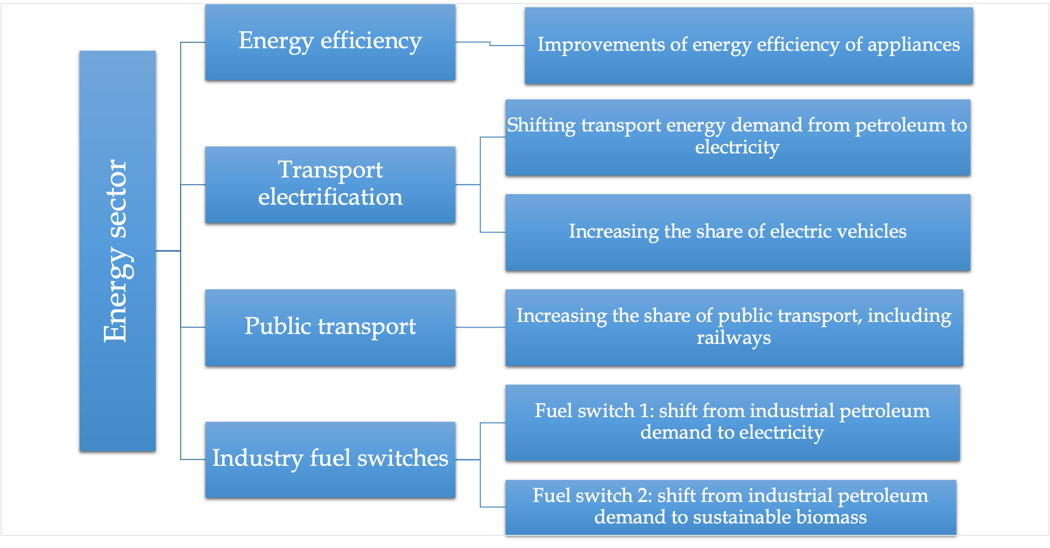

Policy Interventions-Energy
:

Slide 28
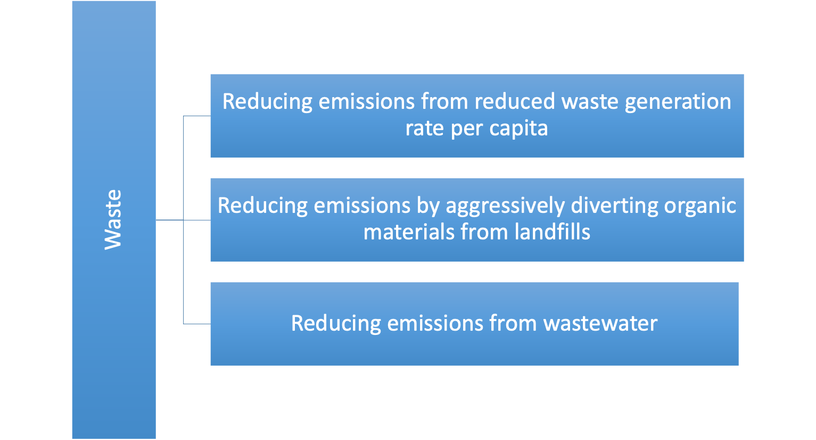
Policy Interventions-Waste

Slide 29
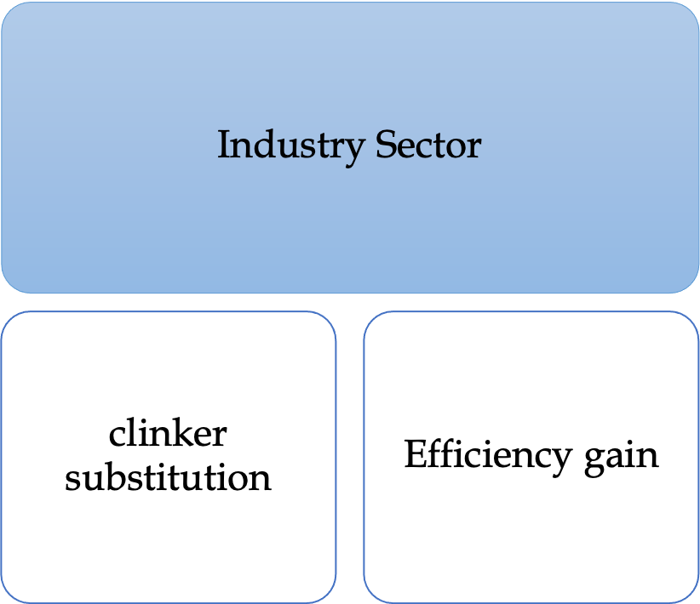
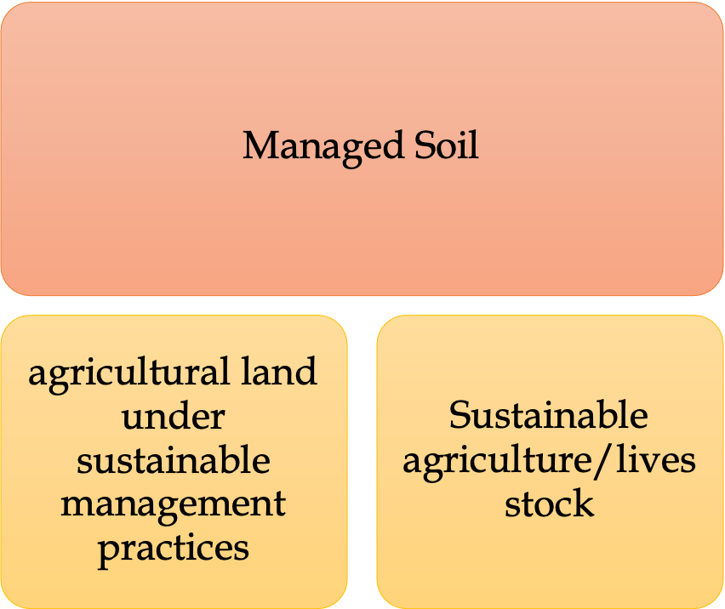
Policy Interventions
:

Slide 30
Adaptation Contribution

Slide 31
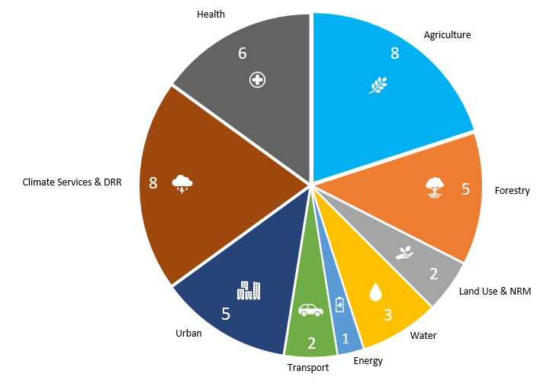
Adaptation contribution

Slide 32
Means of implementation

Slide 33
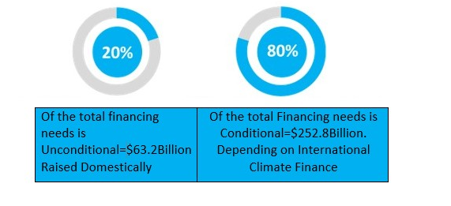
Climate Finance
USD 316 billion, mitigation (USD 275.5 billion) and adaptation (USD 40.5 billion)
Notes:
How do we strike a balance between ambition and feasible? Domestic resource mobilization

Slide 34
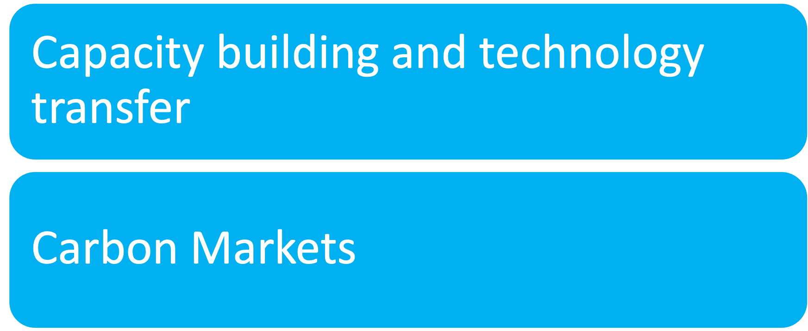
Other enablers

Slide 35
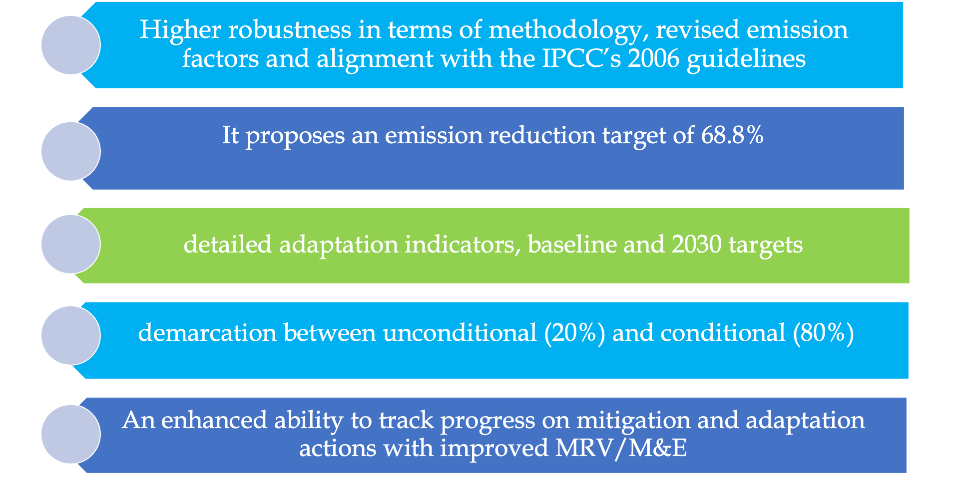
Salient features

Slide 36
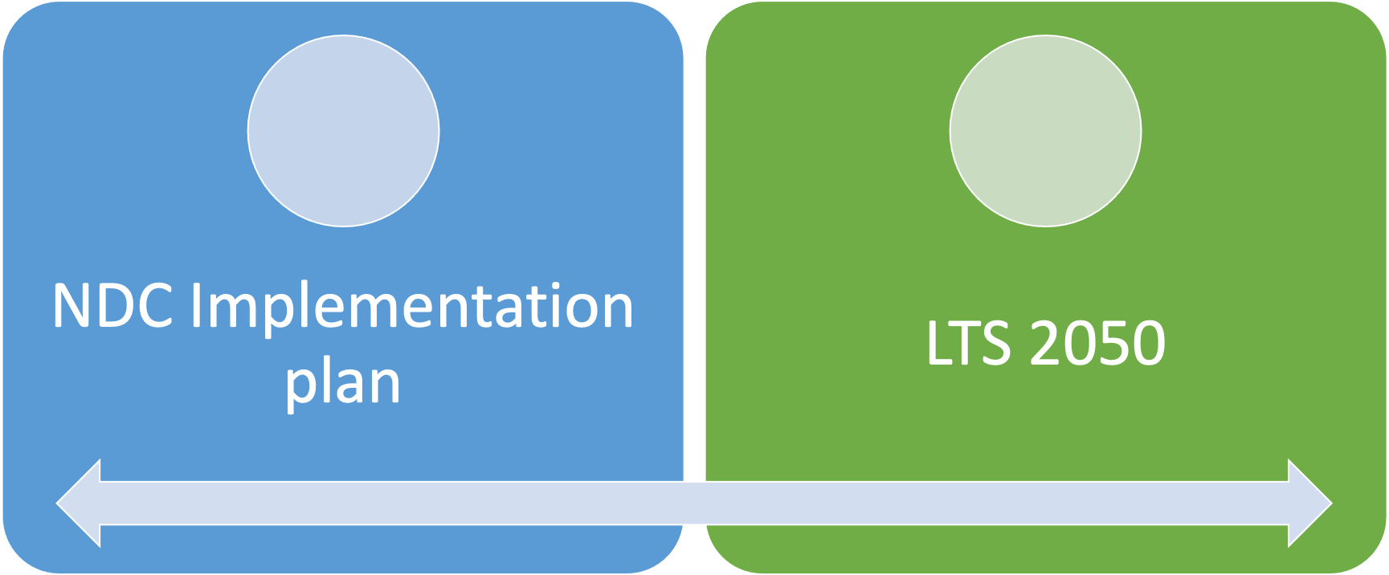
Ongoing works

Slide 37


