Slide 1
International Futures: Training Session 1
pardee.du.edu
@pardeecenterifs
@moyerjonathan

Slide 2
Introductions
Welcome from UNDP SDG Integration TBD
Meet your trainers:
  David K. Bohl
  Keith Gehring
  Vivian Yang
  Jonathan Moyer

Slide 3
Overall training structure: what you need to know
Three training “blocs”, each with four weeks.
  Each training bloc:
    First week is the actual training (1.5 hours).
    Weeks 2-4 are “office hours” where we will solicit questions and provide more directed feedback to those with interest.
  Bloc 1: GDP and Poverty
  Bloc 2: Trade
  Bloc 3: Fiscal
Follow-on conversations on SparkBlue

Slide 4

What you need for today:
  IFs installed on your computer
  Two documents open:
    Template for Training.docx
    Template for Training.xlsx
  Ideally, two screens: keep the presentation open on one screen and toggle between the IFs model, Excel doc, and Word doc on another screen
  Turn your video off after the introduction, mute your microphone
  For questions:
    During the presentation please ask questions using the chat option
    If things are moving too fast or too slow, please also mention that in the chat

Slide 5
International Futures

Slide 6
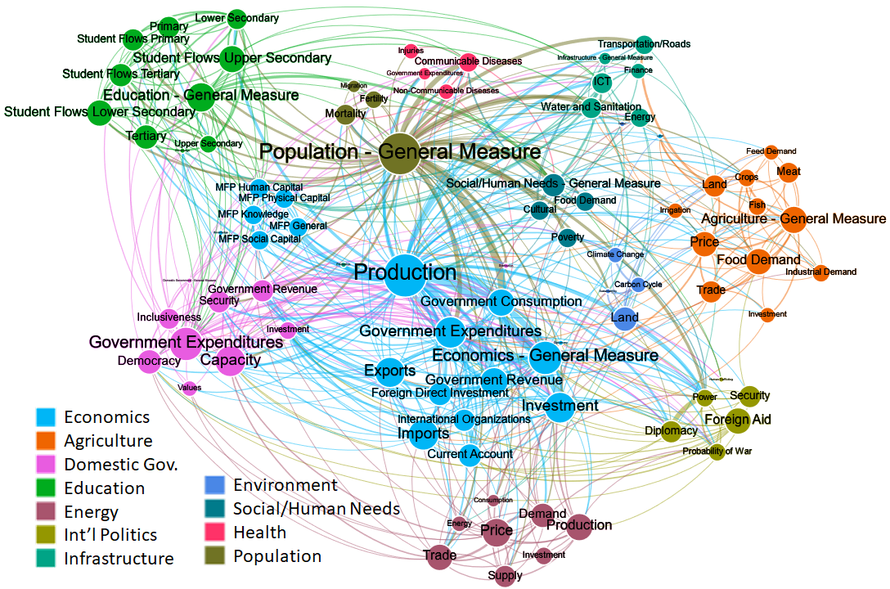
International Futures
What is the purpose of models?
A model is a representation of reality. They can help us think, plan and collaborate.
This is a large model and you should expect to learn about different aspects of the model as you go.
Learning about the model is not easy and requires an investment on your part.

Slide 7
Opening the “Black Box”: Layers of Support
Network map of relationships in IFs: http://54.148.187.79:8080/ifn/
Publications: https://pardee.du.edu/patterns-potential-human-progress
“Drivers” map in IFs (we can show if we have time, but probably during office hours)
Help system wiki: https://pardee.du.edu/wiki/Main_Page
Poverty wiki: https://pardee.du.edu/wiki/Economics#Poverty_2
Basic "How to?" videos: https://pardee.du.edu/ifs-course/getting-started-quick-reference
Additional course materials: https://pardee.du.edu/ifs-course
FAQ: https://www.sparkblue.org/IFs-FAQ-covid-19

Slide 8
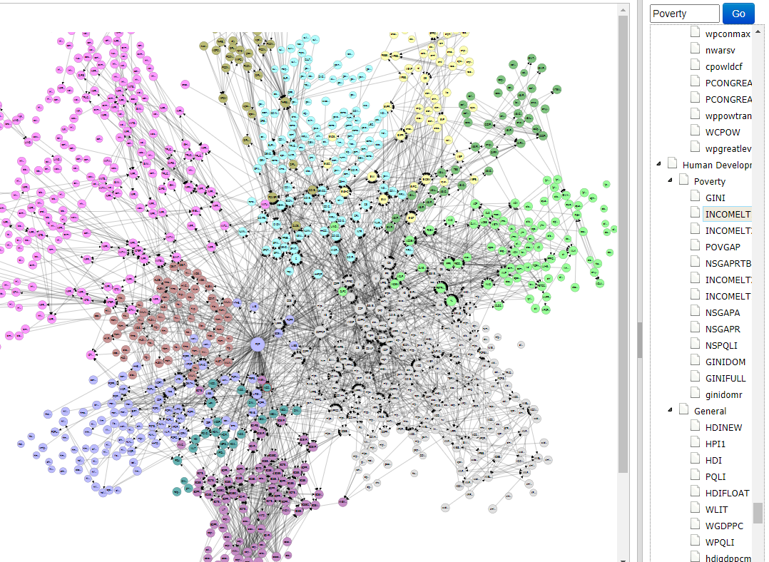
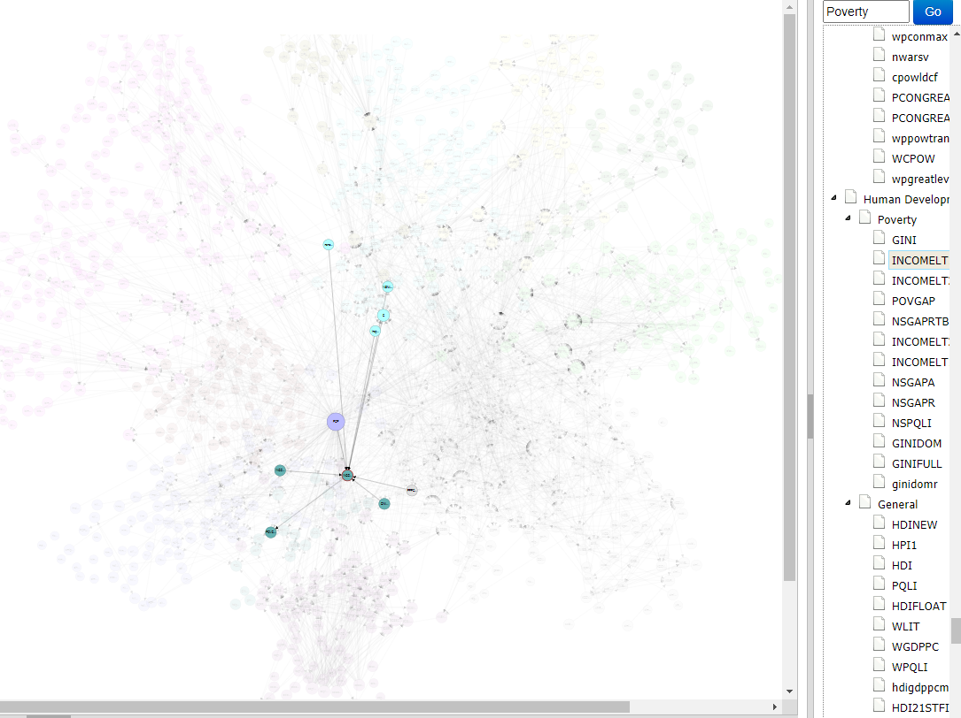
Network Map

Slide 9


Publications are a great resource!

Slide 10
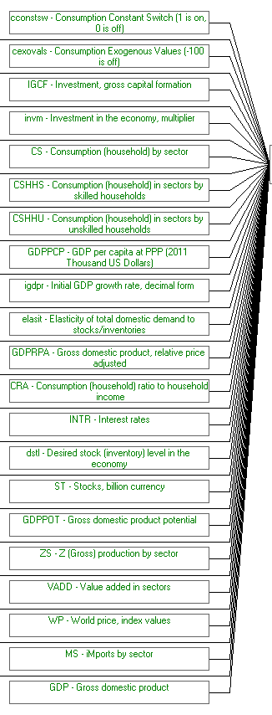
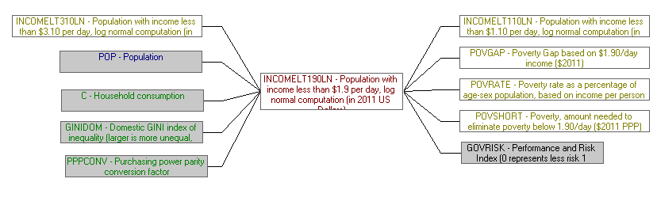
Drivers Display in IFs

Slide 11
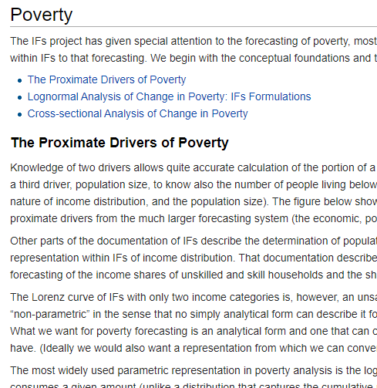
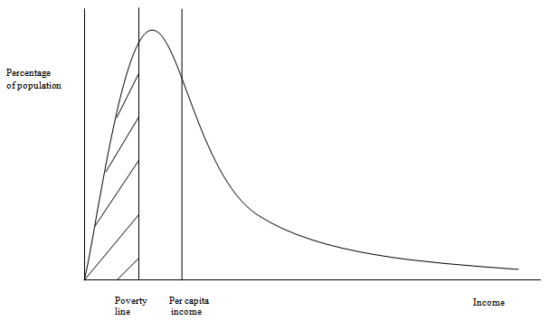
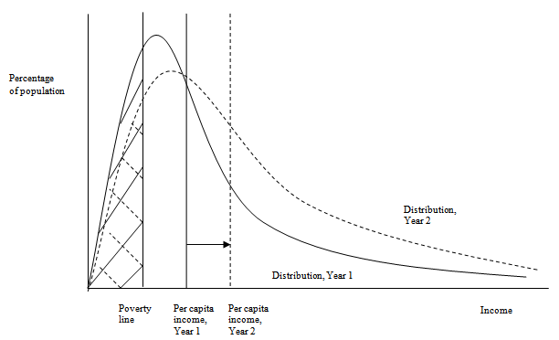
Help System:

Slide 12


Videos and training!

Slide 13
Representing COVID in IFs
Work derived from others (exogenously):
  Economic growth: the focus of this training; IMF WEO
  COVID mortality: Capability to represent in IFs using age-distribution
  Trade effects: Representing now for UNDP Regional Bureau for Africa
  Fiscal effects: Ability to represent along with effects on debt
Knock-on effects in IFs (sample of outcomes from much larger list):
  State fragility effects
  Poverty
  Food security
  International relations

Slide 14
What will you learn today?
COVID Base and the Pre-COVID Base scenarios:
  COVID Base: IMF growth rate updates for 2020 reflecting COVID-19’s effect on economic output and estimates.
  Pre-COVID Base: IMF growth rates published in late 2019 reflecting expectations for development before the spread of COVID-19.
Word template: We will fill in sections in teal and you must fill in sections in yellow for your homework
  We will build two graphs and one table. You are asked to fill in the rest for your homework.

Slide 15
Let’s get started!
Open up IFs, the Word Doc, and the Excel File

Slide 16

Tips and Tricks!
Common issues:
  “Continue” back

Slide 17
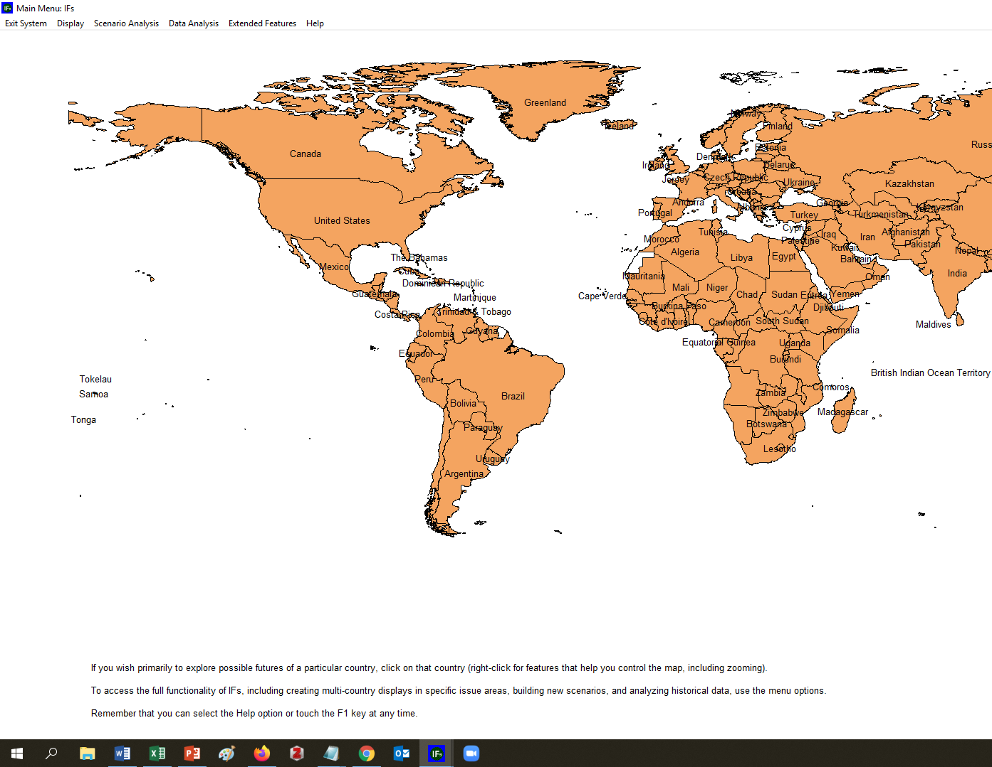
Tips and Tricks!
Common issues:
  “Losing” the screen

Slide 18
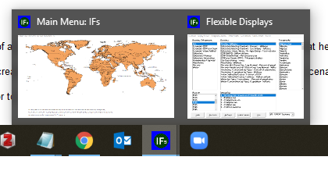
Tips and Tricks!
Common issues:
  “Losing” the screen

Slide 19
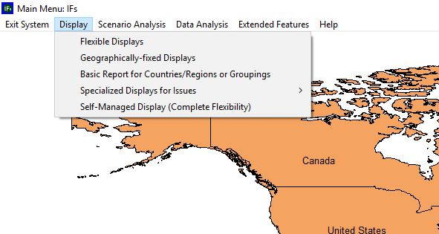
Flex Displays: Your Home in IFs (for now)

Slide 20
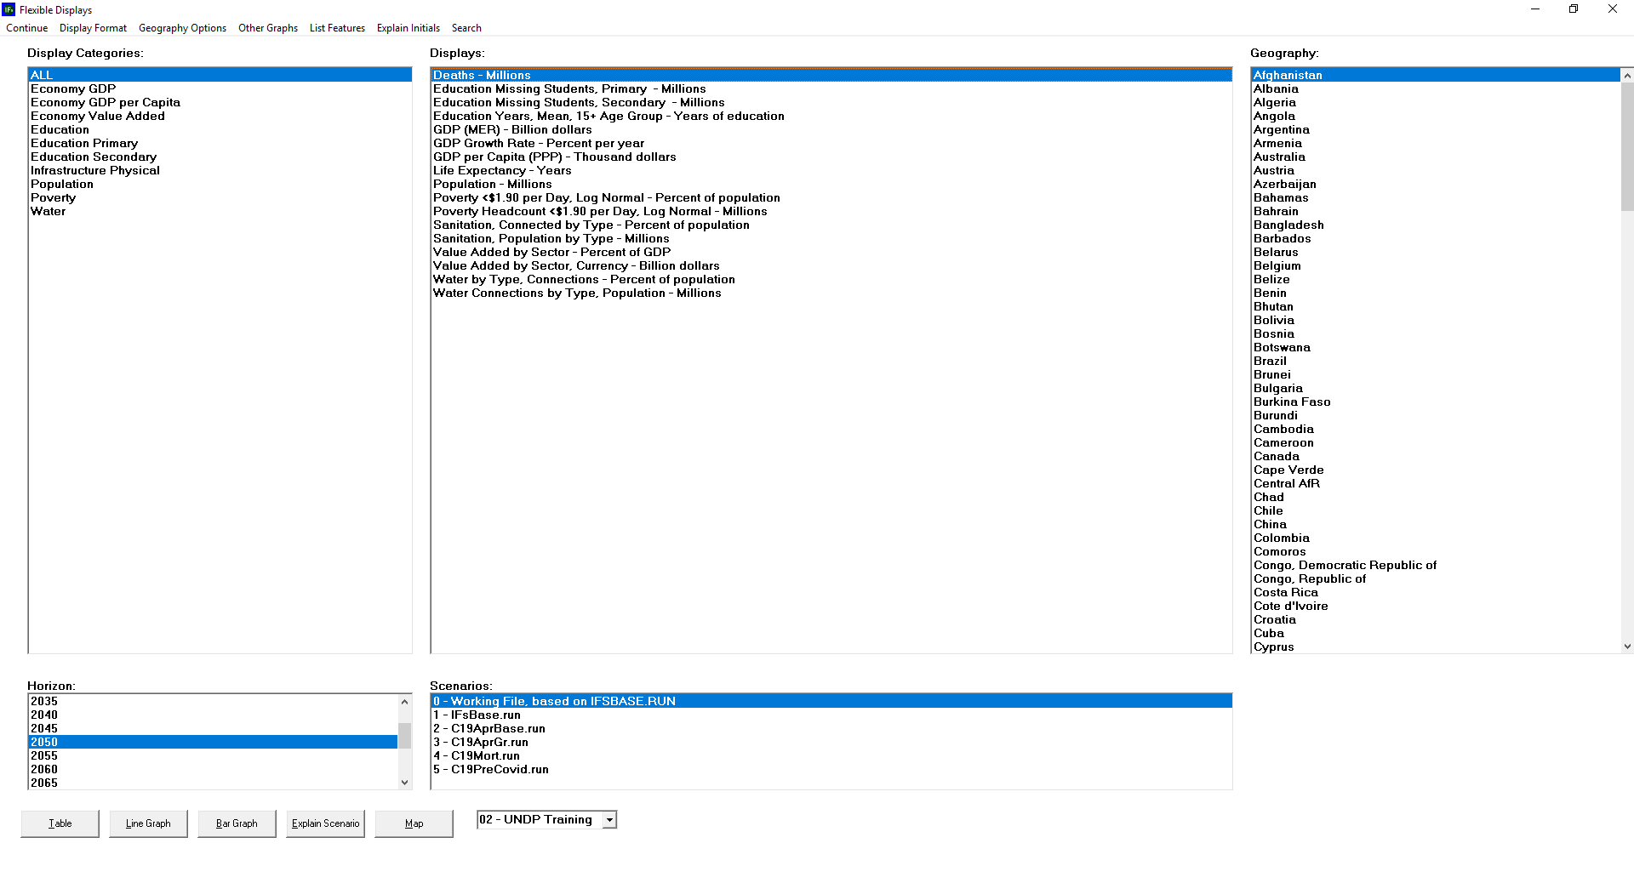

Slide 21
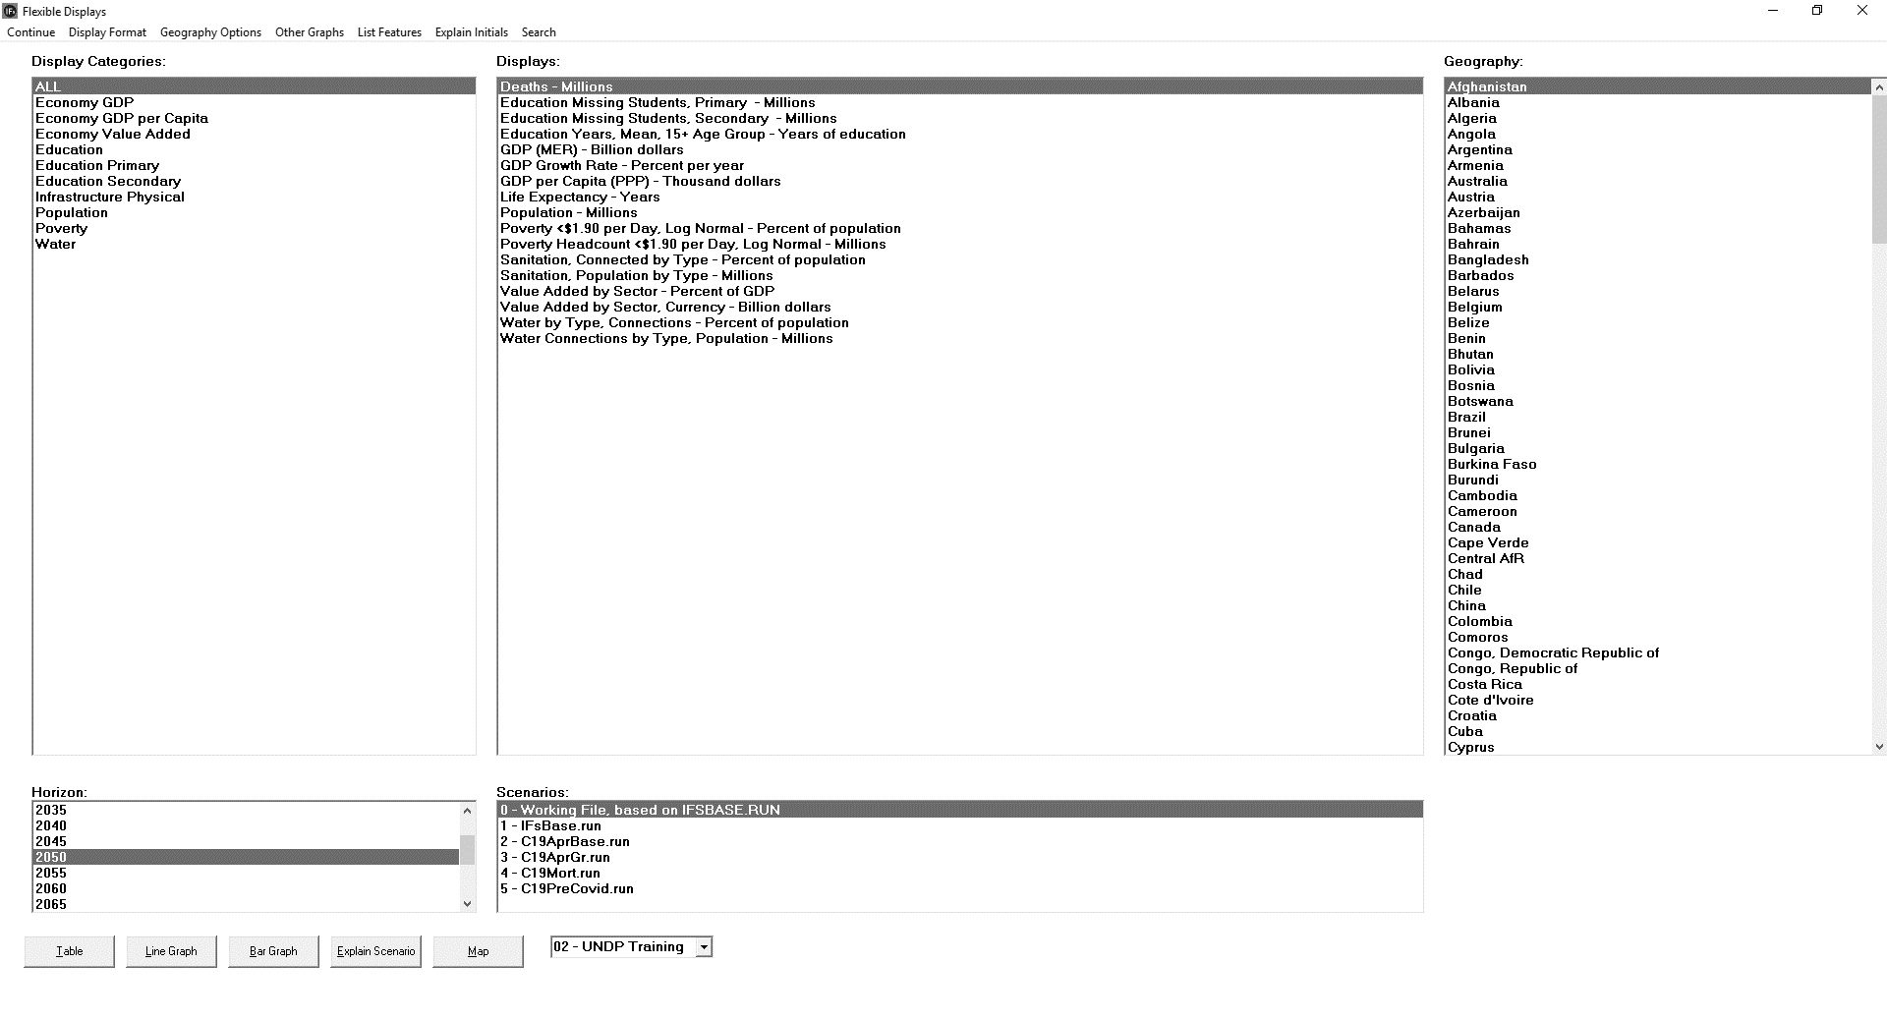

Slide 23
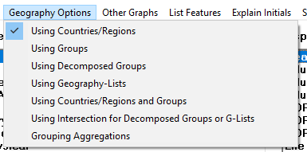

Slide 27


Slide 28
Exercise 1: Pulling Line Graph for Global GDP

Slide 29
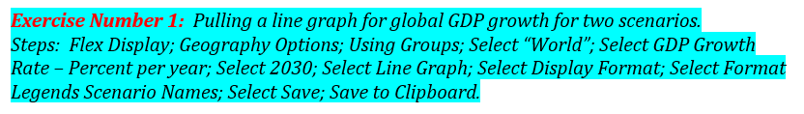
Exercise 1: Pulling Line Graph for Global GDP

Slide 30
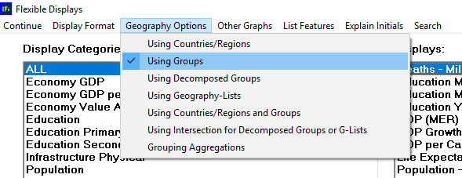
Exercise 1: Pulling Line Graph for Global GDP

Slide 31
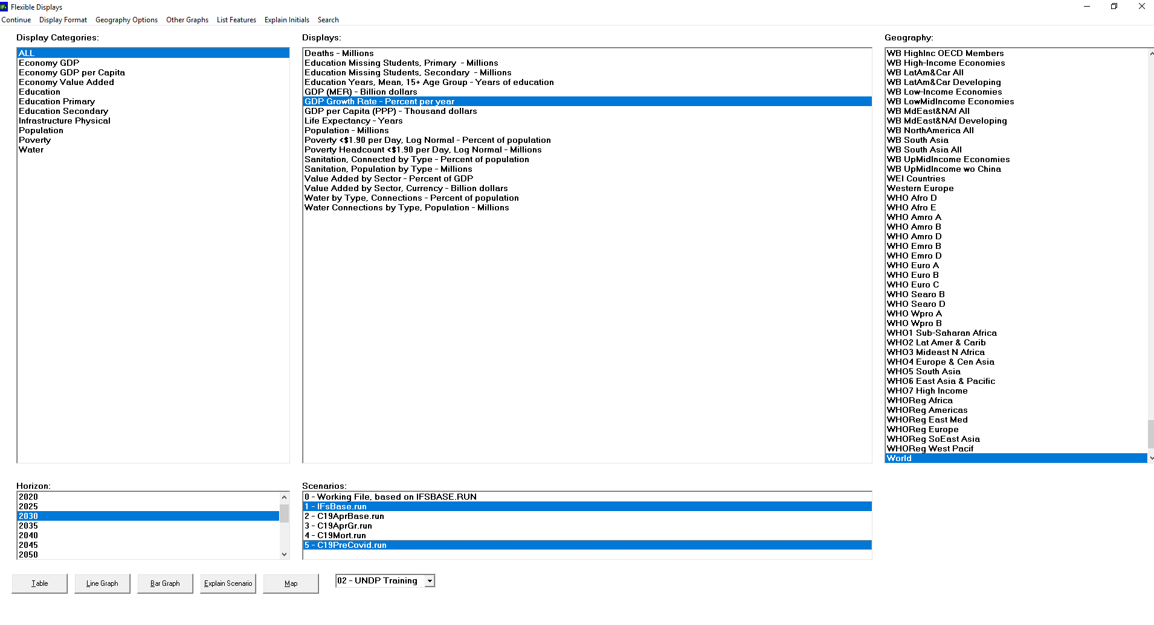
CTRL-click for PC
COMMAND-click for MAC

Slide 32
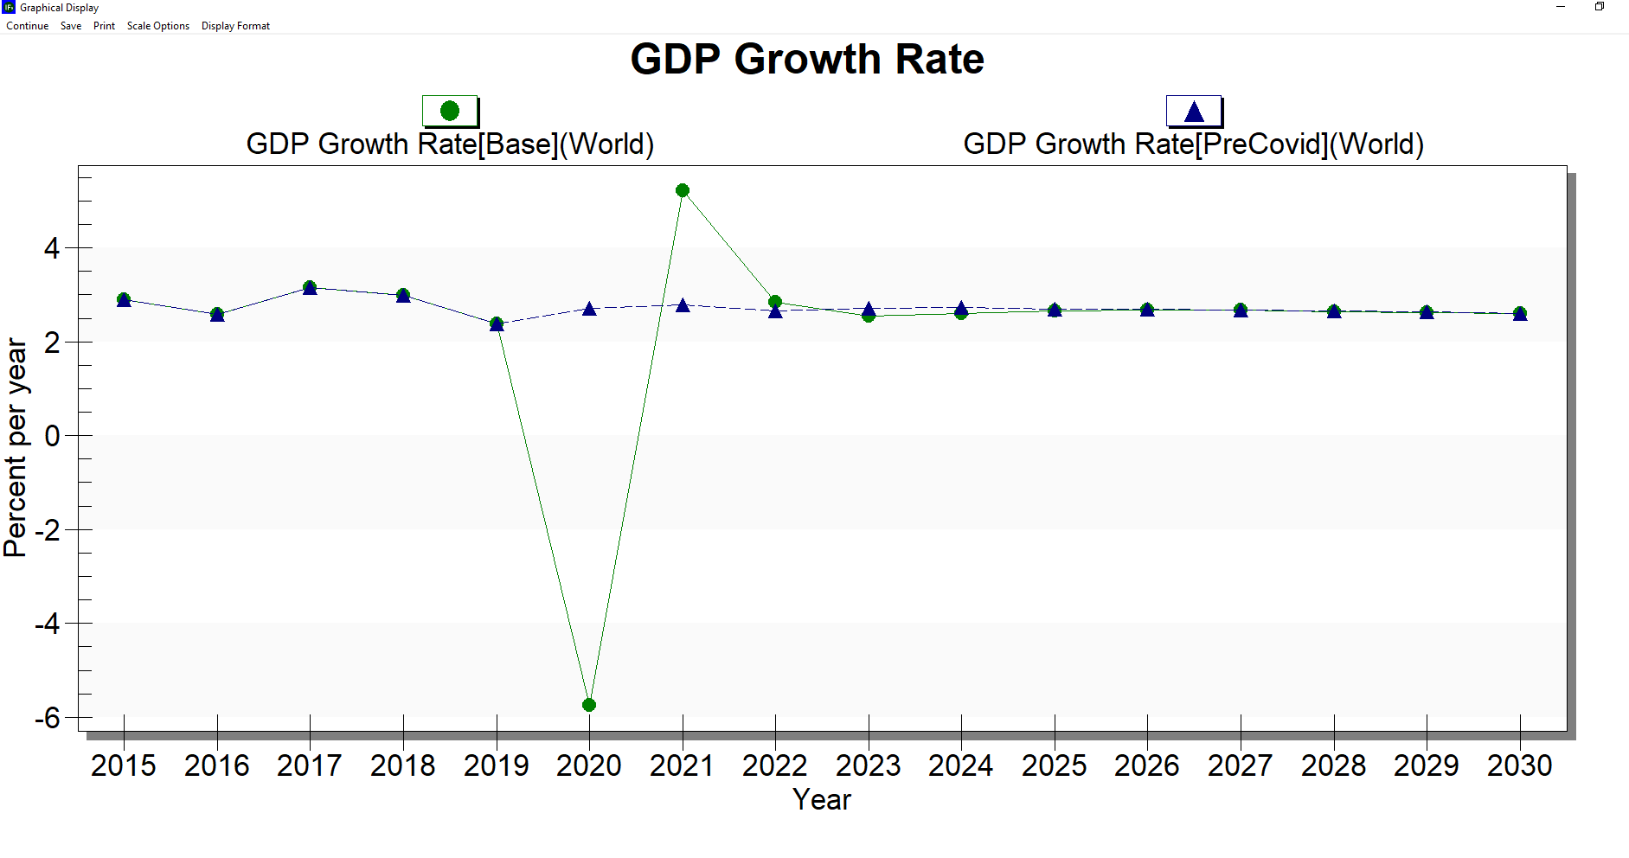

Slide 33
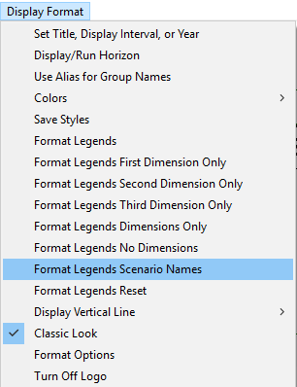

Slide 34
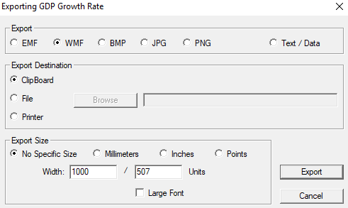
SAVE

Slide 35
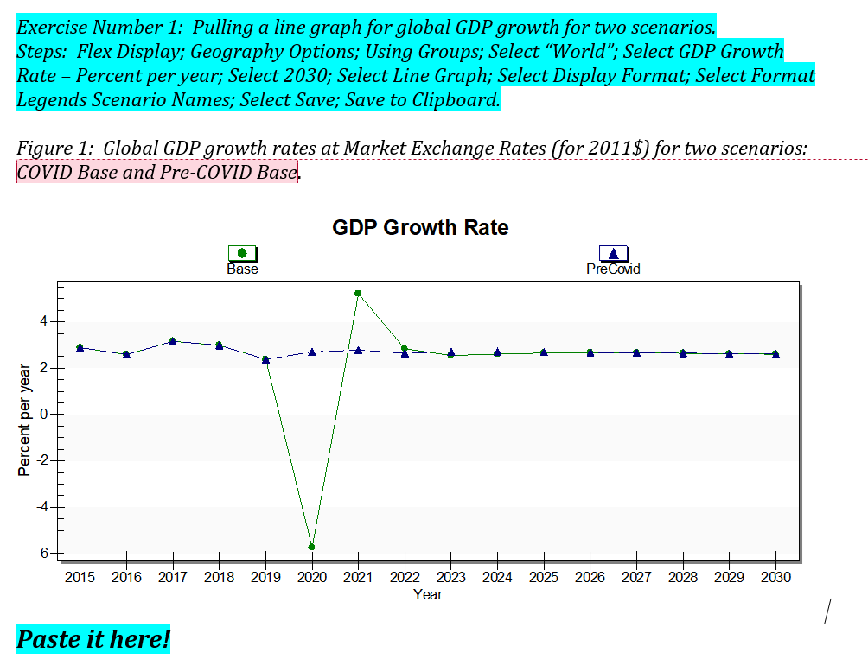

Slide 36
Close the graph
Continue back!
Remember “hidden screens”

Slide 37
Exercise 2: Pulling data on GDP at MER for two scenarios and make a table

Slide 38
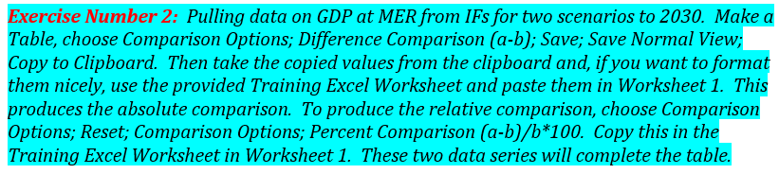
Pulling a table for absolute and relative impact of COVID on GDP

Slide 39
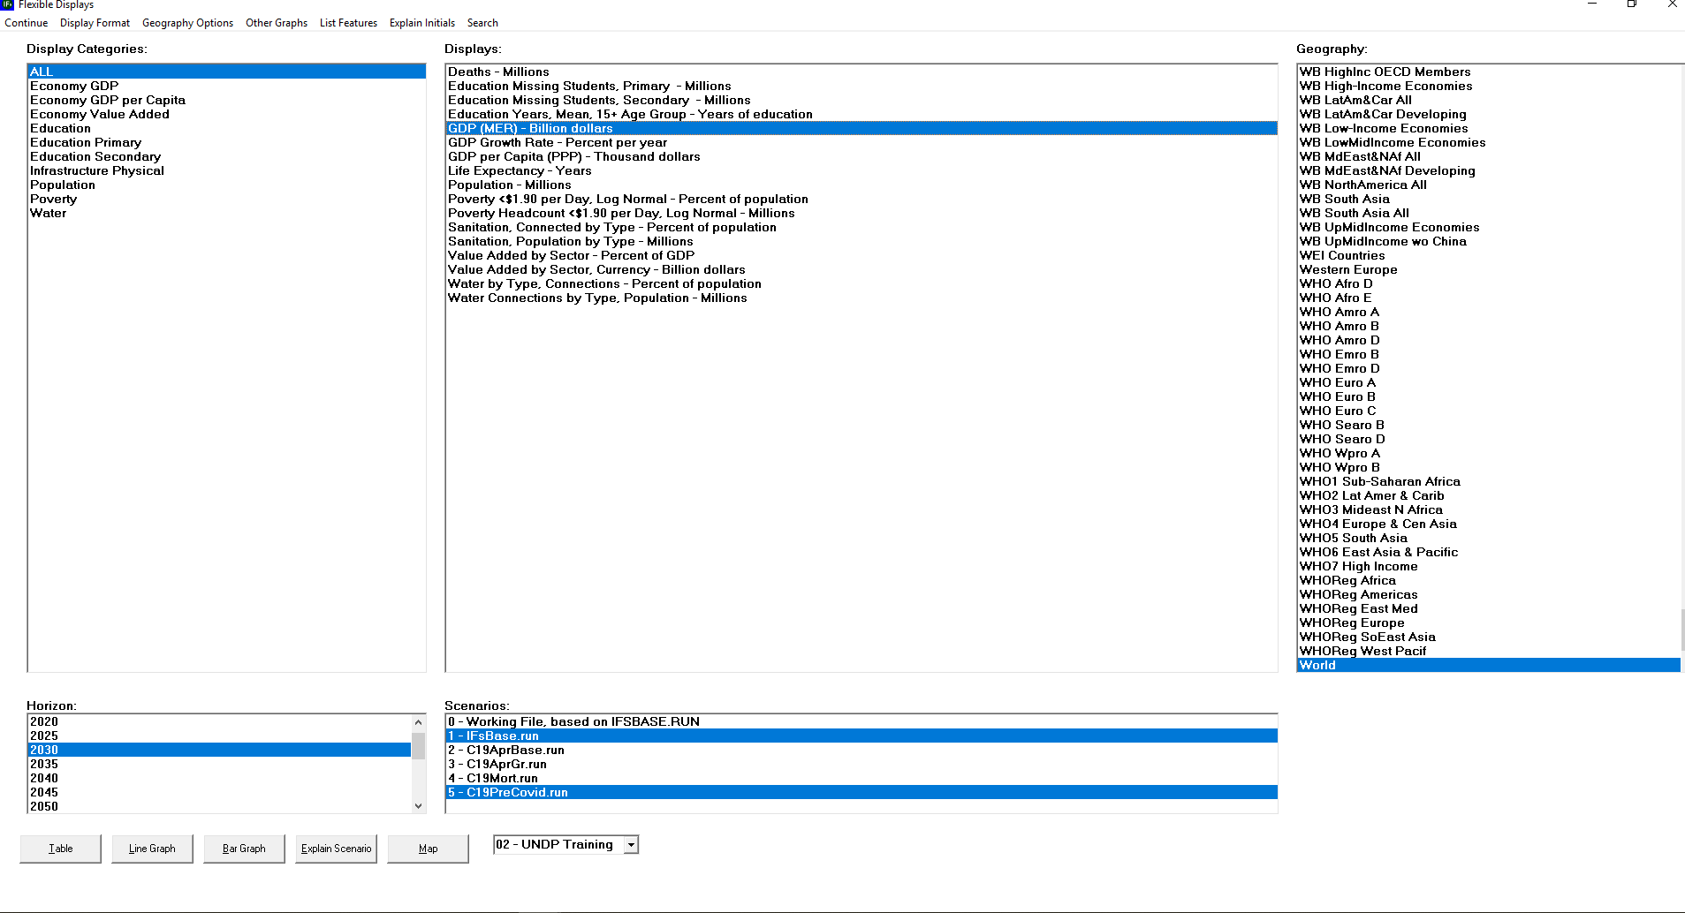

Slide 40
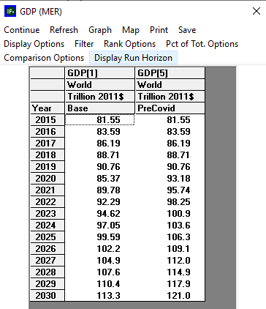

Slide 41
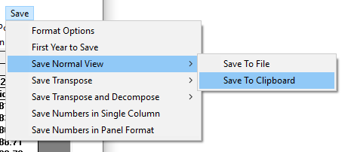

Slide 42
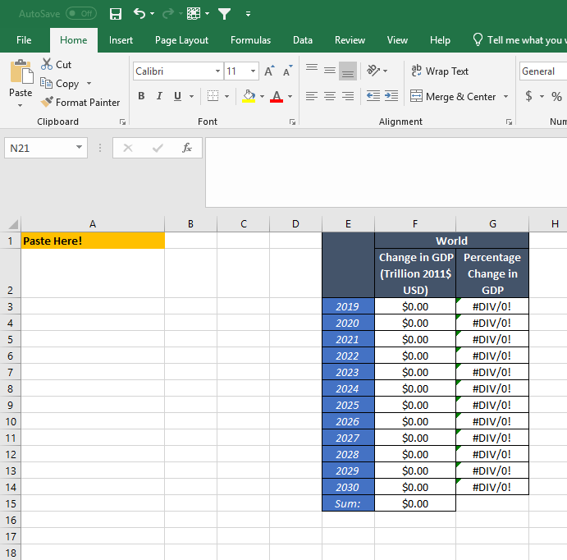

Slide 43
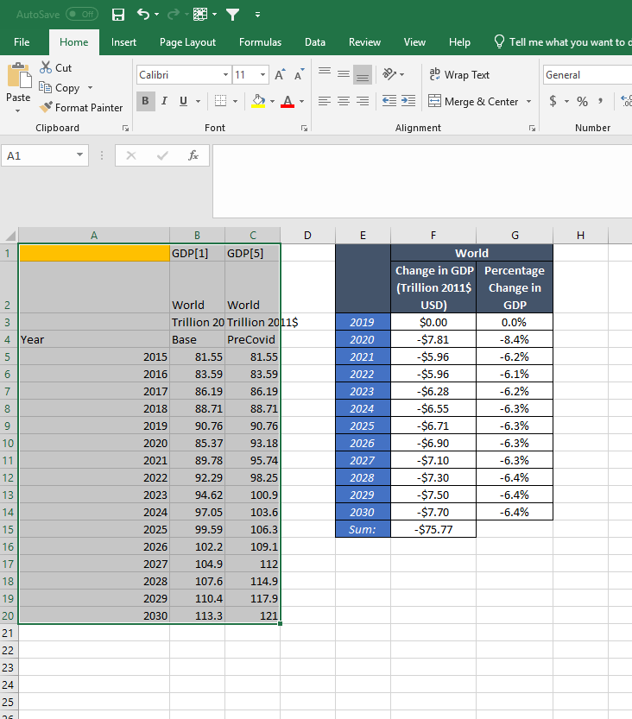

Slide 44
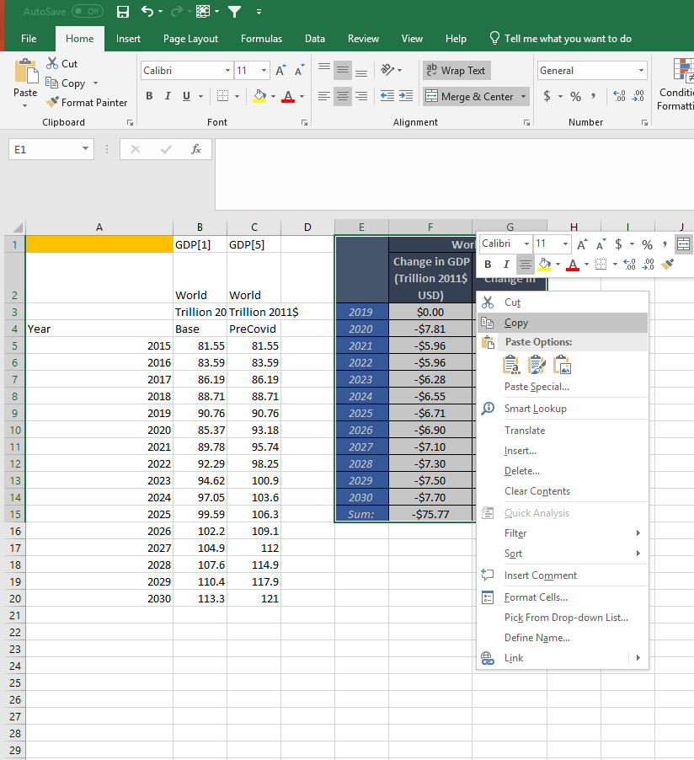

Slide 45
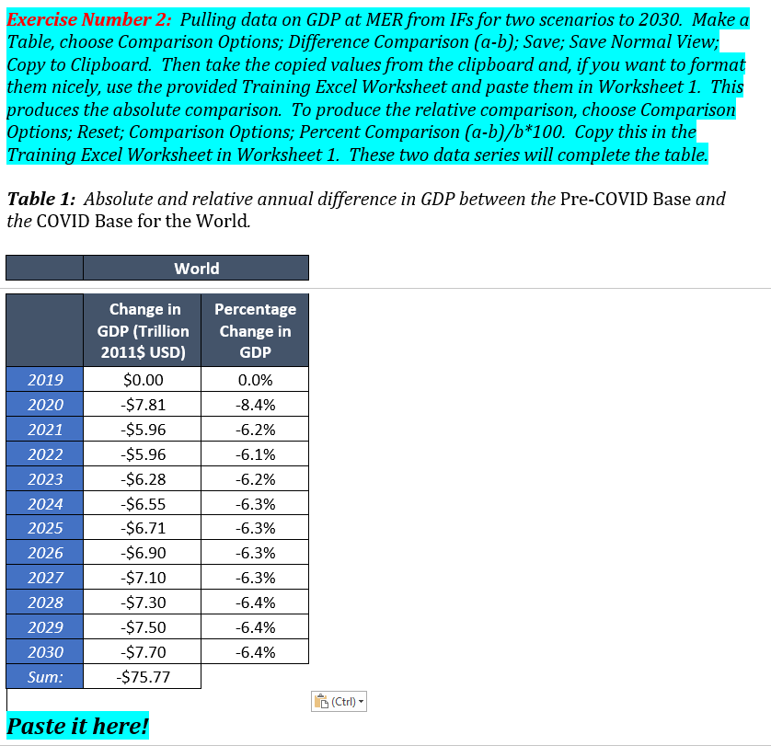

Slide 46
Continue back!
Also, hidden windows!

Slide 47
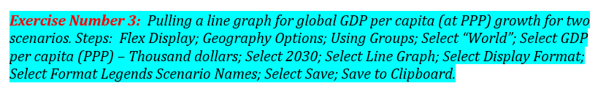
Exercise 3: Same as Exercise 1!

Slide 48
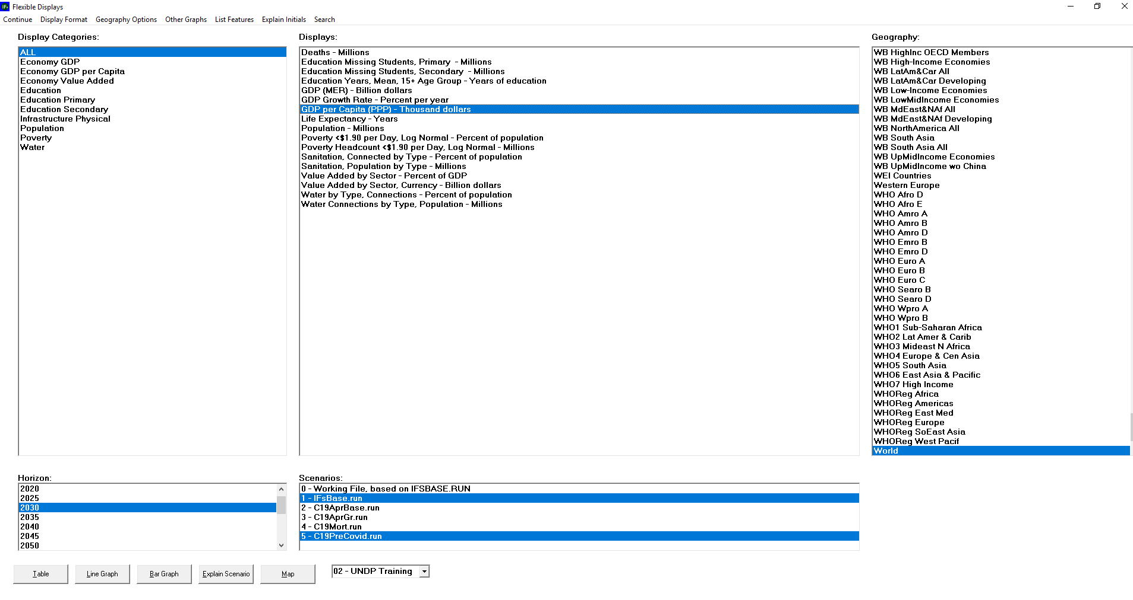

Slide 49
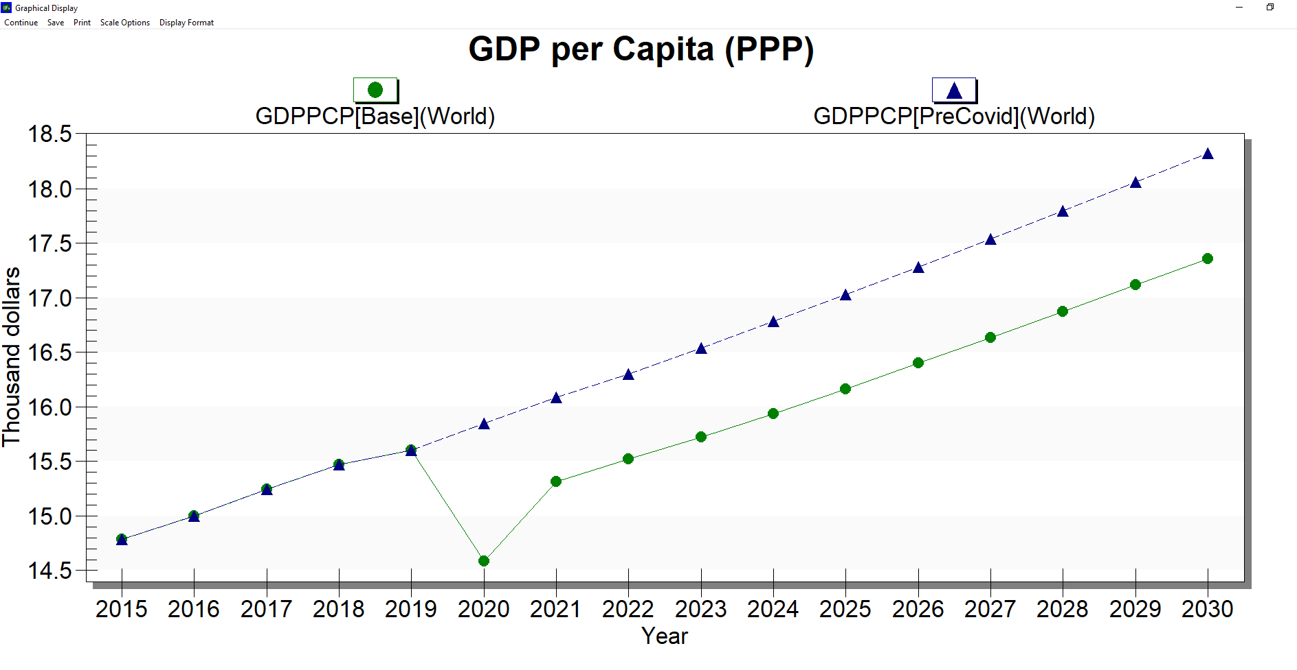
Make it the real line graph

Slide 50
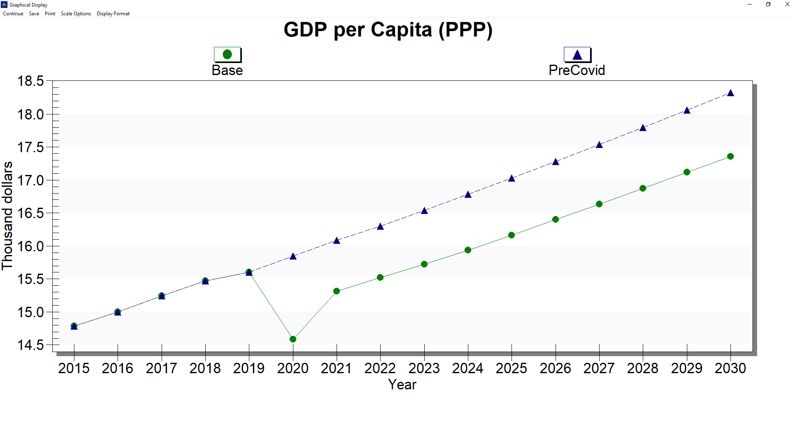
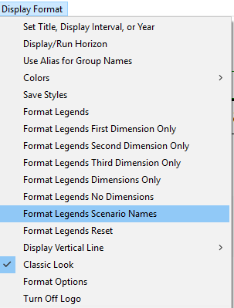

Slide 51
SAVE

Slide 52
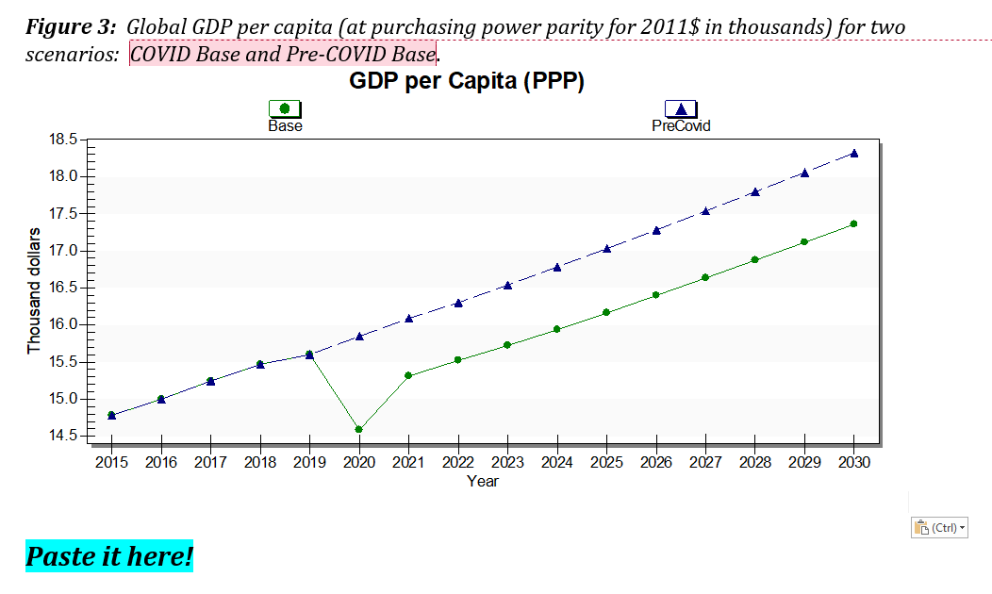

Slide 53
The remaining exercises
Exercise 4, and 5 ask you to do the same as Exercise 1 and 3
  Poverty for population living on less than $1.90 per day
  Poverty for share of population living on less than $1.90
You could also produce tables comparing the total number of people living on poverty using the same Excel sheet

Slide 54
Moving forward

Slide 55
Moving forward
We have office hours for the next three weeks
  We can discuss building your own scenarios, interpreting results, extending analysis
We also have discussion boards set up on SparkBlue. Please participate! Those conversations are useful records of questions for others.
See our additional support material as well on SparkBlue and videos on Pardee’s website https://pardee.du.edu/ifs-course
Learning to use a model is difficult and requires practices and a community of people talking about strengths, weaknesses, and opportunities. We want to help facilitate that community!

Slide 56
Thank you!

