Slide 1
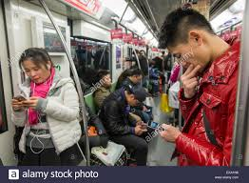
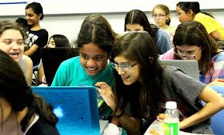
Bridging the Gap between Media, Science and Youth: Mobile Phone Development Collaboration
Dr. David Kenneth Waldman
United Nations 2nd annual International day of women and girls in science
February 10, 2017

Slide 2
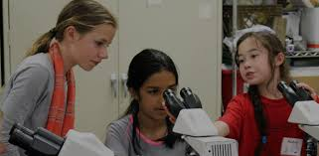
Photo Copyright: G.M.B. Akash/Panos
SDG’s Realization Needs females in science

Slide 3
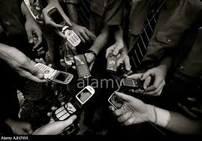
Youth Based Development Collaboration
Young people's use of Mobile Phones and the Internet

Slide 4
Youth Based Development in Science through Mobile Phone Collaboration
ACTION STEPS
Educate through social media via collaborative youth based organizations how gender equality can solve poverty, hunger, poor health and wellbeing, climate change, economic inequality hardships, and societal food insecurity.
Private and Government partnerships to fund Youth Appropriation of social media for collaborative STEM design-based online learning programs
Unite existing UN Youth, Civil Society, Governments, Business Councils whose singular goal will be to create sustainable STEM career paths

Slide 5
Create inclusive structural approach to policies, institutions, and programs, for women and girls to obtain careers in science
Add to UN HeforShe a youth directed media grassroots advocacy, initiative, to support women and girls to gain equity to STEM careers
Audacious Creative and Imaginative ideas implemented through media are essential for successful application of STEM career pathways for girls and women
Who will commit and be held accountable in order to help implement a united multi-sectoral approach for women and girls to obtain careers in science?

Slide 6
